Slide 1

Title: Climate change impact on maize agroecosystems: Linear climate sensitivities and scenario projections in Kikuyu Sub-County 1981-2022.
Author: Jean-Marie V. Minani
Institution: University of Nairobi, Faculty of Agriculture, Department of Land Resources Management and Agriculture Technology (LARMAT), P.O. Box 30197-00100, Nairobi, Kenya.
Event & location: AGRO 2025 BIENNIAL CONFERENCE. University of Nairobi, Faculty of Agriculture-Upper Kabete Campus, 23rd -24th October 2025

Slide 2
Outlines
Background & Introduction
Problem statement
Objectives
2. Methods & Approach
3. Results & Discussion
4. Conclusion & Recommendations

Slide 3
Problem statement
Maize yields in sub-Saharan Africa are shaped by complex factors: climate, soil fertility, pests, seed varieties, farming practices, and socioeconomic conditions.
Smallholder farmers face increasing uncertainty from shifting rainfall, rising temperatures, and limited access to adaptive technologies.
Local-scale assessments of climate impacts remain scarce due to lack of data and limited modeling capacity.
Research objectives
Assess the sensitivity of maize yield seasonal climate variability in Kikuyu Sub-County.
Use data-driven modelling to quantify the influence of temperature, precipitation, and surface soil wetness on maize yields using linear regression models.
Provide a tool for rapid sensitivity testing that supports climate adaptation planning for farmers and decision-makers.

Slide 4
Methods & Approach
Data sources:
FAO-reported national maize yields (1981-2022) used as proxy data for Kikuyu Sub-County
NASA POWER monthly climate data for Kikuyu center (lat −1.25, lon 36.7).
Modeling Pipeline:
Aggregate climate data and run linear regression models across 42 growing seasons (March-August).
Predictor variables : mean temperature (T2M), total precipitation (PRECTOTCORR), and surface soil wetness (GWETTOP). Predicted : maize yield (t/ha).
Fitted two Ordinary Least Squares (OLS) models :
Model 1: T+P, Model 2: T+P+G
Scenario analysis : simulated yield response to changes in T (0–3°C) and P (−20% to +20%)

Slide 5
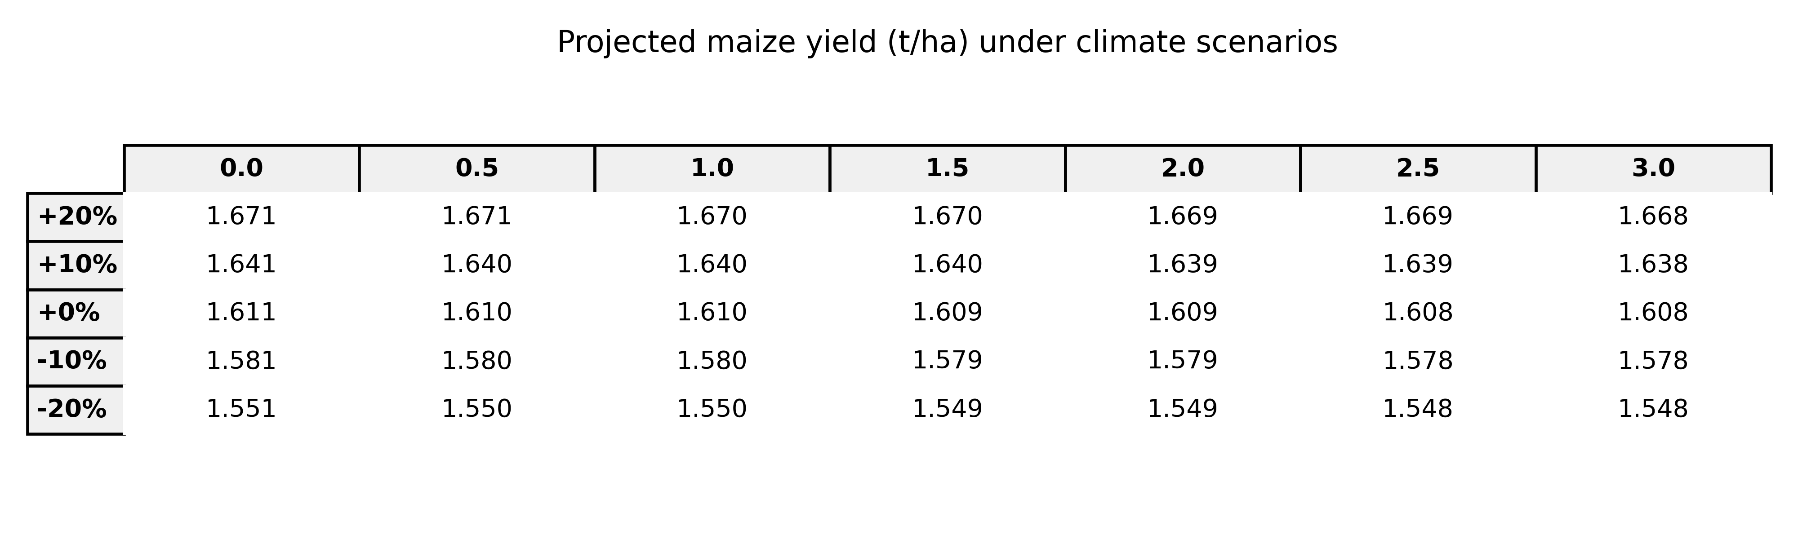
Results & Discussion
Grid scenario table :
Model performance :
Model 1: R² = 0.2278, RMSE = 0.1615 t/ha
Model 2: R² = 0.2323, RMSE = 0.1611 t/ha GWETTOP coefficient = −0.512 t/ha
Climate variables explain ~23% of yield variability;
Remaining 77% reflects agroecosystem complexity

Slide 6
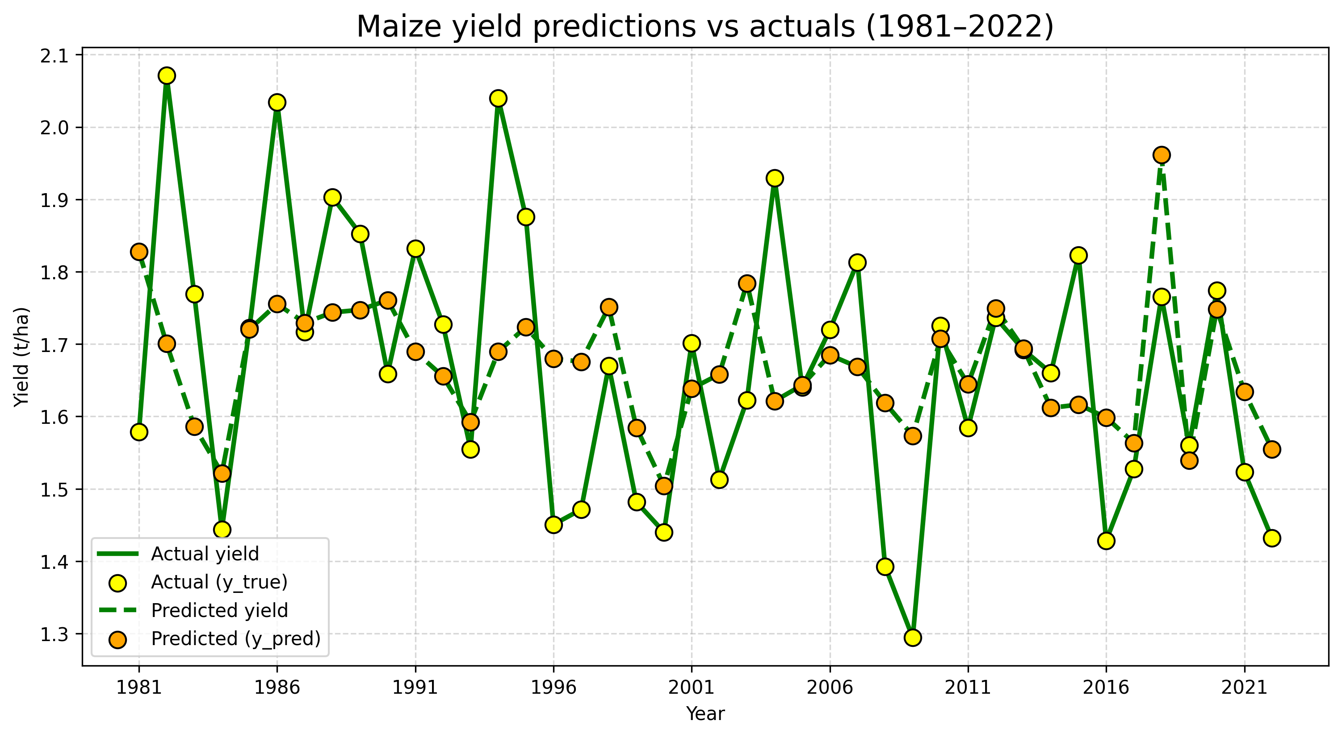
Results & Discussion …
Predicted vs observed:

Slide 7
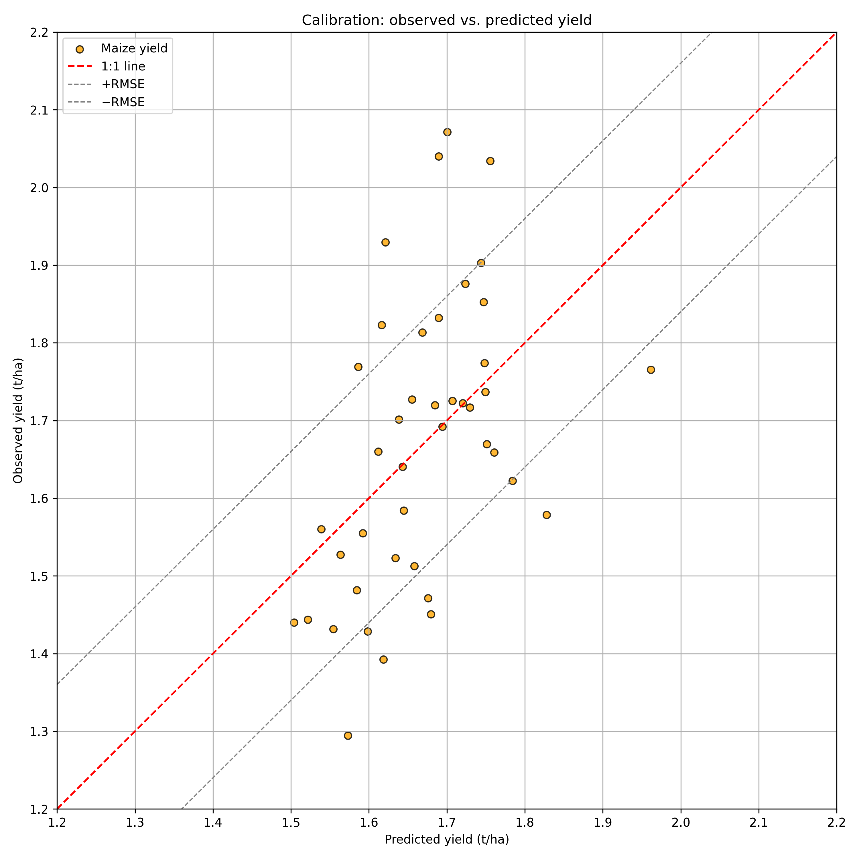
Results & Discussion …
Predicted vs observed …:

Slide 8
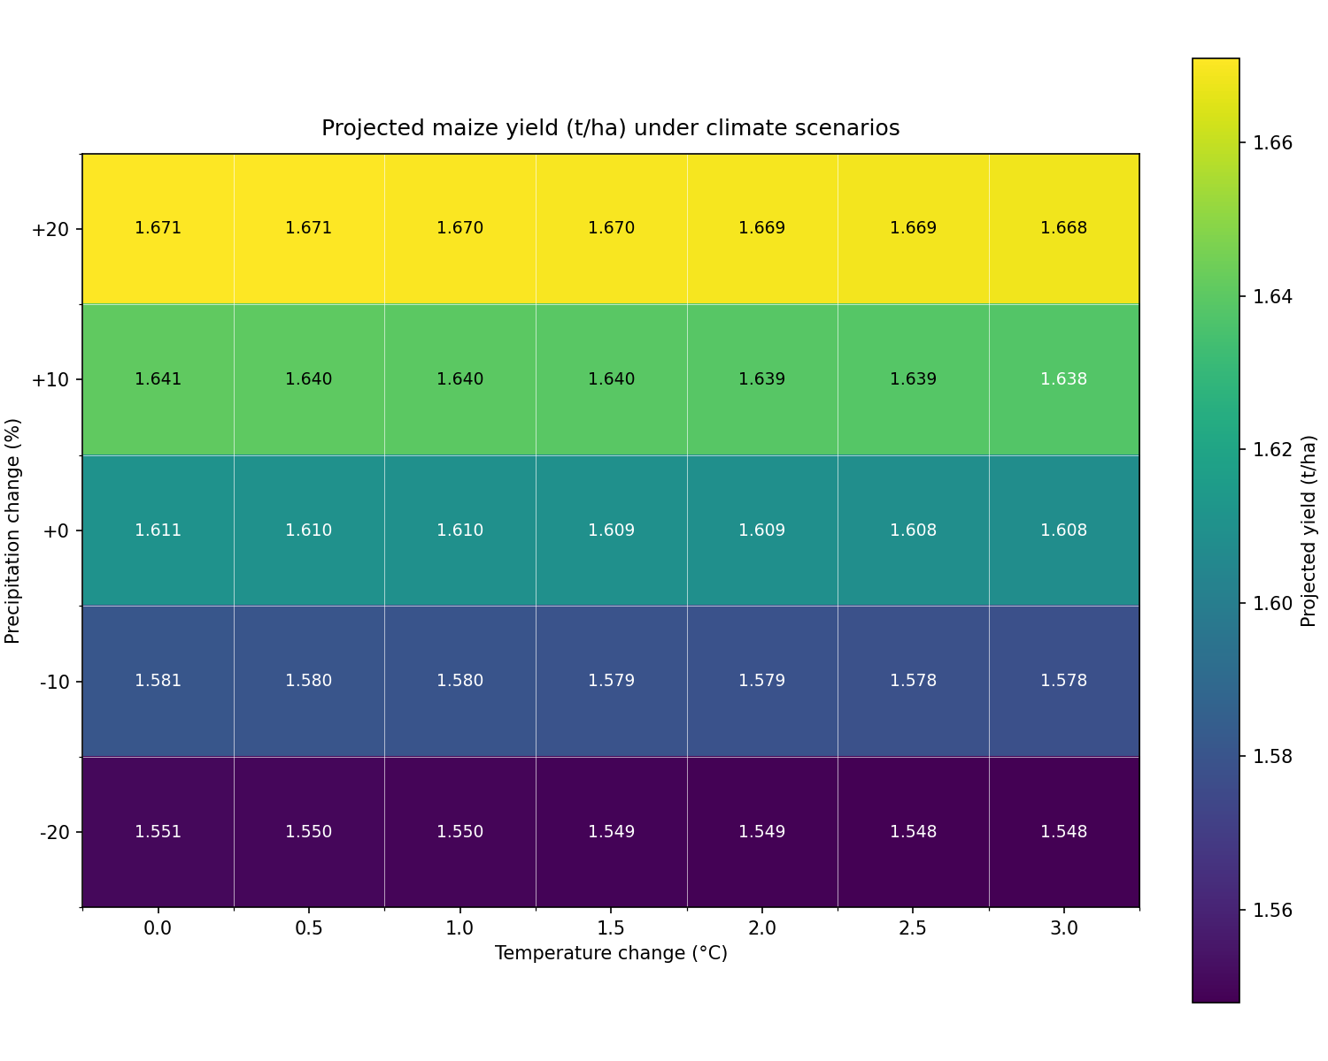
Results & Discussion…

Slide 9

Results & Discussion …

Slide 10
Conclusion & Recommendations
Conclusion:
Climate explains only a fraction of maize yield variability.
OLS models offer transparent sensitivity testing, not precise forecasting.
Precipitation remains the most influential climate variable
Recommendations :
Integrate agronomic & socioeconomic factors: soil fertility, seed variety, pest pressure, farmer experience, mechanization, and market access.
Promote water management strategies
Use climate sensitivity models to guide site-specific adaptation planning.
Future work :
Incorporate field data validation.
Explore machine learning models for nonlinear interactions.
Engage farmers and policymakers to design resilient maize systems

Slide 11



Asante sana, Thank you, Murakoze!
ANY Q U E S T I O NS

