Slide 1
Open World Games Analysis — Excel Dashboard
An Interactive Excel-Based Analytics Project

Slide 2
Problem Statement / Objective
Problem:
- No unified analytics for open world game trends.
Objective:
- Build an interactive Excel dashboard using slicers, timeline, and pivot charts.

Slide 3
Dataset Overview
• Size: ~10,000 rows
• Years: 2000–2024
• Includes: Game, Genre, Platform, Developer, Rating, Release Date

Slide 4
Data Cleaning
• Removed duplicates
• Standardized genre/developer names
• Converted Release Year to Release Date
• Ensured numeric formatting

Slide 5
Dashboard Structure
Pivot Tables:
1. Game Count by Genre
2. Games by Developer
3. Games Over Time
4. Avg Review Scores
5. Platform Popularity
6. Top Developers by Rating

Slide 6
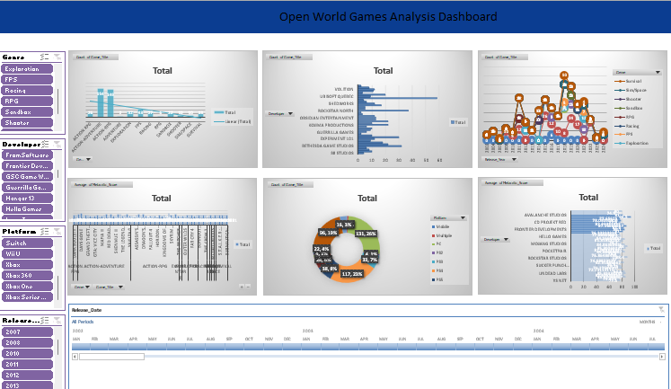
Dashboard Overview

Slide 7
Key Insights
• Action Adventure & RPG dominate
• PC & PlayStation lead platforms
• Rockstar & Ubisoft strong performers
• Scores mostly 7–9
• Release spikes in 2011, 2018, 2020

Slide 8
Conclusion
• Dashboard reveals meaningful gaming trends.
• Strong display of Excel analytics skills.
• Good portfolio project.

