Slide 1

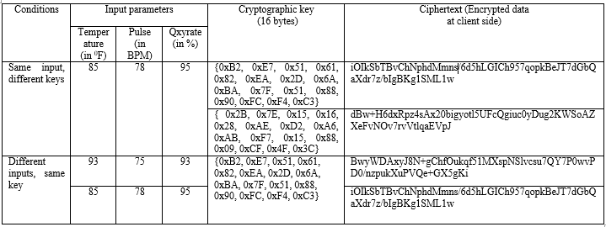
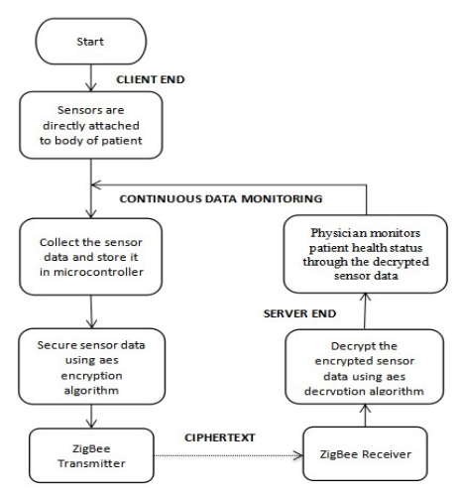
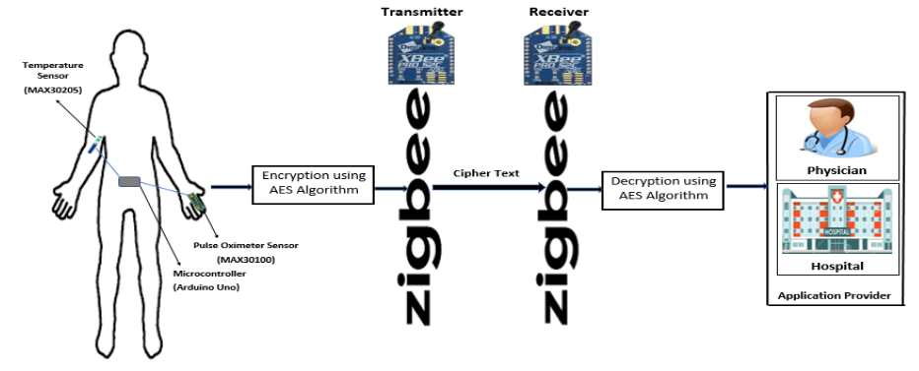
Authenticity and Revocability for Wireless Body Area Network using Certificateless Cryptography
By:
Brunda U S [1SI16EC016]
K Sandhya [1SI16EC031]
Madhurya Kulkarni G V [1SI16EC043]
Navya N [1SI16EC054]
Under the guidance of,
Mr. Pradeep H S
Assistant Professor
INTRODUCTION
METHODOLOGY
EXPERIMENTAL RESULTS
With recent technical advancement in wireless communication, network security has been of great concern. To address this concern, a secured system is to be developed to provide data security over wireless transmission. present wireless body area network (WBAN) with cryptographic AES algorithm which monitors patient biomedical parameters based on Sensors, Arduino and ZigBee. Implementation of algorithm using arduino has been communicated by ZigBee network to provide security to the encrypted data (ciphertext) .
Sensor modules which are considered based on the normal is uses of people are interfaced with the Arduino microcontroller to collect the sensor data; it is encrypted with a secret key and the data transmission is done through ZigBee technology. Arduino IDE is used to program the microcontroller for interfacing of digital sensors and ZigBee modules; to configure the parameters of ZigBee, XCTU software is used. Advanced Encryption Standard (AES) algorithm is used for encryption and decryption of sensor data.
Plaintext will be the combination of sensors’ data as: (Temp: x ‘F Pulse: y bpm Oxirate: z%) in a string format.
OBJECTIVE
FLOW CHART
To adopt the ZigBee technology and protocols which satisfy the requisites of WBANs for healthcare application, to provide security to the sensor data.
To the medical practitioner to understand the patients' issues within a period of time securely.
The results obtained by encrypting the health details using AES at WBAN client and received information is decrypted to get back the original data at the Application provider for analysis.
SYSTEM OVERVIEW
CONCLUSION
"Authenticity and Revocability for Wireless Body Area Network using Certificateless Cryptography“, a data security system is implemented and tested. The consulting physicians having the patient health report with them before the patient presence at his/her place can be helpful in diagnosing or arranging the special medications to patients in advance by those collected data even at distant places on time. This ensures security of data for medical rehabilitation and monitoring of patients.
REFERENCES
[1] R. Filsoof, A. Bodine, B. Gill, S. Makonin and R. Nicholson, "Transmitting patient vitals over a reliable ZigBee mesh network," IEEE Canada International Humanitarian Technology Conference, Montreal, QC, pp. 1-5, June 2014. [2] Sachin S. Patil1, Shrenik S. Sarade2, Sagar V. Chavan, “Zigbee based sensor networks for temperature monitoring and controlling”, IOSR Journal of Electronics and Communication Engineering (IOSR-JECE), ISSN: 2278-2834, ISBN: 2278-8735, PP: 66-71, March 2013.

