Slide 1
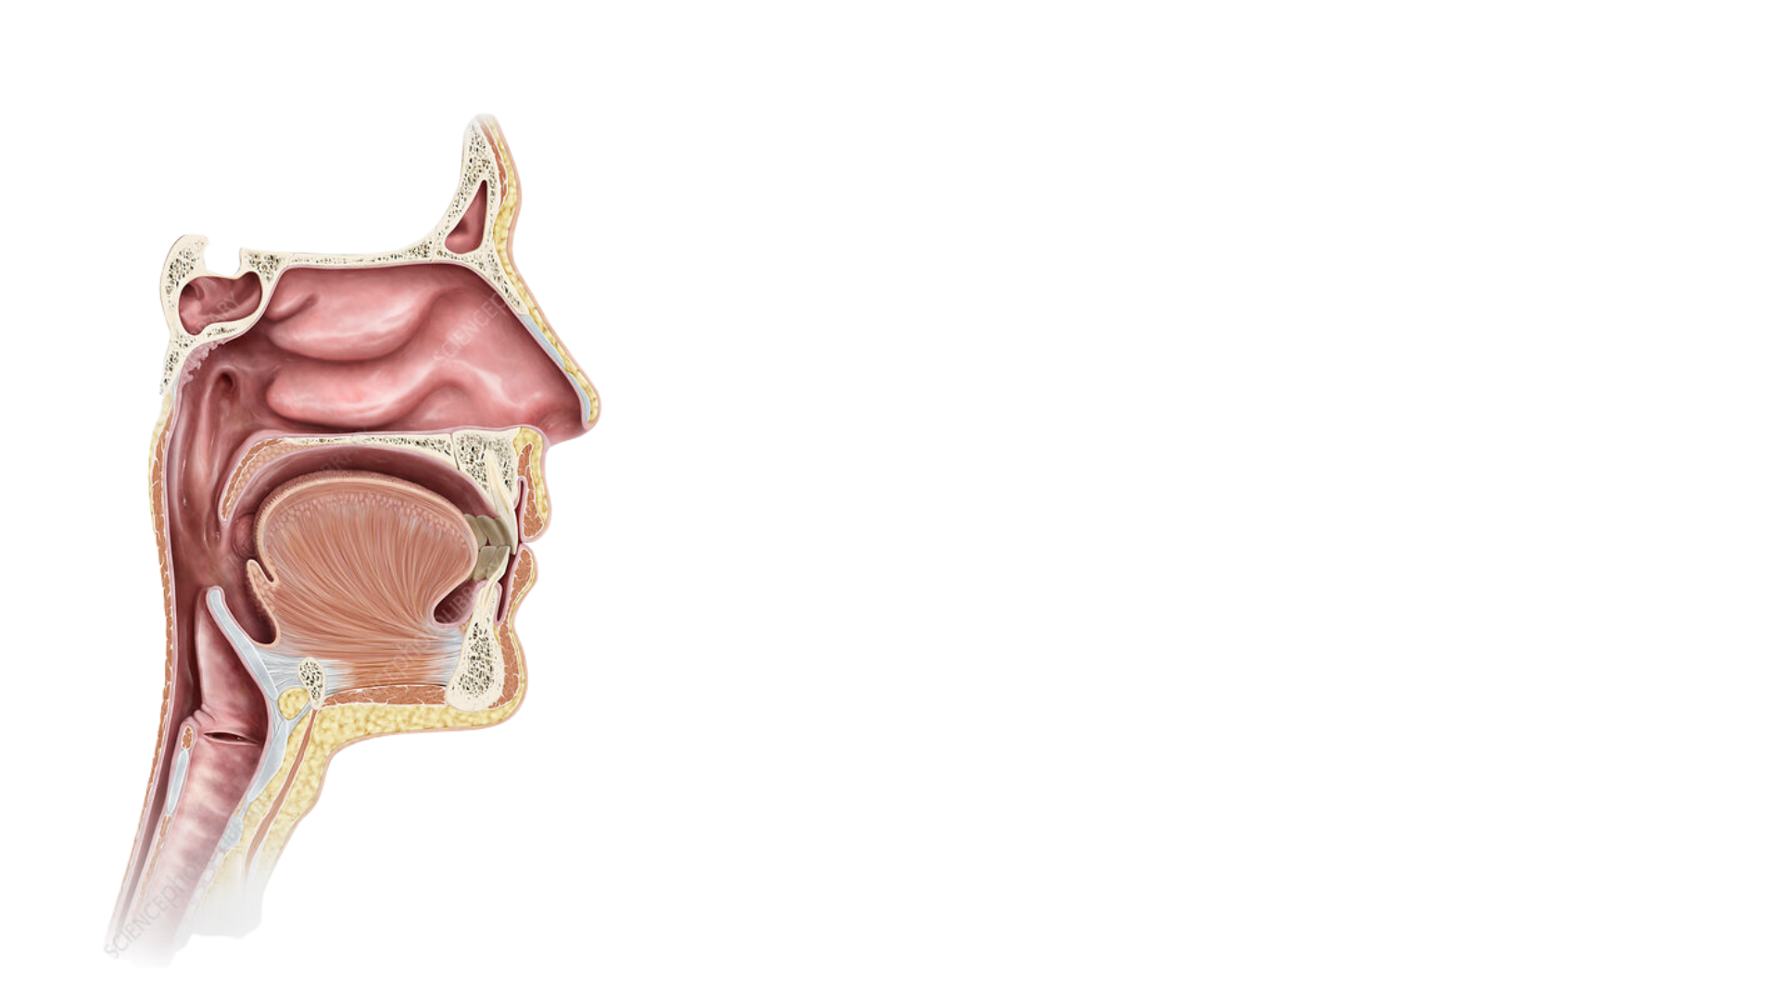
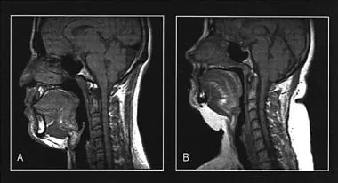
A
B
Normal
Nasopharynx
Spinal Column
Maxillomandibular
Obstructive Sleep Apnea
Epiglottis

Slide 2
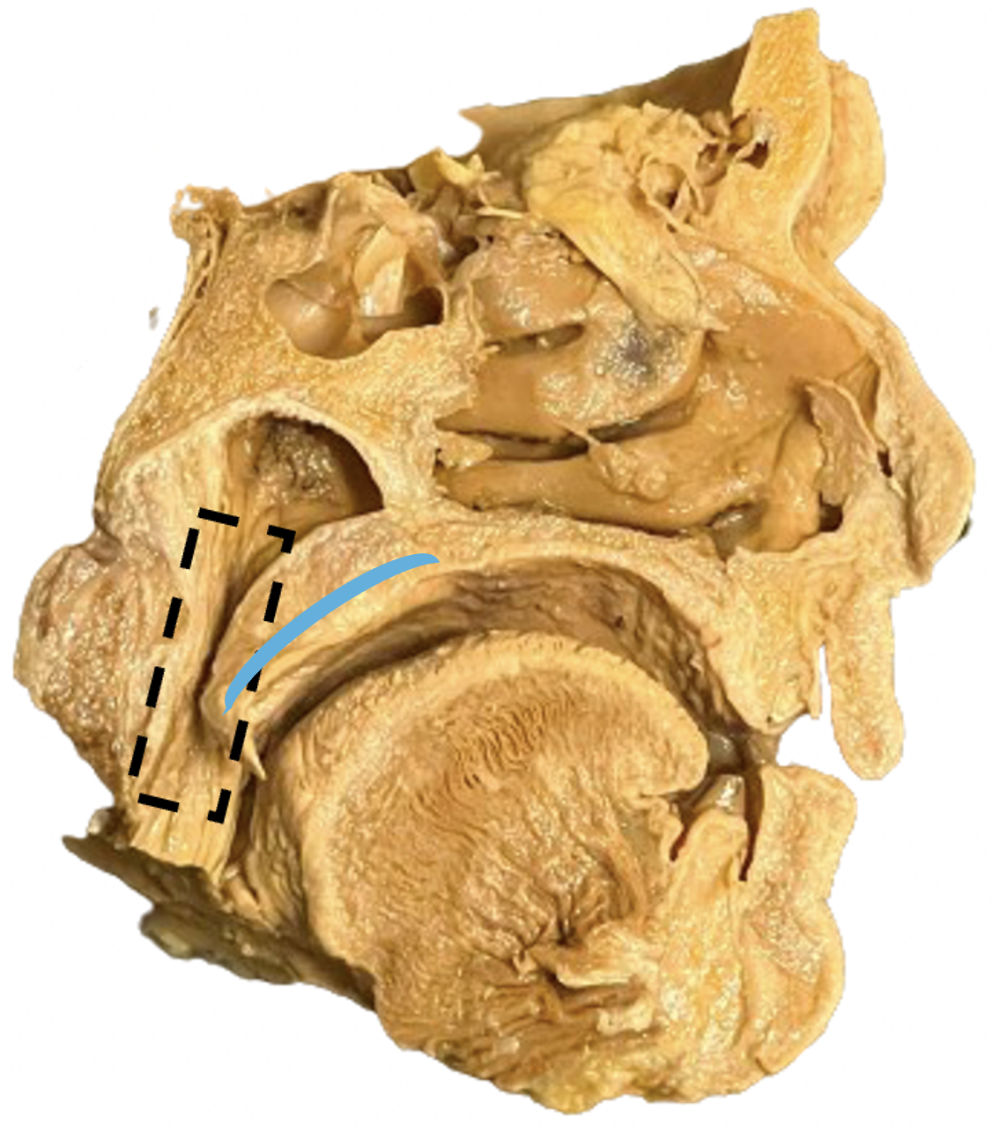
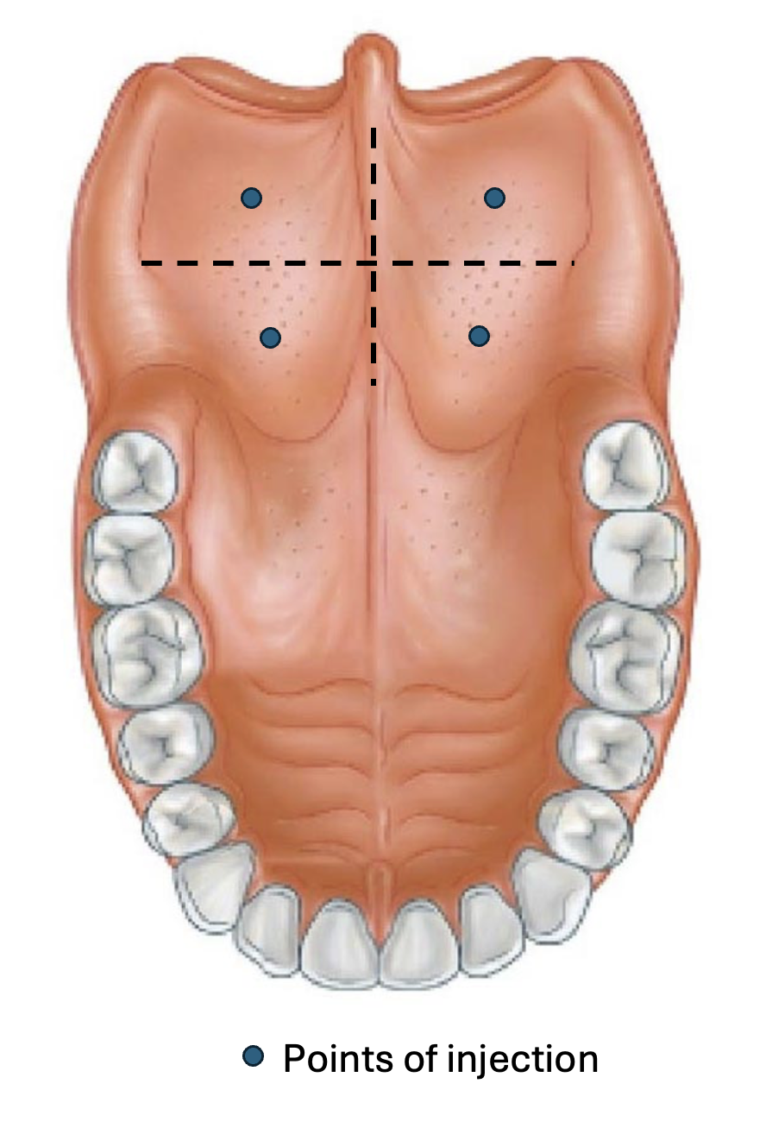
A
B

Slide 3
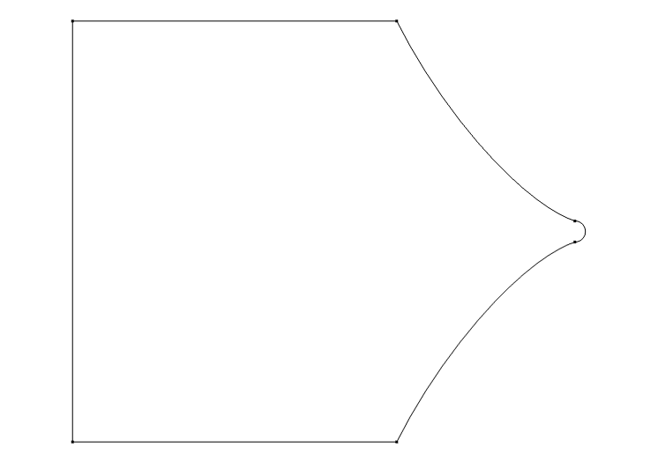






$$0.77D$$
$$0.47D$$
$$0.395D$$
$$D$$
FIXED
$$0.21D$$
$$0.395D$$
FREE

Slide 4
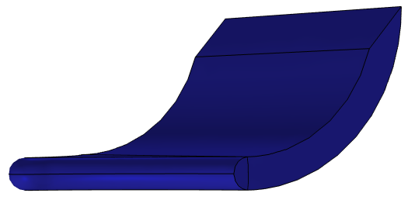
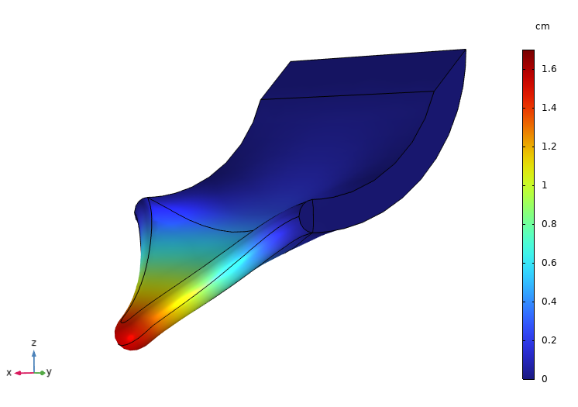
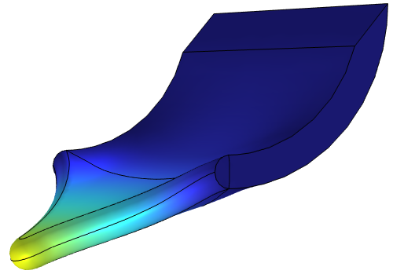
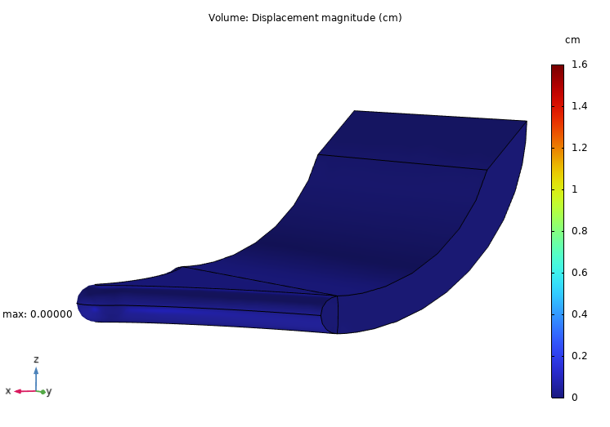
Displacement Magnitude (cm)
A
B
Control
w/o Hydrogel
w/ Hydrogel
C
1 cm
max: 1.60 cm
max: 1.08 cm

Slide 5
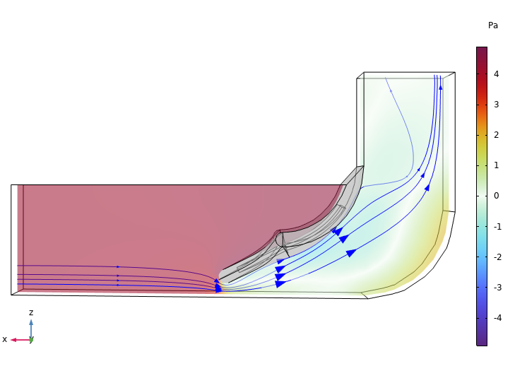
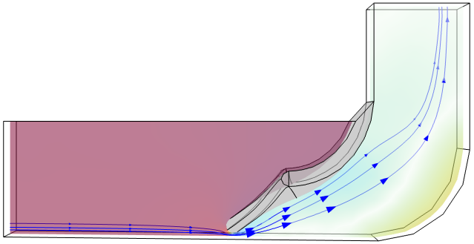
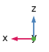
Pressure (Pa)
A
w/o Hydrogel
B
w/ Hydrogel
1 cm

Slide 6
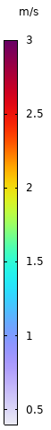
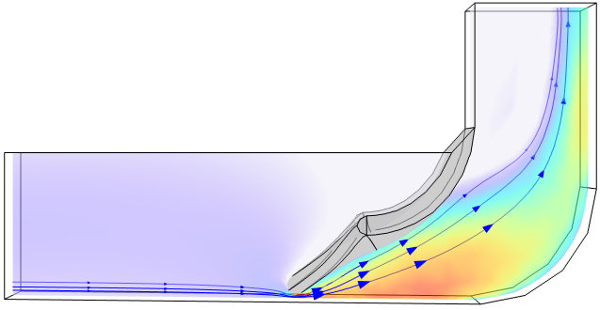
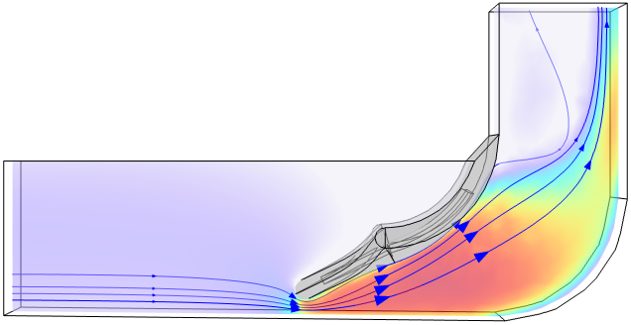
Flow Velocity Magnitude (m/s)
A
w/o Hydrogel
B
w/ Hydrogel
1 cm

Slide 7
Pressure (Pa)
A
w/o Hydrogel
B
w/ Hydrogel
1 cm
Flow Velocity Magnitude (m/s)
A
w/o Hydrogel
B
w/ Hydrogel
1 cm

Slide 8
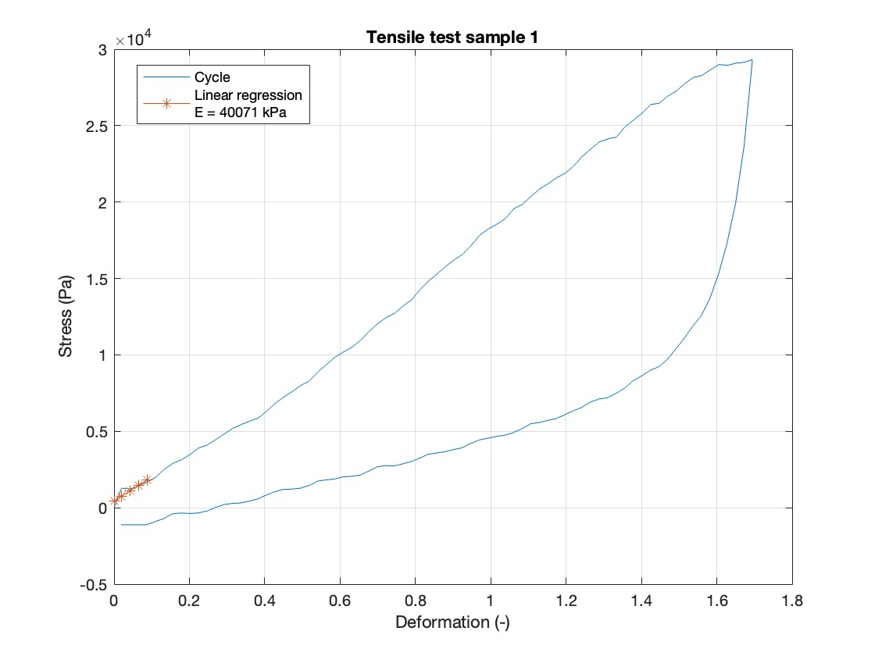
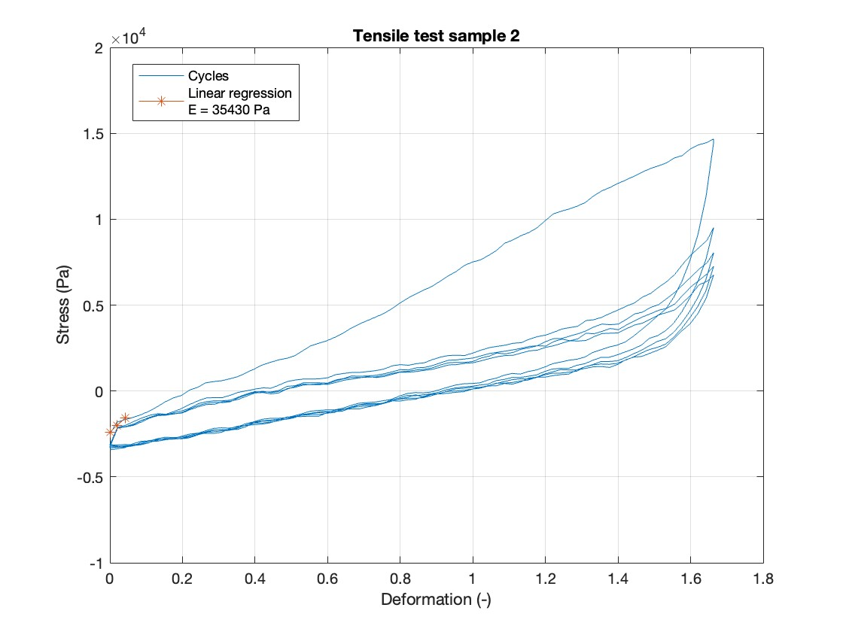
A
B

Slide 9
OLD

Slide 10
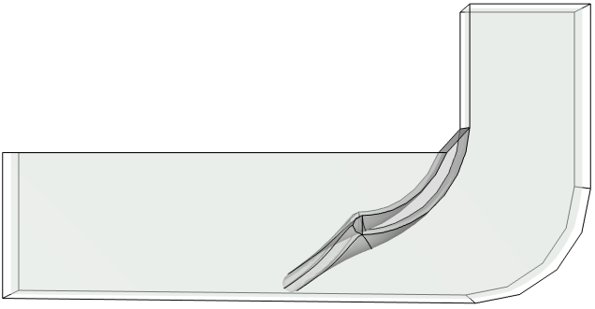
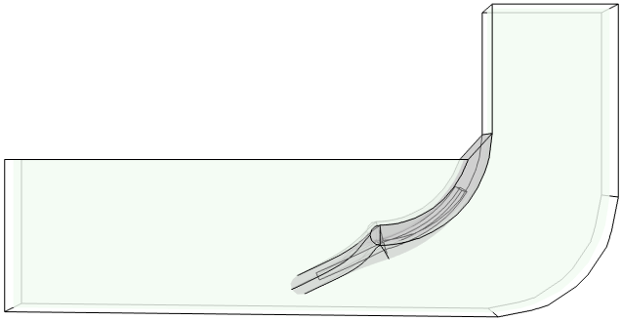
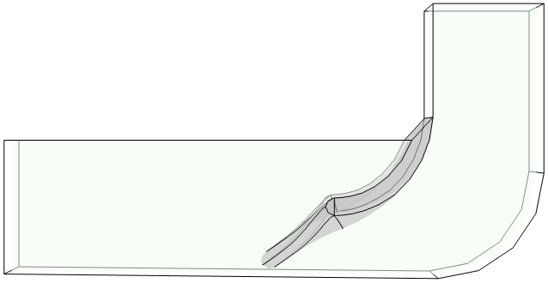

Pressure (Pa) (NO FLOW)
A
B
w/o Hydrogel
w/ Hydrogel
1 cm
max: 1.38 cm
max: 1.12 cm

Slide 11
Pressure (Pa)
A
w/o Hydrogel
B
w/ Hydrogel
1 cm
max: 1.41 cm
max: 1.14 cm

Slide 12
Flow Velocity Magnitude (m/s)
A
w/o Hydrogel
B
w/ Hydrogel
1 cm
max: 1.41 cm
max: 1.14 cm

Slide 13
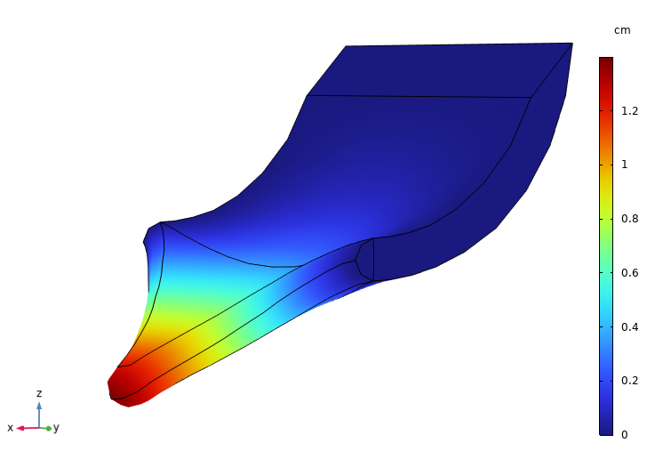
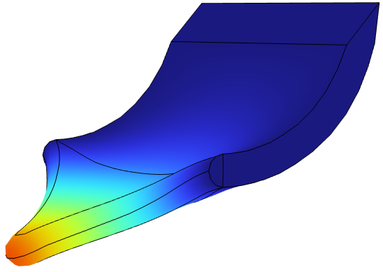
Displacement Magnitude (cm)
A
B
Control
w/o Hydrogel
w/ Hydrogel
C
1 cm
max: 1.38 cm
max: 1.12 cm

Slide 14
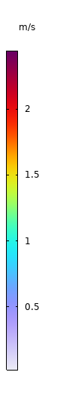
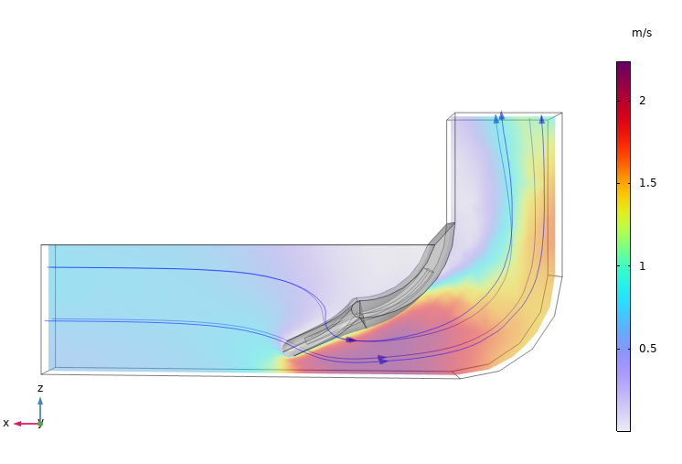
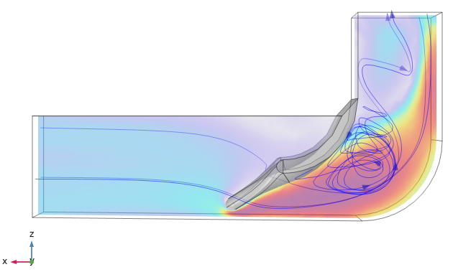
Flow Velocity Magnitude (m/s)
A
B
w/o Hydrogel
w/ Hydrogel
1 cm

