Slide 1
CYBER ATTACK PREVENTION

Slide 2
What is a cyber attack?
A cyber attack is a deliberate and malicious attempt to breach the security of a computer system, network, or device.
It is important for individuals and organizations to take steps to protect themselves from cyber attacks by implementing strong security measures and being vigilant about potential threats.

Slide 3


Simple tips for protection
Use complex passwords.
Ignore spam.
Back up your computer. Shut down your device Clear your browsing history.
Use a pop-up blocker and be cautious when visiting unfamiliar websites.
Avoid opening suspicious emails or clicking on links in emails from unknown sources.

Slide 4


INSTALL FIREWALLS
Firewalls carefully analyze incoming traffic based on pre-established rules and filter traffic coming from suspicious sources to prevent attacks.
Firewalls can either be software or hardware, though it’s best to have both.
Network address translation(NAT) Firewall
Stateful multilayer inspection (SMLI) Firewall

Slide 5

ANTIVIRUS AND ANTI- SPYWARE PACKAGE
Antivirus and anti-spyware software is essential for protecting your computer from viruses, malware, and spyware.
It works by scanning your computer for known threats and quarantining or removing them.

Slide 6

VIRTUALIZATION
Virtualization can help to improve security by allowing you to isolate applications and operating systems from each other, reducing the risk of one being compromised and affecting the others.

Slide 7
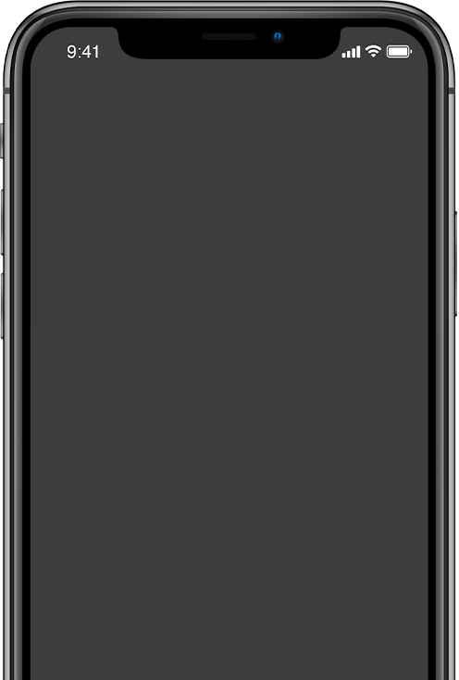

SWITCH OFF AUTOCOMPLETE
Autocomplete is the feature that guesses what you’re typing and completes the word, phrase, or other information for you. While convenient, this tool can hand your email address, mailing address, phone number, and other important information to hackers.

Slide 8
THANK YOU FOR YOUR ATTENTION

