Slide 1
Parking Space Classification
Joshua Ellis | Anthony Harris | Naseem Saquer
Notes:
Josh

Slide 2
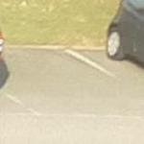
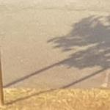
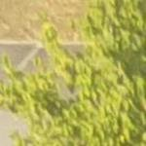
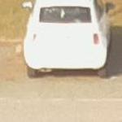
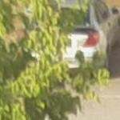
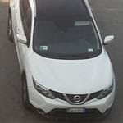
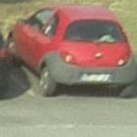
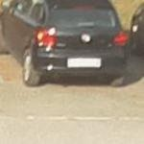
The Problem
Classify a parking space as “free” or “busy”
Dataset URL: http://cnrpark.it/
12.5k image subset
145k image extended set
Notes:
Anthony

Slide 3
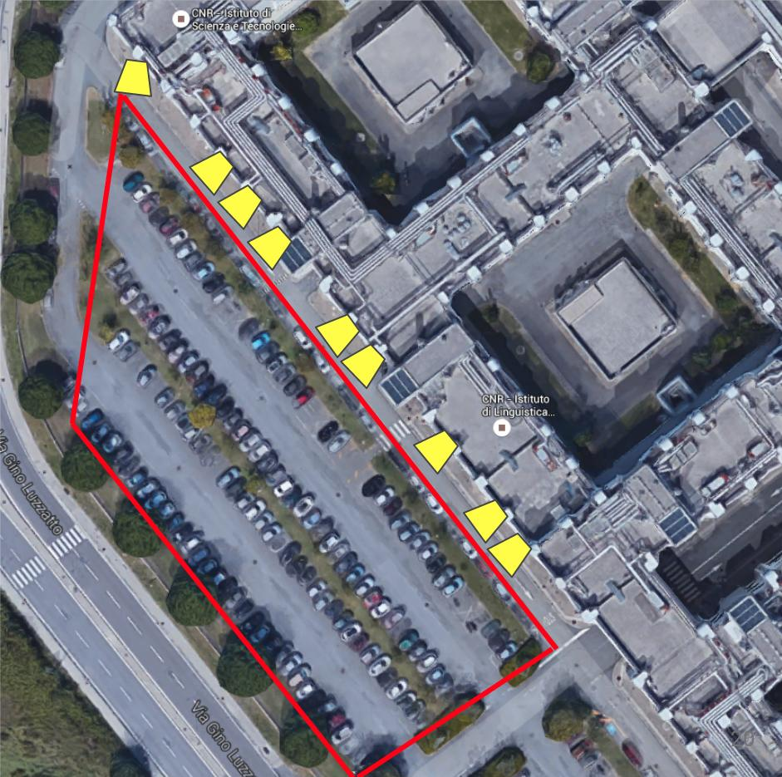
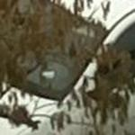

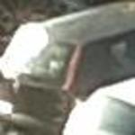
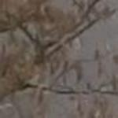
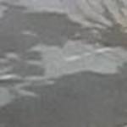
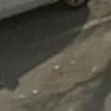
The Data: CNR-EXT-150x150
Weather | Busy | Free | Sum
Overcast | 23176 | 21067 | 44243
Rainy | 18618 | 18926 | 37544
Sunny | 37513 | 25665 | 63178
TOTAL: | 79307 | 65658 | 144965
9 Cams
Nov. 2015 – Feb. 2016
23 Days
Notes:
Anthony

Slide 4
Our Goal
This problem is not novel
Has been solved with AlexNet
Between 86%-98% Accuracy
We want to do it better
Less parameters
Comparable Accuracy
We want to compare different models
AlexNet
ResNet
Simple, 50, 101
DenseNet
Notes:
Anthony

Slide 5
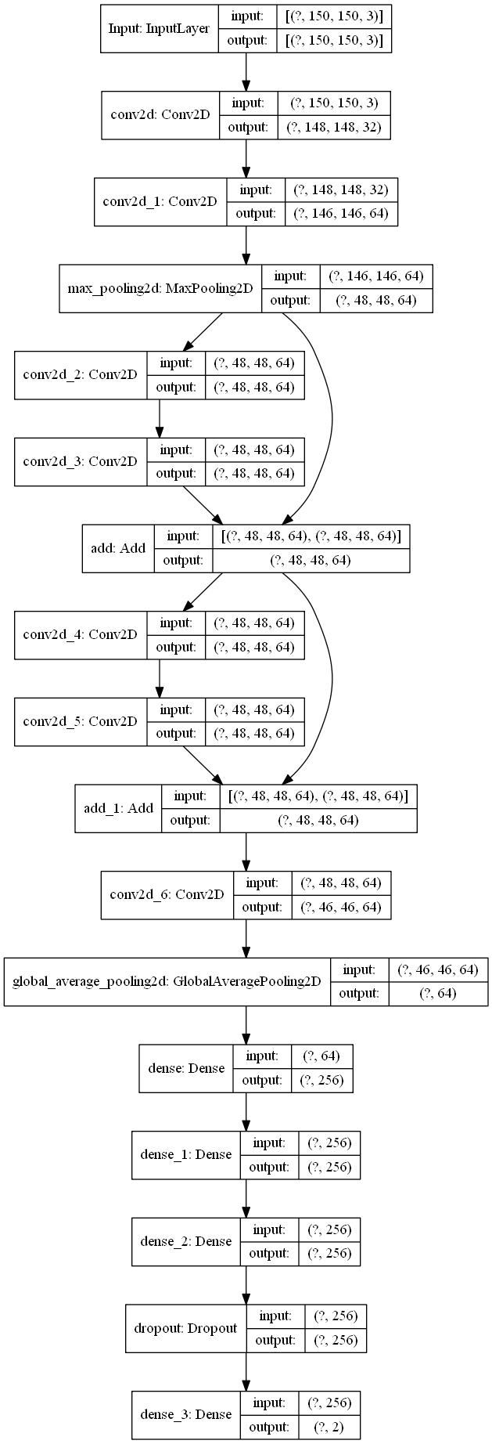
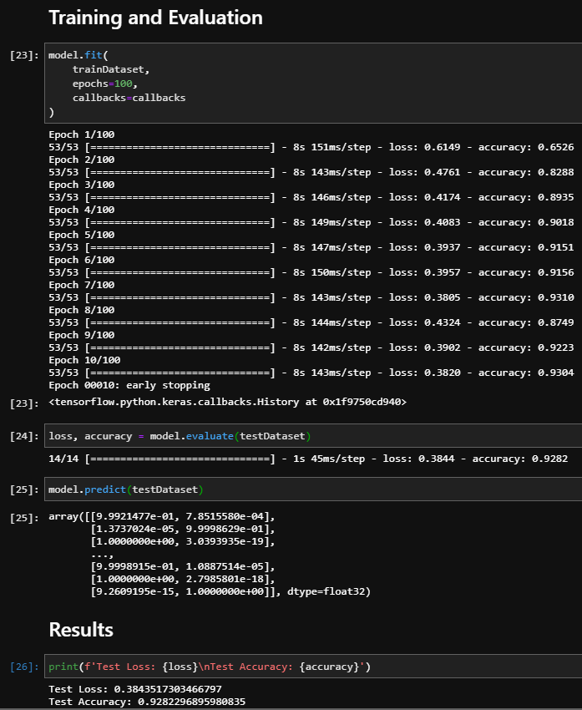
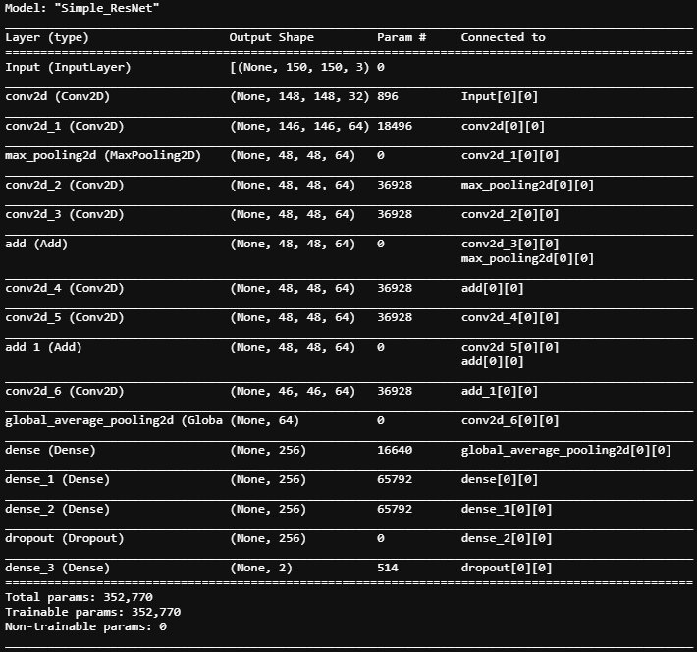
Initial Attempt
Notes:
Naseem

Slide 6
AlexNet
Notes:
Naseem

Slide 7
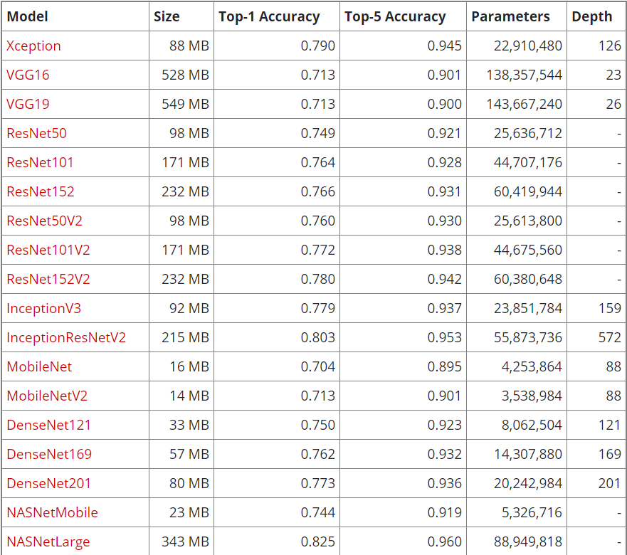
Keras Predefined Models
Notes:
Josh

Slide 8
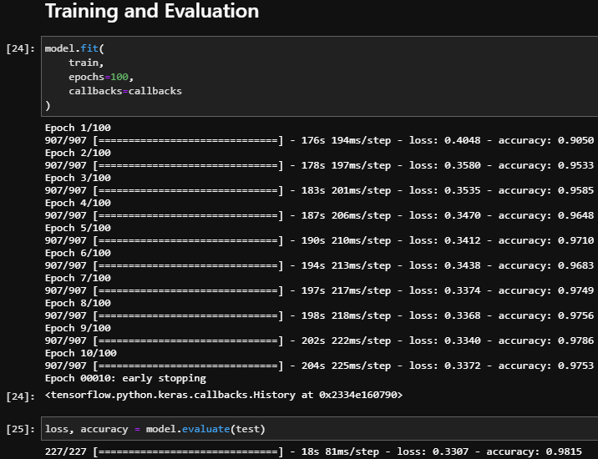
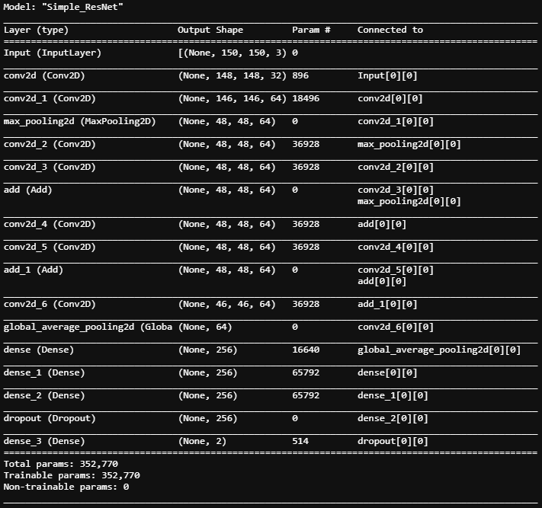
Simple ResNet
Notes:
Anthony

Slide 9
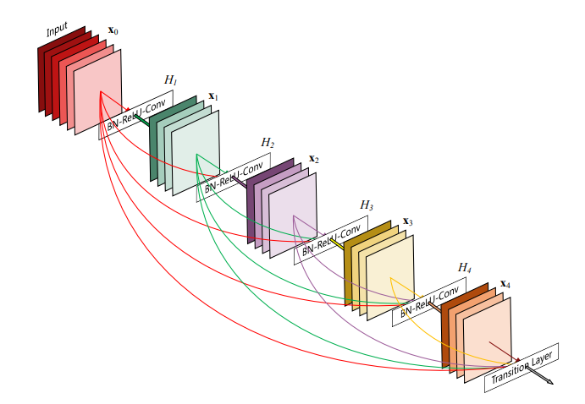
DenseNet
Similar to a ResNet
Contains multiple densely connected colvolutional blocks
Source: Densely Connected Convolutional Networks (2016)
Huang, Gao et al.
Notes:
Naseem

Slide 10
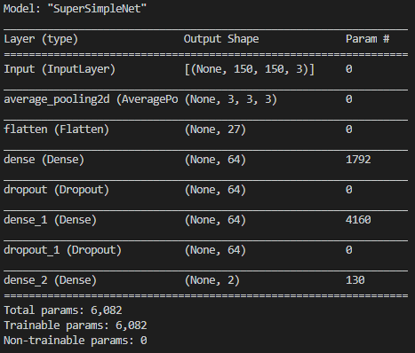
SimpleNet
Notes:
Josh

Slide 11
Conclusion
Model | Params | Train Acc | Test Acc
AlexNet | 50,887,285 | 98.82% | 98.59%
Simple DenseNet | 361,794 | 98.41% | 97.97%
Simple ResNet | 352,770 | 97.53% | 98.15%
DenseNet121 | 9,151,554 | 98.39% | 98.61%
DenseNet201 | 22,271,042 | 98.18% | 98.87%
SimpleNet | 6,082 | 92.25% | 94.43%
Notes:
Josh

Slide 12
Questions?

