Slide 1
Parking Space Classification
Joshua Ellis | Anthony Harris | Naseem Saquer

Slide 2
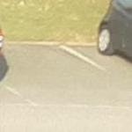


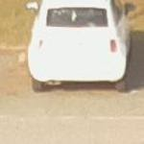
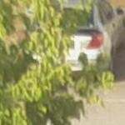
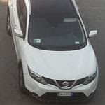
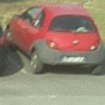
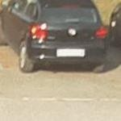
The Problem
Classify a parking space as “free” or “busy”
Dataset URL: http://cnrpark.it/
12.5k image subset
145k image extended set

Slide 3
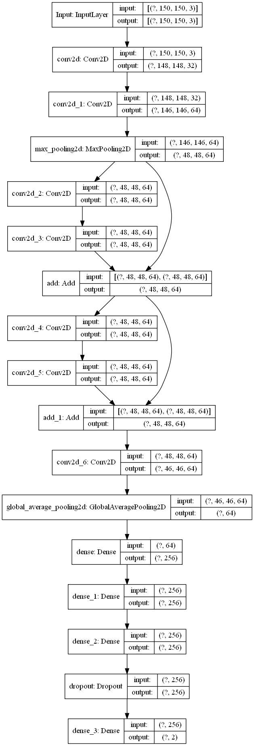
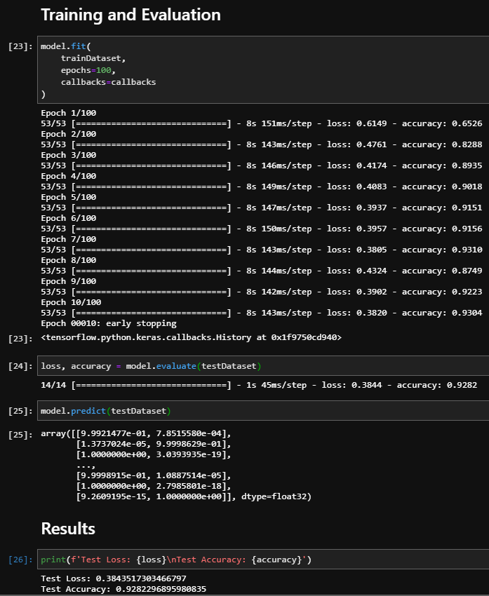
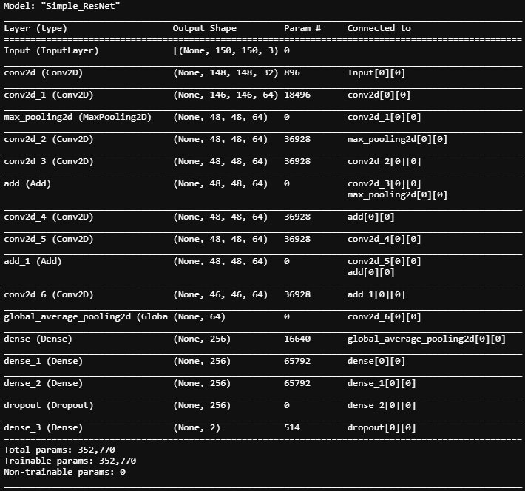
We’ve done…

Slide 4
Future Work
Prepare and train on larger dataset
Compare results with popular models
AlexNet
ResNet50
Expected Completion Date
Dependent upon performance on larger dataset.
We’re already fairly satisfied with our current results.
100% will be done by the end of the semester ☺

Slide 5
Questions?

