Slide 1
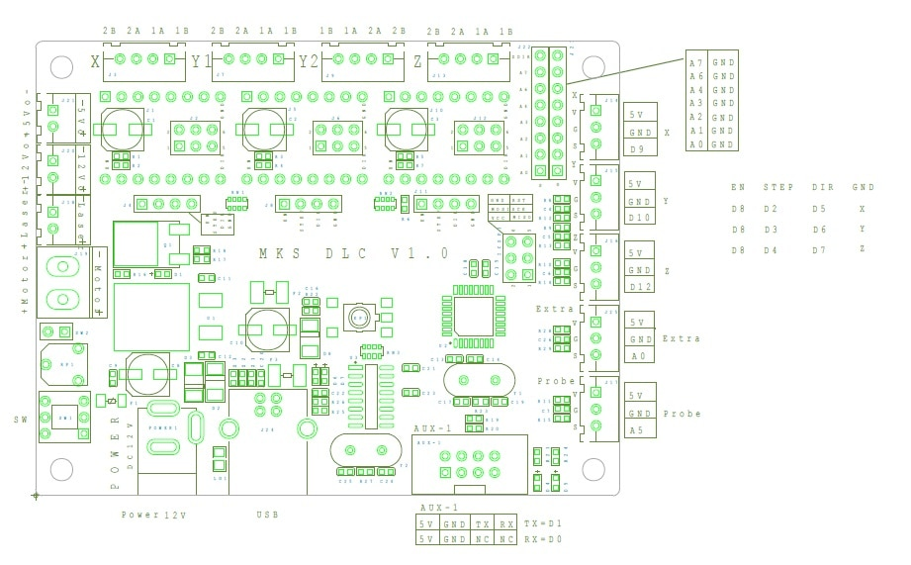
Motor 1
Motor 2
Motor 3
Laser (TTL)
+ / -
Laser (12V)
+ / -
LED
+ / -
LED
Matrix
+ / -
Laser (12V)
+ / -

