Slide 1
Title Screen

Slide 2
Will consist of the four main buttons along with the page
Along with a screenshot of something relevant to the game (Hopefully animated)
Start game – Obviously initiating the game and spawning the player in
Controls – take the player to a page instructing them on all the keys to press in the game
Options – Give the user some options to pick from to allow them to edit things
Exit game will just close the launcher down.
Start Game
Controls
Options
Exit Game

Slide 3
Options
Arrow to go back to main menu
Allow the user to select some basic options for the game which will be kept simple

Slide 4
Page will just show the basic movement of the game and how it will be Possible to do things in the level so the play if they would like can see this before the in game tutorial
Controls
Use WASD To move around
Camera Move with the mouse
Interact with objects through “E”

Slide 5
Basement

Slide 6
Spikes
Box
Box
Locked Door
Box
Spikes
Box
Box
Box
Spikes
Locked Door
Notice board
prop
prop
Locked Door
Desk
prop
prop

Slide 7
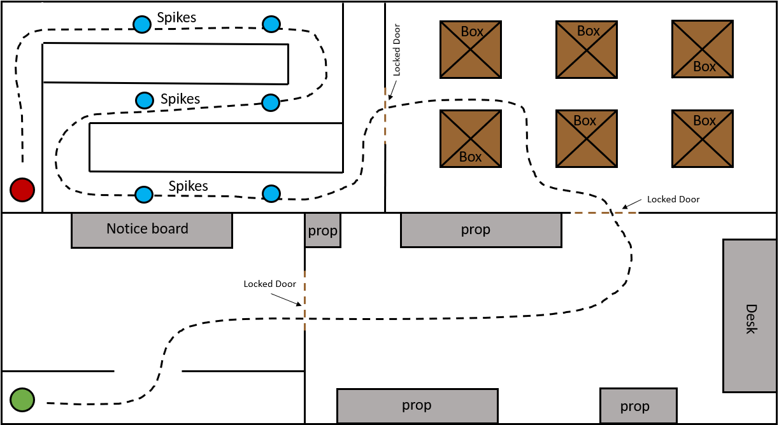
Level 1 (Basement/1st Floor) The player will start the game within a cell where they will be given instructions on basic movement and on how to interact with the game. From here they will progress to the playing area where they can choose to interact with the noticeboard to gain additional information or skip to proceed with the game. The first room of the level is a simple puzzle in which the player must find the missing book from the bookcase, once found and replaced the next door will open. Within the second area of the level the player will have to find 2 keys that are located within the boxes that are randomly placed throughout the room. Once both keys have been located and entered into the locks the next door will open. For the final room the player must navigate the room whilst avoiding the spikes in the floor, if the player hits a spike they will be returned to the beginning of the room. Once all the spikes have been avoided and the player has reached the end of the room they will be able to climb the ladder and enter/begin the 2nd level of the game

Slide 8
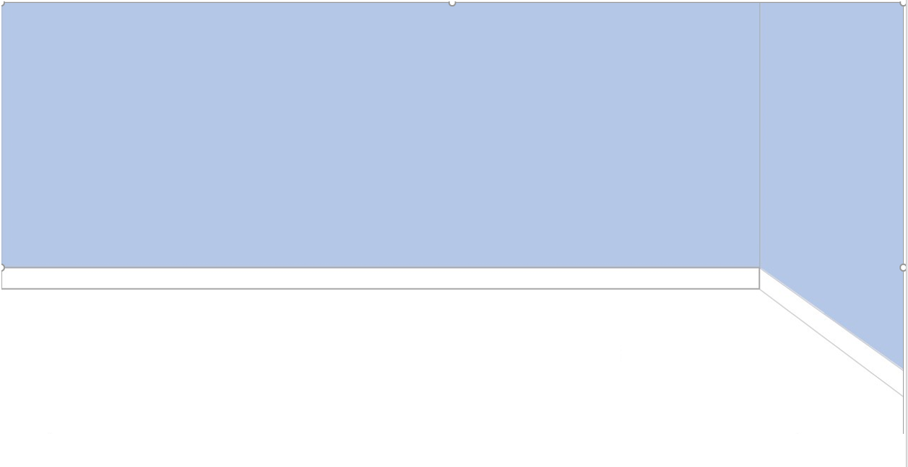
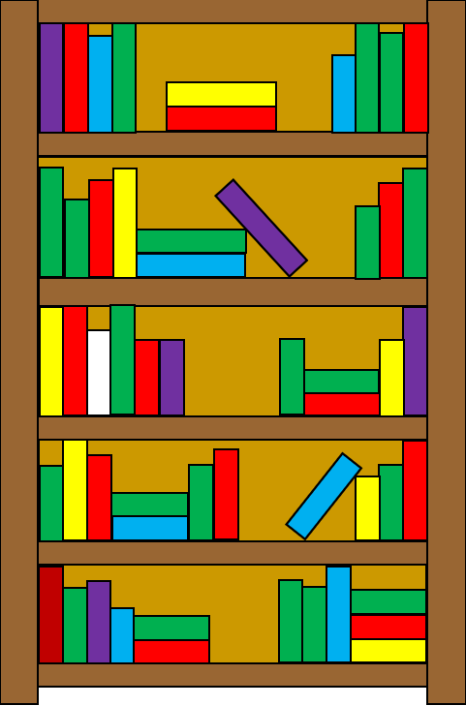
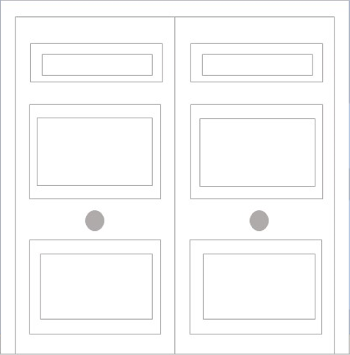

Slide 9
Nb

Slide 10
First Floor

Slide 11
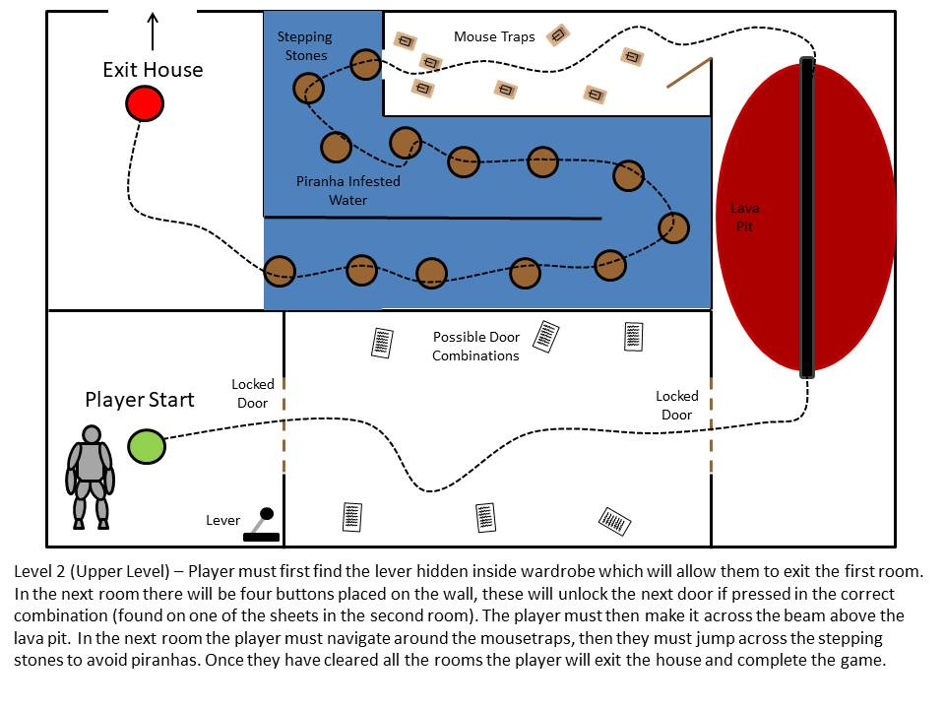

Slide 12
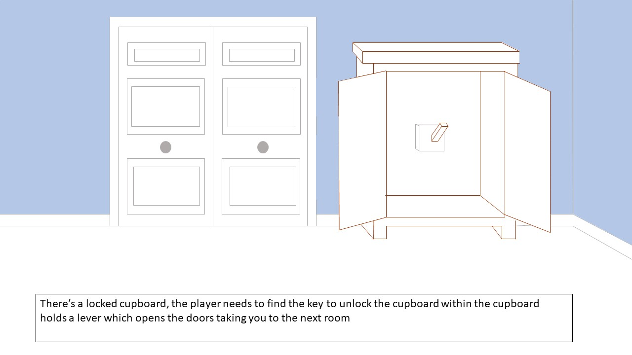

Slide 13
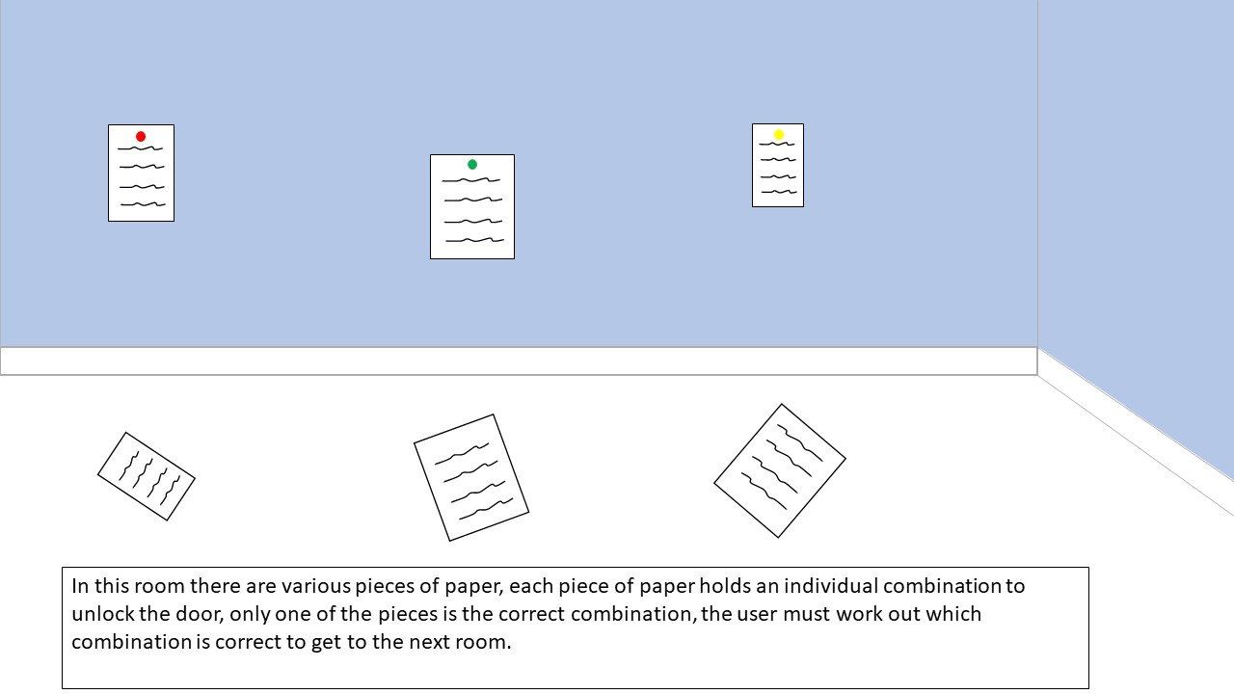

Slide 14
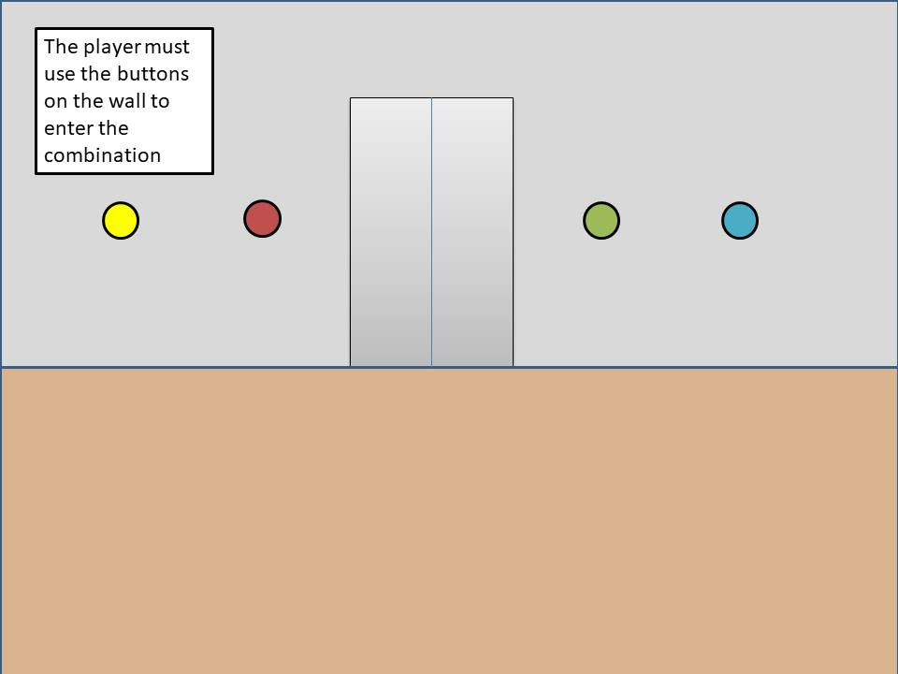

Slide 15
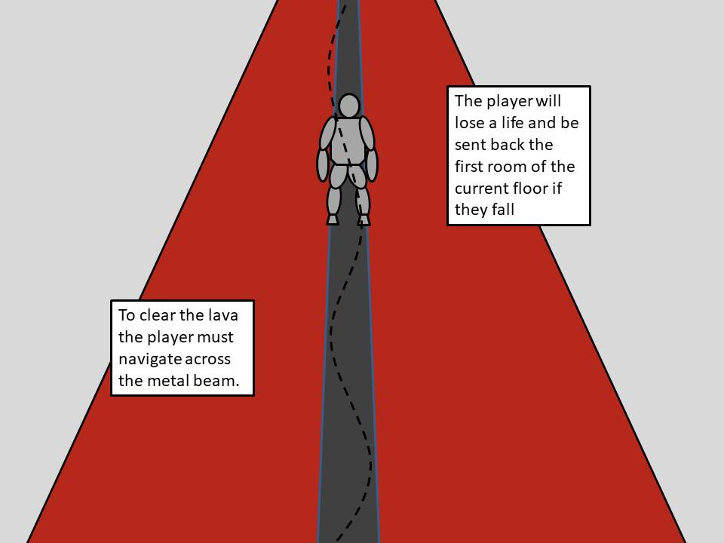

Slide 16
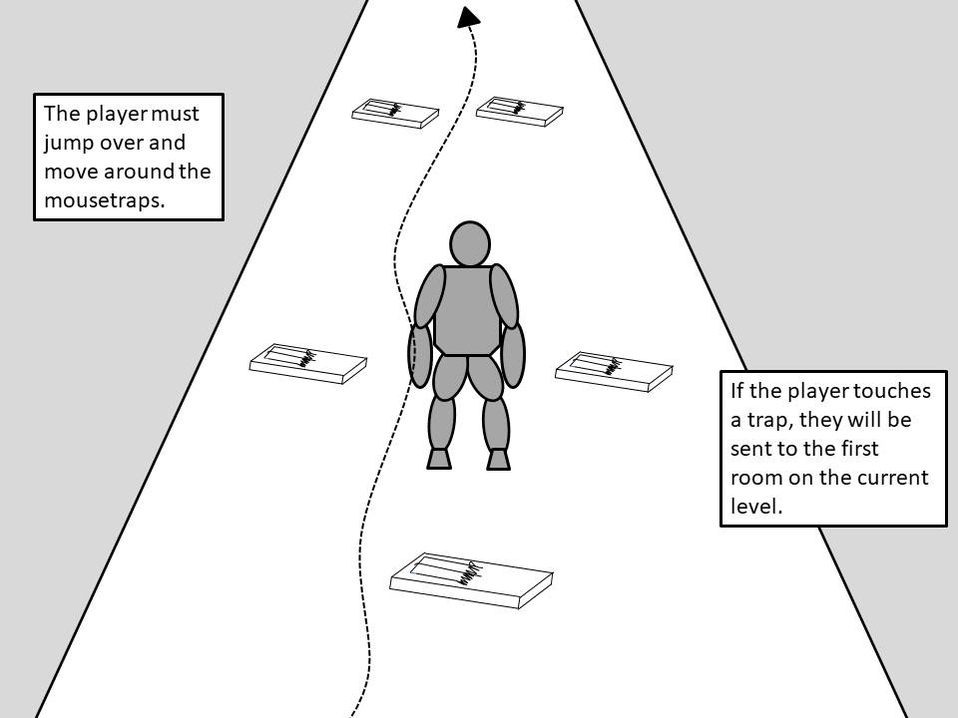

Slide 17
