Slide 1
NordCloud Assignment Assignment Done by, Sarathkumar Soundar email : sarathkumar90@yahoo.co.in mobile : +31-616960398

Slide 2
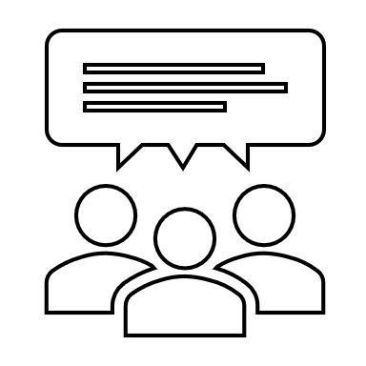
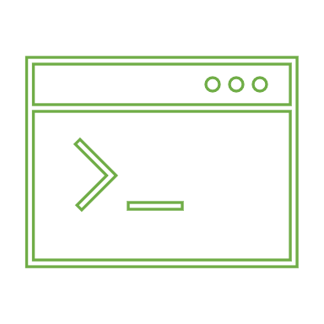
Business Case
Running on
Hosted to own datacenter
Drone Shuttles Ltd
Platform (Outdated)
Data Center

Slide 3
Proof of Concept
Design and implement a solution architecture using major public cloud platform (AWS/Azure/GCP)
The solution should be optimized for costs and easy to maintain/develop in the future
Challenge :
To use kubernetes

Slide 4
Components
Load Balancing
Region Failure / Disaster Recovery
Release new version multiple times per day without downtime
Multiple Environments
Monitoring / Logging / Debugging
Exposed to public internet
Security
Deleting all the post using serverless function

Slide 5
Ghost Platform Details
play-with-docker/play-with-docker: You know it, you use it, now it's time to improve it. PWD!. (github.com)
https://github.com/docker-library/ghost.git
Ghost - Official Image | Docker Hub

Slide 6
Design 1
AWS
VPC
Ghost
EC2
Auto Scaling
CloudWatch

Slide 7
Design 2 - Manual
AWS
VPC
EC2
Ghost
ECR
Docker
Auto Scaling
Docker
CloudWatch

Slide 8
Design 3 - Automated
Pipeline
AWS
Code Deploy
Code build
VPC
EC2
Ghost
Docker
Auto Scaling
Code commit
Docker
ECR
CloudWatch

Slide 9
Design 4 – Kubernetes
AWS
VPC
Kubernetes
Auto Scaling
Ghost
Docker
ECR

Slide 10
Design 5
AWS
Ghost
Elastic Beanstalk
Docker/ Git

Slide 11
Issues / Challenges
Cloning docker image into Elastic Container Repository
Creating build on Code Build in AWS Pipeline

Slide 12
Demo Ready

