Slide 1



Step by Step
Step by Step is a new Android app that makes following a set of instructions as easy as a swipe of your finger.
Brought to you by
Killer Spiders
Our name is random…
Our code is not…

Slide 2
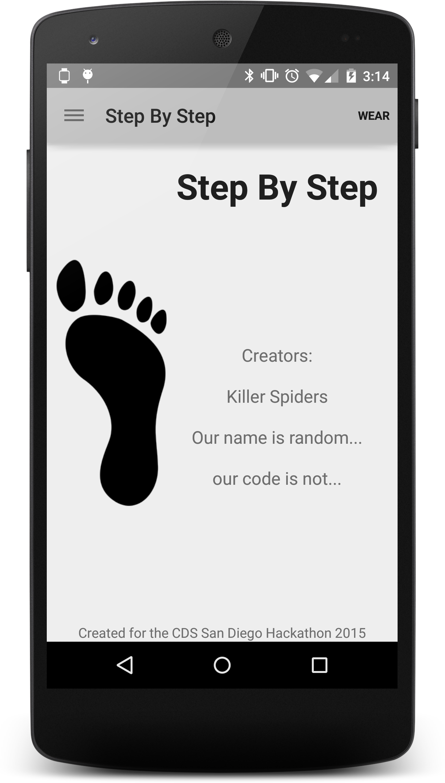
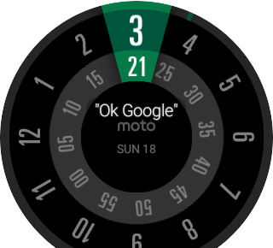

Nexus 5
Moto 360
Killer Spiders
Our name is random…
Our code is not…
Notes:
No foot shadow

Slide 3
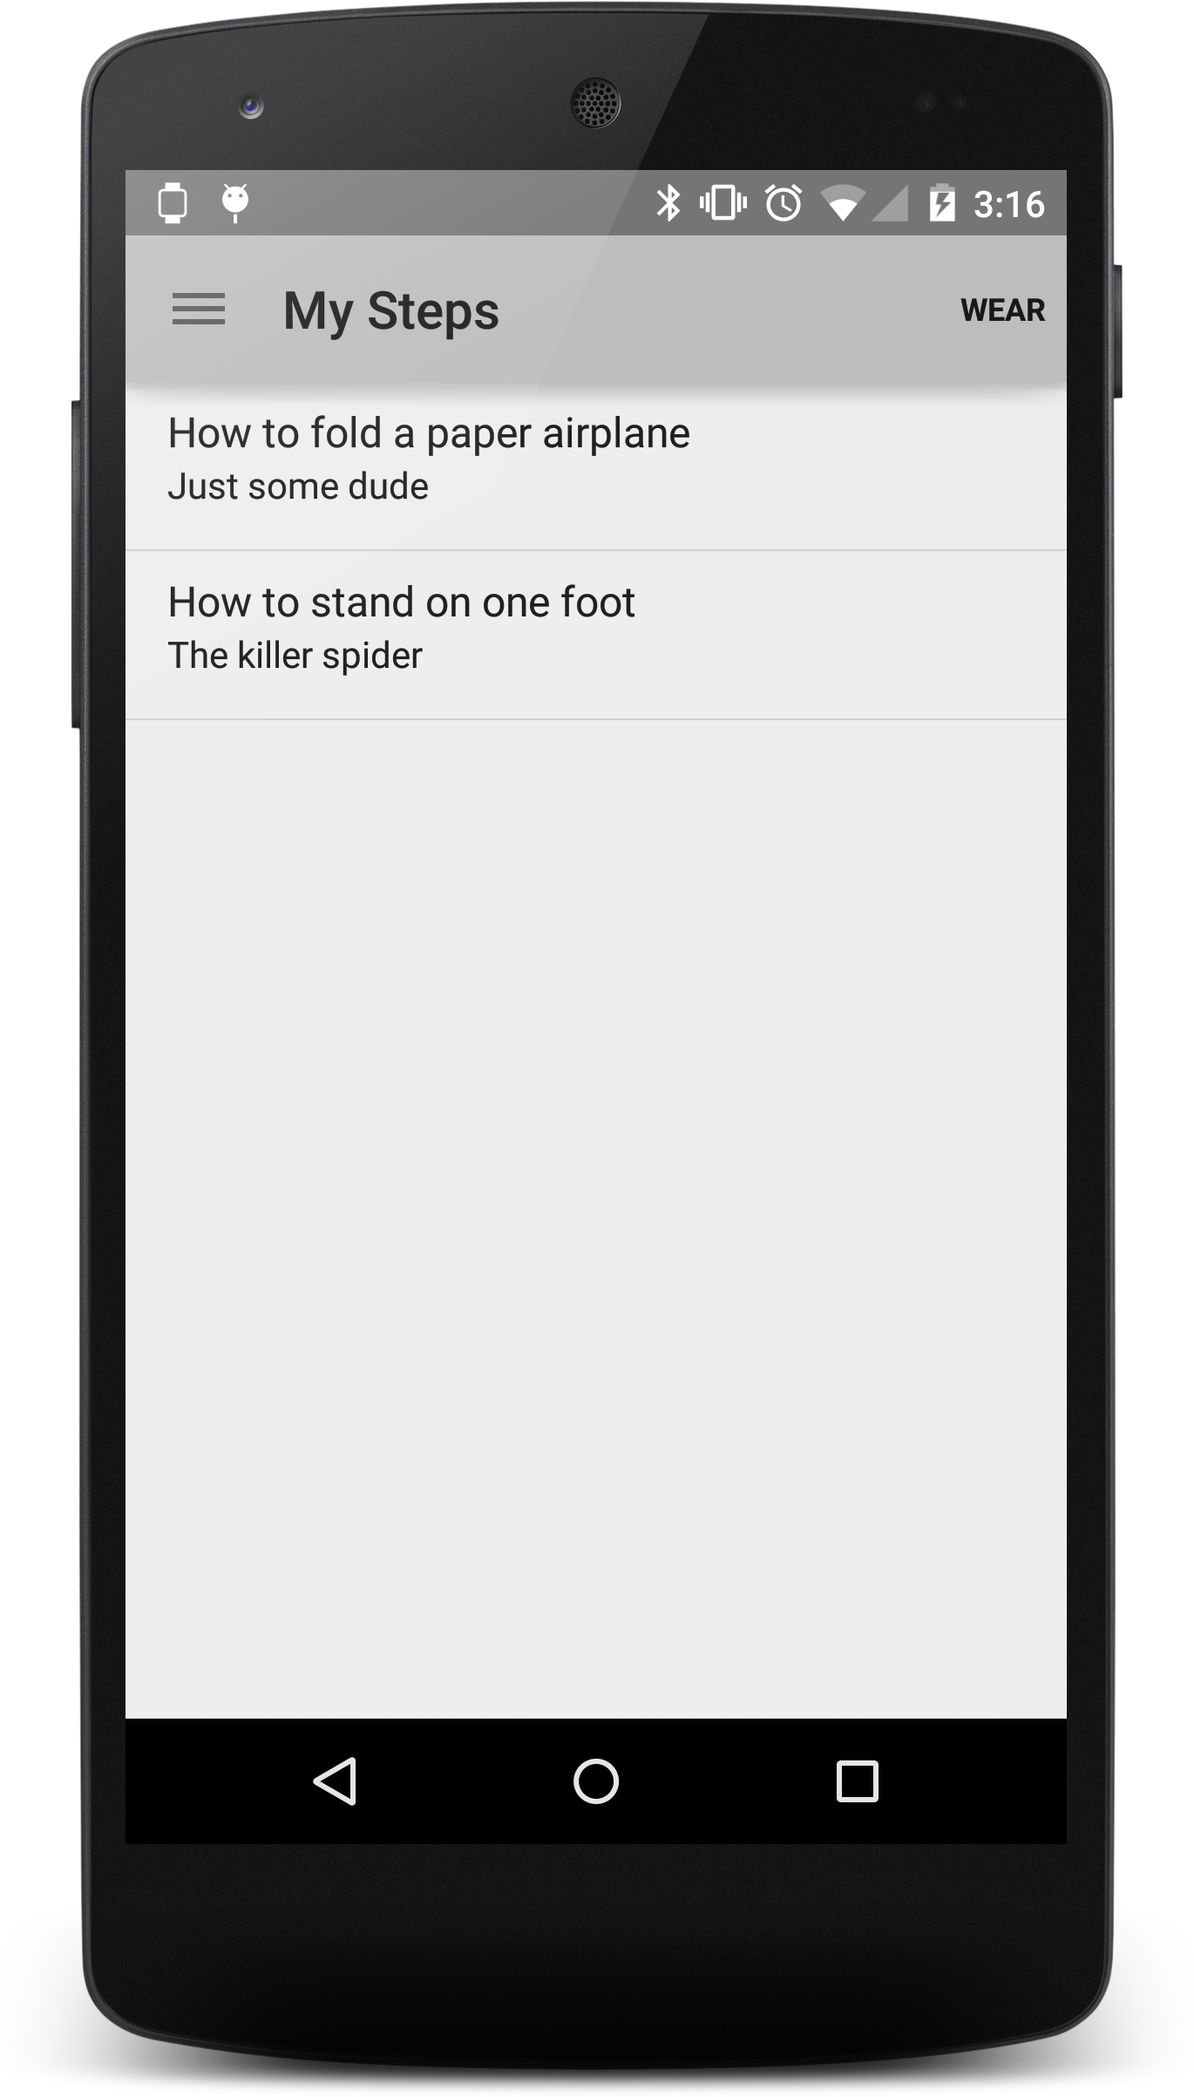

Killer Spiders
Our name is random…
Our code is not…
Notes:
No foot shadow

Slide 4
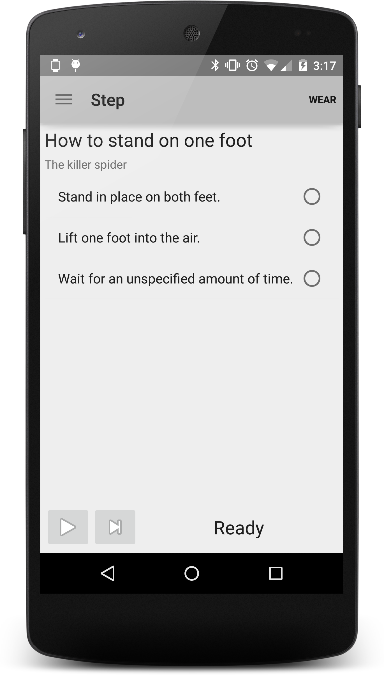
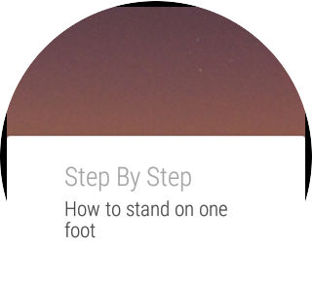
Killer Spiders
Our name is random…
Our code is not…
Notes:
No foot shadow

Slide 5
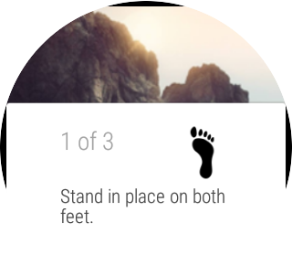
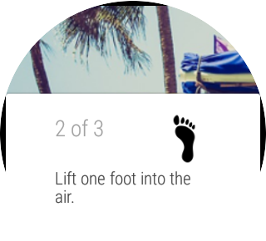
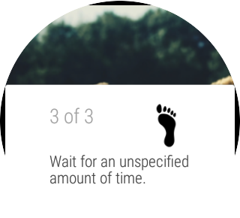

Improvements
Instructions are read aloud as you swipe.
Custom images for each instruction
Ability to download additional instruction lists
Ability to create and edit instruction lists on a computer on a webpage
Killer Spiders
Our name is random…
Our code is not…
Notes:
No foot shadow

