Slide 1

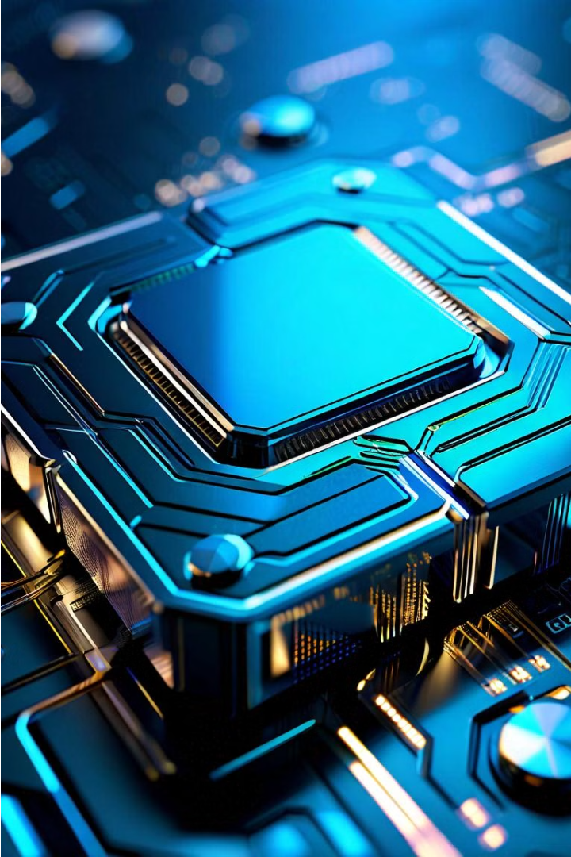
Artificial Neural Networks in NVIDIA Blackwell Chip
NVIDIA's Blackwell chip is a groundbreaking piece of hardware that leverages the power of artificial neural networks to deliver unparalleled performance and efficiency in a wide range of computing applications. By integrating advanced neural network architectures directly into the chip's design, NVIDIA has created a specialized processor that can excel at tasks such as computer vision, natural language processing, and predictive analytics.

Slide 2
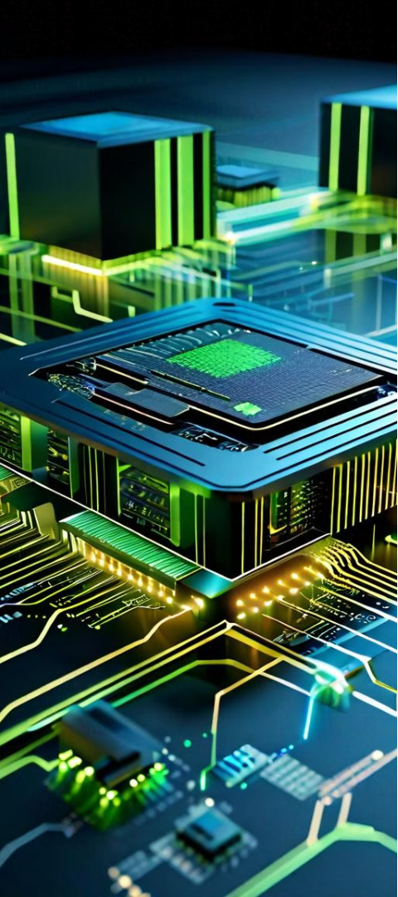
Leveraging Deep Learning for Accelerated Computing
1
Neural Network Acceleration
At the core of the NVIDIA Blackwell chip is a dedicated deep learning processing unit (DPU) that is designed to accelerate the execution of complex neural network models. This specialized hardware can perform matrix multiplications and other key neural network operations with exceptional speed and energy efficiency, enabling real-time processing of data-intensive tasks.
2
Efficient Memory Hierarchy
The Blackwell chip features a carefully designed memory architecture that minimizes data movement and latency. By incorporating high-bandwidth on-chip memory and leveraging advanced memory management techniques, the chip can efficiently feed data to the neural network processing units, maximizing their utilization and boosting overall performance.
3
Scalable Interconnects
The Blackwell chip's high-speed interconnects enable seamless communication between the neural network processing units, the memory subsystem, and other key components. This allows the chip to scale and distribute workloads across multiple processing elements, unlocking even greater performance and power efficiency for demanding deep learning applications.

Slide 3
Optimizing Performance and Efficiency with Specialized Hardware
Power Efficiency
Inference Acceleration
Scalable Performance
The NVIDIA Blackwell chip is designed with power efficiency in mind, drawing significantly less power than traditional CPUs or GPUs while delivering superior performance for deep learning tasks. This makes the Blackwell chip an ideal choice for deployment in energy-constrained environments, such as edge devices or mobile platforms, where power consumption is a critical concern.
The Blackwell chip's neural network processing units are optimized for rapid inference, allowing for the real-time deployment of trained deep learning models. This enables the chip to quickly process and interpret data, making it well-suited for applications like computer vision, natural language processing, and predictive analytics, where low latency is essential.
The Blackwell chip's modular design and high-speed interconnects allow it to be deployed in scalable, high-performance computing environments, such as data centers and cloud infrastructure. By leveraging multiple Blackwell chips in parallel, organizations can achieve unprecedented levels of deep learning performance and throughput, unlocking new possibilities in areas like AI-driven decision making and autonomous systems.

