Slide 1
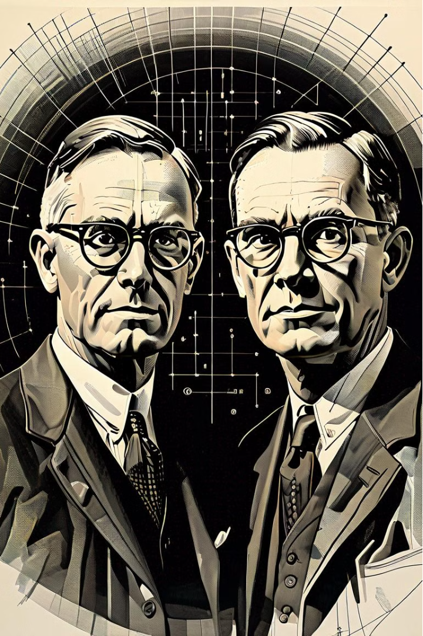
The Groundbreaking Work of Warren McCulloch and Walter Pitts
In the late 1940s, two pioneering researchers, Warren McCulloch and Walter Pitts, made a profound impact on the emerging field of artificial intelligence. Their work laid the foundations for the development of artificial neural networks, which have become a fundamental component of modern AI and machine learning.

Slide 2
Contributions to the Foundations of Artificial Neural Networks
The McCulloch-Pitts Model
1
McCulloch and Pitts created a mathematical model of a neural network, known as the McCulloch-Pitts model. This model represented neurons as simple binary units that could either fire or not fire, based on the weighted sum of their inputs. This groundbreaking work provided a formal framework for understanding the basic principles of how neural networks could process information.
2
Threshold Logic
The duo also introduced the concept of threshold logic, which allowed for the representation of complex Boolean functions using interconnected neural-like units. This laid the foundation for the development of more sophisticated artificial neural network architectures, paving the way for modern deep learning algorithms.
Computational Capabilities
3
McCulloch and Pitts demonstrated that their neural network model could, in theory, compute any computable function, providing a powerful insight into the potential capabilities of artificial neural networks. This laid the groundwork for further advancements in the field of AI and machine learning.

Slide 3
The Lasting Impact on the Field of Artificial Intelligence
Inspiration for Later Advancements
Influence on Cognitive Science
Ongoing Relevance
Even today, the work of McCulloch and Pitts remains highly relevant in the field of artificial intelligence. Their foundational contributions continue to shape the development of neural networks and other machine learning techniques, as researchers strive to create increasingly sophisticated and powerful AI systems that can mimic and even surpass human cognitive abilities.
The work of McCulloch and Pitts has had a lasting impact on the field of artificial intelligence. Their pioneering research inspired generations of researchers to build upon their foundational ideas, leading to the development of more advanced neural network architectures, such as deep learning, and their widespread applications in fields like computer vision, natural language processing, and robotics.
The McCulloch-Pitts model also had a significant influence on the field of cognitive science, as it provided a framework for understanding how the brain might process information. This led to further research into the biological mechanisms underlying human cognition and perception, further advancing our understanding of the mind and its connection to artificial intelligence.

