Slide 1

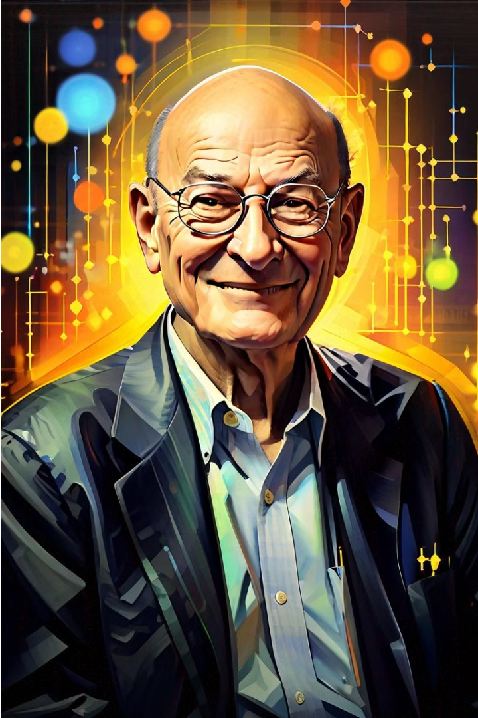
Marvin Minsky: A Pioneer in Artificial Intelligence
Marvin Minsky, a renowned figure in the field of Artificial Intelligence (AI), was a visionary thinker and a driving force behind the development of this transformative technology. As a co-founder of the MIT Artificial Intelligence Laboratory, Minsky's groundbreaking work and influential collaborations paved the way for the advancement of AI, shaping the way we understand and interact with technology today.

Slide 2

Pioneering Work in Artificial Intelligence
1
The Perception of the Human Mind
Minsky's early research focused on the perception of the human mind, exploring how we process and understand information. His work on the theory of mind and the development of intelligent machines laid the foundation for the field of AI, challenging traditional notions of human intelligence and cognition.
2
The Society of Mind
Minsky's seminal work, "The Society of Mind," proposed a revolutionary theory that the human mind is not a single, unified entity, but rather a collection of interconnected agents working together to produce intelligent behavior. This concept has had a profound impact on our understanding of the mind and the development of AI systems.
3
Advances in Neural Networks
Minsky's contributions to the field of neural networks were instrumental in the development of modern AI. He collaborated with Seymour Papert to create the Perceptron, a fundamental building block of neural networks, and their work laid the groundwork for the resurgence of deep learning in the 21st century.

Slide 3
Influential Collaborations and Contributions
Collaborations with Seymour Papert
Founding the MIT AI Lab
Influential Books and Writings
Minsky's partnership with Seymour Papert, a fellow pioneer in AI, was crucial in shaping the field. Together, they made significant contributions, including the development of the Perceptron and the exploration of the limitations of early neural network approaches.
Minsky co-founded the MIT Artificial Intelligence Laboratory, which became a hub of groundbreaking research and innovation in the field. The lab attracted some of the brightest minds in AI and fostered a collaborative environment that drove the field forward.
Minsky's intellectual legacy extends beyond his research contributions. His books, including "The Society of Mind" and "The Emotion Machine," have had a profound impact on the way we understand and conceptualize intelligence, both human and artificial. His writings have inspired generations of researchers and thinkers in the field of AI.

