Slide 1
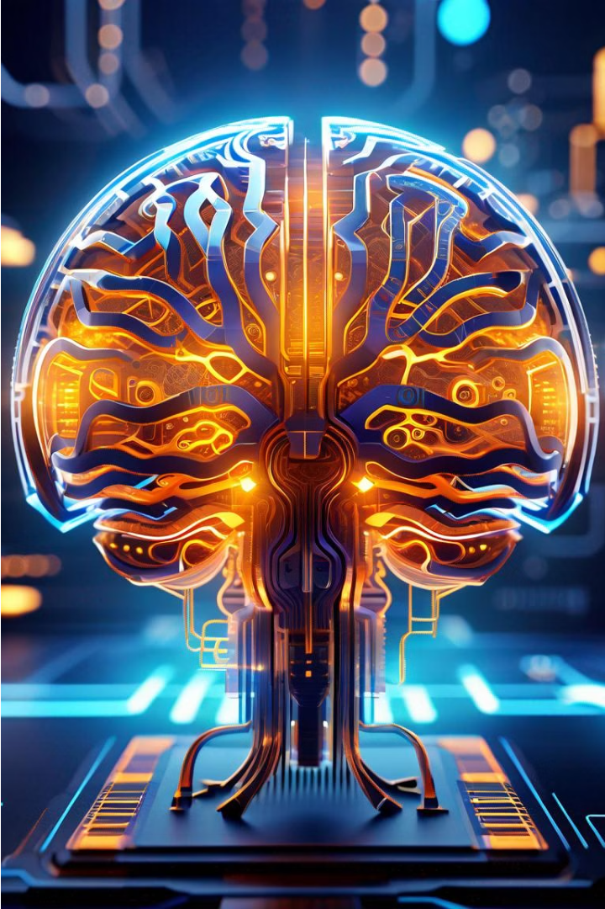
Neuralink: Revolutionizing Brain-Computer Interfaces
Neuralink, the pioneering neurotechnology company founded by Elon Musk, is at the forefront of revolutionizing brain-computer interfaces (BCIs). By developing advanced implantable devices, Neuralink aims to seamlessly integrate the human brain with digital technology, unlocking unprecedented possibilities for medical applications, cognitive enhancement, and even a new era of human-machine symbiosis.

Slide 2
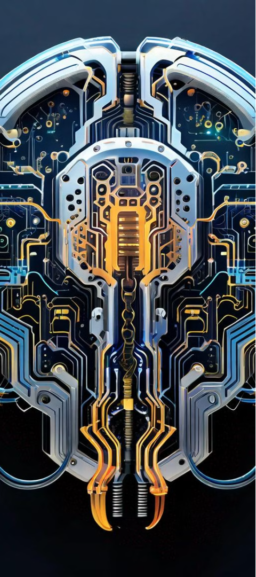
The Science Behind Neuralink's Innovations
1
Precision Electrode Array
At the core of Neuralink's technology is a highly advanced electrode array that can precisely record and stimulate neural activity. This array, made up of thousands of flexible polymer threads, is designed to seamlessly integrate with the brain, minimizing tissue damage and immune response.
2
Wireless Communication
The neural implant device developed by Neuralink features wireless communication capabilities, allowing it to transmit data to and from the brain without the need for cumbersome wired connections. This enables the device to be fully implantable, improving patient comfort and reducing the risk of infection.
3
Closed-Loop Feedback
Neuralink's system incorporates a closed-loop feedback mechanism, where the device can not only read neural signals but also deliver targeted electrical stimulation to the brain. This bidirectional communication allows for precise control and modulation of neural activity, paving the way for novel therapeutic applications.

Slide 3
Potential Applications and Future Developments
Medical Breakthroughs
Cognitive Enhancement
Merging with AI
As Neuralink's technology continues to evolve, the company envisions a future where the human brain is directly integrated with artificial intelligence systems. This integration could lead to the emergence of a new species of "human-AI hybrids," blurring the lines between biological and digital intelligence and ushering in a profound transformation of the human condition.
Neuralink's technology holds immense promise for addressing a wide range of neurological and psychiatric disorders. By directly interfacing with the brain, the company aims to develop treatments for conditions such as Parkinson's disease, depression, and even paralysis, restoring function and improving the quality of life for those affected.
Beyond medical applications, Neuralink's brain-computer interfaces could unlock new possibilities for cognitive enhancement. By augmenting human cognition and expanding the boundaries of our sensory perception, the technology could pave the way for a future where humans and machines seamlessly collaborate, unlocking unprecedented levels of creativity, problem-solving, and intellectual capabilities.

