Slide 1
Health Information System
SOFTWARE ENGINEERING INTERNSHIP TASK PRESENTATION
BY: CAVIN LARRY

Slide 2
Project Approach
HealthInfoSystem is a minimal backend system for managing health programs and client data.
Built with Ktor (Kotlin) and Exposed ORM using an API-first approach.
Provides endpoints for program creation, client management, and enrollment of clients to health program(s).

Slide 3
Technology Stack
Ktor (Kotlin) framework for the server
Exposed ORM for DB access
SQLite with HikariCP connection pooling
kotlinx-serialization for JSON handling
CallLogging for logging server details or logs
ContentNegotiation for content negotiation
CORS for exposing the API endpoints
Testing: ktor-server-test + kotlin-test

Slide 4
System Design Overview
Client → HTTP Request → Ktor API → Exposed ORM → SQLite DB
Modular code: Main entry, Routing, DTOs, Models, Configs, Routes

Slide 5
Implemented Features
Add health program: POST /api/programs
List all programs: GET /api/programs
Create client: POST /api/clients
Enroll client to a program: POST /api/clients/{id}/enroll
Search clients: GET /api/clients?q=...
q takes any parameter from the client table and filter the result giving the best match
View client profile: GET /api/clients/{id}
Exposed these endpoints at 127.0.0.1:8080 for integration and consumption by other codebases or systems

Slide 6
Sample API Response for view client profile
{
"id": 1,
"firstName": "Jane",
"lastName": "Doe",
“email”: “jane.doe@example.com”,
"programs": [
{
"id": 2,
"name": "Malaria",
“description: “Malaria treatment and prevention”
}
]
}

Slide 7
Testing & Validation
ktor-server-test used to simulate HTTP requests
Unit tests for:
- Program creation
- Client creation

Slide 8
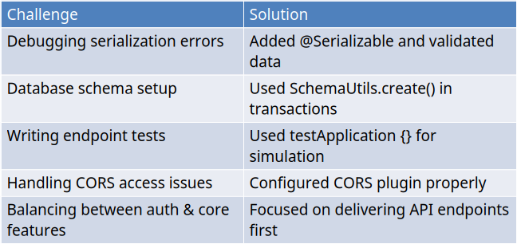
Challenges & Solutions

Slide 9
Project Outcome & Future Work
• Built HealthInfoSystem API with Ktor, Exposed, SQLite
• Implemented full client and program lifecycle
• Tested APIs using ktor-server-test
• Exposed client profiles for external systems
• Future enhancements: Security, UI integration

Slide 10
Thank You
GitHub: https://github.com/Killercavin/HealthInfoSystem

