Slide 1
Checkpoint 3

Slide 2
Synopsis
Project Overview
MMO built with the Godot engine.
Character Creation:
Players create unique characters by selecting names and customizing appearances.
Gameplay Environment:
Players join a server.
See other players and their own attributes.
Talk to each other
NPC Interactions:
Interaction with enemy NPCs in the game world.
Gameplay Dynamics:
Combines multiplayer gameplay and tracking .
Registration
Login
Player level
Player position and location
Players chatting

Slide 3
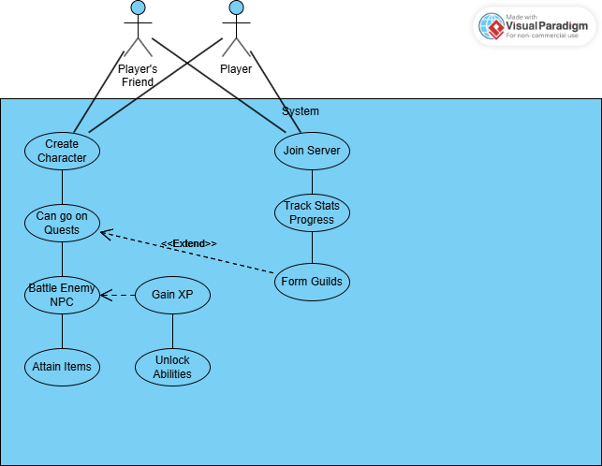
UML Case

Slide 4
ER Diagram
There are 7 relationships
1 to Many
User to Character table
Character to Guild table
Quest to Friendly_NPC table
Many to Many
Character to Quest table
Character to Item table
Quest to Item Table
Quest to Enemy_NPC table

Slide 5
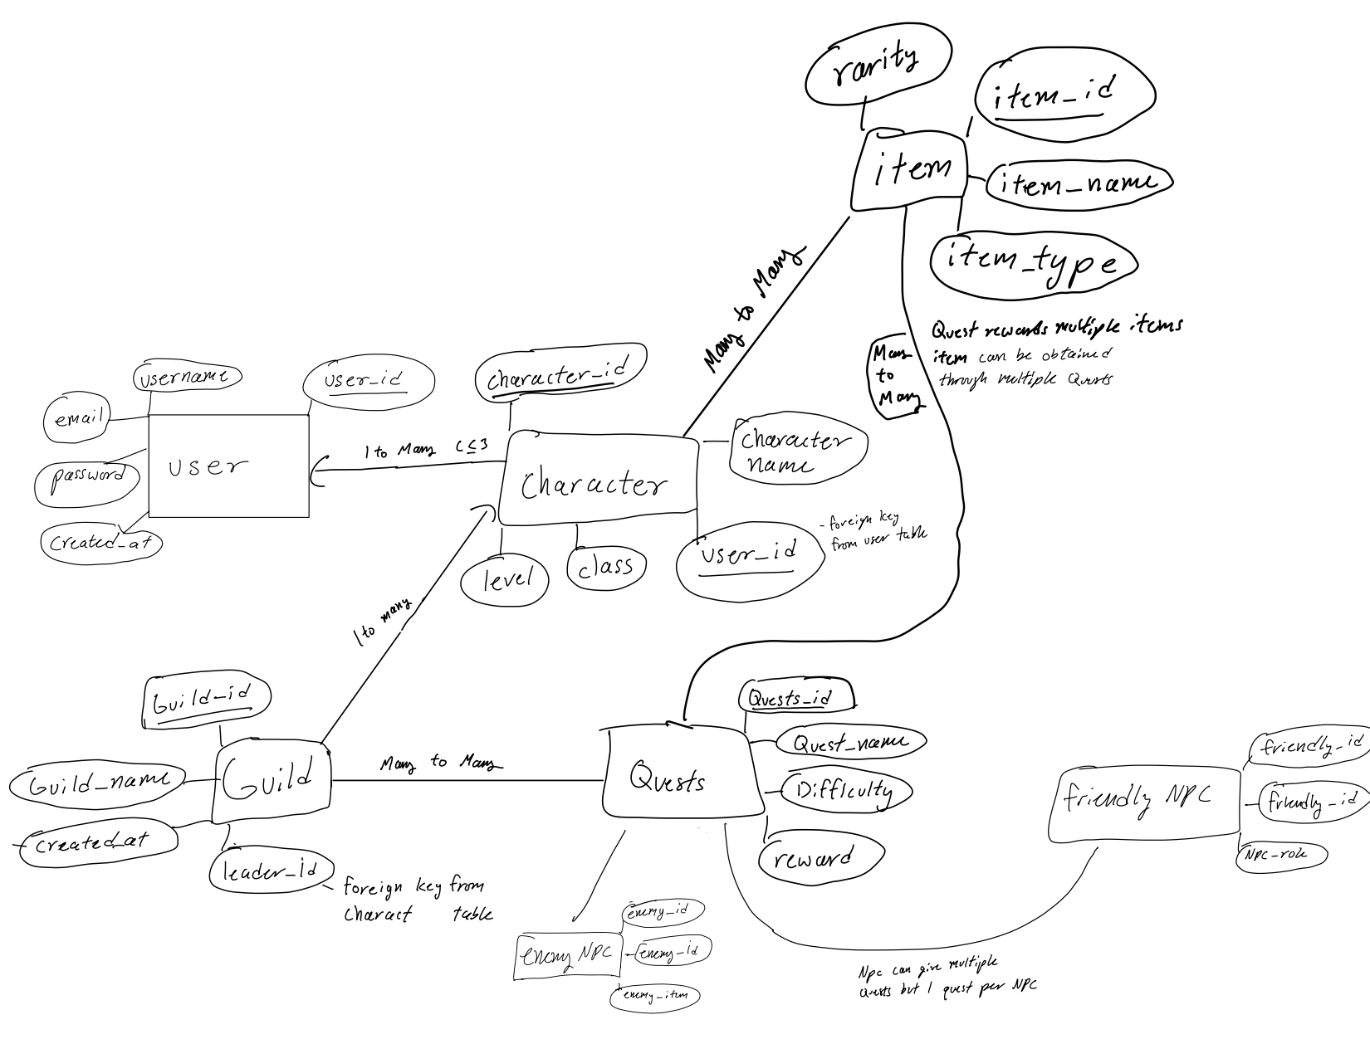
E
R
D
I
A
G
R
A
m

Slide 6
Schema Relations
User table
Character table
Guild table
Quests table
Item table
Friendly_npc table
Enemy_npc table

Slide 7
Schema Relations
CREATE TABLE guild (
guild_id INT PRIMARY KEY,
guild_name VARCHAR(100) NOT NULL,
created_at TIMESTAMP NOT NULL,
leader_id INT,
FOREIGN KEY (leader_id) REFERENCES user(user_id)
);
CREATE TABLE quests (
quests_id INT PRIMARY KEY,
quest_name VARCHAR(100) NOT NULL,
difficulty VARCHAR(50) NOT NULL,
reward VARCHAR(100) NOT NULL
);
CREATE TABLE item (
item_id INT PRIMARY KEY,,
item_name VARCHAR(100) NOT NULL,
item_type VARCHAR(50) NOT NULL
);
CREATE TABLE user (
user_id INT PRIMARY KEY,
username VARCHAR(50) NOT NULL,,
password VARCHAR(100) NOT NULL,
created_at TIMESTAMP NOT NULL
);
CREATE TABLE character (
character_id INT PRIMARY KEY,
level INT NOT NULL,
class VARCHAR(50) NOT NULL,
user_id INT,
character_name VARCHAR(100) NOT NULL,
FOREIGN KEY (user_id) REFERENCES user(user_id)
);

Slide 8
Schema Relations
CREATE TABLE friendly_npc (
friendly_id INT PRIMARY KEY,,
npc_name VARCHAR(100) NOT NULL
);
CREATE TABLE enemy_npc (
enemy_id INT PRIMARY KEY,
enemy_name VARCHAR(100) NOT NULL,);

Slide 9



Languages/Tools
Godot
Django db
Python
Websockets
Custom server

