Slide 1
Sign Language Translator
By William O’Hanlon & Killian Connolly

Slide 2
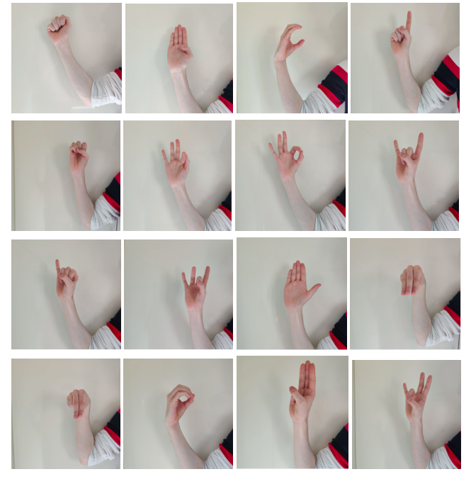
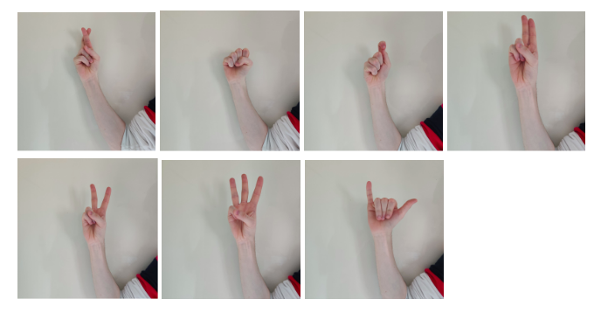
Aim of the Project..
Aims
Produce a program to translation Irish Sign Language from video.
Learn machine learning techniques to help accomplish this.
Why?
Help a person without the ability of speech, but with the ability to perform sign language, to integrate fully into society.
A
B
C
D
E
F
G
H
I
K
L
M
N
O
P
Q
R
S
T
U
V
W
Y

Slide 3
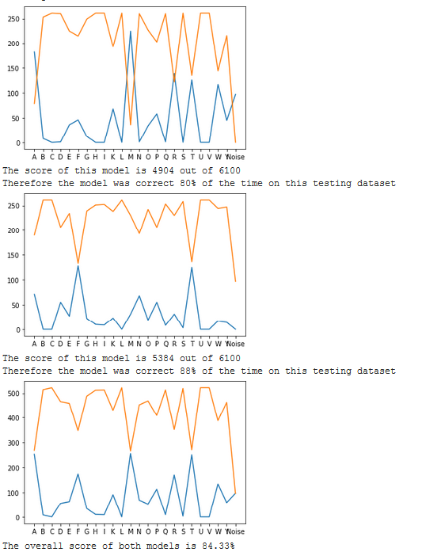
What we achieved..
A combined model with above 80% accuracy.
A program that when given a video of signed letters, it outputs the audio representation of the signs.
Programs to convert image datasets into serialized files.
Multiple testing programs that can be used in tuning other models.
Creating our own image datasets .
Programs compatibility with both Windows 10 and Ubuntu.
First Model
Second Model
Combined Model

Slide 4
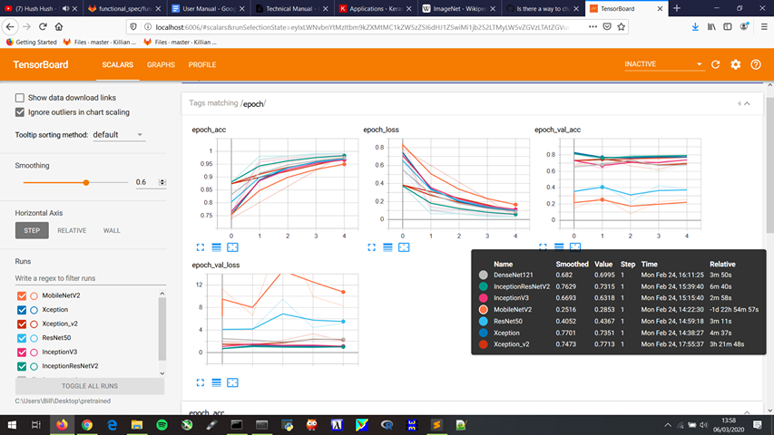
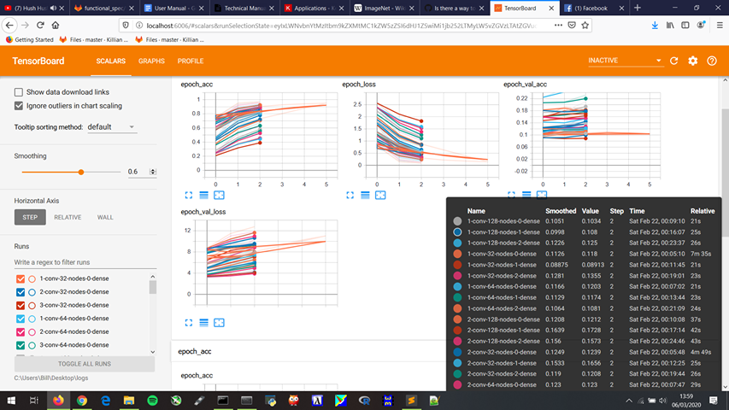
What we learned..
High level understanding of Convoluted Neural Networks and Keras / Tensorflow API
Architecture of CNN and other Machine Learning mechanisms
Multiple libraries
Transfer Learning
Image Processing and serializing files
Preventing Under & Over Fitting
Regularisation
TensorBoard
Designing useful models
Git

Slide 5
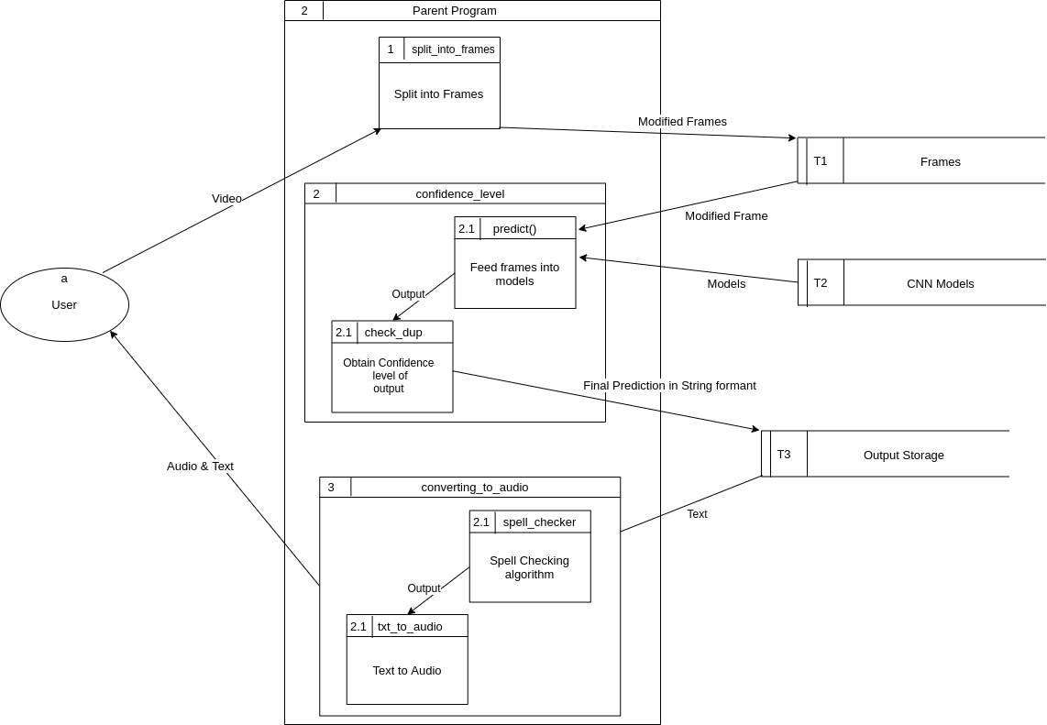
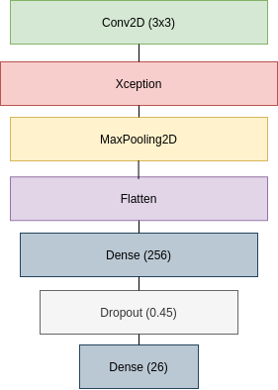
Architecture
24

Slide 6
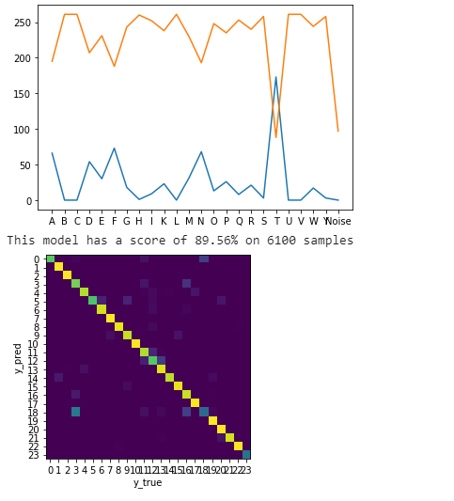
Thanks for listening
Any Questions?
Conclusion
Lots of research conducted
Time constraints were a big factor
Potential and future of the project

