Slide 1
UNIVERSITY OF COMPUTER STUDIES(MANDALAY)
Project Name - Universal Font Converter
Team Name-Kilo (Geo)
Internship Program
2017-2018 Academic Year

Slide 2
Geo-Kilo-Mandalay
Director – U Ravi Chhabra
Supervisor – Daw Htwe Htwe Pyone
Presented By
Ma Mya Theingi (5CS-63)
Ma Theint Thandar Naing (5CS-64)
Ma Ei Thandar Phyo (5CS-62)
Ma Zue Zue Myat Maw (5CS-68)
Ma Thae Ngon Phu (5CS-66)
Ma Khin Yadanar Soe (5CS-67)

Slide 3
Acknowledgement
Firstly, we thank U Kyaw Swar Soe, Rector, Computer University (Mandalay) for his kind permission to do us internship Program at University.
Secondly, we thank Dr. San San Tint(Prorector), Computer University (Mandalay) for her kind permission to do us internship Program at University.
Then, we would like to express any special think to Dr. Aye Aye Chaw, Professor, Head of Software Department and Dr. Mya Thida Kyaw for their helpful recommendation and suggestions .
Then, we really thanks to Daw Htwe Htwe Pyone at Software Department for her helpful recommendations and suggestions.
Then, we specially thanks to Mr. Ravi Chharbra, CEO of GEO Mandalar Investment Technology Co.ltd, for his trust to give us such a heavy responsibility project.

Slide 4
Abstract
Universal Font Converter provide users to easy convert from one font to another font.
Zawgyi is not an input method but just a font. The numeric codes used in Zawgyi are not the same as in the Unicode Standard.
Unicode is a computing industry standard for the consistent encoding, representation, and handling of text expressed in most of the world’s writing system.Unicode converter that works for all the availabe ASCII fonts.
Win Myanmar Font system is common in Myanmar for digitally processing Burmese script.
By using this project to read easily the words on the online.

Slide 5
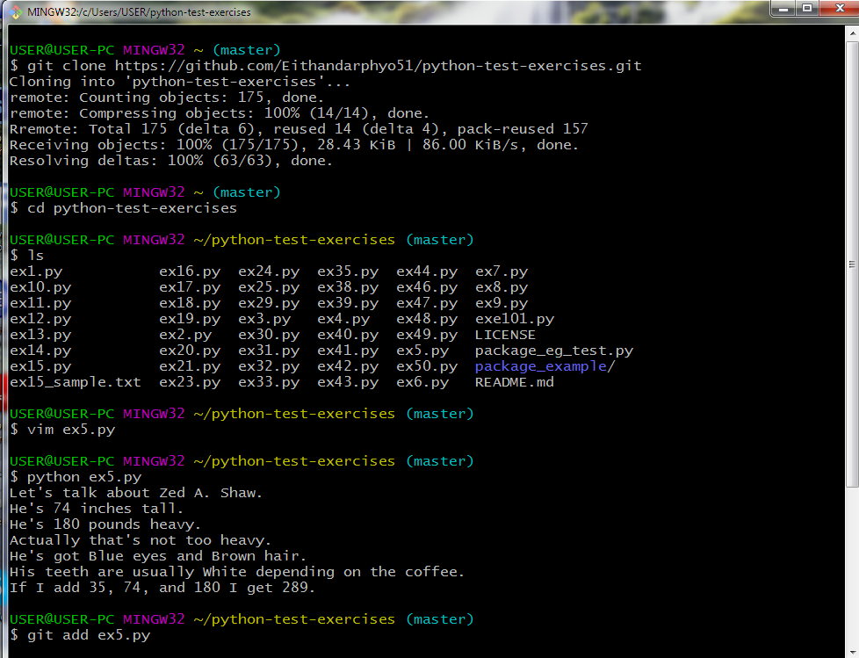
Python_Exercises

Slide 6
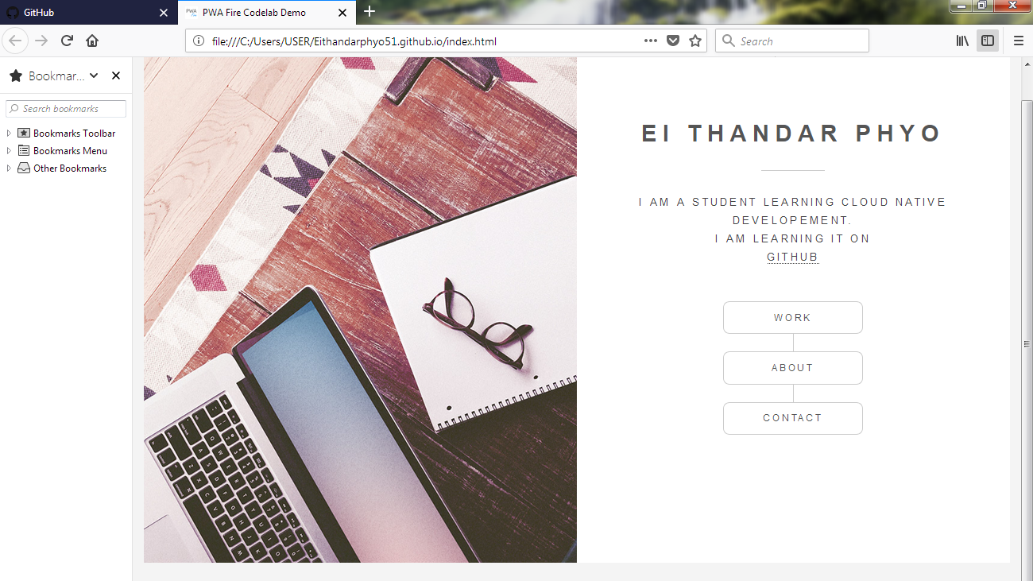
Personal Page at GitHub

Slide 7
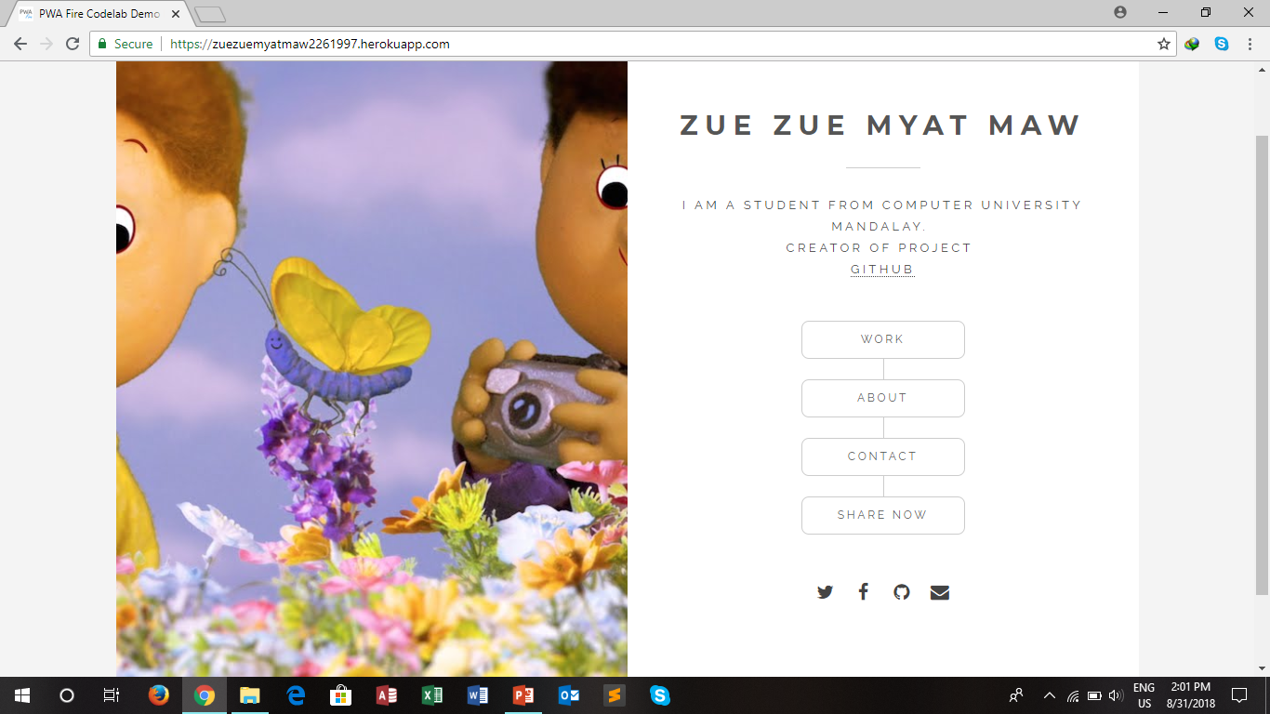
Create Personal Page at Heroku

Slide 8
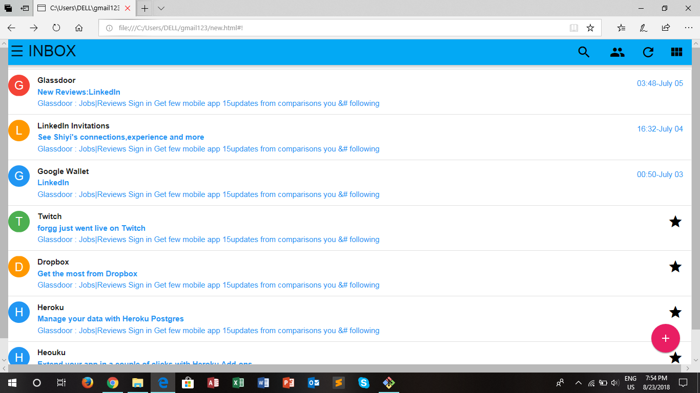
Gmail App Example

Slide 9
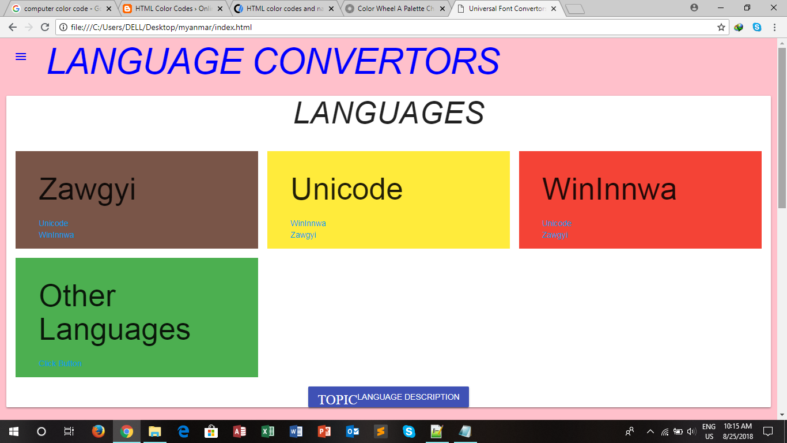
Universal Font Converter Kilo(Geo)

Slide 10
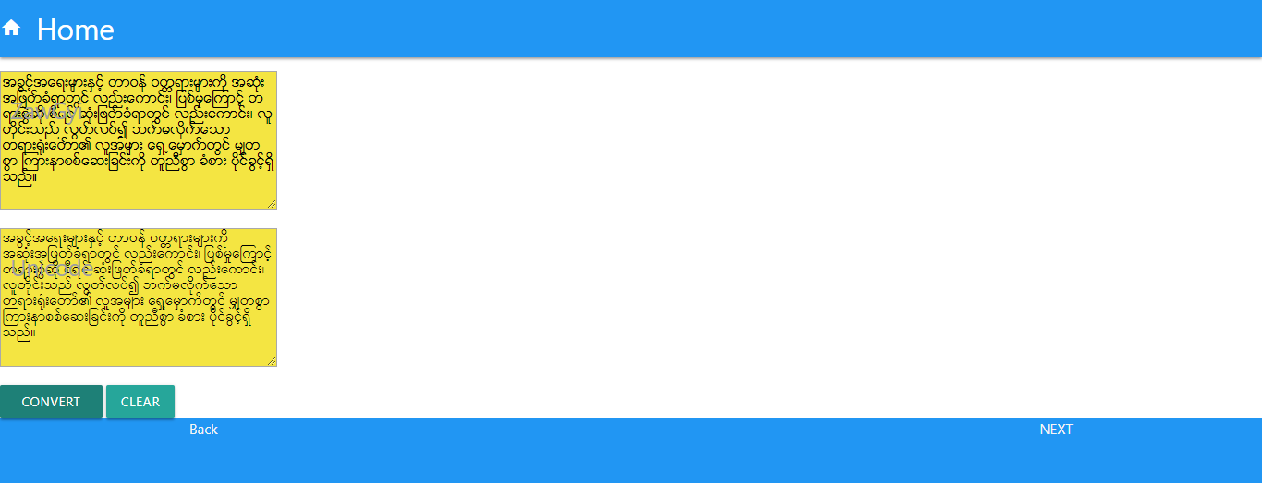
Conversion from Zawgyi to Unicode

Slide 11
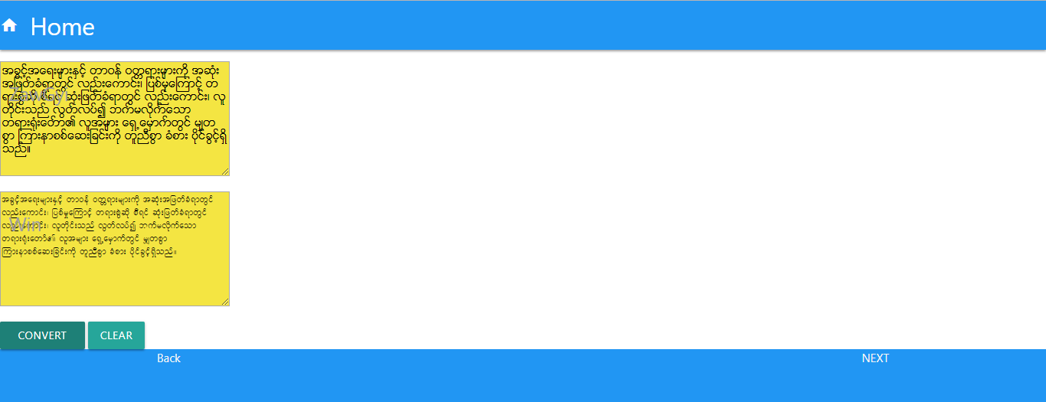
Conversion from Zawgyi to Win

Slide 12
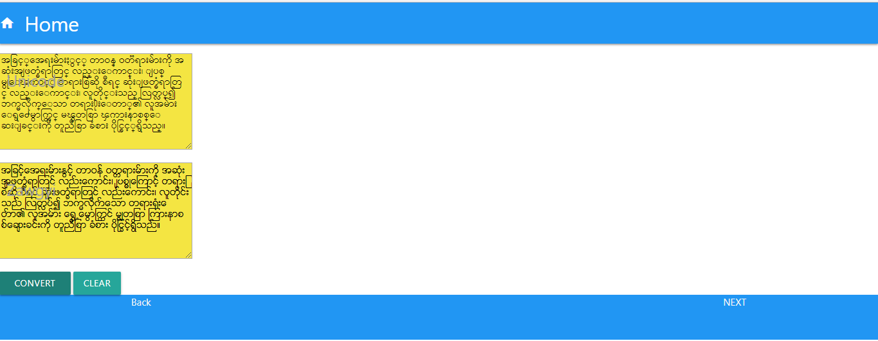
Conversion from Unicode to Zawgyi

Slide 13
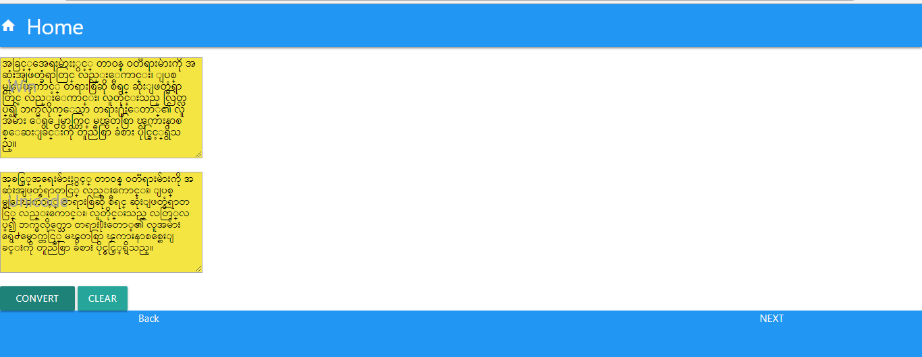
Conversion from Unicode to Win

Slide 14
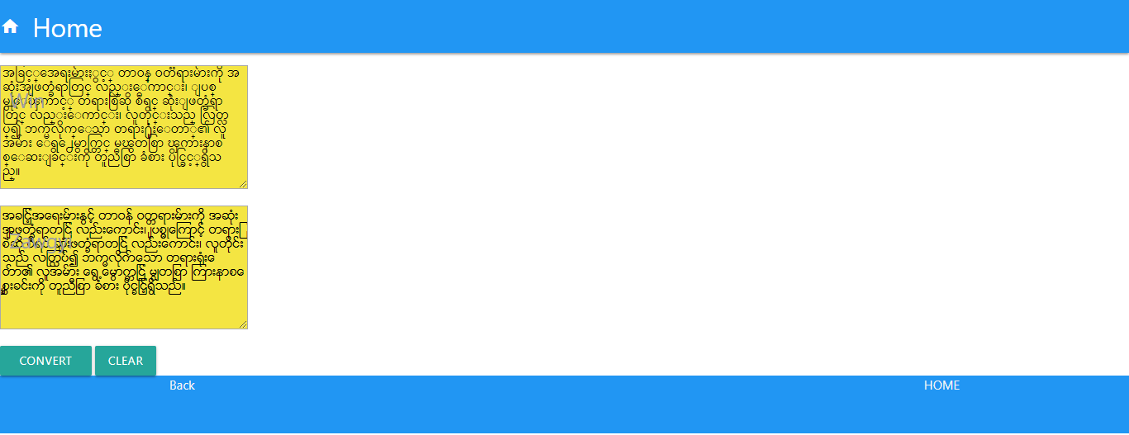
Conversion from Win to Zawgyi

Slide 15
Conversion from Win to Unicode

Slide 16
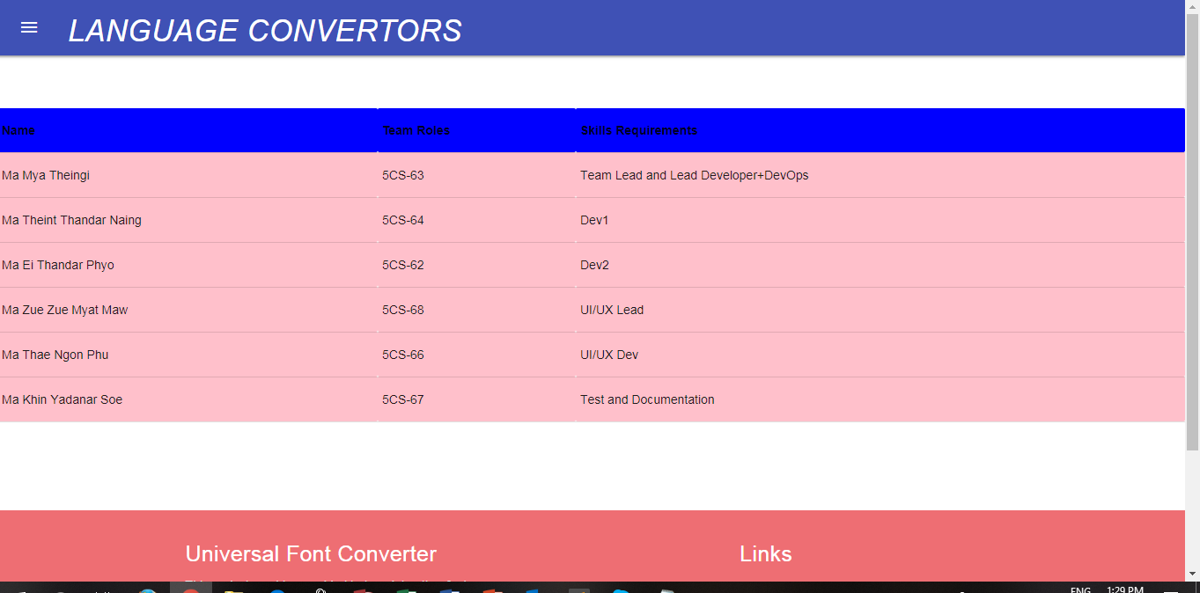
Kilo Geo Team Members

Slide 17
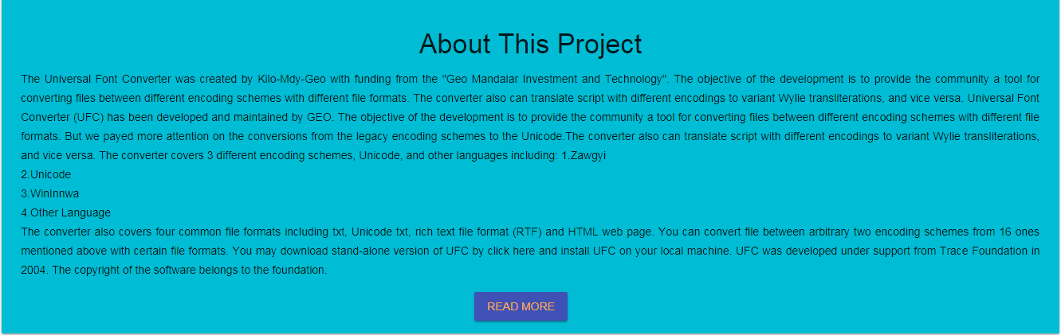
Description of the Universal Font Converter

Slide 18
Universal Font Converter
https://kilo-font-converter.herokuapp.com

Slide 19
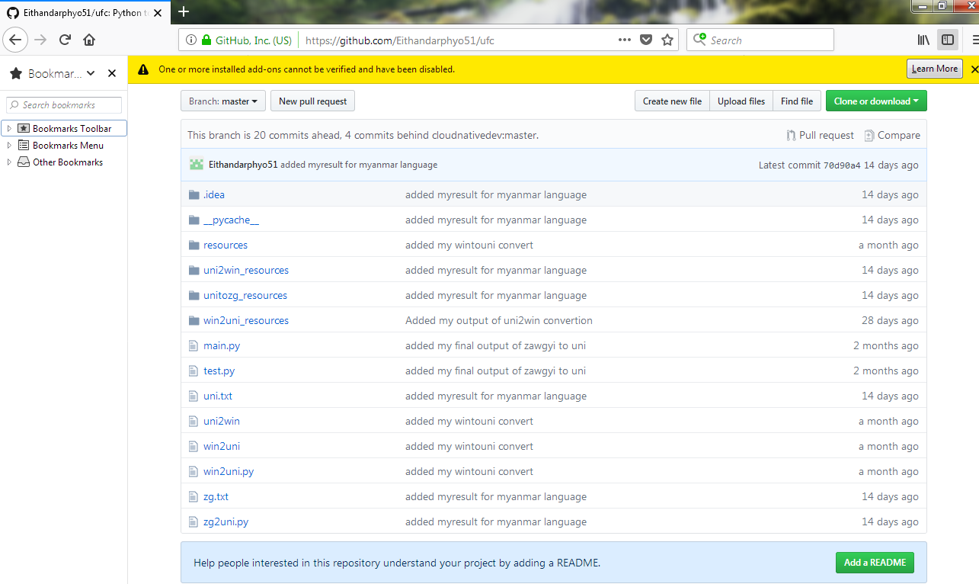
Universal Font Converter Coding Sample

Slide 20
Objectives
To provide the community a tool for converting files between different languages.
To attention on the conversions from the legacy encoding schemes to the unicode.
To translate this language each other.
To help the users for using the different languages.

Slide 21
Intoduction of Universal Font Converter
Universal Font Converter consist of three fonts(Zawgyi, Unicode and Winmyanmar).
When users click the convert button they can change to other font.
This project supply for online class.
All fonts in this project allow us to set font in all the mobile phone and personal computers.

Slide 22
Requirement Analysis
Hardware Requirement
Mobile Phone
Laptop
Software Requirement
Mobile Data
Git Bush
Python 3.6.5
Heroku
Microsoft Word 2013
Microsoft Power Point 2013
Pycharm

Slide 23
Background
Our project makes font both possible and easy to convert type to outline.Converting to outline means turning from one font to another fonts.
If you have a font in your mobile phone , you can change font as you like by using our project.
The user can use easily our project but for us a few difficult during connecting design and coding for this project.
Today many people are using social media and this project effective them.We made this project to easy when they are using the font.

Slide 24
Hypertext Markup Language(HTML)
JavaScript
Cascading Style Sheets(CSS)
Hypertext Markup Language(HTML)
HTML is the standard markup language for creating web page and web application.HTML provides a means to create structured documents by denoting structural semantics for text such as headings, paragraphs, lists, links, quotes and other items.
JavaScript
JavaScript is a high-level, interpreted programming language. JavaScript enables interactive web pages and thus is an essential part of web applications. JavaScript available for writing mobile and desktop applications.
Cascading Style Sheets(CSS)
Cascading Style Sheets(CSS) is a style sheet language used for describing the presentation of a document written in a markup language lile HTML.CSS is designed to enable the separation of presentation and content , including layout , colors and fonts.

Slide 25
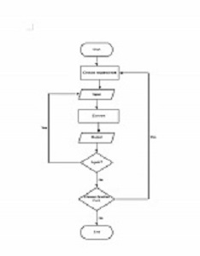
Flowchart Diagram

Slide 26
Conclusion
By using our project the users can convert of one font to another font is very useful in real life.
Our project can be used to convert Zawgyi to Unicode , Unicode to Zawgyi, Win to Unicode, Unicode to Win font.
Our project aim the users to use easily different font and to learn easily Online Class.
Universal Font Converter can be used easily in their mobile phone by everyone.
We have knowledge, communication skills , and teamwork from this Internship.

Slide 27
End Of Presentation
Thanks For Your Attention!

