Slide 1
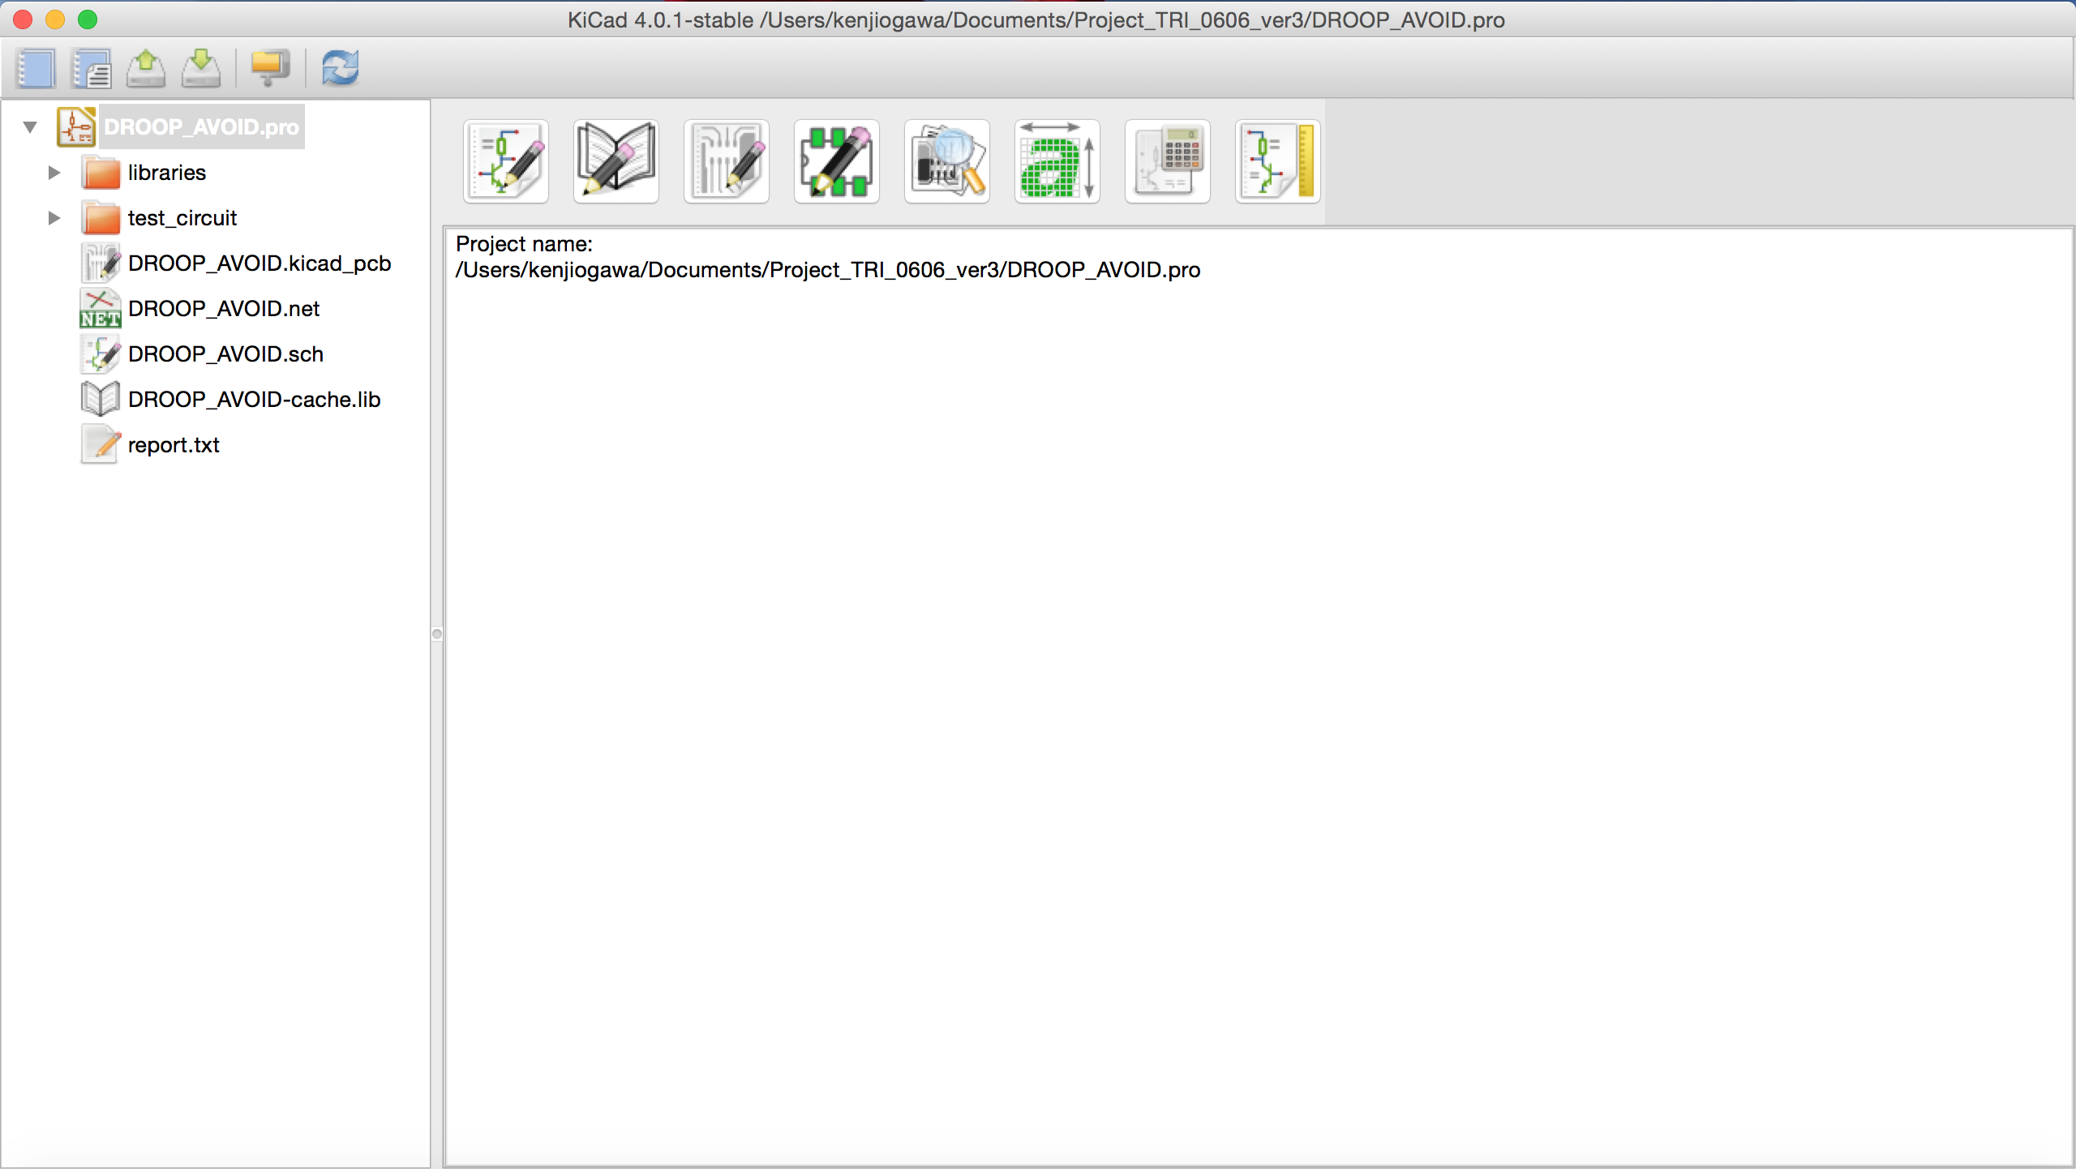
A
B
D
E
F
G
C

Slide 2
Start
Setup Page Style
Select Components
No Components ?
Create Components
Using Library Editor

Slide 3
