Slide 2
Tokyo.R #80
2019.07.27
R Interface to Python

Slide 3
一昔前
私もそろそろ
を、始めたいんだけど。
ぱそこん
できるんでしょ？教えてよ。
いいけど、
ぱそこん
で何がしたいの？
ぱそこん
って何でもできるんでしょ？
でも、どうしたらいいか分かんないんだ。

Slide 4
最近
私もそろそろ
を、始めたいんだけど。
じんこう
ちのー
できるんでしょ？教えてよ。
じんこう
ちのー
いいけど、
で何がしたいの？
じんこう
ちのー
って何でもできるんでしょ？
でも、どうしたらいいか分かんないんだ。

Slide 5

私もそろそろ
を、始めたいんだけど。
できるんでしょ？教えてよ。
いいけど、
で何がしたいの？
って何でもできるんでしょ？
でも、どうしたらいいか分かんないんだ。

Slide 6

私もそろそろ
を、始めたいんだけど。
できるんでしょ？教えてよ。
いいけど、
で何がしたいの？
って何でもできるんでしょ？
でも、どうしたらいいか分かんないんだ。

Slide 7

Do NOT start from here
Input
Output

Slide 8

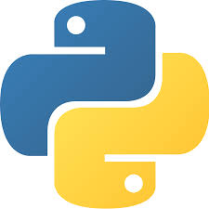
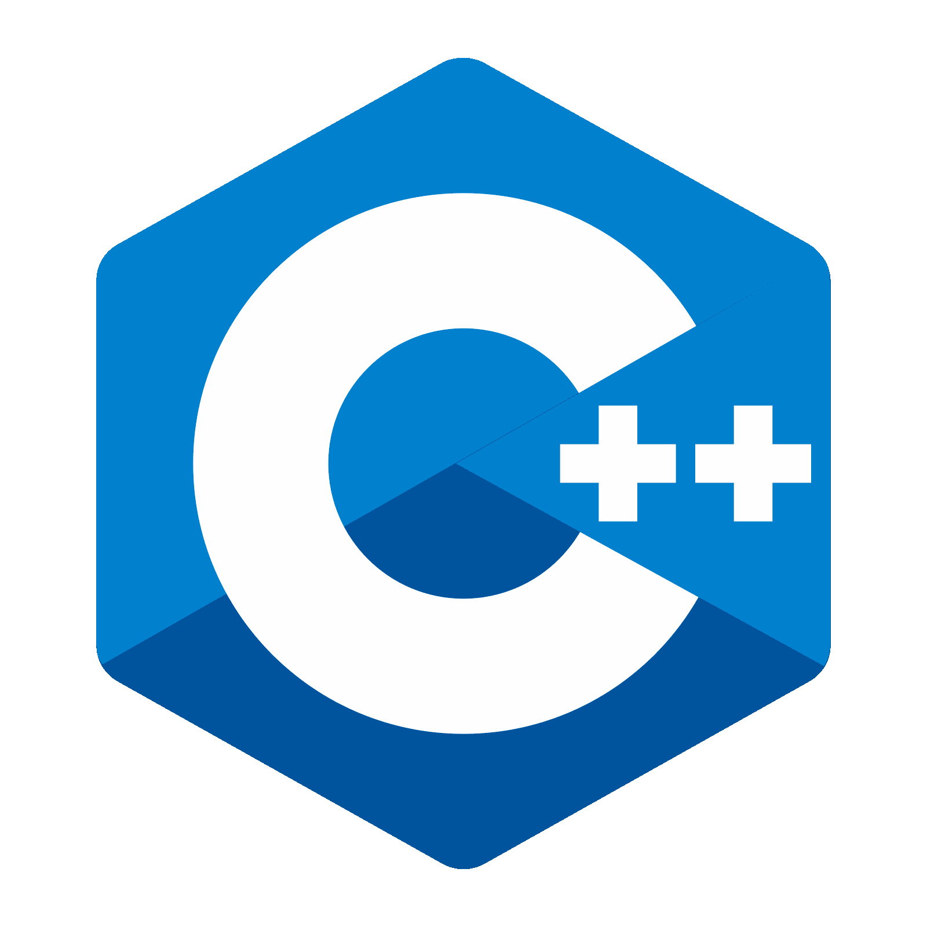
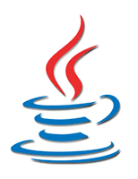

Do NOT start from here
Input
Whatever
Output
…

Slide 9
2
Do NOT start from here
Input
3
1
Whatever
Output
…

Slide 10

Input
Output

Slide 11
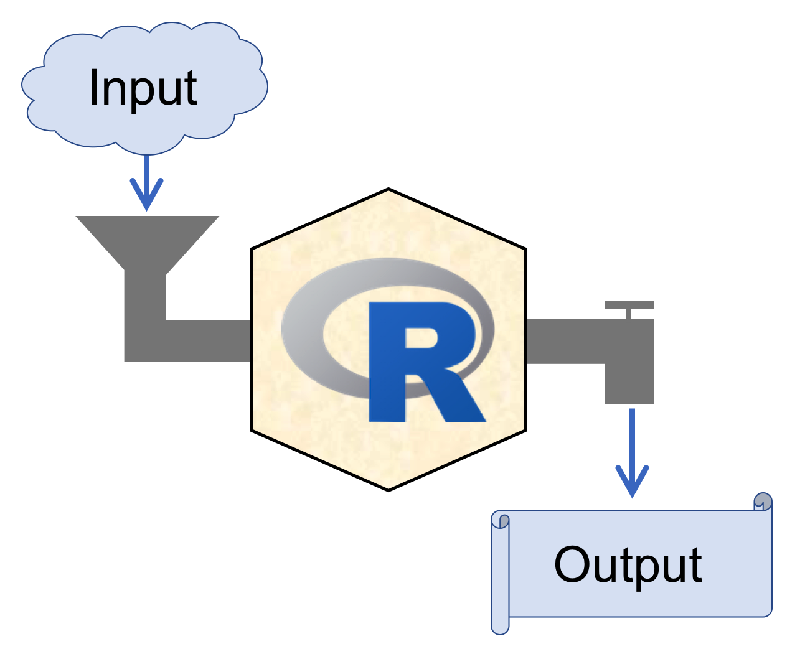

RStudio
https://www.rstudio.com/
Recommended!!
Integrated Development Environment

Slide 12
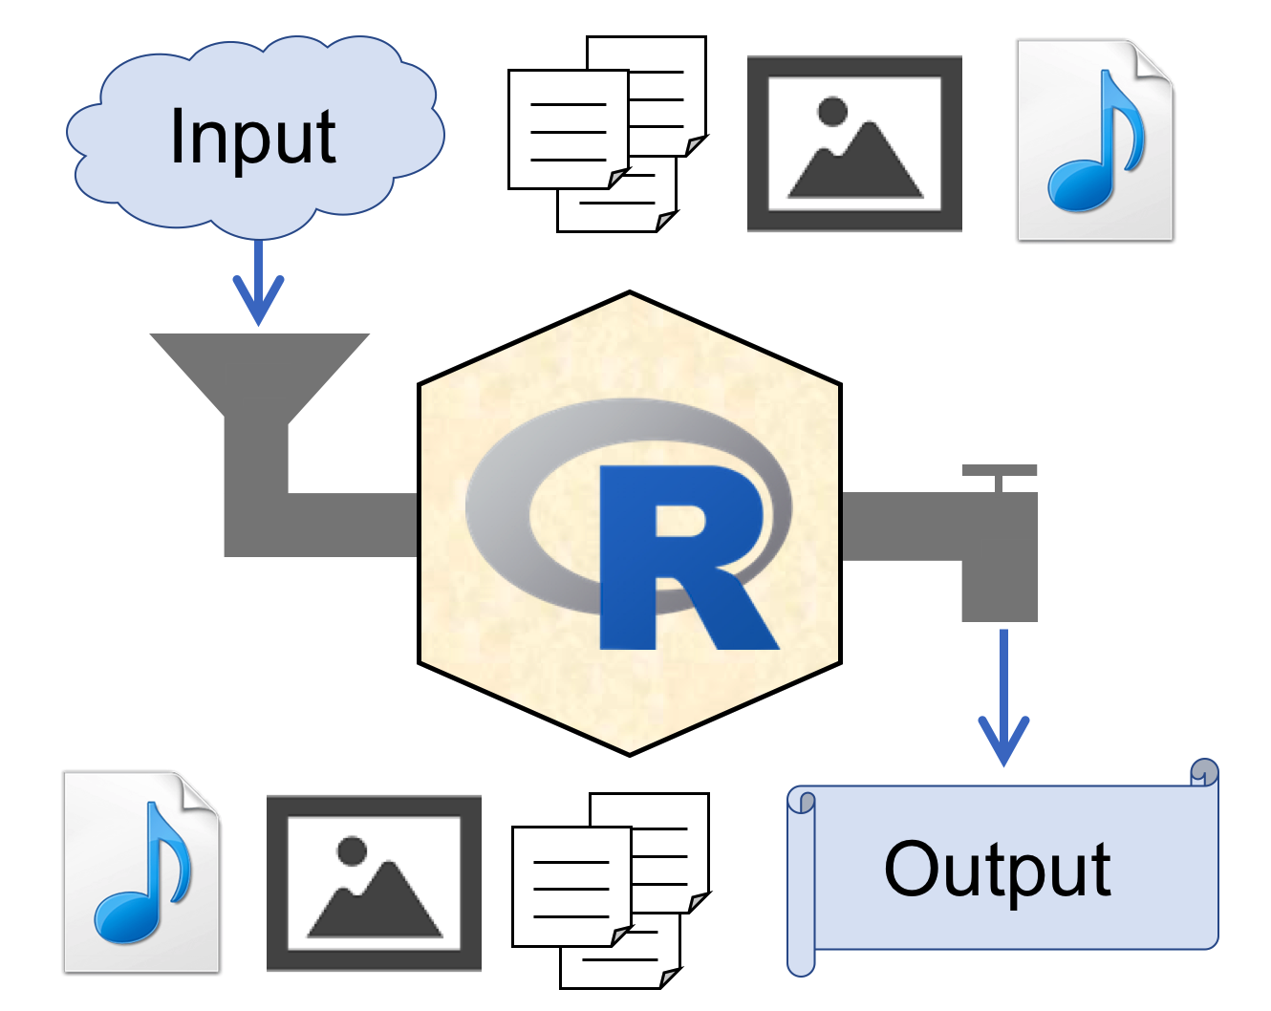
RStudio
https://www.rstudio.com/
Integrated Development Environment

Slide 13
RStudio

Slide 14
RStudio
Projects

Slide 15
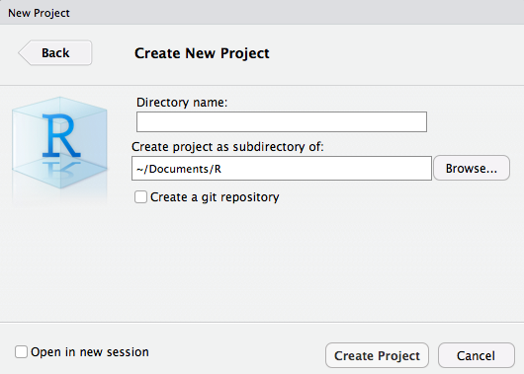
File > New Project… > New Directory > New Project
hogehoge

Slide 16



~/Documents/R
Project Root Directory
New!!
hogehoge
Double click!!
hogehoge.Rproj
Open project
.Rproj.user
Auto saved
project information
.RData
.Rhistory

Slide 17
~/Documents/R
project3
project1
project4
project2

Slide 18
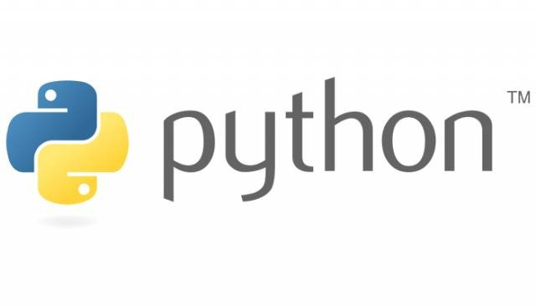

Slide 19
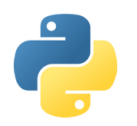
Variable assignment & naming
○
var_1 <- 1
○
1 -> var_1
○
var_1 = 1
var_1 = 1
▼
×
1var <- 1
×
1var = 1
×
_var <- 1
_var = 1
▼
○
.var <- 1
×
.var = 1
var.1 <- 1
var.1 = 1
○
▼
list <- 1
list = 1
▼
▼

Slide 20
Variable type (basic)
Character
String
> typeof("1")
[1] "character"
>>> type("1")
<type 'str'>
Double
Float
> typeof(1)
[1] "double"
> typeof(1.0)
[1] "double"
>>> type(1.0)
<type 'float'>
Integer
Integer
> typeof(as.integer(1))
[1] "integer"
>>> type(1) <type 'int'>
> typeof(1L)
[1] "integer"

Slide 21
Use packages
library(reticulate)
py_str(...)
imort numpy
numpy.array([1:3])
or
or
imort numpy as np
np.array([1:3])
reticulate::py_str(...)
or
from numpy import array
array([1:3])

Slide 22
Loop
for(i in 1:10){
i = i + 1
}
for i in range(10)
i = i + 1
for(i in 1:10){
i = i + 1
}
× INDENT ERROR
for i in range(10)
i = i + 1
for i in range(10)
i += i
for(i in 1:10) i = i + 1

Slide 23
Function definition
f <- function(val1, ...){
....
return(...)
}
def f(val1, ...):
....
return(...)
CHECK YOUR INDENT
Import & Export csv
import pandas as pd
dat = pd.read_csv(<path>)
dat.to_csv(<path>)
dat <- read.csv(<path>)
write.csv(dat, <path>)

Slide 24

reticulate package
URL: https://github.com/rstudio/reticulate

Slide 25
reticulate package
Calling Python from R in a variety of ways including R Markdown, sourcing Python scripts, importing Python modules, and using Python interactively within an R session.
Translation between R and Python objects (for example, between R and Pandas data frames, or between R matrices and NumPy arrays).
URL: https://github.com/rstudio/reticulate

Slide 26
Environment setup
for Python
(in macOS Mojave 10.14.3)

Slide 27

Sandbox

Slide 28


http://buzz-plus.com/2014/07/25/suna/
Sandbox
http://www.sandart-j.com/work/work3.html

Slide 29
Sandbox A
http://buzz-plus.com/2014/07/25/suna/
Sandbox B
http://www.sandart-j.com/work/work3.html

Slide 30
Sandbox A
Isolated
&
Independent
http://buzz-plus.com/2014/07/25/suna/
Sandbox B
http://www.sandart-j.com/work/work3.html

Slide 31
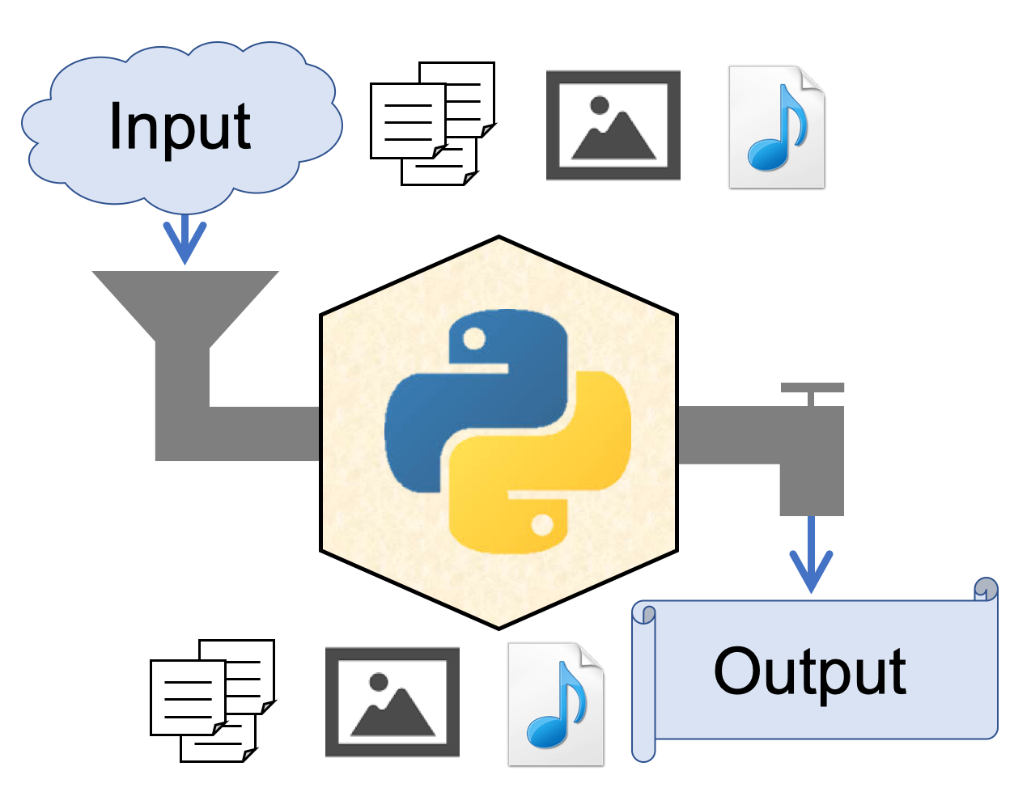
"Sandboxed" Python
Isolated & Independent virtual environment for secure and reproducibility
A sandbox is a type of software testing environment that enables the isolated execution of software or programs for independent evaluation, monitoring or testing.

Slide 32
RStudio
Projects

Slide 33
"Sandboxed" Python
Isolated & Independent virtual environment for security & reproducibility
[python]
version = "3.7"
[packages]
cycler==0.10.0
kiwisolver==1.1.0
matplotlib==3.1.1
numpy==1.16.4
opencv-python==4.1.0.25
pandas==0.25.0
pyparsing==2.4.0
PypeR==1.1.2 ...
[python]
version = "2.7"
[packages]
numpy==1.16.4
...

Slide 34
Pipenv
→ "Sandboxed" Python manager
Install Python
Recommended!!
https://www.python.org/
Install Pipenv (in MacOS)
$ brew install pipenv

Slide 35
Pipenv
→ "Sandboxed" Python manager
Create virtualenv
$ cd <project root>
$ pipenv --python 3.7
<project root>
.venv
← interpreter, env info
Pipfile
← package info

Slide 36
Pipenv
→ "Sandboxed" Python manager
Activate virtualenv
$ pipenv shell
Deactivate virtualenv
(prj) $ exit
Delete virtualenv
$ pipenv --rm

Slide 37
Pipenv
→ "Sandboxed" Python manager
Activate virtualenv
$ pipenv shell
Install packages
(prj) $ pipenv install <pkg>~=<version>
Uninstall packages
(prj) $ pipenv uninstall <pkg>

Slide 38
For reticulate,
you need NumPy package
in your virtualenv.

Slide 39
Pipenv
→ "Sandboxed" Python manager
Install Numpy
$ cd <prj>
$ pipenv shell
(prj) $ pipenv install numpy
# activate
# install
(prj) $ pipenv run pip freeze
# check
(prj) $ python
>>> import numpy
# check

Slide 40
Pipenv
→ "Sandboxed" Python manager
Address of the virtualenv
$ cd <prj>
$ pipenv shell
(prj) $ pipenv --venv
<prj>/.venv
# activate
# check

Slide 41
back to

Slide 42
Use Python in R
Install reticulate from CRAN
install.packages(reticulate)
Attach Python virtualenv
library(reticulate)
pyenv <- "<prj>/.venv/bin/python"
use_python(python = pyenv, required = TRUE)

Slide 43
Use Python in R
Check your Python
py_config()
## python: <prj>/.venv/bin/python
## libpython: /Library/Frameworks/Python.framework...
## pythonhome: /Library/Frameworks/Python.fram...
## virtualenv: <prj>/.venv/bin/activate_this.py
## version: 3.7.4 (v3.7.4:e09359112e, Jul 8 2019...
## numpy: <prj>/.venv/lib/python3.7/site-packages/...
## numpy_version: 1.16.4
##
## NOTE: Python version was forced by use_python...

Slide 44
Use Python in R
Import Python pkg in R
os <- import("os")
Use Python pkg in R
os$listdir()
## [1] ".Rhistory" ".DS_Store"
## [2] ".gitignore" ".RData"
## ...

Slide 45
Use Python in R
Import Python source
source_python("sample.py")
sample.py
import pandas as pd
def pd_load_csv(path):
df = pd.read_csv(path)
return df
def pd_head(df, n = 3):
return df.head(n)
File > New File > Python script

Slide 46
Use Python in R
Import Python source
source_python("sample.py")
dat <- pd_load_csv("hoge.csv")
dat %>% pd_head()
iris %>% pd_head

Slide 47
Benchmark test
source_python("sample.py")
f_pd <- function(path) pd_load_csv(path)
f_base <- function(path) read.csv(path)
f_readr <- function(path) readr::read_csv(path)
f_fread <- function(path) data.table::fread(path)

Slide 48
Benchmark test
source_python("sample.py")
f_pd <- function(path) pd_load_csv(path)
f_base <- function(path) read.csv(path)
f_readr <- function(path) readr::read_csv(path)
f_fread <- function(path) data.table::fread(path)
microbenchmark::microbenchmark(
pd_load_csv = f_pd(path),
read.csv = f_base(path),
read_csv = f_readr(path),
fread = f_fread(path)) -> mbm
ggplot2::autoplot(mbm)

Slide 49
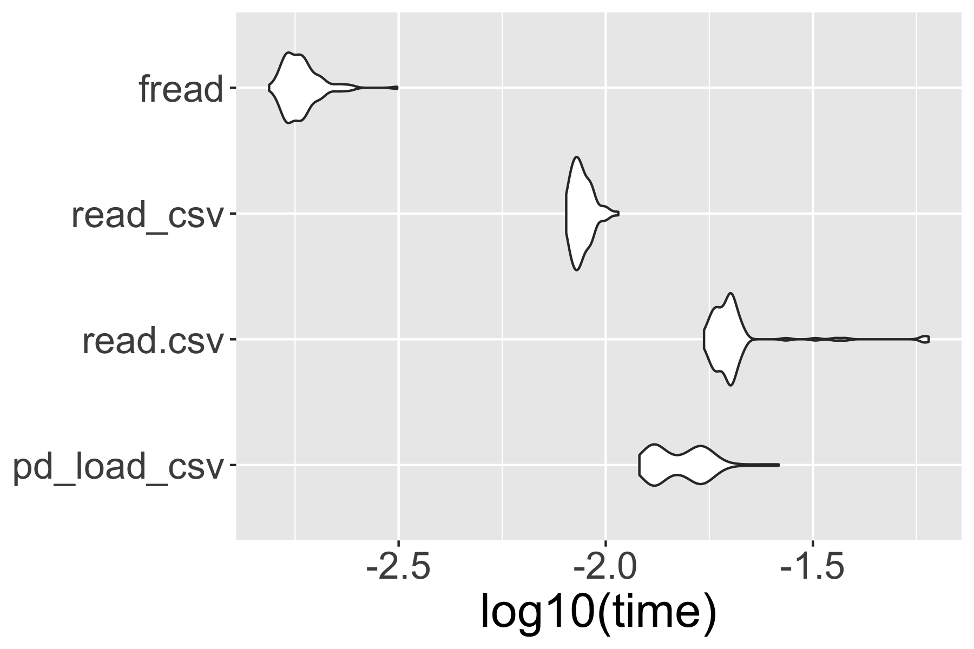
Benchmark test

Slide 50
Use Python in R
Import Python source
source_python("sample.py")
iris %>%
pd_head(5)
## y_call_impl(callable, dots$args, dots$keywords) ## でエラー:
## TypeError: cannot do slice indexing on <class
## 'pandas.core.indexes.range.RangeIndex'> with ## these indexers [5.0] of <class 'float'>

Slide 51
Variable type (basic)
Character
String
> typeof("1")
[1] "character"
>>> type("1")
<type 'str'>
Double
Float
> typeof(1)
[1] "double"
> typeof(1.0)
[1] "double"
>>> type(1.0)
<type 'float'>
Integer
Integer
> typeof(as.integer(1))
[1] "integer"
>>> type(1) <type 'int'>
> typeof(1L)
[1] "integer"

Slide 52
Use Python in R
Import Python source
source_python("sample.py")
iris %>%
pd_head(5)
# type ERROR
iris %>%
pd_head(5L)
# set as integer

Slide 53
reticulate package
Calling Python from R in a variety of ways including R Markdown, sourcing Python scripts, importing Python modules, and using Python interactively within an R session.
Translation between R and Python objects (for example, between R and Pandas data frames, or between R matrices and NumPy arrays).
URL: https://github.com/rstudio/reticulate

Slide 54
reticulate package
Calling Python from R in a variety of ways including R Markdown, sourcing Python scripts, importing Python modules, and using Python interactively within an R session.
Translation between R and Python objects (for example, between R and Pandas data frames, or between R matrices and NumPy arrays).
URL: https://github.com/rstudio/reticulate

Slide 55
Use Python in Rmd
Create .Rmd file
File > New File > R markdown
Import Python virturalenv in R chunk
```{r}
library(reticulate)
pyenv <- "<prj>/.venv/bin/python"
use_python(python = pyenv, required = TRUE)
```

Slide 56
Use Python in Rmd
Use Python in python chunk
```{python}
import pandas as pd
path = "<path>/sample.csv"
df = pd.read_csv(path)
df.head(3)
```

Slide 57
Use Python in Rmd
Use Python in python chunk
```{python}
import pandas as pd
path = "<path>/sample.csv"
df = pd.read_csv(path)
df.head(3)
```
preview

Slide 58
Use Python in Rmd
Shear pyobj between pychunks
```{python}
import pandas as pd
path = "<path>/sample.csv"
df = pd.read_csv(path)
```
```{python} df.head(3) ```

Slide 59
Use Python in Rmd
Import R object to python chunk
```{python}
import pandas as pd
df = r.iris
df.head(3)
```

Slide 60
Use Python in Rmd
Import R object to python chunk
```{python}
import pandas as pd
df = r.iris
```
Import python object to R chunk
```{r}
py <- import_main()
py$df
```

Slide 61
Benchmark test in python chunk
```{python}
import pandas as pd
from time import time
path = "<path>/sample.csv"
result = []
for i in range(0, 100):
start = time()
df = pd.read_csv(path)
time_i = time() - start
result = result.append(time_i)
```

Slide 62
Benchmark visualization in R chunk
```{r}
py <- import_main()
py$result %>% data.frame(expr = "py_pd", time = .) %>%
rbind(data.frame(mbm) %>%
mutate(time = time/10^9)) %>%
ggplot(aes(expr, log10(time)))+
gem_violin()+
coord_flip()
```

Slide 63
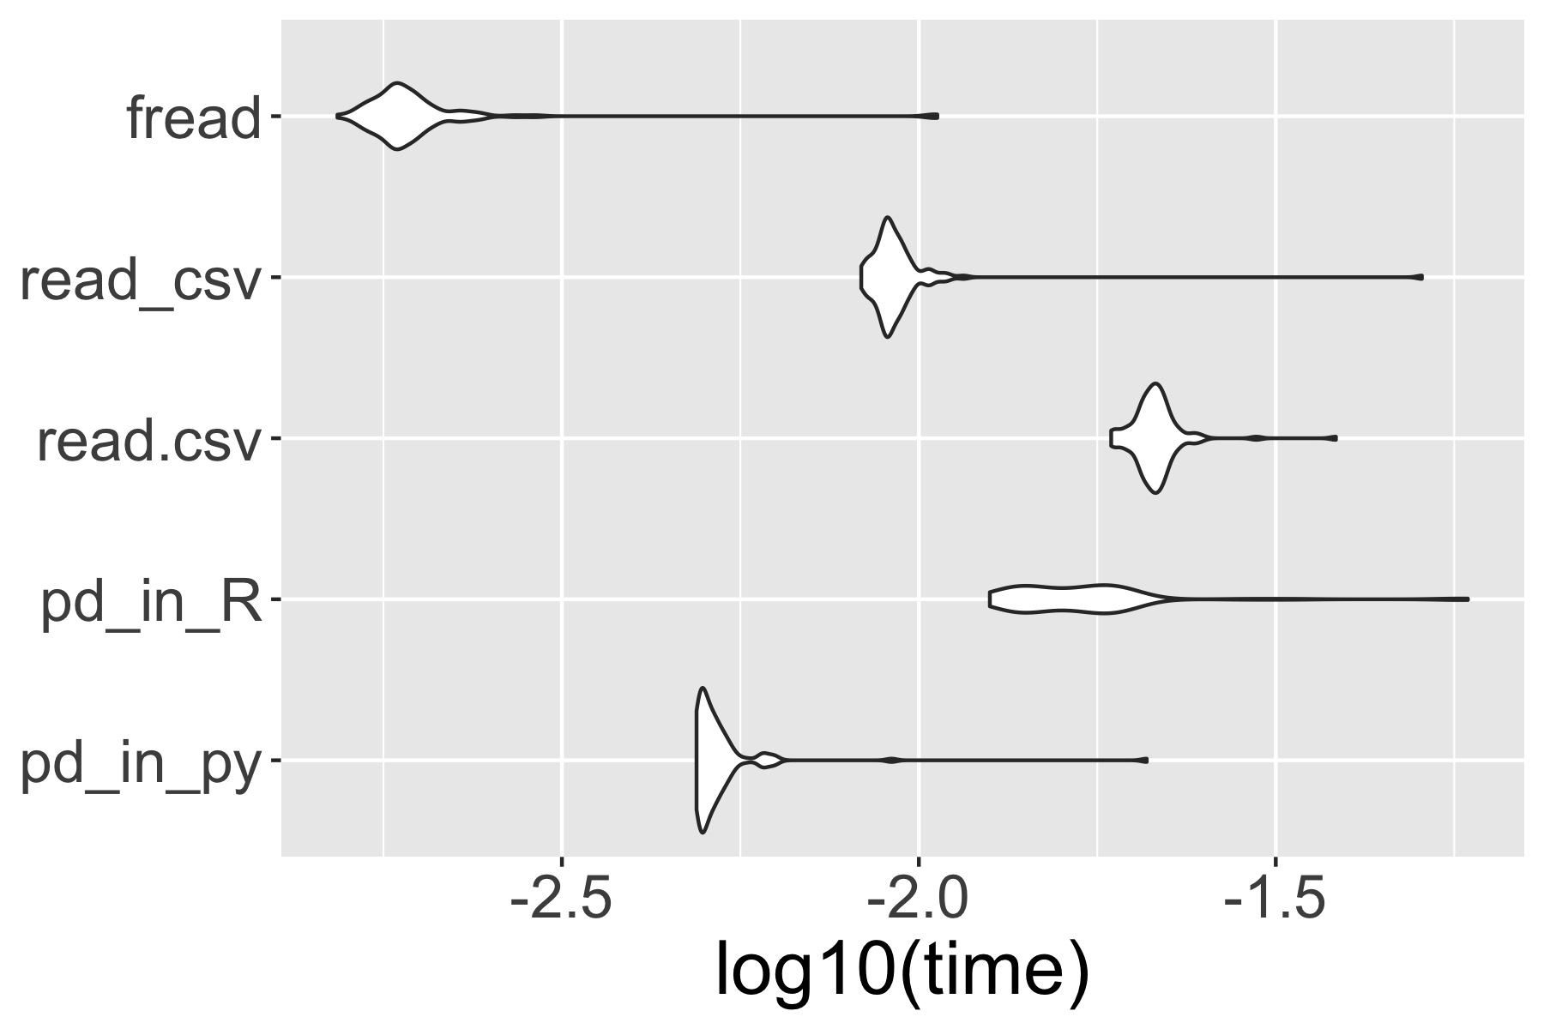
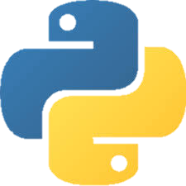
Benchmark visualization in R chunk

Slide 64
reticulate package
Calling Python from R in a variety of ways including R Markdown, sourcing Python scripts, importing Python modules, and using Python interactively within an R session.

Slide 65

reticulate package
Calling Python from R in a variety of ways including R Markdown, sourcing Python scripts, importing Python modules, and using Python interactively within an R session.

Slide 66
Run Python in Rstudio
1. Attach Python virtualenv
library(reticulate)
pyenv <- "<prj>/.venv/bin/python"
use_python(python = pyenv, required = TRUE)
2. Create .py file
File > New File > Python script
3. write in .py file
a = 1

Slide 67

https://www.amazon.co.jp/dp/B00Y0UI990/

Slide 68
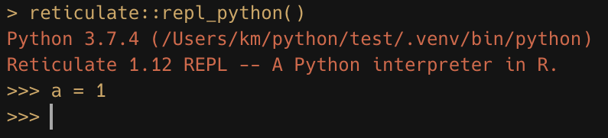

Slide 69
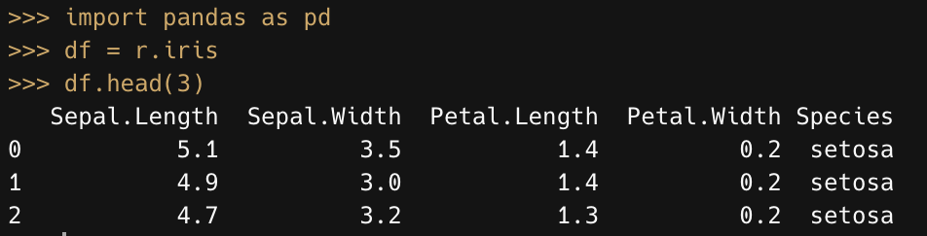

Slide 70
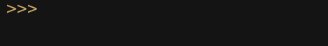
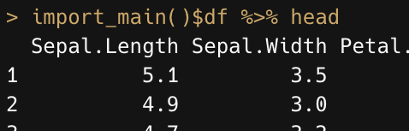
(escape key)

Slide 71

reticulate package
Calling Python from R in a variety of ways including R Markdown, sourcing Python scripts, importing Python modules, and using Python interactively within an R session.

Slide 72
summary

Slide 75


Input
Output

Slide 76
Input
Output

Slide 77
?
?

Slide 78
?
?

