Slide 1
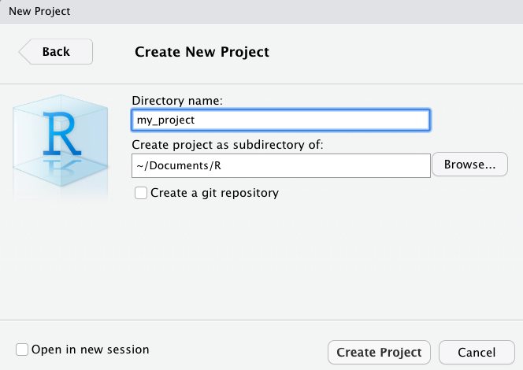
Create New Project
File > New Project > New Directory > New Project >

Slide 2



Project Folder
~/Documents/R
Project Root folder
my_project
Workspace setting
my_project.Rproj
.Rproj.user
Open RStudio
Auto saved
working information
(Unsaved edits, tab order, etc.)

