Slide 1
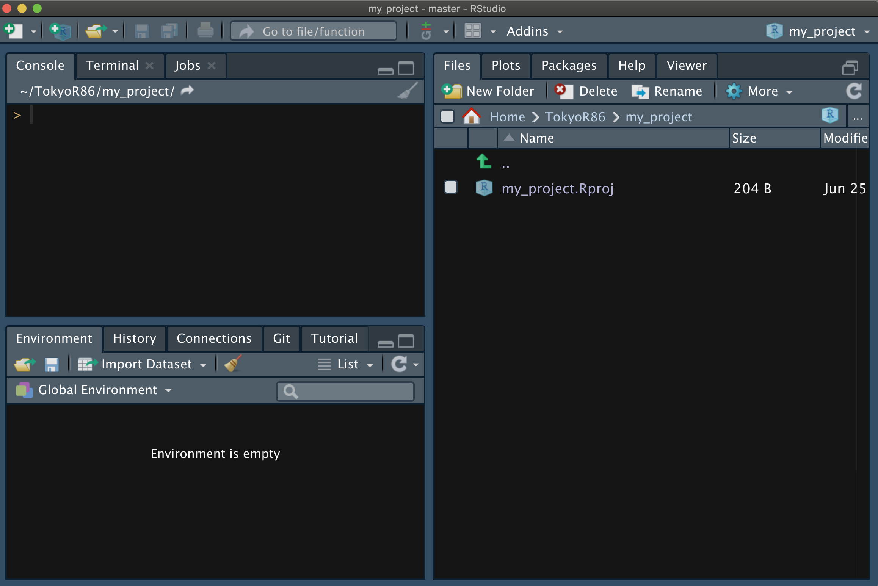
RStudio
File > New File > R script (⌘ + ⇧ + N)

Slide 2
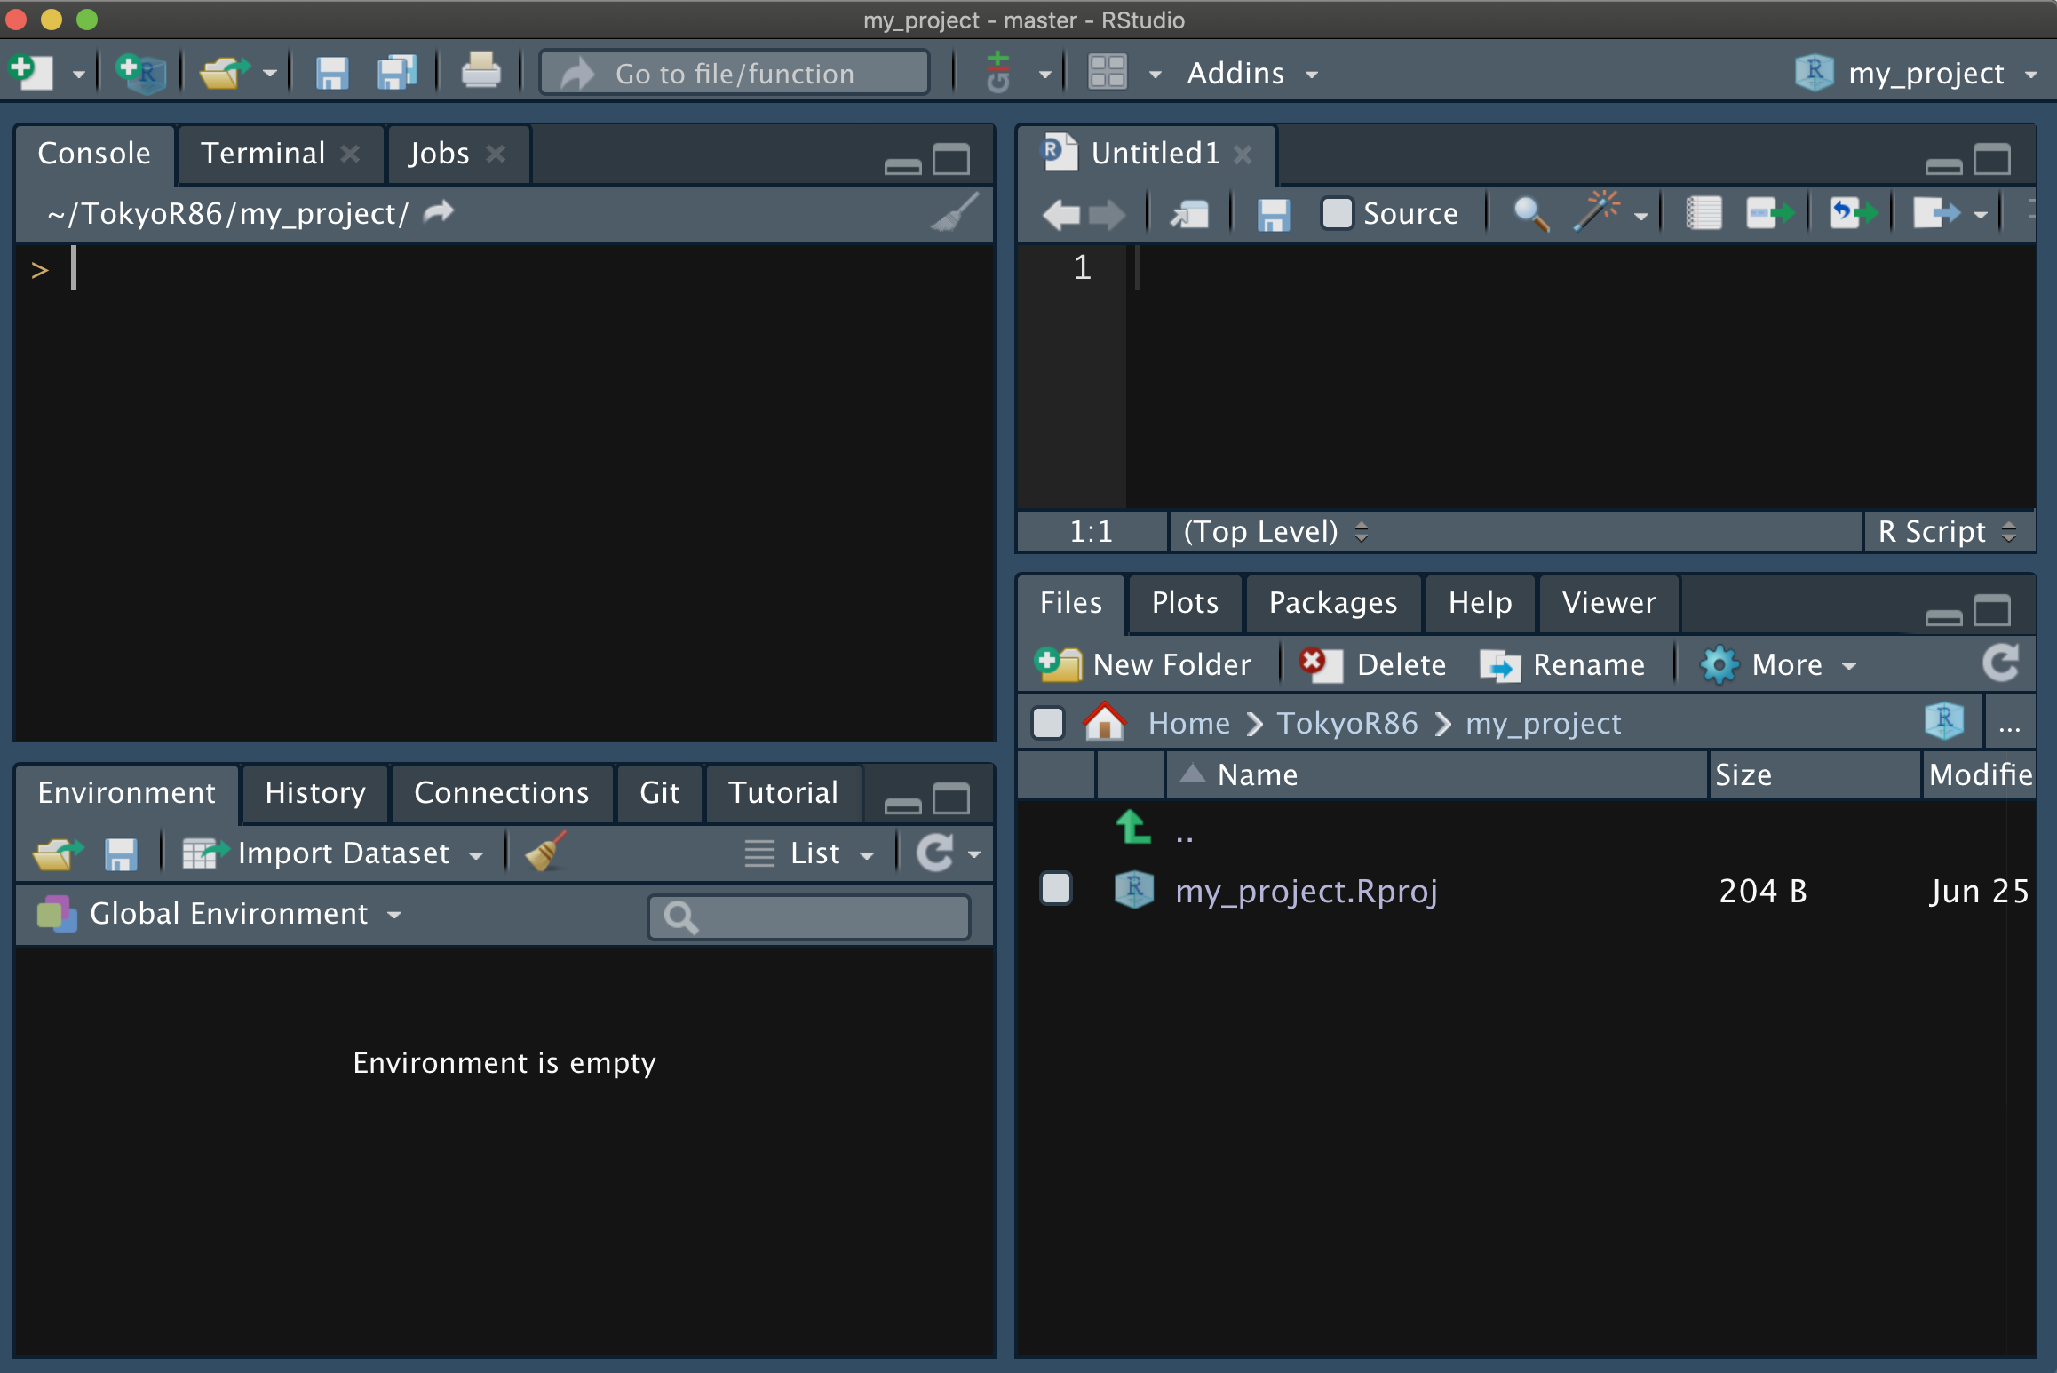
RStudio
File > New File > R script (⌘ + ⇧ + N)
Script Editor
Console
Files, Plots, Pkgs, ...
Env., HIstoly, Git, ...

Slide 3
RStudio
File > New File > R script (⌘ + ⇧ + N)
Run
≈
Script Editor
Console
Files, Plots, Pkgs, ...
Env., HIstoly, Git, ...

Slide 4
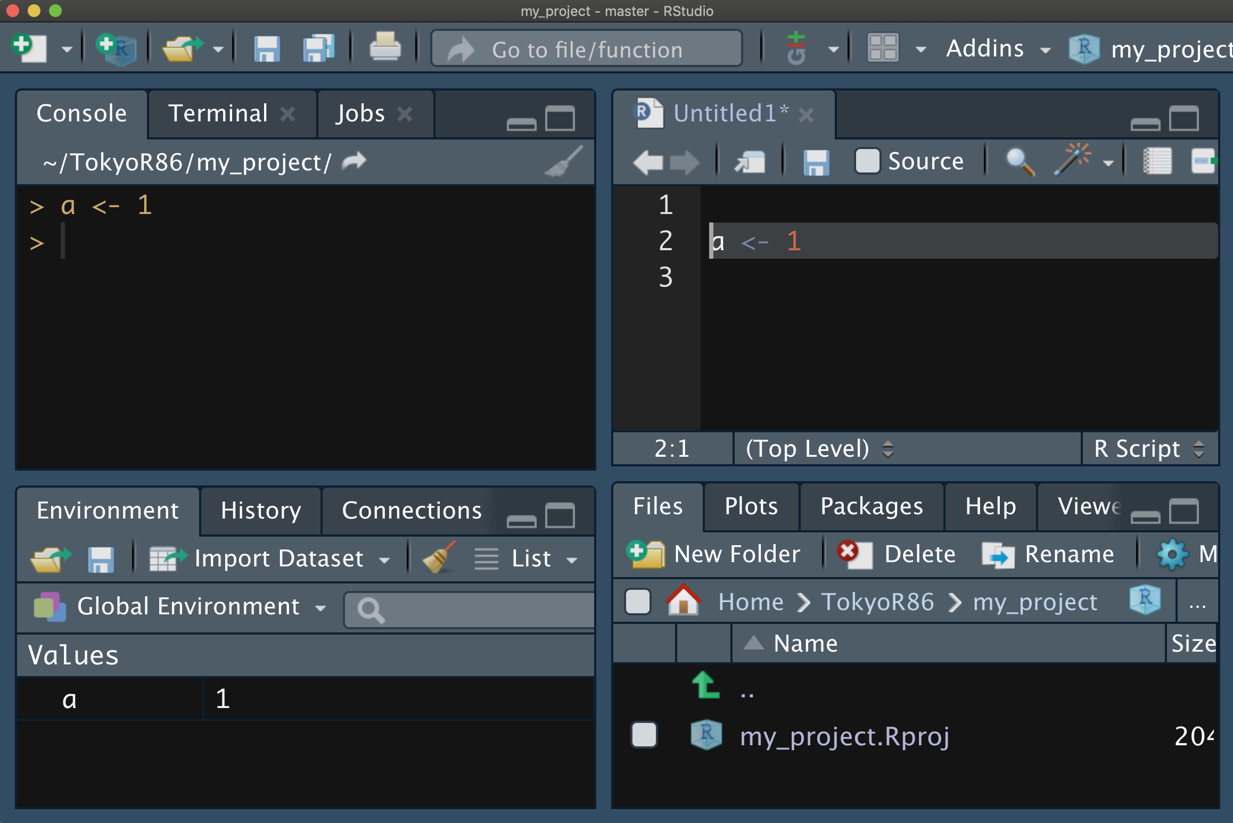
RStudio
≈
Select ↩︎

Slide 5
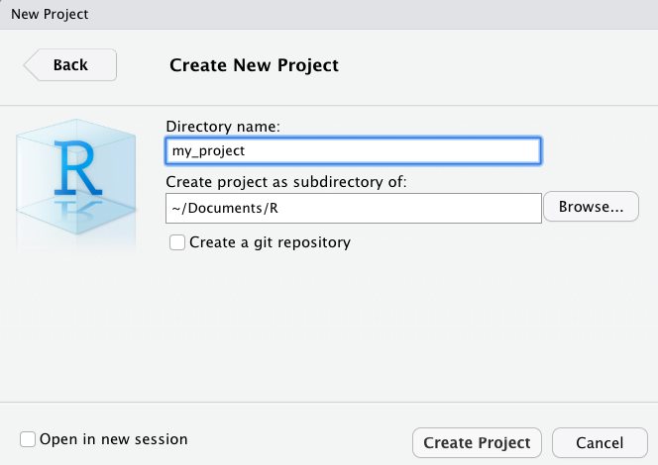
Create New Project≈
File > New Project > New Directory > New Project >

Slide 6



Project Folder
~/Documents/R
Project Root folder
my_project
Workspace setting
my_project.Rproj
.Rproj.user
Open RStudio
Auto saved
working information
(Unsaved edits, tab order, etc.)

Slide 7
Project Folder
~/Documents/R
my_project
my_project.Rproj
data
fig
script.R

Slide 8
Project Folder
~/Documents/R
my_project
my_project.Rproj
data
data_raw
fig
data_all.csv
script.R

Slide 9

Project Folder
Project

