Slide 1
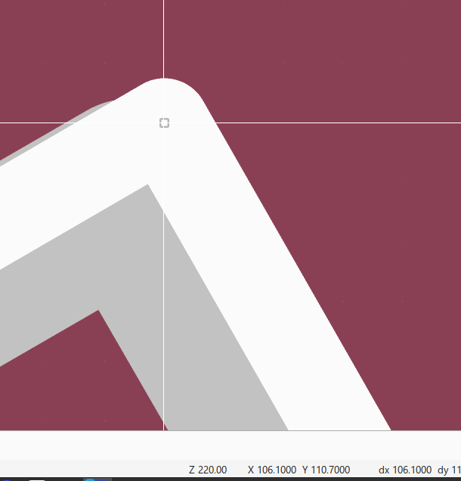
Top - 106.1,
Y=110.7

Slide 2
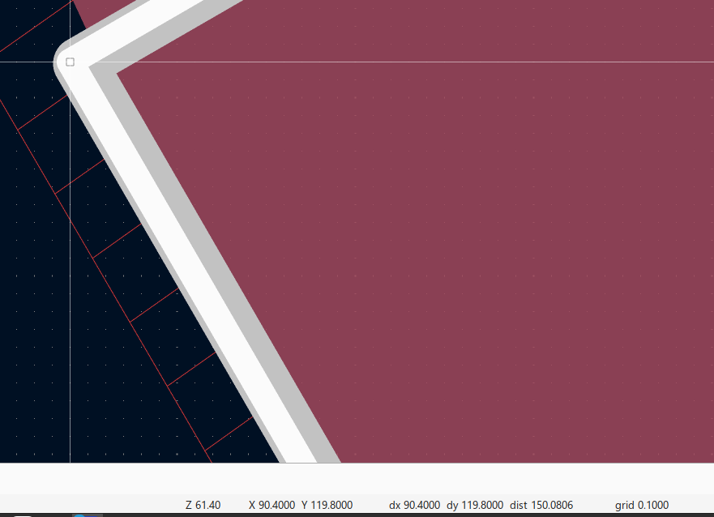
Left: X=90.4,
119.8

Slide 3
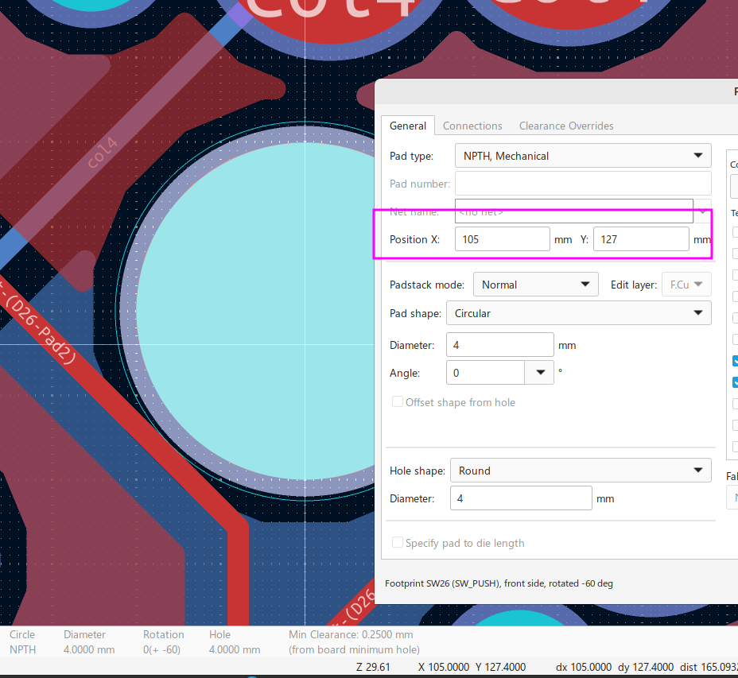
Hole Center: X=105, Y=127

Slide 4
Right edge: X=120.1
Bottom edge: Y=143.5
Top edge: Y=110.7
Left edge: X=90.4
Center of switch: (105, 127)

