Slide 1


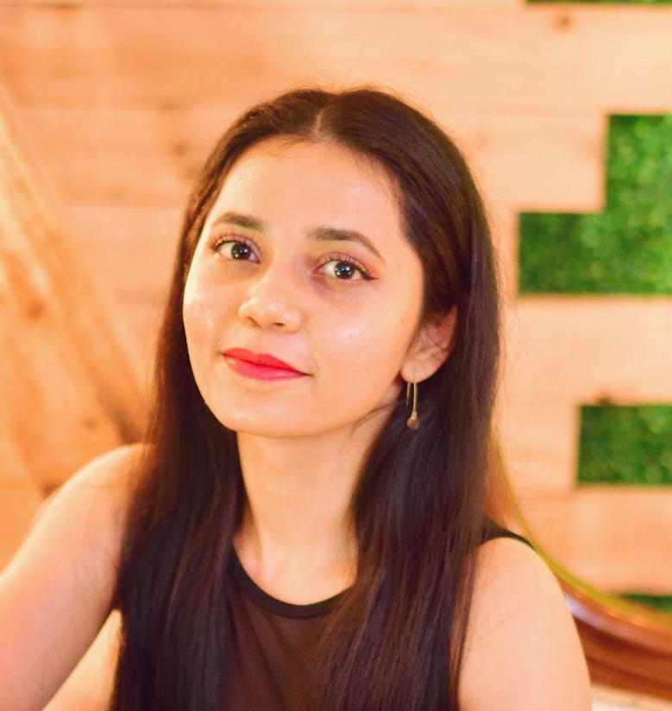
Project Overview
Java Project
A Java Object Oriented application making use of multiple models and classes to run complex game logic from the command line.
React API Project
A React application that pulls data from an external public API and presents it in a dashboard or multi-page layout.
Typescript Game Project
A browser-based game using modern JavaScript
programming techniques and DOM manipulation.
Portfolio Website
Built using correct version control and modern coding
standards with HTML and SCSS.
Kimberley Antao
(She / Her)
Junior Software Engineer
About Me
I am a keen individual who is passionate about learning new things and always push myself out of my comfort zone. From the varied roles that I worked in and bootcamps joined, I developed both technical and transferable skill such being adaptable, stakeholder management, time management and prioritisation.
Nowadays, everything revolves around technology. It is a sector where there is a lot to learn and potiential to grow. This combined with my love for coding is what made me join _nology.
Fluent in Hindi and Konkani
Work Experience
April 2023 - June 2024
Tech Specialist| ACE, London, UK| Full-time Contractor
Automate business processes which ensure quick result and prompt updates using power-automate
Research new hardware to improve office space
Create power apps
October 2022 - April 2023
PMO | ACE, London, UK | Full-time Contractor
Ensured ACE processes are followed during the entire project lifecycle
Kept track of finances
Took charge of scrum ceremonies in the absence of the Delivery Lead
September 2017 - March 2022
Customer Trading Manager| Sainsburys, London, UK
Led and coached a team of 20
Prioritized and delegated duties to colleagues
Delivered on all set KPIs
Carried out payroll processes
Juner 2016 - September 2017
Customer Service Assistant| Sainsburys, London, UK
Provided good customer service and achieved 100% score from mystery customers.
Managed code and quality control
Carried out lottery and till checks.
Key Course Skills
HTML5, CSS3, SASS, JavaScript, React, Jest, Typescript, React Testing Library, Github Actions, TDD, CI/CD, OOP and Java.
View my GitHub here.
Education
2022 | QA Ltd
BCS Foundation in Business Analysis
2020-2021 | Code Institute
Full Stack Web Development
2013-2016
BSc Computer Science
Parvatibai Chowgule College of Arts and Science, Goa, India
Hobbies
i
My love for learning different things follows me in my personal life. Which has led me to learn sewing, baking, DIYs, Muay Thai (in progress) and I currently attend Salsa dance classes.

