Slide 1
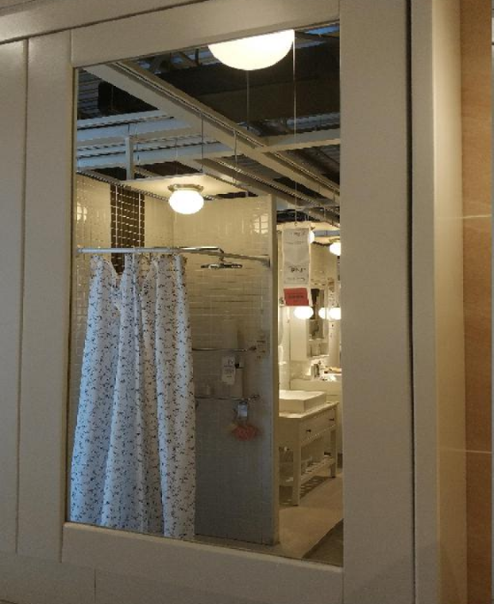
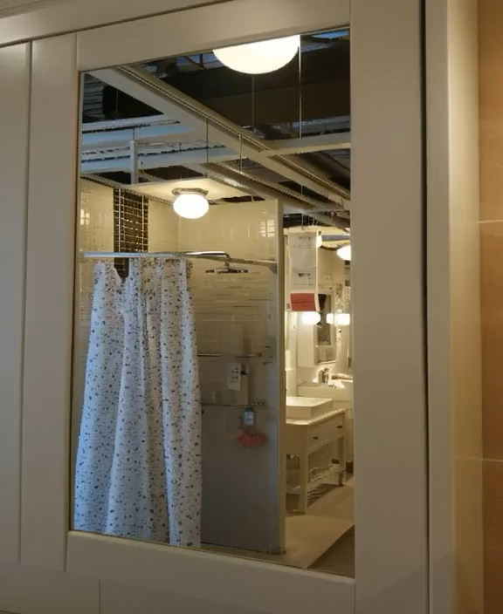


Task: Generative Novel View Synthesis with Reflections
Input
SEVA (baseline)
Ours

Slide 2

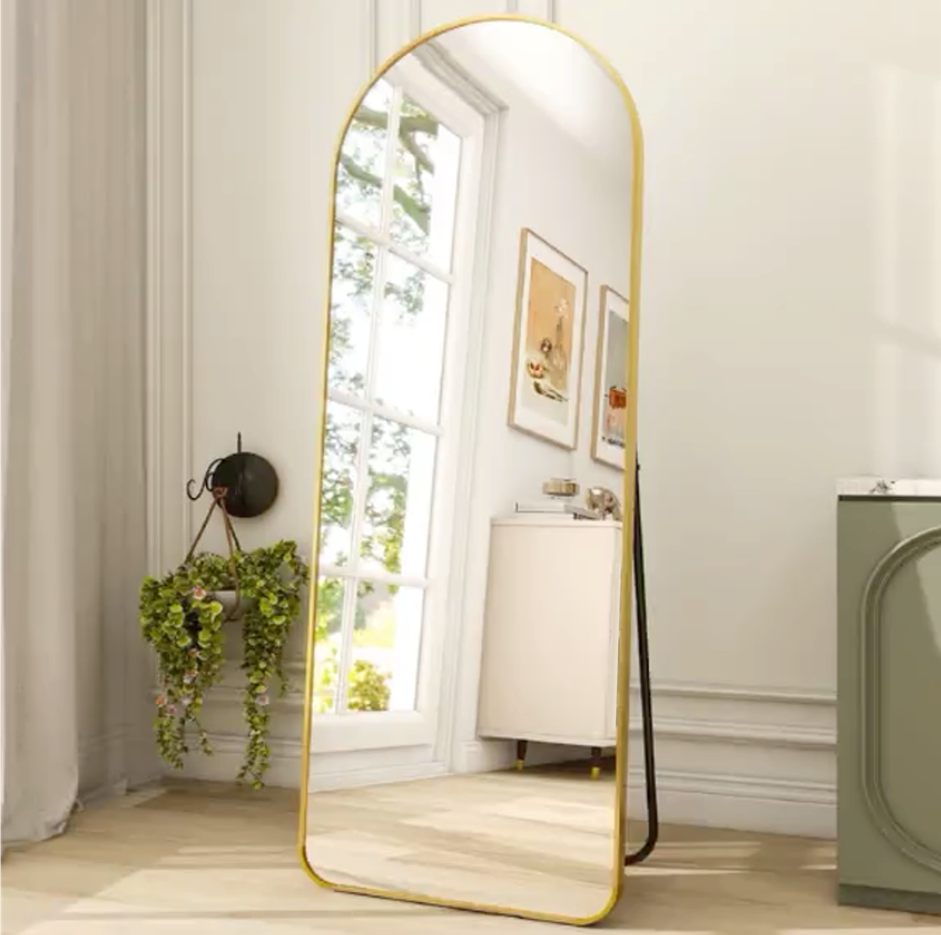
Given input image, can you imagine the rest of the scene?
There should be a window, a drawer, paintings on the wall, …
Q.
Input image & camera pose
Humans can easily imagine the unseen views using a mirror.

Slide 3

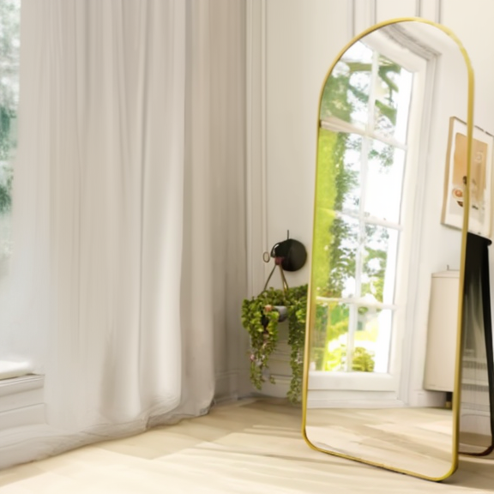
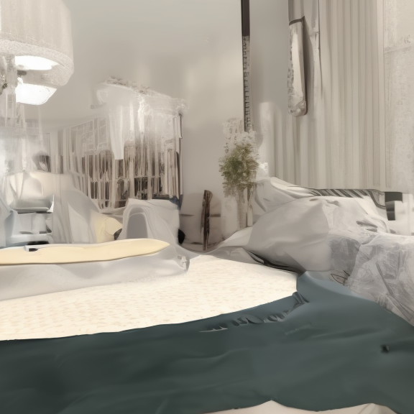
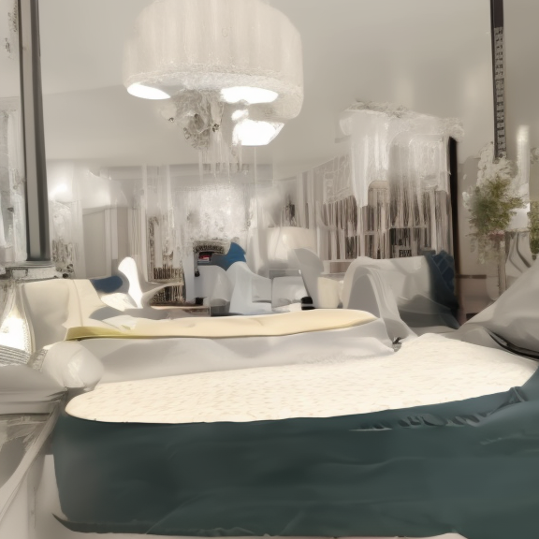
Given input image, can you imagine the rest of the scene?
There should be a window, a drawer, paintings on the wall, …
Q.
SEVA
Generated images
Input image & camera pose
How about machines?

Slide 4
Given input image, can you imagine the rest of the scene?
There should be a window, a drawer, paintings on the wall, …
Q.
Leakage
Reflection inconsistency
SEVA
Generated images
Input image & camera pose
Even SOTA models generate reflection-inconsistent novel view images..

Slide 5
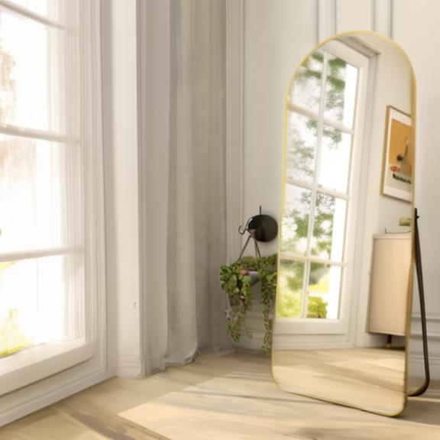
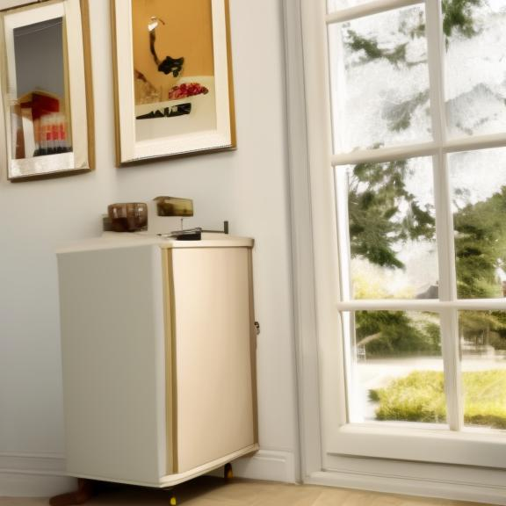
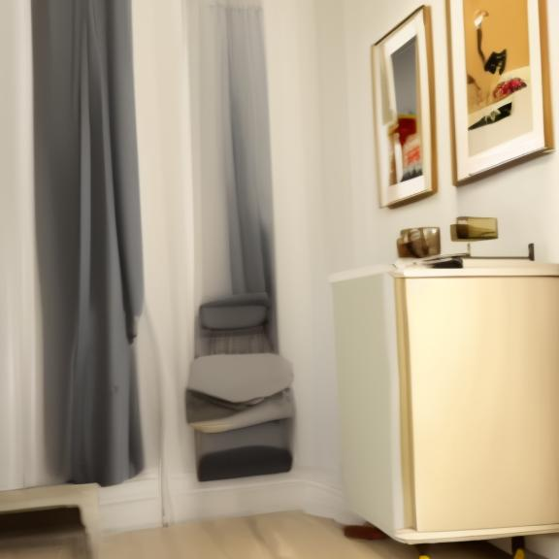
Ref-GeNVS generates reflection-consistent novel view images!
The first reflection-aware method for generative novel view synthesis
Ours
Generated images
Input image & camera pose
by using mirror reflections as auxiliary cues for novel view generation

