Slide 1
Jongchan Kim
GW Data Science Master program
(2020 ~ 2022)
MILITARY EXPENDITURE ANALYSIS PRESENTATION
across 10 countries over past five years
Data Source
Data Cleansing
Analysis
Conclusion

Slide 2
DATA
SOURCE
NAME | CONTENTS | SOURCE
GDP | Gross domestic product for each country and year (https://data.worldbank.org/indicator/NY.GDP.MKTP.CD) | THE WORLD BANK
Military Expenditure | Military Expenditure for each country and year (https://data.worldbank.org/indicator/MS.MIL.XPND.CD) | THE WORLD BANK
Population Total | Total Population for each country and year (https://data.worldbank.org/indicator/SP.POP.TOTL) | THE WORLD BANK
Data Source
Data Cleansing
Analysis
Conclusion
LAST UPDATE : 8 SEP 2020

Slide 3
DATA
CLEANSING
Step 1. Select countries and years of interest.
• Year : 2014, 2015, 2016, 2017, 2018
• Country: US, China, Russia, Germany, UK, France, Italy, Saudi Arabia, South Korea, Israel
Step 2. Check if there’s any null values
Step 3. Create Columns
Data Source
Data Cleansing
Analysis
Conclusion

Slide 4
DATA
CLEANSING
FINAL DATA FRAME
• Country
• Year
• GDP
• Military Expenditure
• Population
• Percentage of Military Expenditure over GDP
• Per-capita Military Expenditure
• Per-capita GDP
• Percentage of military spending over total military spending in a year
• Year-on-year increase of military expenditure
• Year-on-year growth rate of military expenditure
Data Source
Data Cleansing
Analysis
Conclusion

Slide 5
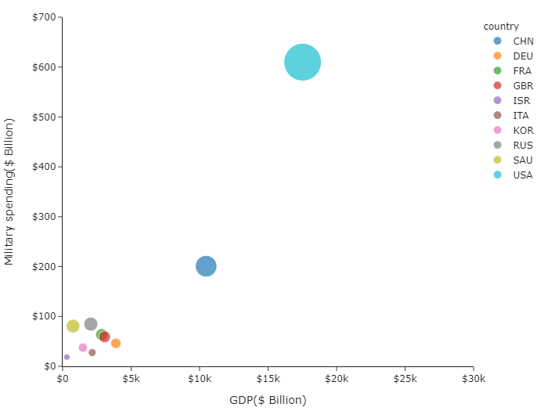
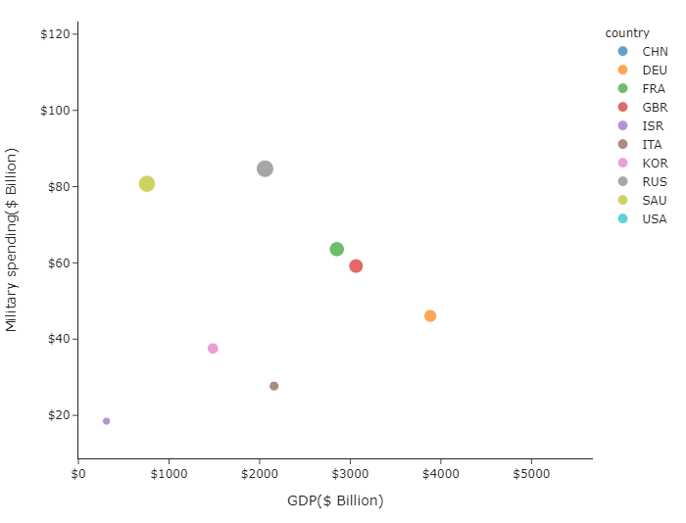
ANALYSIS
GDP vs Military Spending
10 countries can be divided into three groups based on military spending and GDP
Data Source
Data Cleansing
Analysis
Conclusion
High
Middle
Low
High : USA, China
Low : Israel
Middle: Other countries

Slide 6
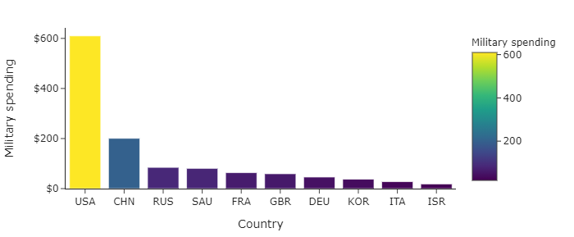
ANALYSIS
Absolute Military spending
This graph also confirms that the U.S. and china are spending noticeably higher military costs than other countries.
Data Source
Data Cleansing
Analysis
Conclusion

Slide 7
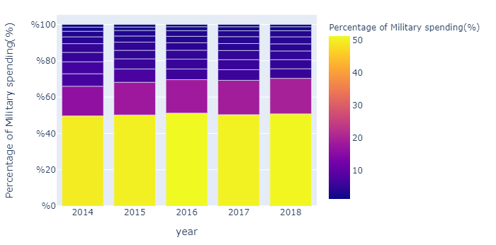
ANALYSIS
Percentage of military expenditure over total costs
Together, the USA and China account for nearly 70 percent of the total military costs.
30
Data Source
Data Cleansing
Analysis
Conclusion
70

Slide 8
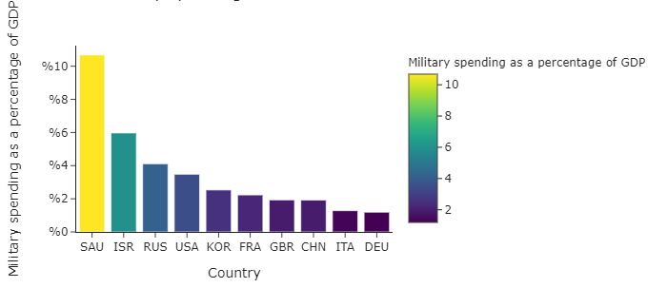
ANALYSIS
Relative Military Expenditure
Given the military spending relative to GDP, Saudi Arabia tops the list.
Data Source
Data Cleansing
Analysis
Conclusion

Slide 9
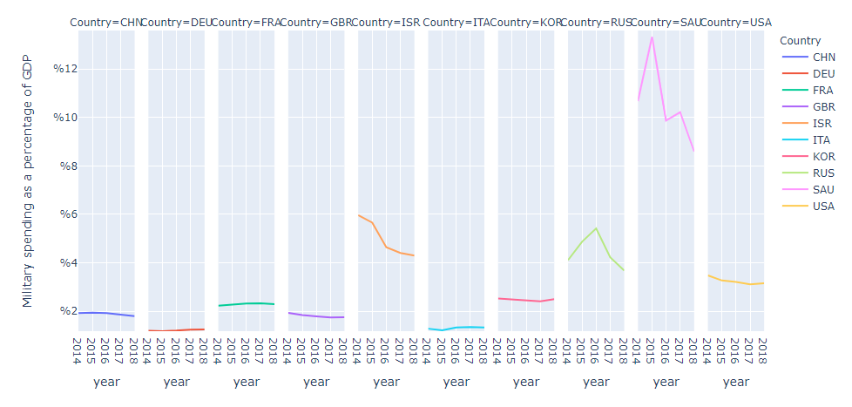
ANALYSIS
Relative Military Expenditure
If we put them together over years by country, It can be divided into 3 clusters by relative military expenditure.
Data Source
Data Cleansing
Analysis
Conclusion
10% ~ 12%
3% ~ 6%
2 % or less

Slide 10
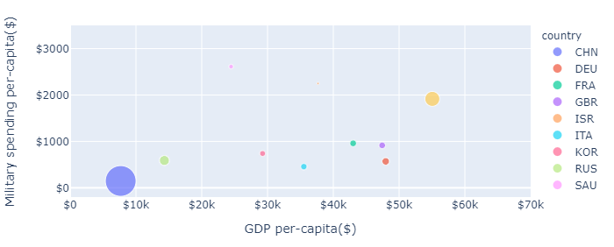
ANALYSIS
GDP vs Military spending Per-capita
Russia and China have significantly lower GDP per capita than other countries
China has lowest military spending per capita because of the relatively large population
Israel ranked second in terms of military spending per capita because of its small population
Data Source
Data Cleansing
Analysis
Conclusion

Slide 11
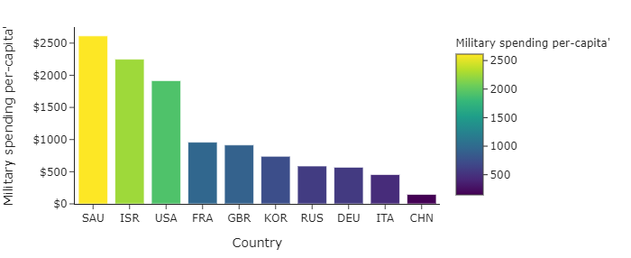
ANALYSIS
Military Spending per-capita
As color suggests, 10 countries can be divided into three groups based on military spending per capita.
Data Source
Data Cleansing
Analysis
Conclusion

Slide 12
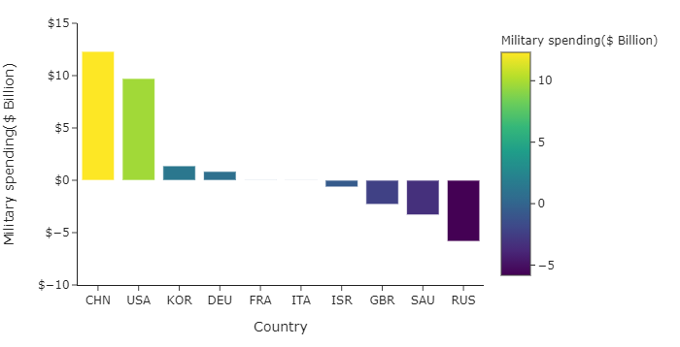
ANALYSIS
Growth Analysis : Annual Average Growth
China and the United states show noticeably high average annual growth
$12.3 Billon
Data Source
Data Cleansing
Analysis
Conclusion
$9.7 Billon

Slide 13
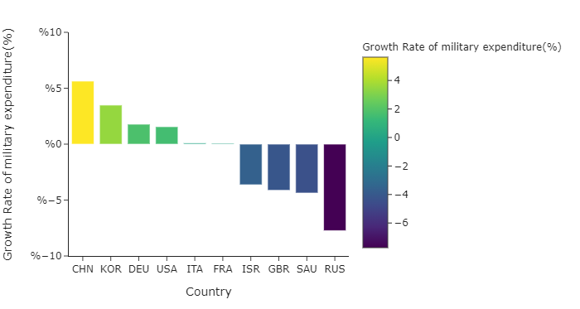
ANALYSIS
Growth Analysis : Compound Annual Growth Rate
On the other hand, based on the compound annual growth rate, which is the popular measure of an investment's annual growth rate over time, china topped the list with 5.6 percent, while the US came in fourth with 1.5 percent.
Data Source
Data Cleansing
Analysis
Conclusion
$12.3 Billon
5.6 %
$9.7 Billon
1.5 %

Slide 14
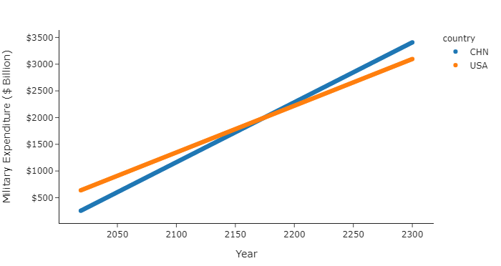
ANALYSIS
Forecast of military expenditure
Scenario 1 : Military expenditure will increase linearly every year.
It takes about 150 years from now for US military spending to be caught up by China.
Data Source
Data Cleansing
Analysis
Conclusion
$12.3 Billon
5.6 %
$9.7 Billon
1.5 %

Slide 15
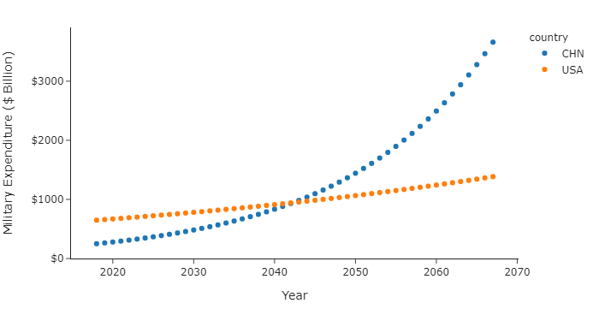
ANALYSIS
Forecast of military expenditure
Scenario 2 : Military expenditure will increase exponentially with the compound annual growth rate
It takes about only about 23 years from now to be caught up by China.
Data Source
Data Cleansing
Analysis
Conclusion
$12.3 Billon
5.6 %
$9.7 Billon
1.5 %

Slide 16
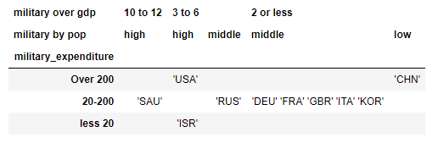
Conclusion
On the basis of three axes of absolute military spending, relative military spending and per capita military spending, the 10 countries can be grouped as follows.
Also, It is also necessary to look carefully at the increasing military costs of China and the United States based on various indicators such as annual average growth and Compound Annual Growth Rate. Because Although There is still a gap of nearly 400 billion dollars between two countries, We need to pay attention to China’s steep growth rate.
Data Source
Data Cleansing
Analysis
Conclusion
$12.3 Billon
5.6 %
$9.7 Billon
1.5 %

