Slide 1

TensorFlow
Graduate Tutorial Presentation By Kim Lam

Slide 2
Overview
What is Tensorflow?
What is Keras?
Typical uses
Coding Implementations
Sentiment analysis example
Image recognition example
Conclusion
Benefits/Disadvantages of Tensorflow
Competition
Extra resources and References

Slide 3

What is Tensorflow? What is Keras?
https://www.tensorflow.org/
TensorFlow is an open source machine learning library that the Google Brain team created
Released in November 2015
Tensorflow creates dataflow graphs, structures that describe how data moves through a graph, or a series of processing nodes. Each node in the graph represents a mathematical operation, and each connection or edge between nodes is a multidimensional data array, or tensor
Tensorflow is named after the literal flow of tensors, or the operations of neural networks on multidimensional arrays
https://keras.io/
Keras is also an open-source deep learning library
Tensorflow is usually used in tandem with Keras that builds a model for predictions

Slide 4
Typical uses
Mainly used for: Classification, Perception, Understanding, Discovering, Prediction, Creation
Voice/Sound Recognition
Voice recognition – IoT, Automotive, Security, UX/UI
Voice search – Telecoms, Handset Manufacturers
Sentiment Analysis – CRM
Flaw Detection (ex: engine noise) – Automotive, Aviation
Language understanding (ex: Speech-to-text)
Text Based Applications
Sentimental analysis - CRM, Social Media
Threat Detection - Social Media, Government
Fraud Detection - Insurance, Finance
Language Detection (ex: Google Translate)
Text Summarization (sequence-to-sequence learning) - produces headlines for articles
Google SmartReply - generates email responses
Notes:
Voice/Sound Recognition, Text Based Applications, Image Recognition, Time Series, Video Detection

Slide 5
Typical uses (cont.)
Image Recognition
Face Recognition, Image Search, Motion Detection, Machine Vision, Photo Clustering, Image Recognition - Social Media, Telecom, Handset Manufacturers, Automotive, Aviation, Healthcare
Object recognition (classify/identify arbitrary objects within larger images)
Engineering - identify shapes for modeling purposes (3D construction from 2D images)
Social networks - photo tagging (Facebook’s Deep Face)
Time Series
extract meaningful statistics to forecasting non-specific time periods and generate alternative versions
Recommendation - Amazon, Google, Facebook, Netflix
Even more advanced: Recommend gifts/TV shows that your family/friends might like
Finance, Accounting, Government, Security and IoT with Risk Detections, Predictive Analysis, Enterprise/Resource Planning
Video Detection
Motion Detection, Real-Time Thread Detection in Gaming, Security, Airports, UX/UI
Universities working on Large scale Video Classification datasets like YouTube-8M
accelerate research on large-scale video understanding, representation learning, noisy data modeling, transfer learning, domain adaptation approaches
Nasa is designing system with TensorFlow for orbit classification/object clustering of asteroids to classify/predict NEOs (near earth objects).

Slide 6
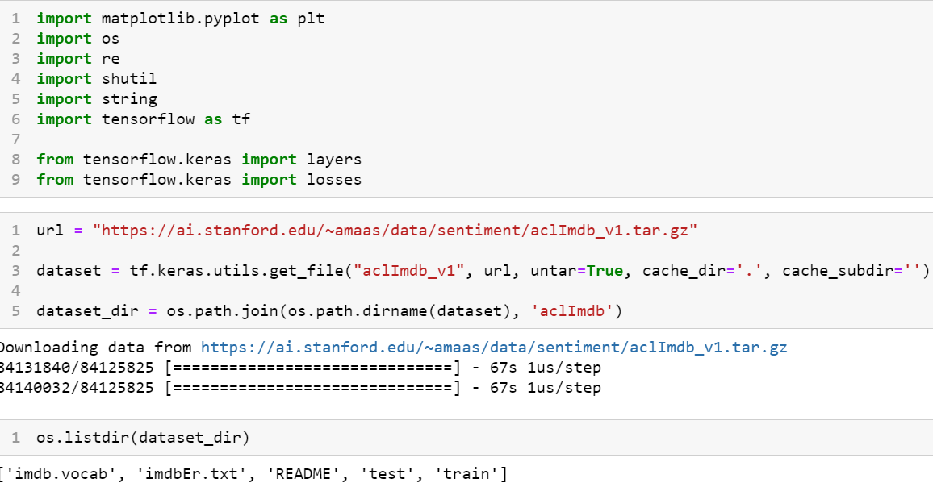
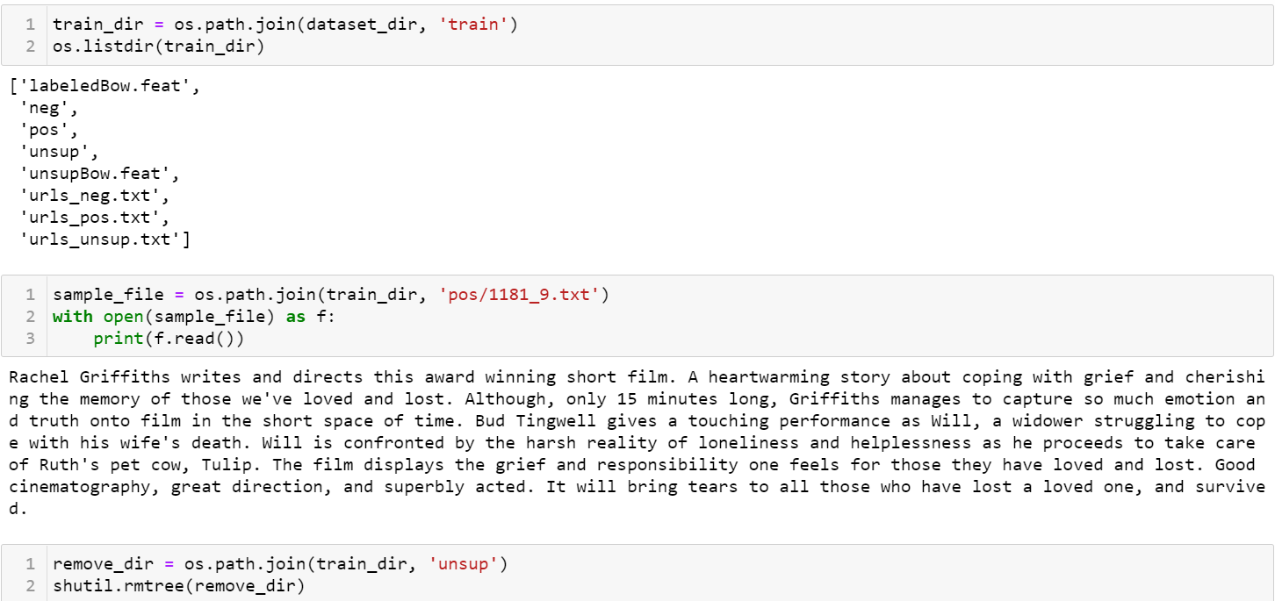
Sentiment analysis example
Notes:
You'll use the [Large Movie Review Dataset](https://ai.stanford.edu/~amaas/data/sentiment/) that contains the text of 50,000 movie reviews from the [Internet Movie Database](https://www.imdb.com/). These are split into 25,000 reviews for training and 25,000 reviews for testing. The training and testing sets are *balanced*, meaning they contain an equal number of positive and negative reviews.
To prepare a dataset for binary classification, you will need two folders on disk, corresponding to `class_a` and `class_b`. These will be the positive and negative movie reviews, which can be found in `aclImdb/train/pos` and `aclImdb/train/neg`. As the IMDB dataset contains additional folders, you will remove them before using this utility.

Slide 7
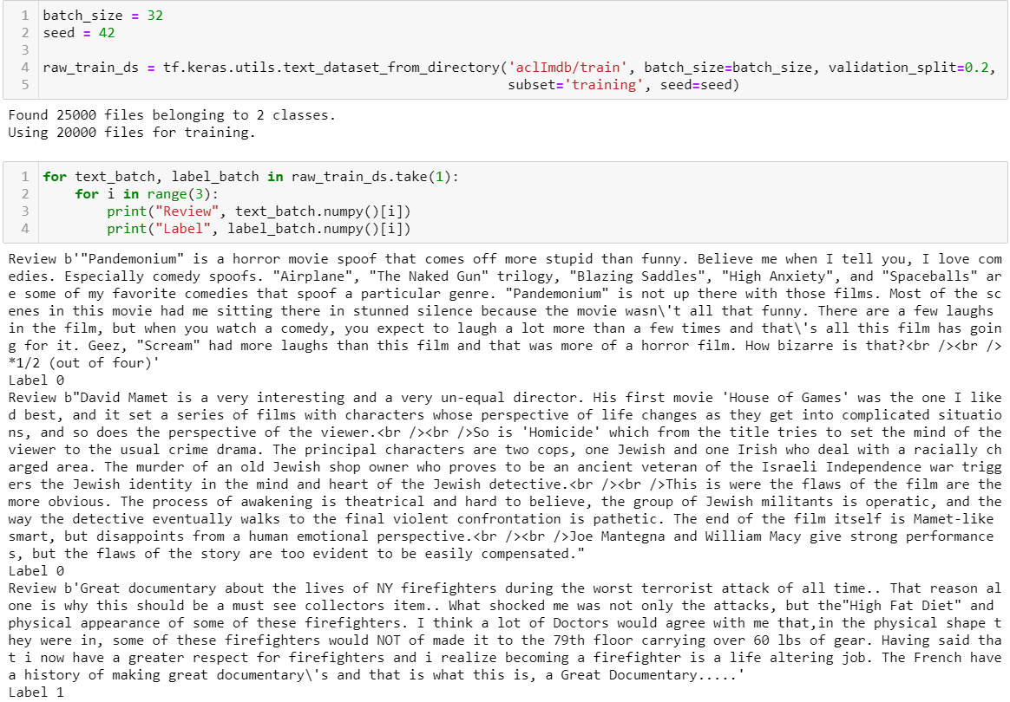
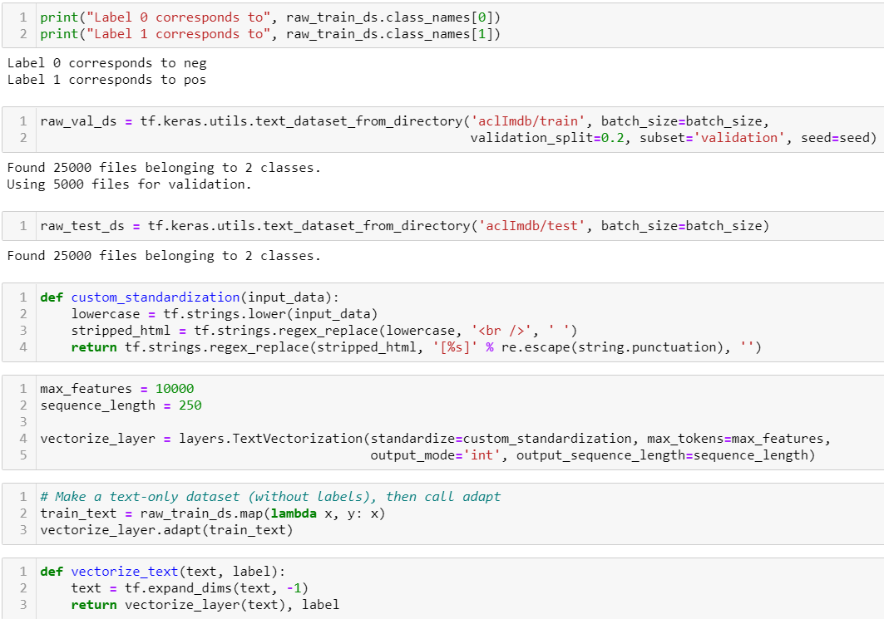
Notes:
Next, you will use the `text_dataset_from_directory` utility to create a labeled `tf.data.Dataset`. [tf.data](https://www.tensorflow.org/guide/data) is a powerful collection of tools for working with data.
When running a machine learning experiment, it is a best practice to divide your dataset into three splits: [train](https://developers.google.com/machine-learning/glossary#training_set), [validation](https://developers.google.com/machine-learning/glossary#validation_set), and [test](https://developers.google.com/machine-learning/glossary#test-set). The IMDB dataset has already been divided into train and test, but it lacks a validation set. Let's create a validation set using an 80:20 split of the training data by using the `validation_split` argument below.

Slide 8
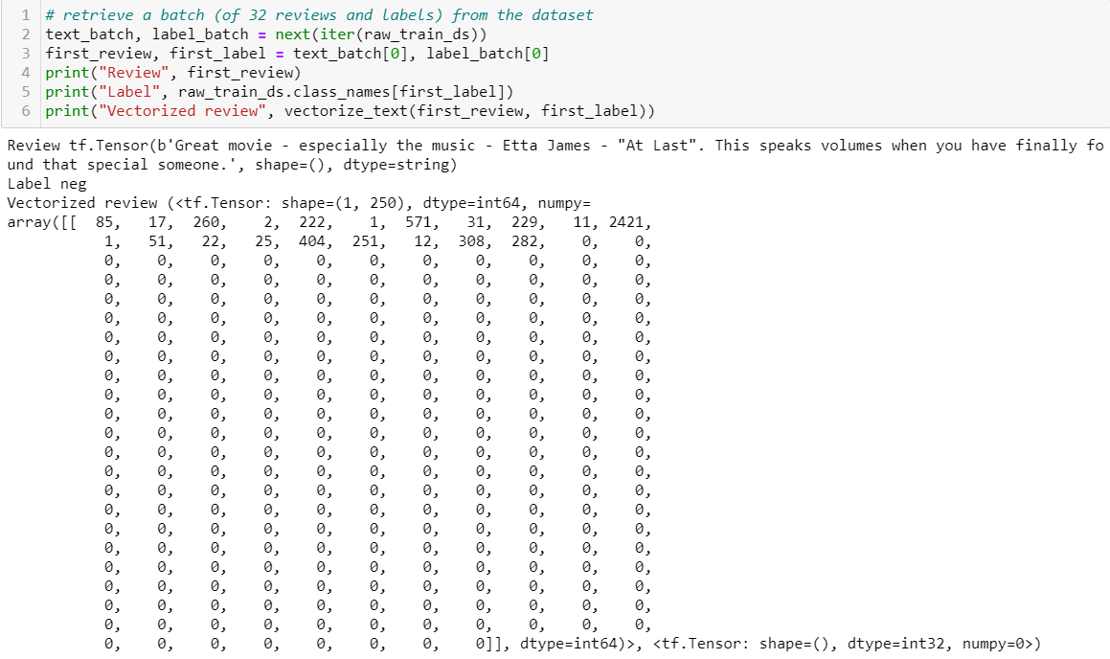
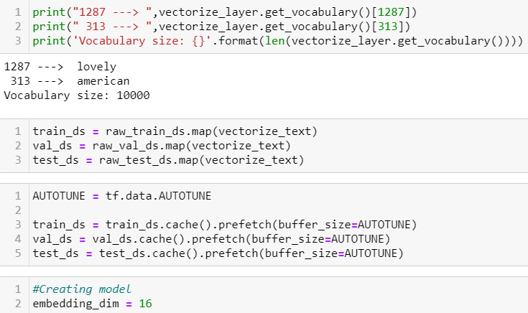
Notes:
As you can see above, each token has been replaced by an integer. You can lookup the token (string) that each integer corresponds to by calling `.get_vocabulary()` on the layer.
These are two important methods you should use when loading data to make sure that I/O does not become blocking.
`.cache()` keeps data in memory after it's loaded off disk. This will ensure the dataset does not become a bottleneck while training your model. If your dataset is too large to fit into memory, you can also use this method to create a performant on-disk cache, which is more efficient to read than many small files.
`.prefetch()` overlaps data preprocessing and model execution while training.
You can learn more about both methods, as well as how to cache data to disk in the [data performance guide](https://www.tensorflow.org/guide/data_performance).

Slide 9
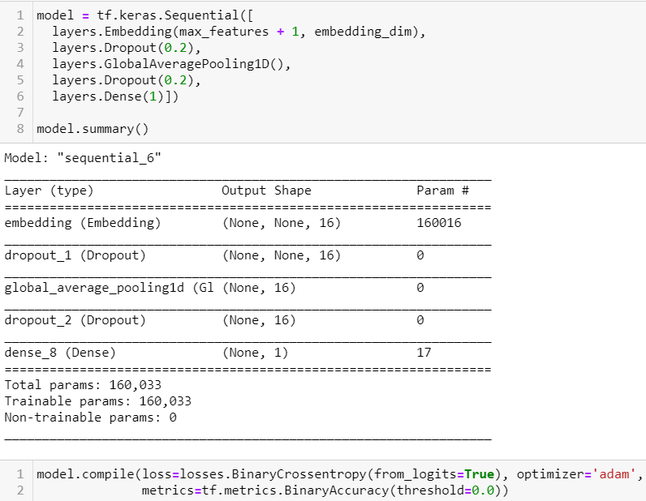
Notes:
The layers are stacked sequentially to build the classifier:
1. The first layer is an `Embedding` layer. This layer takes the integer-encoded reviews and looks up an embedding vector for each word-index. These vectors are learned as the model trains. The vectors add a dimension to the output array. The resulting dimensions are: `(batch, sequence, embedding)`. To learn more about embeddings, see the [word embedding tutorial](../text/word_embeddings.ipynb).
2. Next, a `GlobalAveragePooling1D` layer returns a fixed-length output vector for each example by averaging over the sequence dimension. This allows the model to handle input of variable length, in the simplest way possible.
3. This fixed-length output vector is piped through a fully-connected (`Dense`) layer with 16 hidden units.
4. The last layer is densely connected with a single output node.

Slide 10
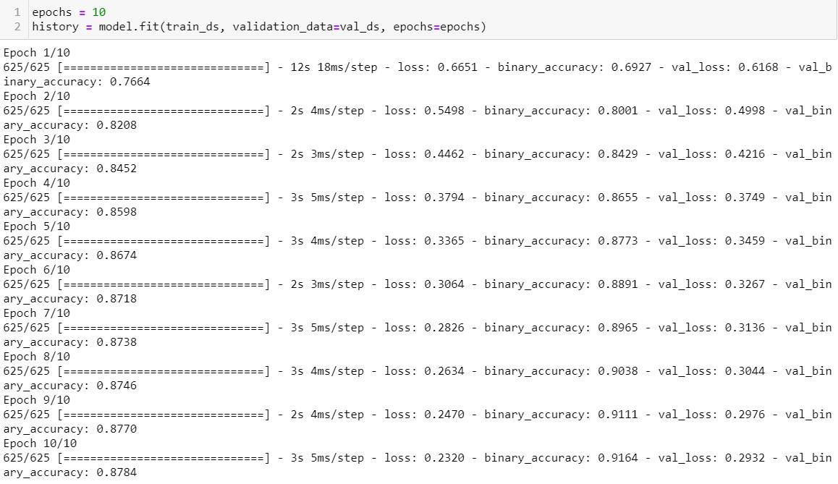
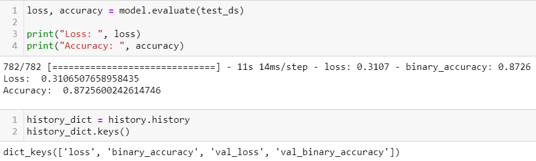
Notes:
A model needs a loss function and an optimizer for training. Since this is a binary classification problem and the model outputs a probability (a single-unit layer with a sigmoid activation), you'll use `losses.BinaryCrossentropy` loss function.
Now, configure the model to use an optimizer and a loss function:
LOSS = ERROR

Slide 11
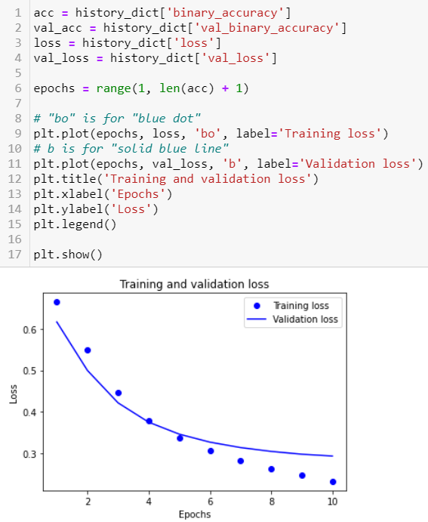
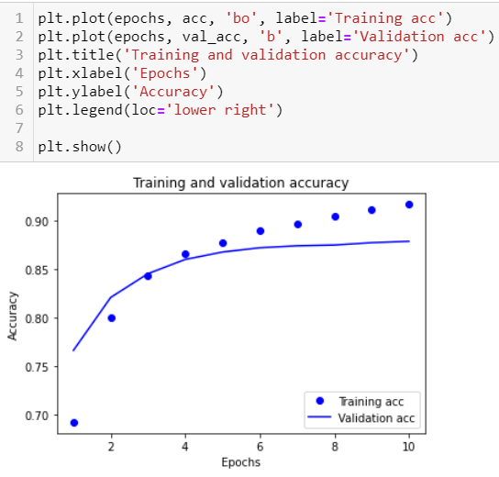
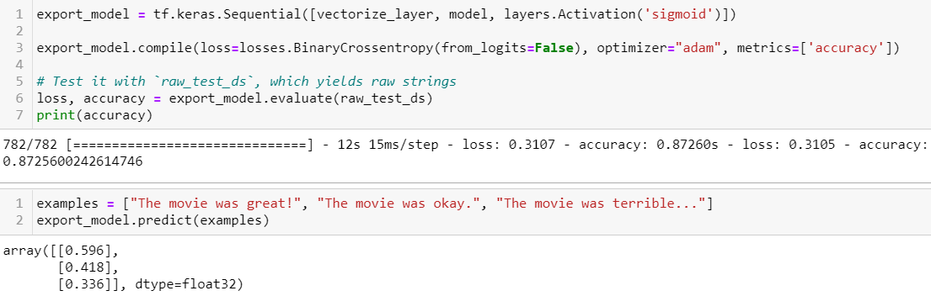
Notes:
In the code above, you applied the `TextVectorization` layer to the dataset before feeding text to the model. If you want to make your model capable of processing raw strings (for example, to simplify deploying it), you can include the `TextVectorization` layer inside your model. To do so, you can create a new model using the weights you just trained.
See probability outputs

Slide 12
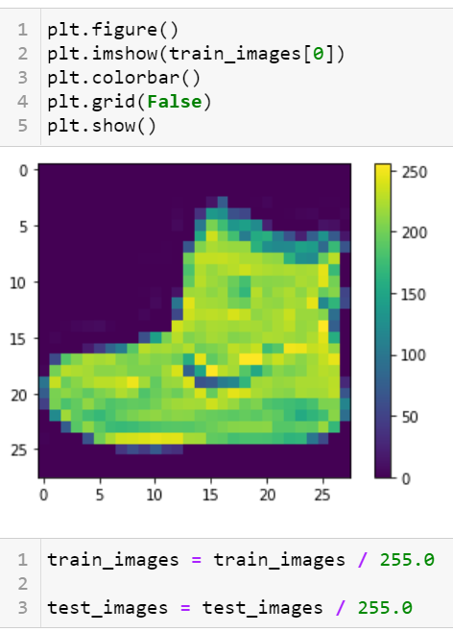
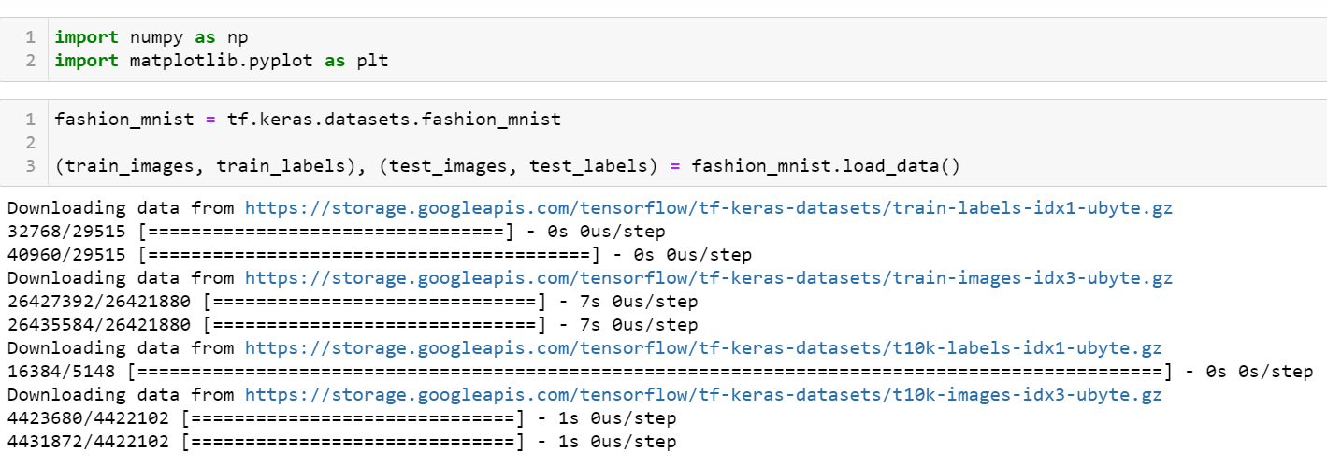
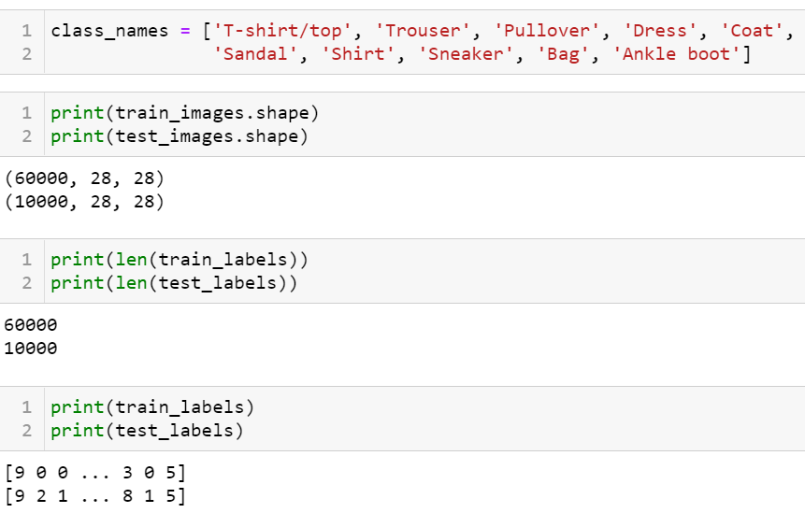
Image recognition example

Slide 13
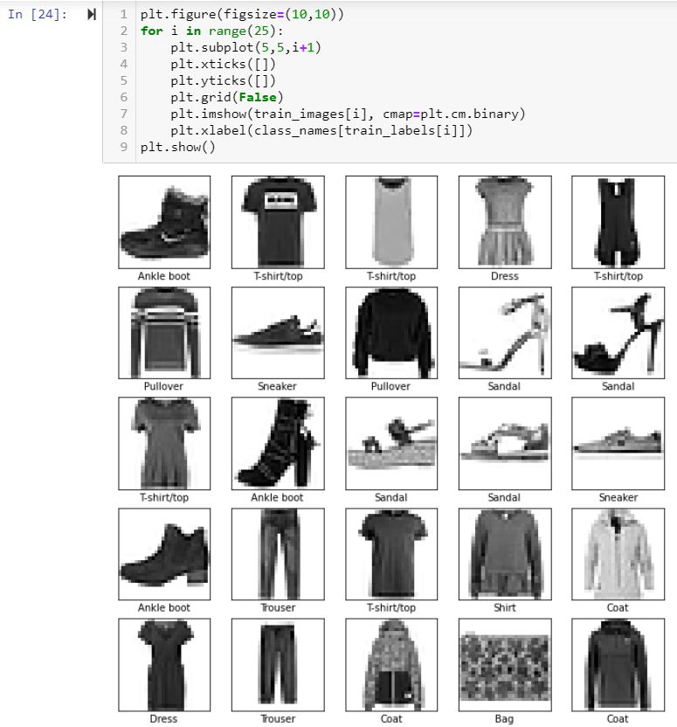
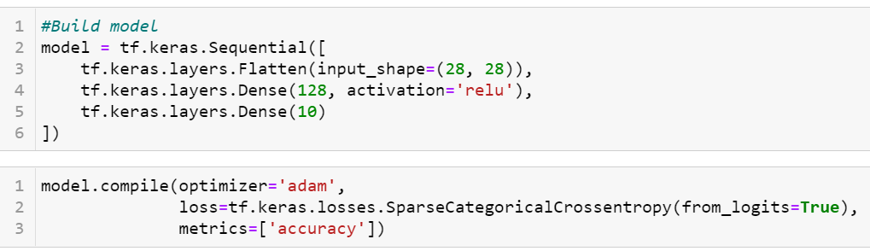

Slide 14
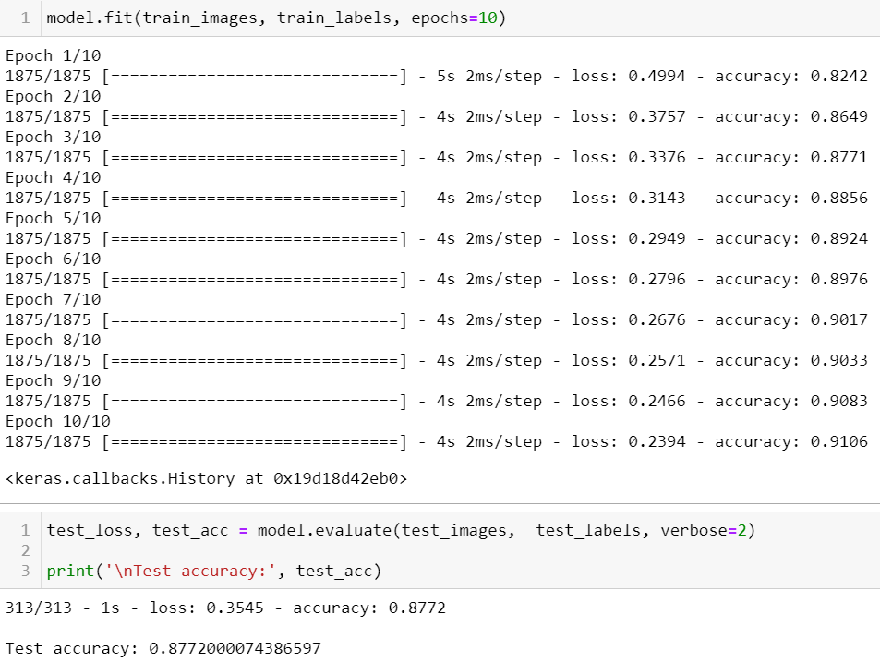

Slide 15
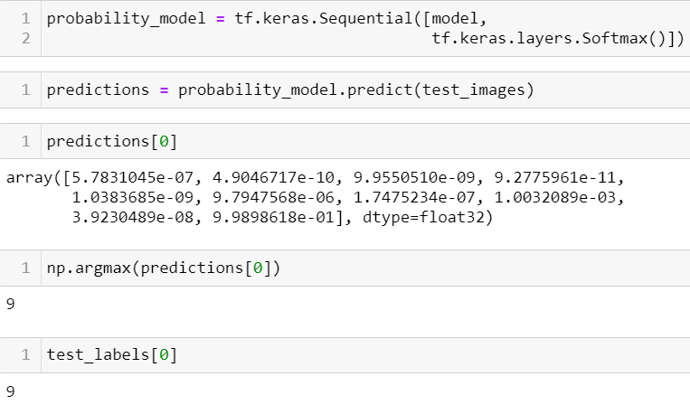

Slide 16
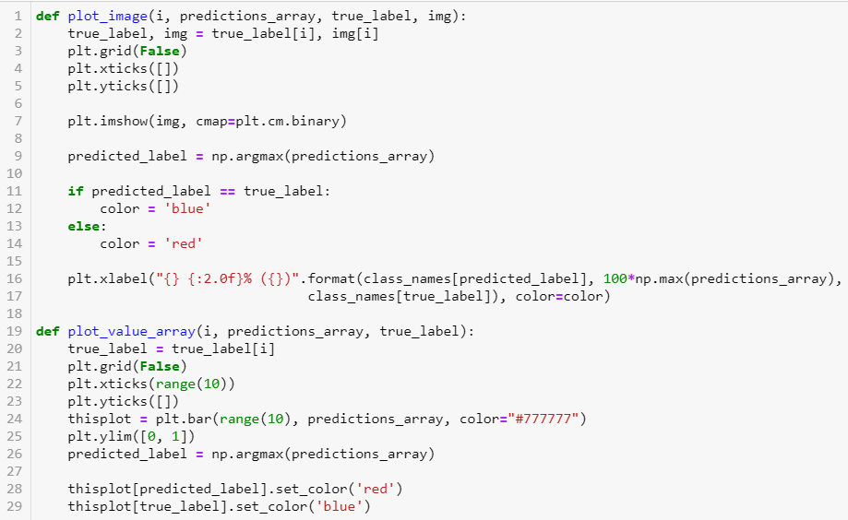

Slide 17
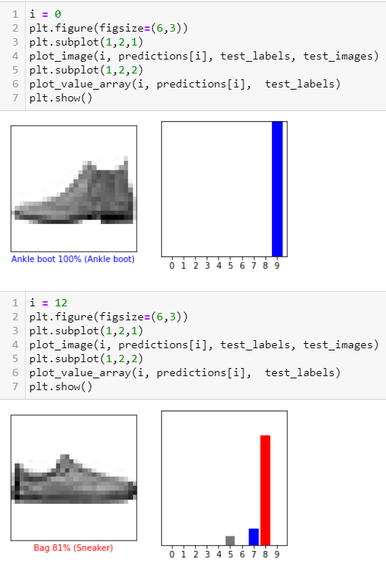
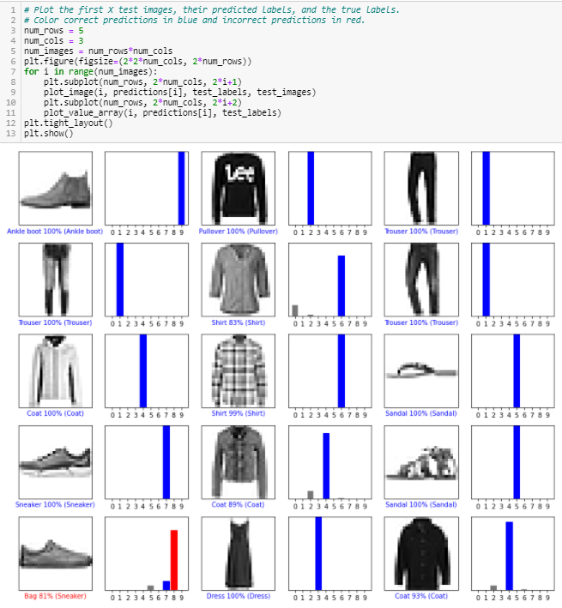

Slide 18
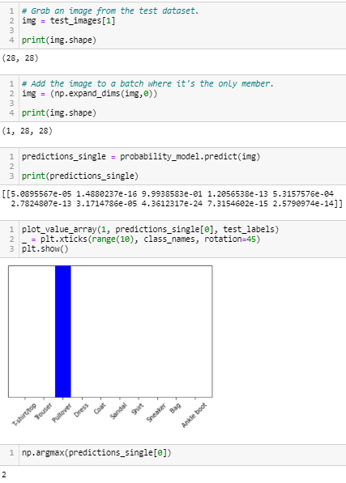

Slide 19
Conclusion - Benefits/Disadvantages of Using Tensorflow
Abstraction
No details of implementing algorithm, developer can focus on the overall logic of the application. TensorFlow takes care of the details behind the scenes.
TensorFlow apps
TensorBoard visualization suite lets you inspect and profile the way graphs run by way of an interactive, web-based dashboard
Google backing
rapid pace of development
accelerated performance in Google’s cloud
online hub for sharing models
in-browser and mobile-friendly
Disadvantage: Hard to obtain totally deterministic model-training results
model trained on one system will vary slightly from a model trained on another, even when they are fed the exact same data.
random numbers are seeded, certain non-deterministic behaviors when using GPUs, etc.
TensorFlow’s team is considering more controls to affect determinism in a workflow.

Slide 20
Conclusion - Tensorflow Competitions
PyTorch
built with Python
similarities to TensorFlow: hardware-accelerated components, a highly interactive development model that allows for design-as-you-go work, and many useful components already included.
PyTorch is generally a better choice for fast development of projects that need to be up and running in a short time, but TensorFlow wins out for larger projects and more complex workflows.
CNTK
Microsoft Cognitive Toolkit, like TensorFlow uses a graph structure to describe dataflow, but focuses most on creating deep learning neural networks.
handles many neural network jobs faster, and has a broader set of APIs (Python, C++, C#, Java).
But CNTK isn’t currently as easy to learn or deploy as TensorFlow.
Apache MXNet
adopted by Amazon for deep learning on AWS
scale almost across multiple GPUs/multiple machines
supports a broad range of language APIs—Python, C++, Scala, R, JavaScript, Julia, Perl, Go—although its native APIs aren’t as pleasant to work with as TensorFlow’s.

Slide 21
References
Metz, Cade. “Google Just Open Sourced TensorFlow, Its Artificial Intelligence Engine.” Wired, 9 Nov. 2015, www.wired.com/2015/11/google-open-sources-its-artificial-intelligence-engine.
“TensorFlow Decision Forests.” TensorFlow, www.tensorflow.org/decision_forests. Accessed 28 Oct. 2021.
Toydemir, Fikret. “Top Five Use Cases of Tensorflow.” Exastax, 3 Feb. 2017, www.exastax.com/deep-learning/top-five-use-cases-of-tensorflow.
“Tutorials | TensorFlow Core.” TensorFlow, www.tensorflow.org/tutorials. Accessed 28 Oct. 2021.
Yegulalp, Serdar. “What Is TensorFlow? The Machine Learning Library Explained.” InfoWorld, 18 June 2019, www.infoworld.com/article/3278008/what-is-tensorflow-the-machine-learning-library-explained.html.
Extra:
Brownlee, Jason. “TensorFlow 2 Tutorial: Get Started in Deep Learning With Tf.Keras.” Machine Learning Mastery, 27 Aug. 2020, machinelearningmastery.com/tensorflow-tutorial-deep-learning-with-tf-keras.
Brownlee, Jason. “Your First Deep Learning Project in Python with Keras Step-By-Step.” Machine Learning Mastery, 13 Oct. 2021, machinelearningmastery.com/tutorial-first-neural-network-python-keras.
Willems, Karlijn. “TensorFlow Tutorial For Beginners.” DataCamp Community, 16 Jan. 2019, https://www.datacamp.com/community/tutorials/tensorflow-tutorial.
"I pledge that on all academic work that I submit, I will neither give nor receive unauthorized aid, nor will I present another person's work as my own." - Kim Lam

