Slide 1
Algorithms
By
Dr Abanti, C.M PhD

Slide 2
Introduction
What is an Algorithm?
An algorithm is an explicit, precise, unambiguous, mechanically-executable sequence of elementary instructions, usually intended to accomplish a specific purpose.
Informally, an algorithm is any well-defined computational procedure that takes some value, or set of values, as input and produces some value, or set of values, as output. We can also view an algorithm as a tool for solving a well-specified computational problem.
An algorithm is a sequence of unambiguous instructions for solving a problem, i.e., for obtaining a required output for any legitimate input in a finite amount of time.

Slide 3
Introduction cont...
The word “algorithm” does not derive, as algorithmophobic classicists might guess, from the Greek roots arithmos, meaning “number”, and algos , meaning “pain”.
Rather, it is a corruption of the name of the 9th century Persian scholar, the writer of the treatise.
The methods described in this latter treatise, using either written figures or counting stones, became known in English as algorism or augrym

Slide 4
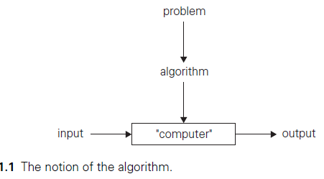
Introduction cont...

Slide 5
Introduction cont...
The reference to “instructions” in the definition implies that there is something or someone capable of understanding and following the instructions given.
We call this a “computer,”
Keeping in mind that before the electronic computer was invented, the word “computer” meant a human being involved in performing numeric calculations.
Nowadays, of course, “computers” are those ubiquitous electronic devices that have become indispensable in almost everything we do.
Note, however, that although the majority of algorithms are indeed intended for eventual computer implementation, the notion of algorithm does not depend on such an assumption.

Slide 6
Introduction cont...
As examples illustrating the notion of the algorithm, we consider three methods for solving the same problem: computing the greatest common divisor of two integers.
Euclid’s algorithm
Consecutive integer checking algorithm
Middle-school procedure
These examples will help us to illustrate several important points:
The non ambiguity requirement for each step of an algorithm cannot be compromised.
The range of inputs for which an algorithm works has to be specified carefully.
The same algorithm can be represented in several different ways.
There may exist several algorithms for solving the same problem.
Algorithms for the same problem can be based on very different ideas and can solve the problem with dramatically different speeds.

Slide 7
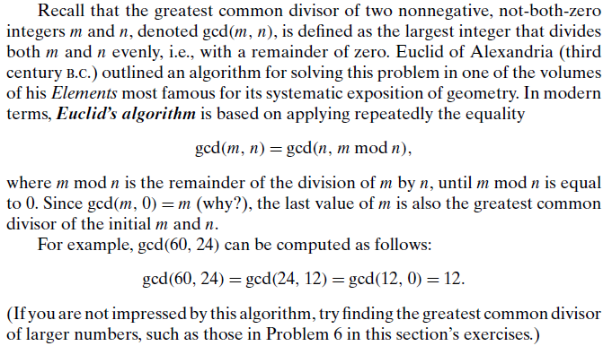
Euclid’s algorithm

Slide 8
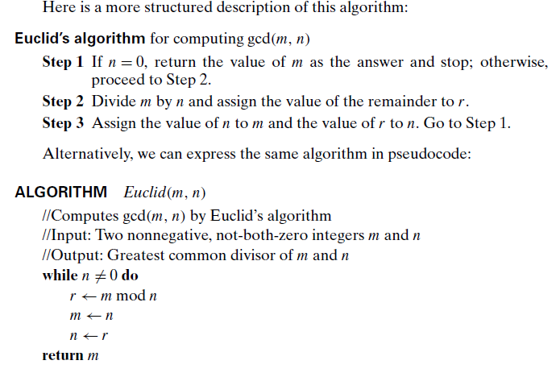
Euclid’s algorithm cont…

Slide 9
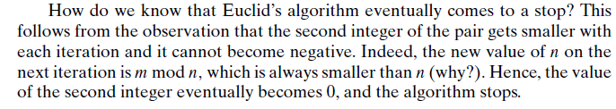
Euclid’s algorithm cont…

Slide 10
Consecutive integer checking algorithm
This is simply based on the definition of the greatest common divisor of m and n as the largest integer that divides both numbers evenly

Slide 11
Consecutive integer checking algorithm cont…
Such a common divisor cannot be greater than the smaller of these numbers, which we will denote by t = min{m, n}.
So we can start by checking whether t divides both m and n: if it does, t is the answer; if it does not, we simply decrease t by 1 and try again.
(How do we know that the process will eventually stop?)
For example, for numbers 60 and 24, the algorithm will try first 24, then 23, and so on, until it reaches 12, where it stops.

Slide 12
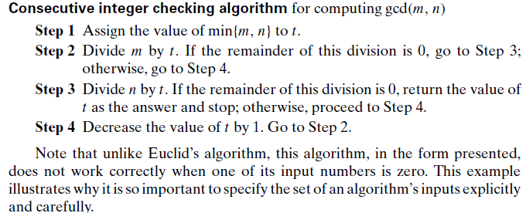
Consecutive integer checking algorithm cont…

Slide 13
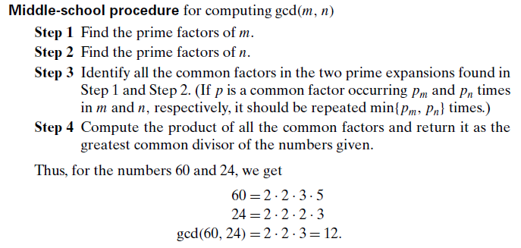
Middle-school procedure

Slide 14
Middle-school procedure cont…
Note that the middle-school procedure is
much more complex than Euclid’s algorithm.
Much slower than Euclid’s algorithm.
inferior efficiency,
does not qualify, in form as a legitimate algorithm.

Slide 15
Middle-school procedure cont…
Why? Because the prime factorization steps are not defined unambiguously:
require a list of prime numbers,
how to obtain such a list can not be explained.
Unless this issue is resolved, we cannot, write a program implementing this procedure.
Incidentally, Step 3 is also not defined clearly enough. Its ambiguity is much easier to rectify than that of the factorization steps,

Slide 16
sieve of Eratosthenes
This is a simple algorithm for generating consecutive primes not exceeding any given integer n > 1.
The algorithm starts by initializing a list of prime candidates with consecutive integers from 2 to n.
Then, on its first iteration, the algorithm eliminates from the list all multiples of 2, i.e., 4, 6, and so on.
Then it moves to the next item on the list, which is 3, and eliminates its multiples.
The next remaining number on the list, which is used on the third pass, is 5.
The algorithm continues in this fashion until no more numbers can be eliminated from the list.
The remaining integers of the list are the primes needed.

Slide 17
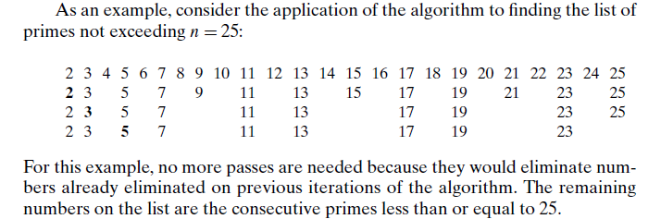
sieve of Eratosthenes cont…

Slide 18
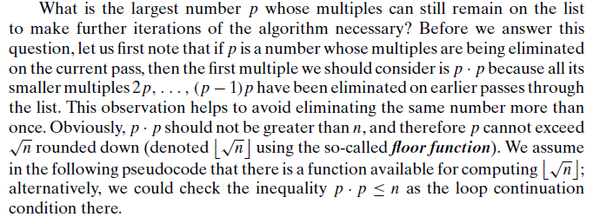
sieve of Eratosthenes cont…

Slide 19
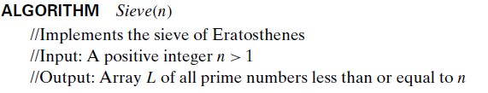
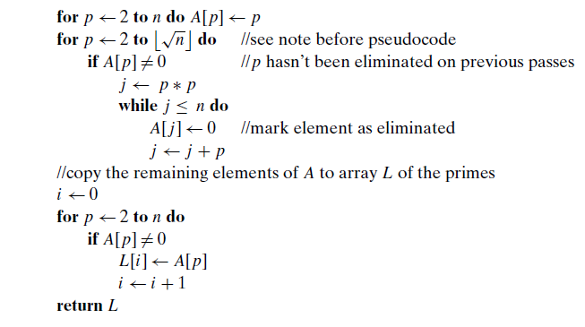
sieve of Eratosthenes cont…

Slide 20
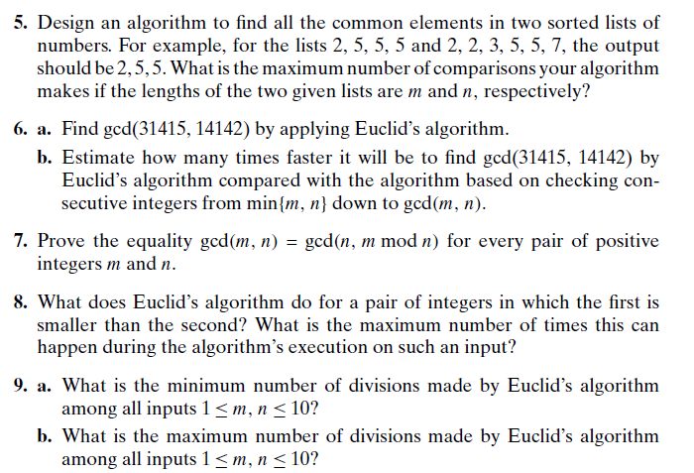
Exercise

Slide 21
Fundamentals of Algorithmic Problem Solving
We can consider algorithms to be procedural solutions to problems.
These solutions are not answers but specific instructions for getting answers.
It is this emphasis on precisely defined constructive procedures that makes computer science distinct from other disciplines

Slide 22
Fundamentals of Algorithmic Problem Solving cont…
A sequence of steps one typically goes through in designing and analyzing an algorithm are:
Understanding the Problem
Ascertaining the Capabilities of the Computational Device
Choosing between Exact and Approximate Problem Solving
Algorithm Design Techniques
Designing an Algorithm and Data Structures
Methods of Specifying an Algorithm
Proving an Algorithm’s Correctness
Analyzing an Algorithm
Coding an Algorithm

Slide 23
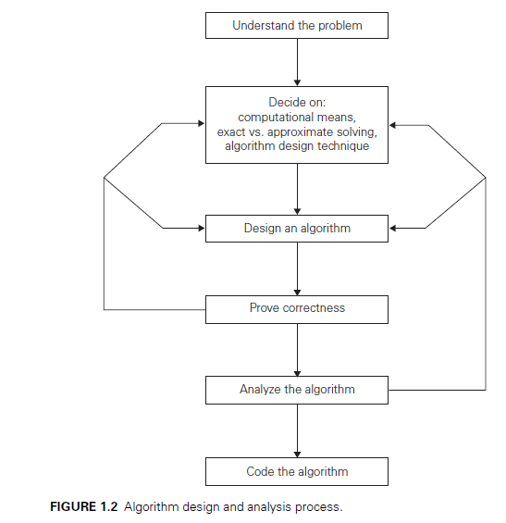
Fundamentals of Algorithmic Problem Solving cont…

Slide 24
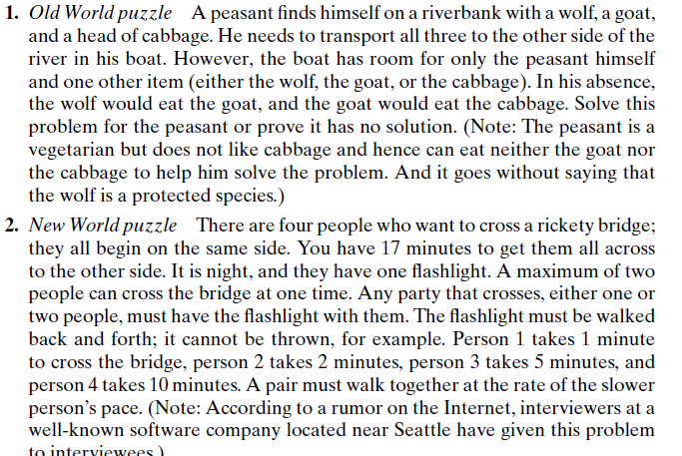
quiz

Slide 25
Important Problem Types
The most important problem types:
Sorting
Searching
String processing
Graph problems
Combinatorial problems
Geometric problems
Numerical problems

Slide 26
Multiplication
Lattice Multiplication-The most familiar method for multiplying large numbers, the lattice algorithm.
Duplation and Mediation (Russian peasant multiplication, Ethiopian peasant multiplication, or just peasant multiplication)
Compass and Straightedge

Slide 27
Lattice Multiplication
The most familiar method for multiplying large numbers, is the lattice algorithm.
This algorithm was popularized by Fibonacci and al-Khw¯arizm¯ı,
The lattice algorithm assumes that the input numbers are represented as explicit strings of digits;
Multiply one factor (the “multiplicand”) by each digit in the other factor (the “multiplier”), writing down all the multiplicand-by-digit products before adding them up

Slide 28
Compass and Straightedge
Using only compass and straightedge, reduced several complex
geometric constructions to the following primitive operations, starting with one or more identified reference points.
Draw the unique line passing through two distinct identified points.
Draw the unique circle centered at one identified point and passing through another.
Identify the intersection point (if any) of two lines.
Identify the intersection points (if any) of a line and a circle.
Identify the intersection points (if any) of two circles.

Slide 29
Duplation and Mediation
This older simpler algorithm, which does not rely on place-value notation, is sometimes called Russian peasant multiplication, Ethiopian peasant multiplication, or just peasant multiplication
The peasant multiplication algorithm reduces the difficult task of multiplying arbitrary numbers to a sequence of four simpler operations:
(1) determining parity (even or odd),
(2) addition,
(3) duplation (doubling a number), and
(4) mediation (halving a number, rounding down).

Slide 30
Describing Algorithms
The skills required to effectively design and analyze algorithms are entangled the skills required to effectively describe algorithms.
A complete description of any algorithm has four components:
What: A precise specification of the problem that the algorithm solves.
How: A precise description of the algorithm itself.
Why: A proof that the algorithm solves the problem it is supposed to solve.
How fast: An analysis of the running time of the algorithm

Slide 31
Describing Algorithms cont…
As with any writing, it’s important to aim your descriptions at the right audience
Even if you never have to explain your algorithms to anyone else, it’s still important to develop them with an audience in mind.
Trying to communicate clearly forces you to think more clearly.
Your primary job as an algorithm designer is teaching other people how and why your algorithms work.

Slide 32
Analyzing Algorithms
It’s not enough just to write down an algorithm and say “Behold!” We must also convince our audience (and ourselves!) that the algorithm actually does what it’s supposed to do, and that it does so:
Efficiency (time and space)
Correctness
Running Time
Simplicity
Generality

Slide 33
Coding an Algorithm
Most algorithms are destined to be ultimately implemented as computer programs.
Programming an algorithm presents both a
peril and
an opportunity.
The peril lies in the possibility of making the transition from an algorithm to a program either incorrectly or very inefficiently.

Slide 34
Fundamental Data Structures
Since the vast majority of algorithms of interest operate on data, particular ways of organizing data play a critical role in the design and analysis of algorithms.
A data structure can be defined as a particular scheme of organizing related data items.
The nature of the data items is dictated by the problem at hand; they can range from elementary data types (e.g., integers or characters) to data structures (e.g., a one-dimensional array of one-dimensional arrays is often used for implementing matrices).

Slide 35
Fundamental Data Structures cont…
Review of data structure are:
Linear Data Structures (the array and the linked list)
Graphs
Trees
Sets and Dictionaries

