Slide 1
MSDM 6980 report
Week 1 (2.24)

Slide 2
Establish the framework
https://github.com/Kim-Q/gambling
strategy.py
recorder.py
main.py

Slide 3
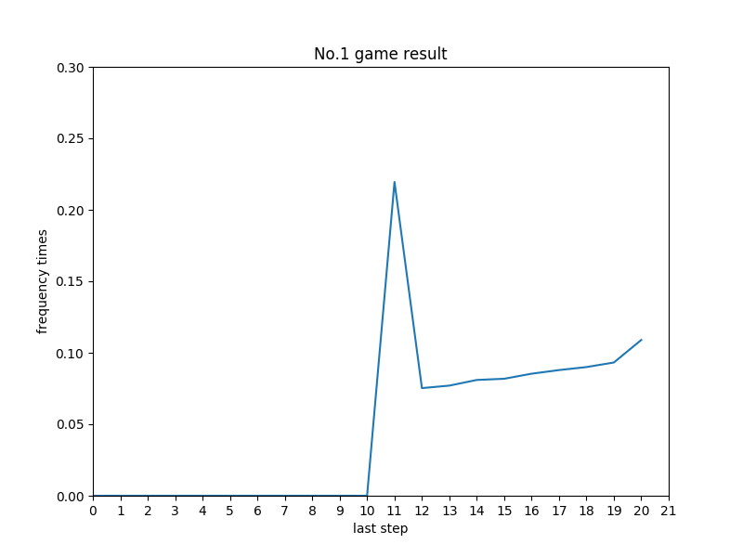
Strategy.py
Store the different kinds of strategies of Blackjack
This week I realize a simple one to statistic the point has the highest win rate and the result shows that it is 11.

Slide 4
Recorder.py
class Recorder
class Manager

Slide 5
Next step
Do more strategies on the Blackjack and observe the results.
Add the details to the game, like A’value, multiple players and special rules.
探究赌场为什么总是赢，研发系统究竟有什么作用？？？？
玩多少局或者赌金为多少可以把庄家整垮

