Slide 1
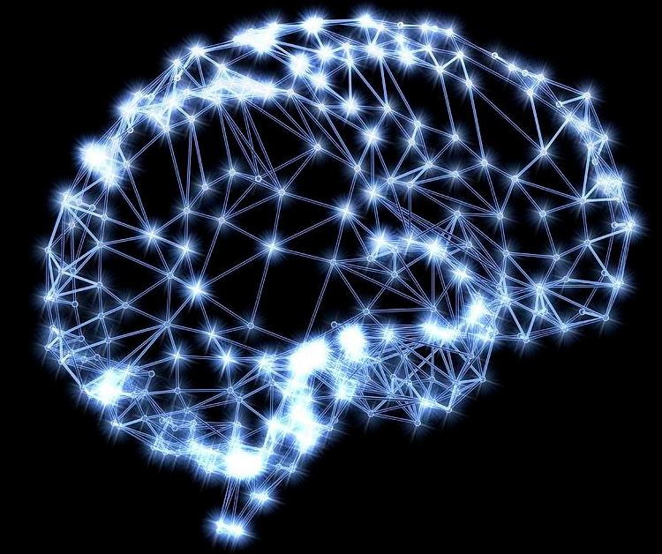
Word Window classification and Neural Networks
2017-03-24
조수현

Slide 2
Contents
Extrinsic task
Softmax classification and regularization
Window classification
Neural networks

Slide 3


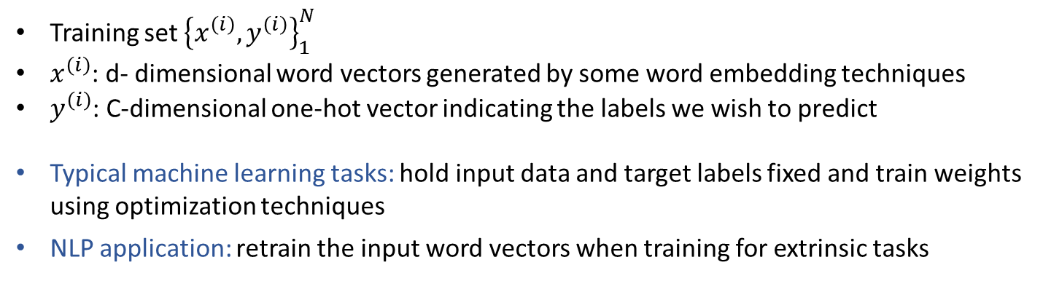
Extrinsic task
Extrinsic task: Using the resulting word vectors for some other extrinsic task
Extrinsic evaluation: evaluation of a set of word vectors generated by an embedding technique on the real task at hand
Most NLP extrinsic tasks can be formulated as classification tasks
Ex 1) “We will keep out happiness to ourselves”
Ex 2) Named entity recognition
“Jim bought 300 shares of Acme Corp. in 2006”
“Jim bought 300 shares of Acme Corp. in 2006”
Name
Organization
Time
Training set ${\left\{x^{\left(i\right)},y^{\left(i\right)}\right\}}_{1}^{N}$
$x^{\left(i\right)}$: d- dimensional word vectors generated by some word embedding techniques
$y^{\left(i\right)}$: C-dimensional one-hot vector indicating the labels we wish to predict
Typical machine learning tasks: hold input data and target labels fixed and train weights using optimization techniques
NLP application: retrain the input word vectors when training for extrinsic tasks

Slide 4
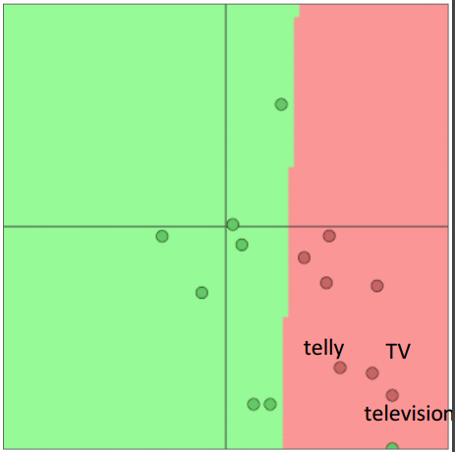
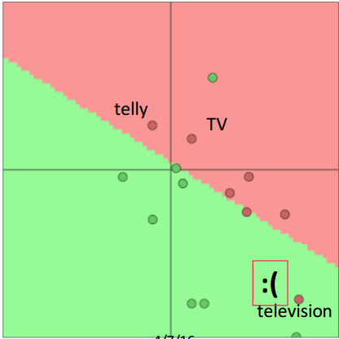
Retraining word vectors
Pre trained
word vectors
Optimize word vectors
Classification
Intrinsic task
Extrinsic task
Pre trained word vectors could be retrained using extrinsic task
to perform better

Slide 5
Retraining word vectors
Pre trained
word vectors
Optimize word vectors
Classification
Intrinsic task
Extrinsic task
Pre trained word vectors could be retrained using extrinsic task
to perform better
Word vectors should not be retrained
if the training data set is small
It may work better to train word vectors to the task if you have a very large dataset

Slide 6
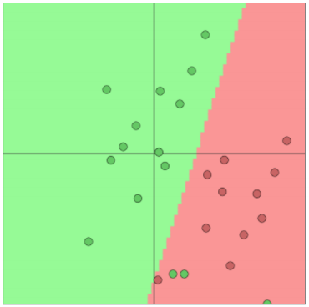

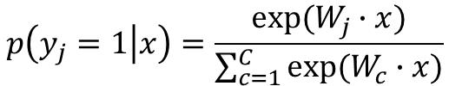
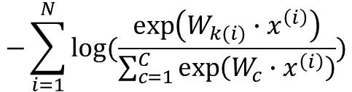



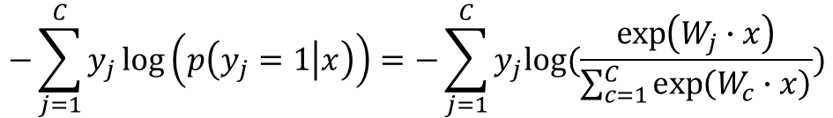

Softmax classification and regularization
Softmax classification
$$p\left(y_{j}=1 | x\right)=\frac{exp⁡(W_{j}∙x)}{\sum_{c=1}^{C}{exp⁡(W_{c}∙x)}}$$
$$x:word vector$$
$$W:weight$$
$$C:class$$
Cross-entropy loss function
$$−\sum_{j=1}^{C}{y_{j}\log\left(p\left(y_{j}=1 | x\right)\right)=−\sum_{j=1}^{C}{y_{j}log⁡(\frac{\exp\left(W_{j}∙x\right)}{\sum_{c=1}^{C}{\exp\left(W_{c}∙x\right)}})}}$$
Simplified version
$−log⁡(\frac{exp⁡(W_{k}∙x)}{\sum_{c=1}^{C}{exp⁡(W_{c}∙x)}}$)
$$k:index of the correct class$$
Loss to a dataset of N points
$$−\sum_{i=1}^{N}{log⁡(\frac{\exp\left(W_{k(i)}∙x^{\left(i\right)}\right)}{\sum_{c=1}^{C}{\exp\left(W_{c}∙x^{\left(i\right)}\right)}})}$$

Slide 7
Softmax classification and regularization
Why do we use cross entropy error? Instead of MSE and classification error
Most basic one
Easy to understand
Speed up training when there are many classes
Squared error doesn’t work well in neural network empirically
…

Slide 8
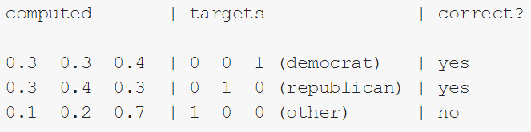
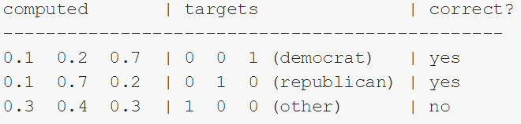
Softmax classification and regularization
Why do we use cross entropy error? Instead of MSE and classification error
Model 1
Classification error = 1/3= 0.33
Model 2
Classification error = 1/3= 0.33
https://jamesmccaffrey.wordpress.com/2013/11/05/why-you-should-use-cross-entropy-error-instead-of-classification-error-or-mean-squared-error-for-neural-network-classifier-training/

Slide 9
Softmax classification and regularization
Why do we use cross entropy error? Instead of MSE and classification error
Model 1
-(ln(0.3)*0+ln(0.3)*0+ln(0.4)*1)=-ln(0.4)
(0.3-0)^2+ (0.3-0)^2+(0.4-1)^2 =0.09+0.09+0.36=0.54
Cross entropy: -(ln(0.4)+ln(0.4)+ln(0.1))/3=1.38
MSE: (0.54+0.54+1.34)/3=0.81
Model 2
Cross entropy: -(ln(0.7)+ln(0.7)+ln(0.3))/3=0.64
MSE: (0.14+0.14+0.74)/3=0.34

Slide 10
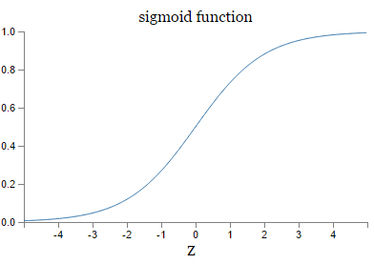
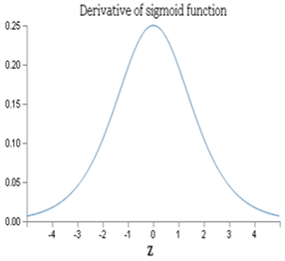







Softmax classification and regularization
Why do we use cross entropy error? Instead of MSE and classification error
MSE VS Cross entropy
$$bias b$$
$$z=wx+b$$
$$weight w$$
$$a=σ(z)$$
Cost function
$$C=\frac{{\left(y−a\right)}^{2}}{2}$$
$$\frac{∂C}{∂w}=\left(a−y\right)σ^{′}\left(z\right)x=aσ^{′}\left(z\right)$$
$$\frac{∂C}{∂b}=\left(a−y\right)σ^{′}\left(z\right)=aσ^{′}\left(z\right)$$
http://laonple.blog.me/220548474619

Slide 11
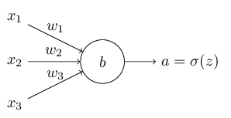



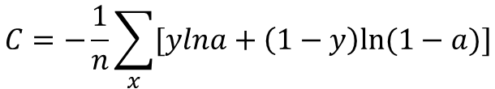

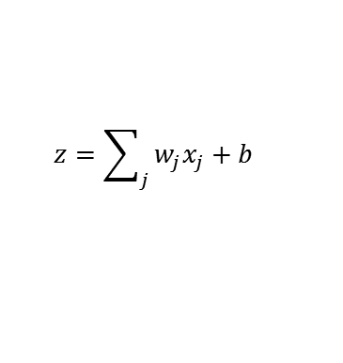

Softmax classification and regularization
Why do we use cross entropy error? Instead of MSE and classification error
MSE VS Cross entropy
$$z=\sum_{j}{w_{j}x_{j}}+b$$
$$σ\left(z\right)=\frac{1}{1+e^{−z}}$$
$$a=σ(z)$$
$$σ^{′}\left(z\right)=σ(z)(1−σ\left(z\right))$$
$$C=−\frac{1}{n}\sum_{x}{[ylna+\left(1−y\right)ln⁡(1−a)]}$$
Cost function
$$\frac{∂C}{∂w_{j}}=−\frac{1}{n}\sum_{x}{\left(\frac{y}{σ\left(z\right)}−\frac{\left(1−y\right)}{1−σ\left(z\right)}\right)\frac{∂σ}{∂w_{j}}}=−\frac{1}{n}\sum_{x}{\left(\frac{y}{σ\left(z\right)}−\frac{\left(1−y\right)}{1−σ\left(z\right)}\right)σ^{′}\left(z\right)x_{j}}$$
$$=\frac{1}{n}\sum_{x}{\frac{\left(σ\left(z\right)−y\right)}{σ(z)(1−σ(z)}σ^{′}\left(z\right)x_{j}=\frac{1}{n}\sum_{x}{\left(σ\left(z\right)−y\right)x_{j}}}$$
$$\frac{∂C}{∂b}=\frac{1}{n}\sum_{x}{\left(σ\left(z\right)−y\right)}$$

Slide 12
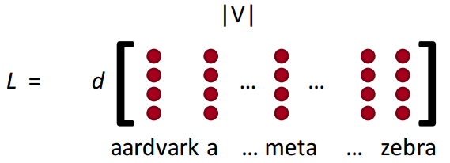
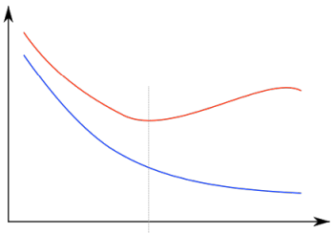
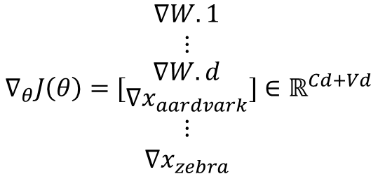
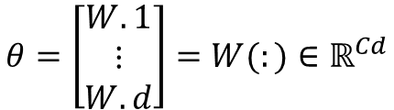
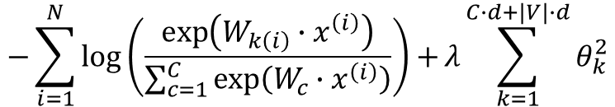
Softmax classification and regularization
Parameters
Weight update
$$θ=\left[\begin{matrix}W.1 \\ ⋮ \\ W.d\end{matrix}\right]=W(:)∈ℝ^{Cd}$$
Weight update + update word vectors for every word in the vocabulary V
$$∇_{θ}J\left(θ\right)=[\begin{matrix}∇W.1 \\ ⋮ \\ \begin{matrix}∇W.d \\ \begin{matrix}∇x_{aardvark} \\ ⋮ \\ ∇x_{zebra}\end{matrix}\end{matrix}\end{matrix}]∈ℝ^{Cd+Vd}$$
A large number of parameters
Overfitting
Regularization
error
Ts
$$−\sum_{i=1}^{N}{\log\left(\frac{\exp\left(W_{k\left(i\right)}∙x^{\left(i\right)}\right)}{\sum_{c=1}^{C}{\exp\left(W_{c}∙x^{\left(i\right)}\right)}}\right)+}λ\sum_{k=1}^{C∙d+|V|∙d}{θ_{k}^{2}}$$
Tr
Power or iteration

Slide 13
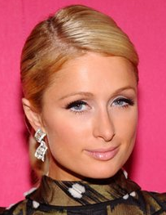
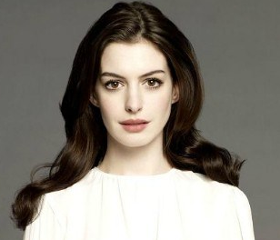


Window classification
Backgrounds
Classifying single words is rare
Ambiguity of words
Example: auto-antonyms
“permit”
“sanction”
Same words for different meaning
“punish”
Example: ambiguous named entities
“Paris”
“Hathaway”
Context of the word is needed to discriminate between meanings

Slide 14
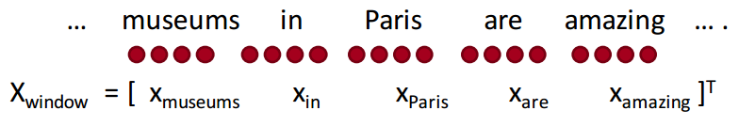
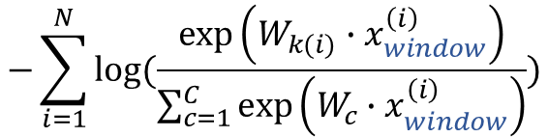
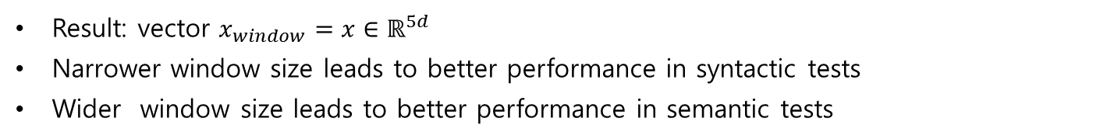
Window classification
Idea
Classify a word in its context window of neighboring words
Train softmax classifier by assigning a label to a center word and concatenating all word vectors surrounding it
$$−\sum_{i=1}^{N}{log⁡(\frac{\exp\left(W_{k(i)}∙x_{window}^{\left(i\right)}\right)}{\sum_{c=1}^{C}{\exp\left(W_{c}∙x_{window}^{\left(i\right)}\right)}})}$$
Result: vector $x_{window}=x∈ℝ^{5d}$
Narrower window size leads to better performance in syntactic tests
Wider window size leads to better performance in semantic tests

Slide 15
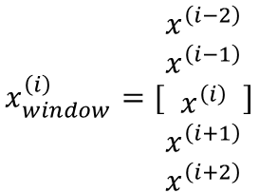

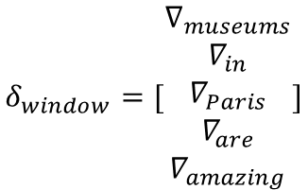
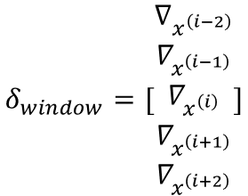
Window classification
Updating concatenated word vectors
The gradient that updates the word vectors can simply be split up for each word vector
$∇_{x}J=W^{T}δ=δ_{x_{window}}$
$$x_{window}^{\left(i\right)}=[\begin{matrix}x^{\left(i−2\right)} \\ \begin{matrix}x^{\left(i−1\right)} \\ x^{\left(i\right)} \\ \begin{matrix}x^{\left(i+1\right)} \\ x^{\left(i+2\right)}\end{matrix}\end{matrix}\end{matrix}]$$
$$δ_{window}=[\begin{matrix}∇_{x^{\left(i−2\right)}} \\ ∇_{x^{\left(i−1\right)}} \\ \begin{matrix}∇_{x^{\left(i\right)}} \\ ∇_{x^{\left(i+1\right)}} \\ ∇_{x^{\left(i+2\right)}}\end{matrix}\end{matrix}]$$
$$δ_{window}=[\begin{matrix}∇_{museums} \\ ∇_{in} \\ \begin{matrix}∇_{Paris} \\ ∇_{are} \\ ∇_{amazing}\end{matrix}\end{matrix}]$$
d-dim
W$∈ℝ^{5d×C}$
d-dim
W
This will push word vectors into areas such they will be helpful in determining named entities
d-dim
C-dim
d-dim
d-dim

Slide 16
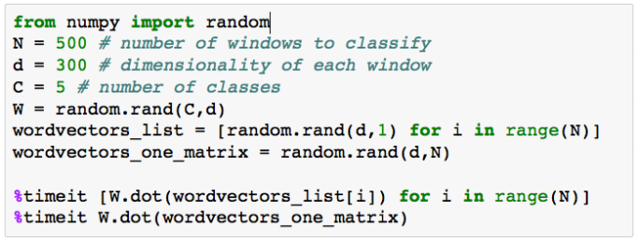
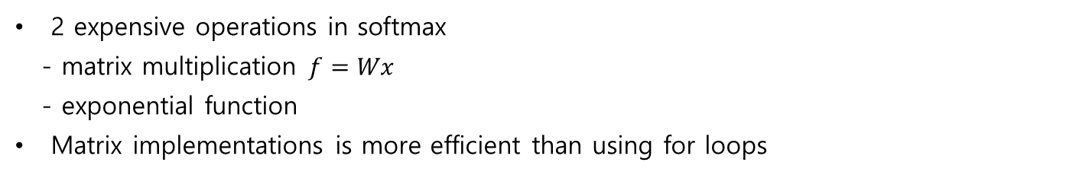
Window classification
Matrix implementations
2 expensive operations in softmax
- matrix multiplication $f=Wx$
- exponential function
Matrix implementations is more efficient than using for loops
Using for loop: 639 us
One large matrix: 53.85 us

Slide 17
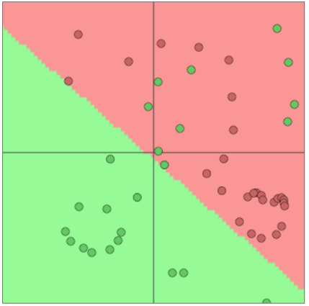
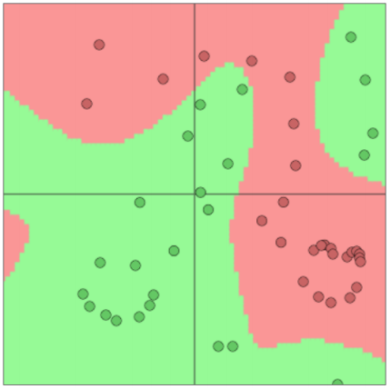
Non-linear classifiers
Need for non-linear classification models
Better classification is possible
when using neural networks

Slide 18
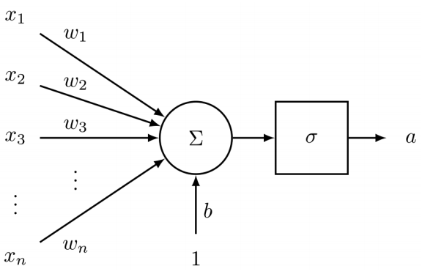
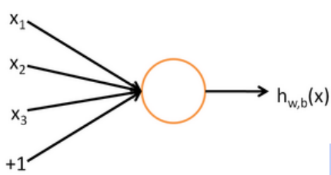
Neural networks
Neuron
Output
Activation function
Inputs
Sigmoid neuron
Computation unit
n inputs
Single output
Parameters(weights) differentiate the outputs of different neurons
Choices of neurons: sigmoid, binary classification….
Activation: weighted combination of features

Slide 19
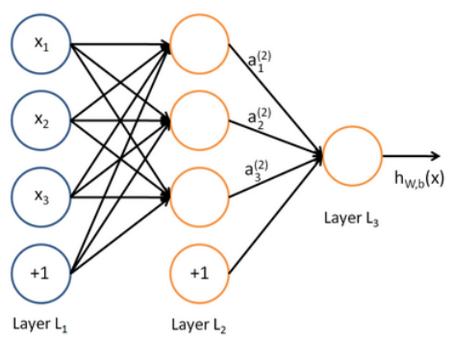




Neural networks
A Neural network
Most data are not linearly separable
Classification performance on them is limited
Same as running several logistic regressions at the same time
$$a_{1}=f(W_{11}x_{1}+W_{12}x_{2}+W_{13}x_{3}+b_{1})$$
$$a_{2}=f(W_{21}x_{1}+W_{22}x_{2}+W_{23}x_{3}+b_{2})$$
$$a_{3}=f(W_{31}x_{1}+W_{32}x_{2}+W_{33}x_{3}+b_{3})$$
$$a=f(z)$$
$$z=Wx+b$$
$$f\left(\left[z_{1},z_{2},z_{3}\right]\right)=[f\left(z_{1}\right),f\left(z_{2}\right),f\left(z_{3}\right)]$$
$$f\left(z\right)=\frac{1}{1+exp⁡(z)}$$

Slide 20
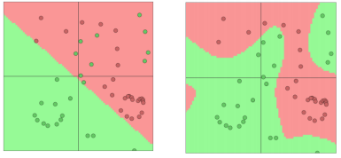
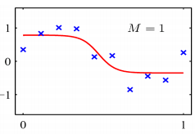
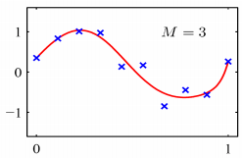
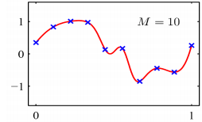

Neural networks
A Neural network
Most data are not linearly separable
Classification performance on them is limited
Same as running several logistic regressions at the same time
Build much mode complex decision boundaries with mode layers
Extra layers could be compiled down into a single linear transform
$$W_{1}W_{2}x=Wx$$
M: the number of hidden layers
Classification
Regression

Slide 21
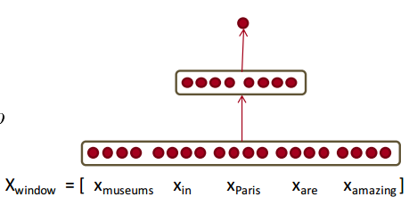







Neural networks
Feed forward computation
$$x_{window}=[x_{museums} x_{in} x_{Paris} x_{are} x_{amazing}]$$
s=score(museums in Paris are amazing)
$$s=U^{T}f(Wx+b)$$
$$x∈ℝ^{20×1}$$
$$s=U^{T}a$$
$$W∈ℝ^{8×20}$$
$$a=f(z)$$
$$U∈ℝ^{8×1}$$
$$z=Wx+b$$
8 hidden neurons
4 dimensional word vectors and 5 windows
If center word is at location, the score is very large

Slide 22
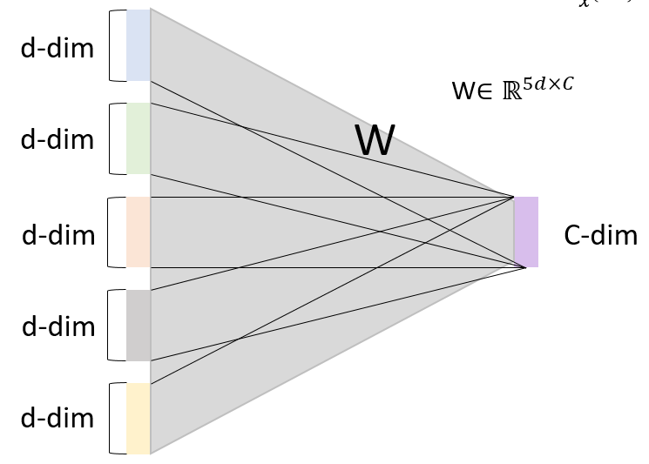






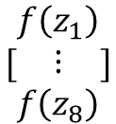







Neural networks
Feed forward computation
$$x_{window}=[x_{museums} x_{in} x_{Paris} x_{are} x_{amazing}]$$
$$s=U^{T}f(Wx+b)$$
$$s=U^{T}a$$
$$x∈ℝ^{20×1}$$
$$a=f(z)$$
$$z=Wx+b$$
$$W∈ℝ^{8×20}$$
$$U∈ℝ^{8×1}$$
x
W
b
z
$$×$$
$$+$$
$$=$$
(8*20)
(20*1)
(8*1)
(8*1)
$$[\begin{matrix}f\left(z_{1}\right) \\ ⋮ \\ f\left(z_{8}\right)\end{matrix}]$$
s
$$U^{T}$$
$$×$$
$$=$$
(1*8)
(8*1)

Slide 23


