Slide 1
Counterfactual simulations to evaluate glance behavior in combination with system/AD modelities
Jonas Bärgman
2020-02-17
1

Slide 2
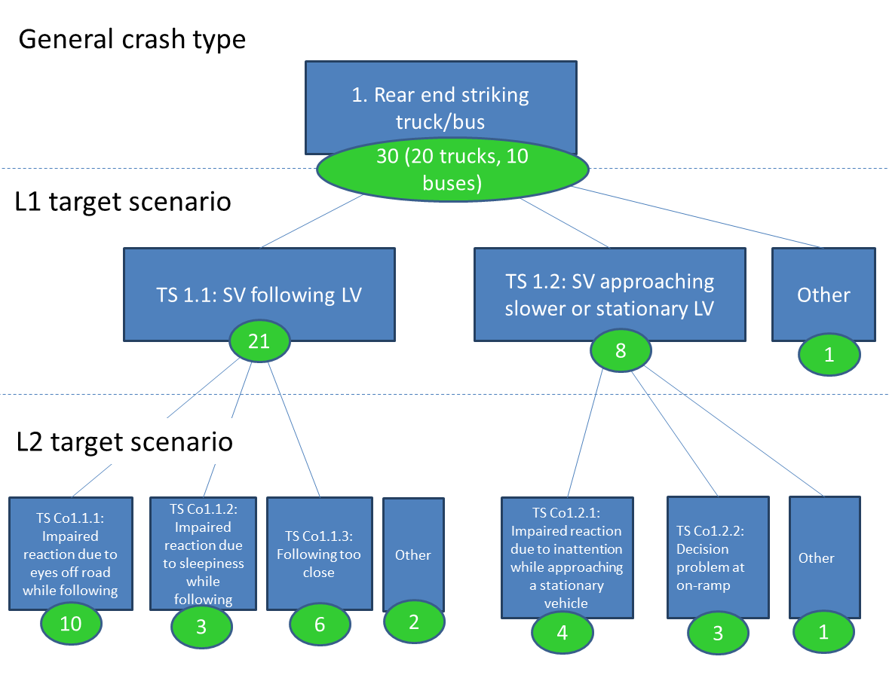
Break-down of crash driver-related crash causation mechanisms (in Chalmers+AB Volvo method project)
Following vehicle approaching slow or fixed lead vehicle | Frequency per year | % of crashes in L1 target scenario | % of crashes in general crash type (rear-end) | % of all truck crashes
 | 20234 | 100% | 63% | 5%
Following vehicle following lead vehicle | Frequency per year | % of crashes in L1 target scenario | % of crashes in general crash type (rear-end) | % of all truck crashes
 | 10829 | 100% | 34% | 2.5%
Woodoof et al. 2012: Database GES+TIFA
Notes:
Research gap:

Slide 3
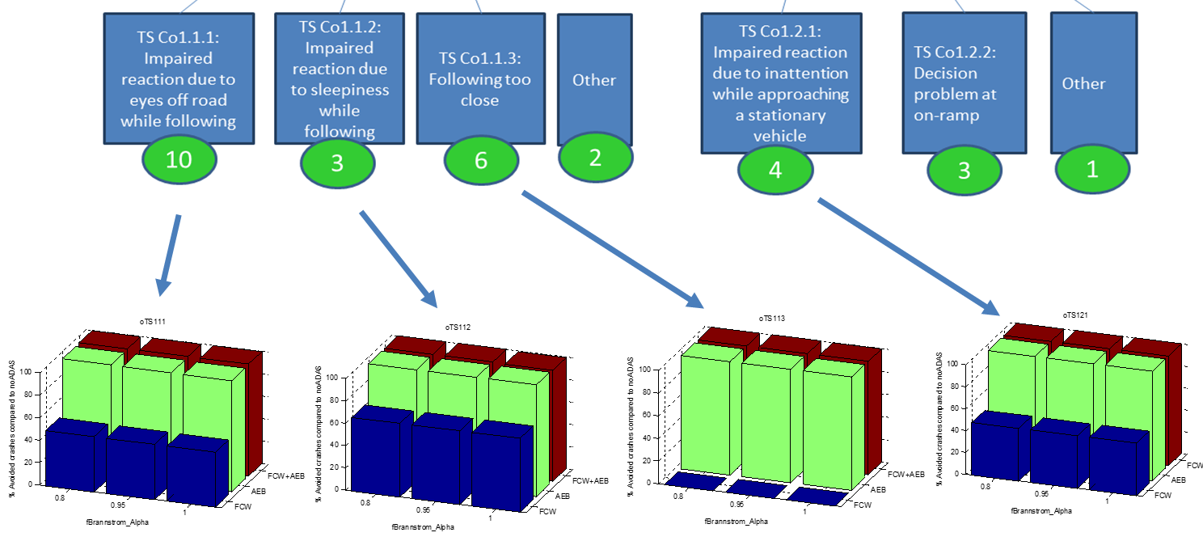
Different driver models for different scenarios/events – and weighting (method only)
Eyes-off-road model
Eyes always closed
Eyes always on-road
Eyes-off-road model
Notes:
Research gap:

Slide 4
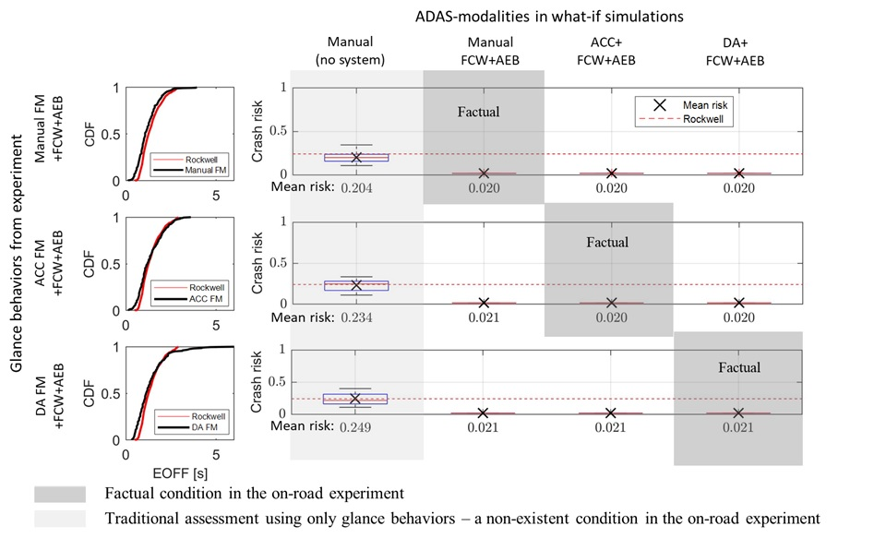
Evaluations of tasks + system modalities + individual drivers
34 crashes: 6800 simulations per cell!
➔ 81 600 simulations in total ➔ 600 days
Notes:
Research gap:

Slide 5
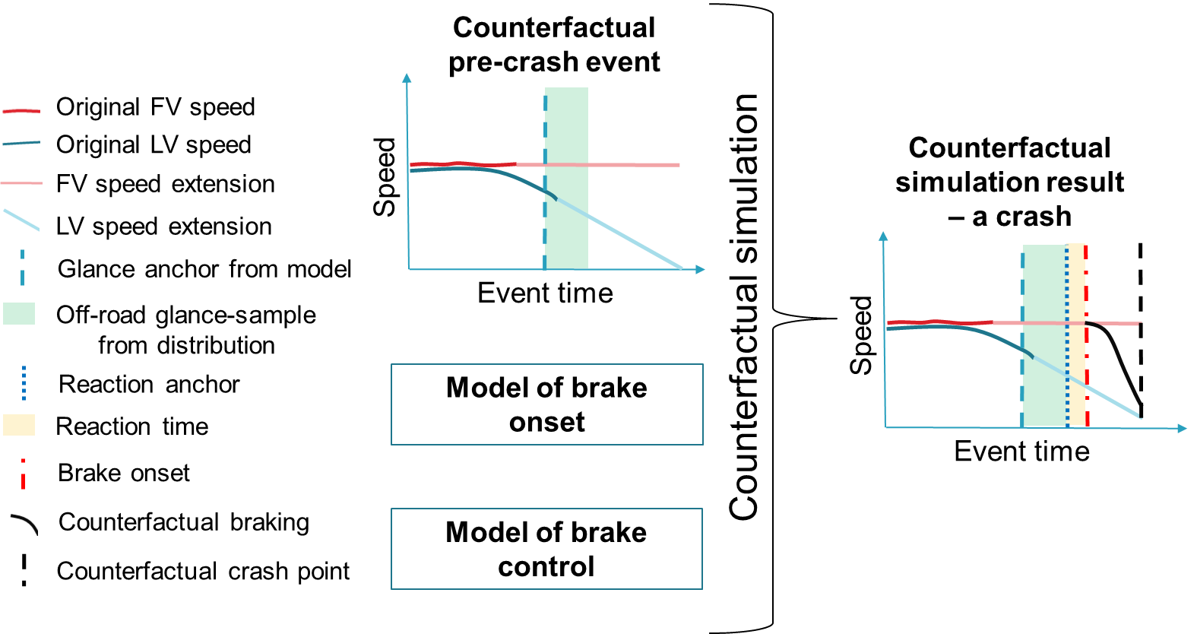
Counterfactual simulations with glances
Notes:
Research gap:

Slide 6
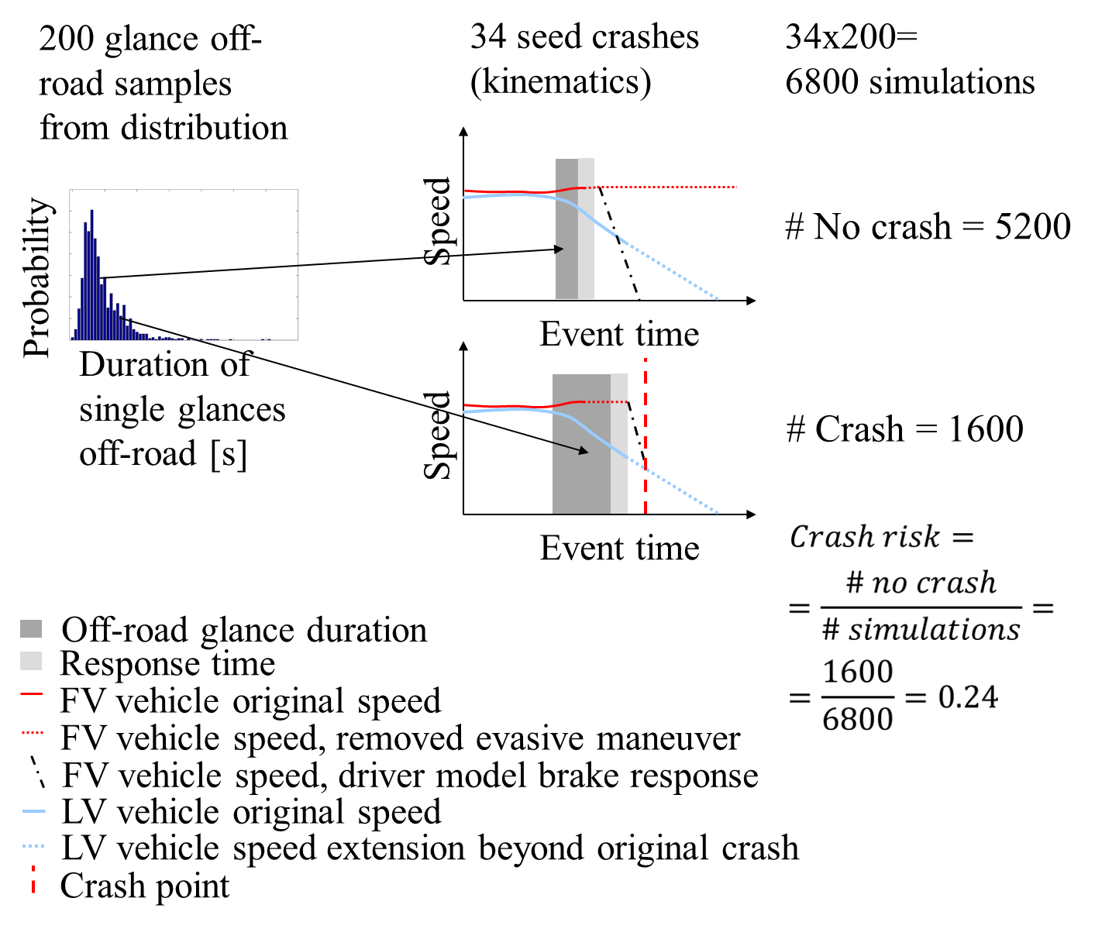
Number of simulations…
Keeping number of simulations down will be a major challenge:
If individual drivers to be studies ➔ more
If overshot distributions to be used ➔ fewer
Use of probability weighting ➔ fewer
If maximum decel to be sampled too ➔ more
1

Slide 7
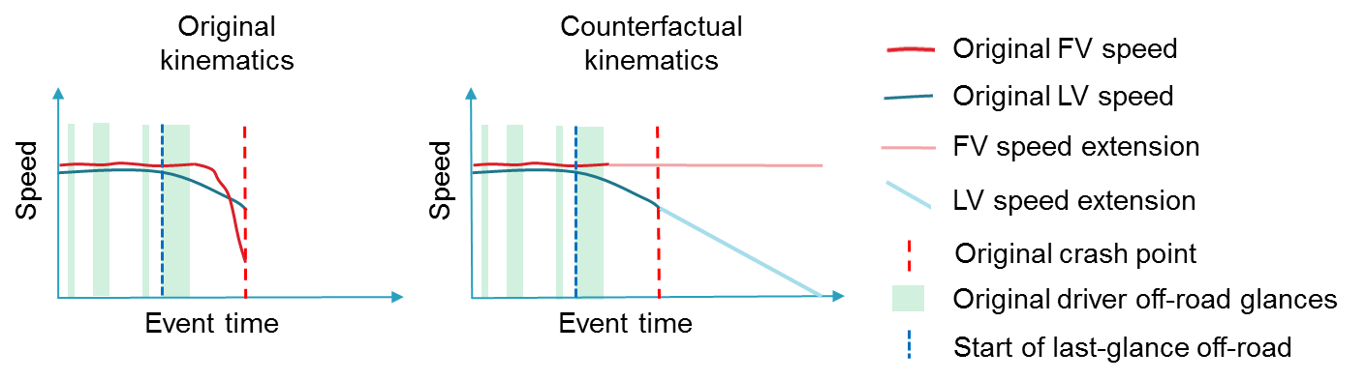
Removal of evasive maneuvers
The actual behavior in the original event is just “one instance” of a driver’s behavior. We need to trust the driver+glance models, or results cannot be interpreted (actual driver actions will interfere)
Why:
Validation:
See next slide…
Notes:
Research gap:

Slide 8
Validation of the driver+glance model?
Run MC simulations with models (driver response model + glance model) on batch events with evasive maneuvers removed, with the systems that were active in each specific crash in the batch.
Compare impact speeds for each type of crash (or the whole set) – the individual crashes will not be identical as each of the original batches are assumed to be one instance of the MC simulation, but on a larger sample, they should have a similar impact speed profile, on average.
“Easily” done – one of the first things that should be done when implementation in place.
1

Slide 9
Questions to ask that influence overall setup (not directly related to actual glance implementation)
Evaluation of individual drivers behaviors?
Create batches with individual drivers glance behaviors.
May impact setup of glance sampling and driver model
➔
Need glance behavior: EOFF, %EON, total task time (TTT)
Batches per task/HMI, possibly in combination with system modality + individual drivers
Evaluation of tasks and/or HMIs?
➔
Evaluation of different system modalities?
Batches per system modality, possibly in combination with HMI + individual drivers
Only modalities without driver intervention?➔ alt drv model
➔
What driver model is/should be used?
Driver model choice influence which glance sampling method
Should different crash causation mechanism be addressed? Consider splitting batches on mechanism + different models
➔
Notes:
Research gap:

Slide 10
The generative eyes-off-road (EOFF) model
1

Slide 11
Some basics
Notes:
Research gap:

Slide 12
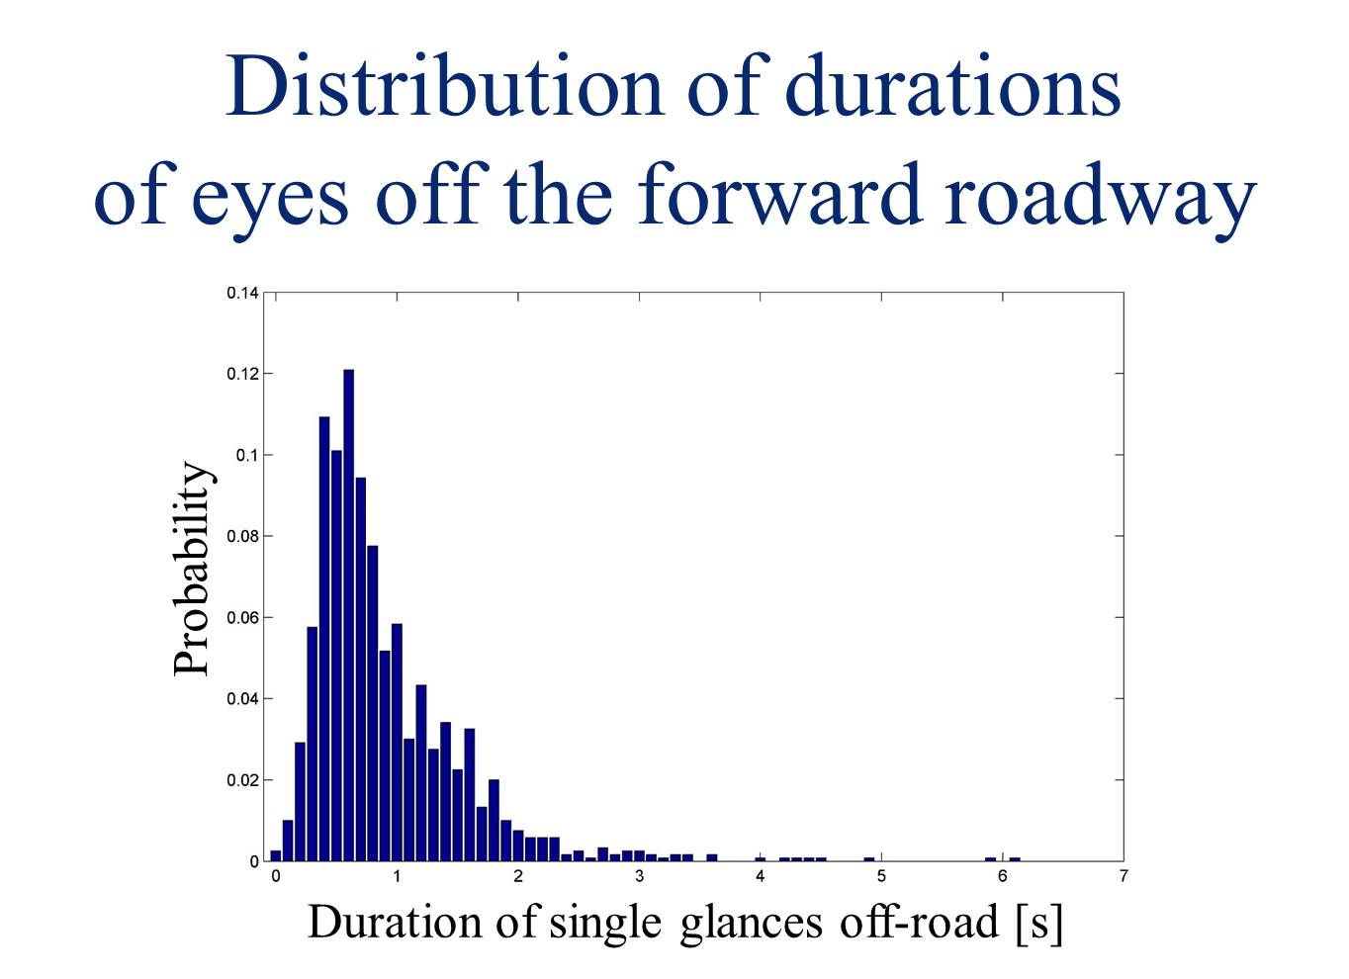
SHPR2 off-road glance durations: 1157 glances from baseline epochs (30s long)
20% of the time drivers look off-road
Example:
Time
Notes:
Research gap:

Slide 13
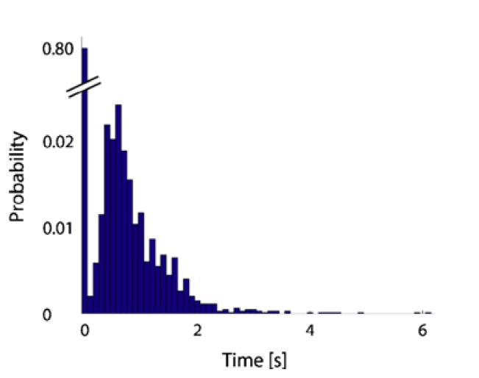
Point mass (80% eyes-on-road for everyday driving)
Notes:
Research gap:

Slide 14
SHPR2 off-road glance durations: Cumulative distribution (without point mass)
Notes:
Research gap:

Slide 15
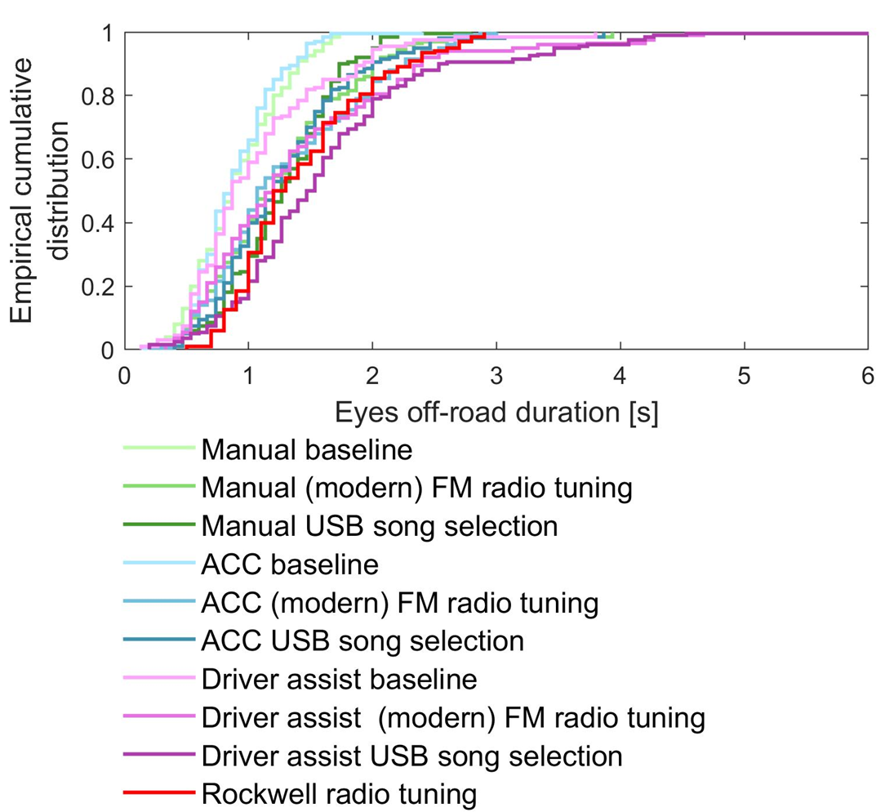
Off-road glance distributions from “Kungälv experiment”: system+task combinations
Notes:
Research gap:

Slide 16
Probability weighting used in Monte Carlo sampling?
0.5
Run one simulation per bin (here, 3)
Weight based on probability
Example:
2 cases simulated for each bin
1s➔ no crash
2s➔ one crash, one no crash
3s➔ both crashes
➔
Weighting
00000 00000 1111 0000 1 1 ➔
crash probability: 6/20
0.4
Probability
0.1
1
2
3
EOFF duration [s]
Notes:
Research gap:

Slide 17
Now specifics…
Notes:
Research gap:

Slide 18
What is the glance anchor point?
Examples:
Time
When we add glances to the data, where do we put it?
Depends… assumptions:
A lead vehicle has the same probability to brake at all times (we ignore other possible cues).
When a situation is critical “enough” drivers will not look away again (unless escape glance)
➔ What may be a good candidate?
Notes:
Research gap:

Slide 19
How to define the anchoring point?
Notes:
Research gap:

Slide 20
Alternative 1: Random
These glances actually what matters
Invtau
Say we choose a point, early in the event, and just place the glances on top 1) the glances may not reach the critical event. 2) we would need to do a lot of sampling to get long glances to overlap the critical event.
Notes:
Research gap:

Slide 21
Alternative 2: Use Invtau 0.2 – based on literature
After invtau=0.2 drivers typically do not look away again
After invtau=0.2, drivers typically react to the threat as soon as possible (prior to it, more random brakings, based on other cues?)
Notes:
Research gap:

Slide 22
How to sample the data?
Notes:
Research gap:

Slide 23
Alternative 1: Completely random (seen before)
If we have a full sequence and just place the it on the original data – all good! Or?
In baseline 80% of the time look on road, and depending on simulation and closeness to next glance we need to run every single sample! Not efficient.
Also, we need to sample very many times to capture all glances, including very short ones, which are the most dangerous ones! (may have a probability of 0.000001)
Notes:
Research gap:

Slide 24
Alternative 2: Use glance distributions
Sample, then randomly choose a point in that glance.
Example: 2.1s, glance anchor at rand(2.1) ➔ 0.9 ➔ overshot = 2.1-0.9=1.2s
0.9s,
1.2s,
2.1s,
When using distribution and MC sampling you need to sample ones from the original EOFF distribution and sample within the chosen glance (if MC sampling, number of samples needed will depend on duration of the EOFF: compare EOFF 0.2 s and EOFF 5.3s). Using probability weighing reduce number of simulations. In summary: Sampling from two independent distributions needed ➔ increase # sims.
Notes:
Research gap:

Slide 25
Alternative 3: Use of overshot distributions (details in next slides)
Main assumption/limitation
Can/should only be done if information about on/off road glances before the anchor point does not matter, as with the overshot, we do not know what is before. Make sure that is the case before using it
Main benefit:
We only need to sample from one glance distribution ➔ reduce # sims needed much ➔ if/when we can use it, we should.
Notes:
Research gap:

Slide 26
Alternative 4: Other?
Depending on model, it may be other anchors
For example: looming detection threshold.
Notes:
Research gap:

Slide 27
Overshot distribution, what is it..
Notes:
Research gap:

Slide 28
Simple example EOFF distribution
0.33
Probability
1
2
3
EOFF duration [s]
Equal probability of occuring ➔
Eyes off-road glances (EOFF)
Time
Notes:
Research gap:

Slide 29
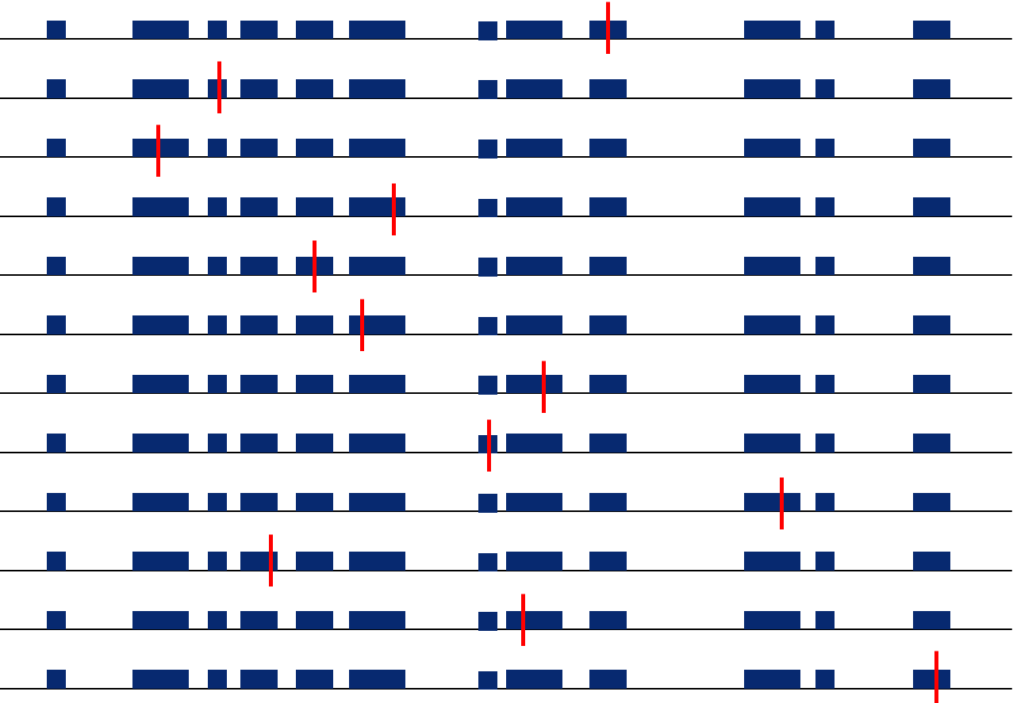
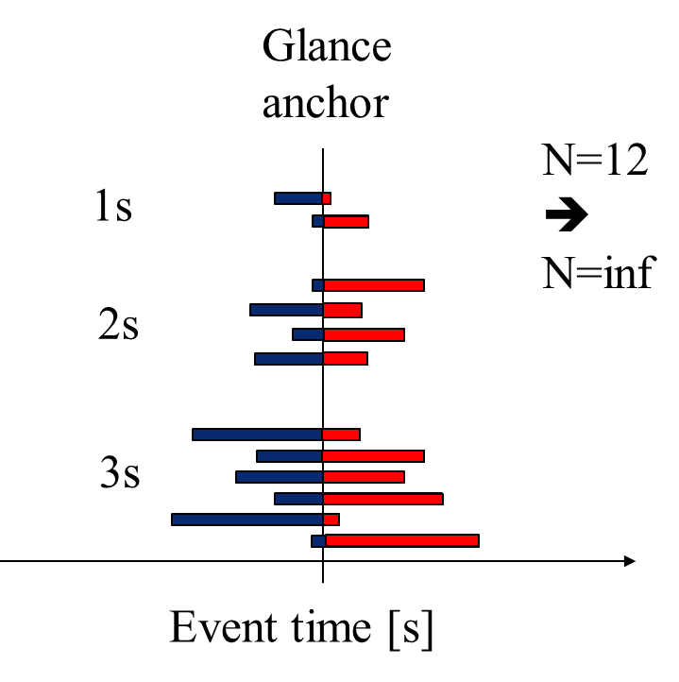
Size bias in sampling – “throw a dart”
Higher probability of ”hitting” a longer glance.
Note: Discarded ”throws” that did not hit an EOFF glance
Extra info (not needed):To correct for size bias, scale by the duration and normalize with the average EOFF (µ) ➔
$$\frac{x}{µ}$$
Notes:
Research gap:

Slide 30
Overshoot distribution
(Glance)
Anchor
Example N=12
➔
N=inf
P₁
P₂
P₃
1s
0.33
Probability
2s
1
2
3
3s
EOFF duration [s]
In this example: P₁=P₂=P₃=1/3
Event time [s]
Assuming an ”event” can occur at any time, with equal probability
Notes:
Research gap:

Slide 31
Overshot through statistical transformation or empirically brute force (for loops…)
Original EOFF
Overhot
Some hairy statistics…
Wrong!!
Notes:
Research gap:

Slide 32
Eccentricity in the models
Add angle between where the driver is looking and the “target
Notes:
Research gap:

Slide 33
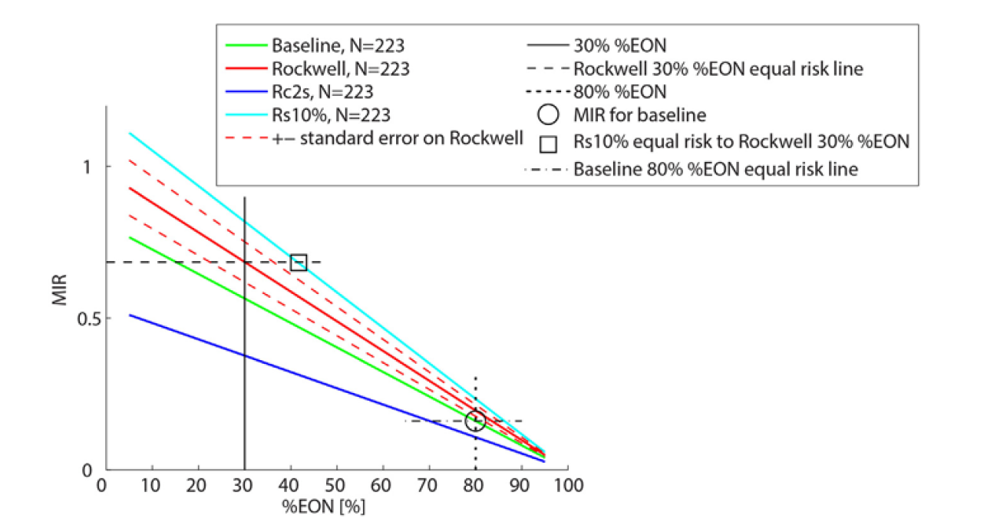
Comparing risk between tasks – the influence of percent eyes on road
Notes:
Research gap:

Slide 34
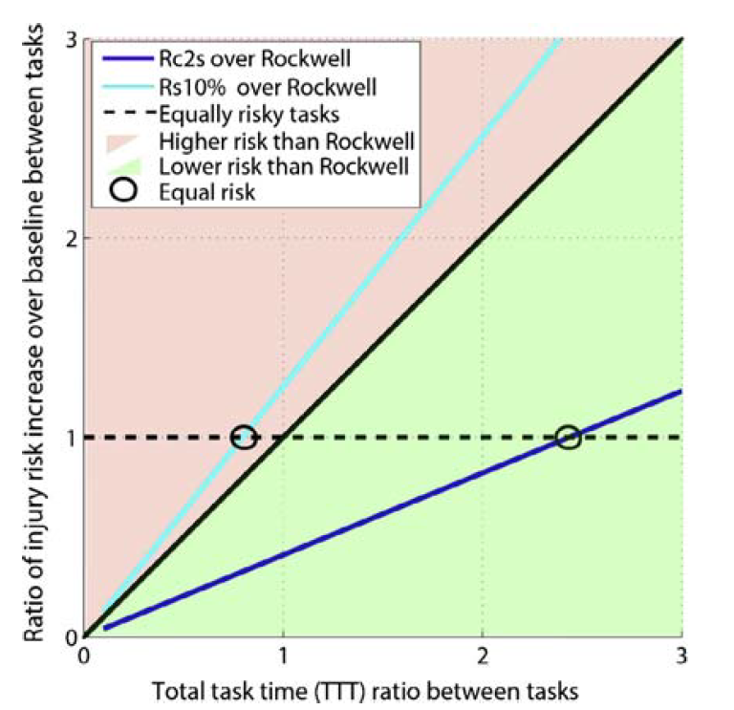
Comparing risk between tasks – the influence of total task time (ratio between tasks)
Notes:
Research gap:

Slide 35
The End (slides after this are just extra and on no particular order – looking at them will likely just confuse, but I keep them anyway)
Notes:
Research gap:

Slide 36
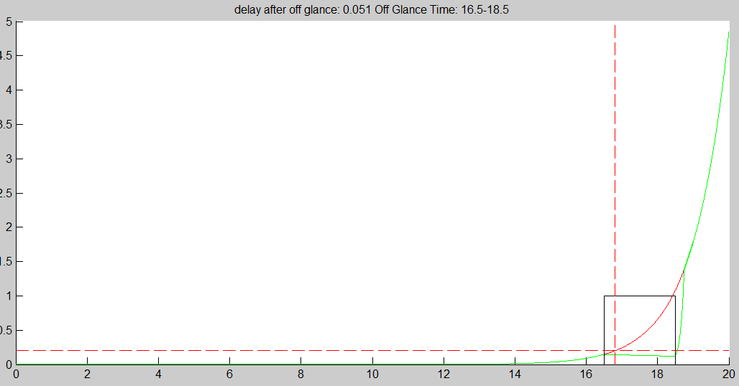
At some point in a critical situation, drivers do not look away again – good to use as anchor point
Notes:
Research gap:

Slide 37
When and why to use overshot?
Use Overshot?
No
When?
Accumulation before anchor will not affect outcome
Accumulation before anchor only potentially affect outcome marginally
➔ Consequence:
Only need to sample the overshot, not the duration of the glance, or care about previous glances.
Impact: Will save a lot of simulation time!
Suggestion: When new driver model is used, check if overshot glances can be used on a subset of data? = compare overshot and “complete” simulation
Yes
Notes:
Research gap:

Slide 38
When and why to use overshot?
Use Overshot?
No
When?
Accumulation before anchor will not affect outcome
Accumulation before anchor only potentially affect outcome marginally
➔ Consequence:
Only need to sample the overshot, not the duration of the glance, or care about previous glances.
Impact: Will save a lot of simulation time!
Suggestion: When new driver model is used, check if overshot glances can be used on a subset of data? = compare overshot and “complete” simulation
Yes
Notes:
Research gap:

Slide 39
What maximum deceleration to use?
Notes:
Research gap:

Slide 40
Overshoot distribution – “my interpretation”
Glance
anchor
N=12
➔
N=inf
1s
2s
3s
Event time [s]
Notes:
Research gap:

Slide 41
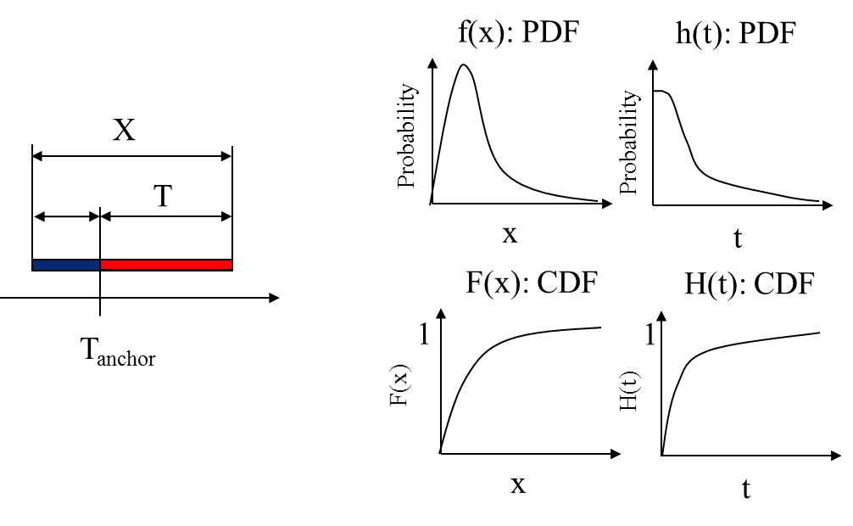
Overshoot distribution
X : The duration of the off road glance (EOFF). A random entity
f(x) : The probability density function (PDF) of X
F(x) : The cumulative distribution function (CDF) of X
T_{anchor} : A random time in in the EOFF (X).
T: Given that T_{anchor} occur witin the EOFF ([0,X]) denote the part that is ”left” on the right T.
h(t) : The probability density function of T
H(t) : The cumulative distribution function of T
Notes:
Research gap:

Slide 42
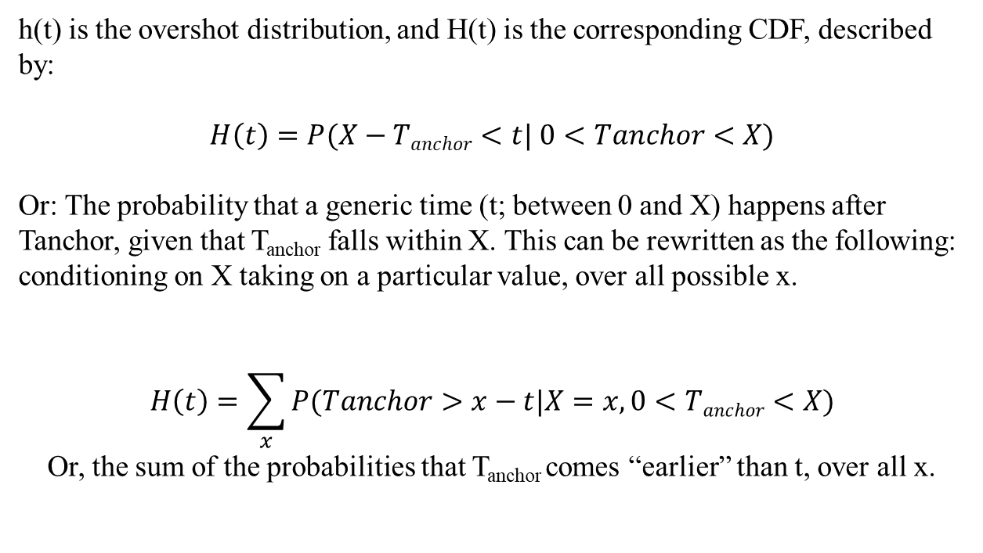
Overshoot distribution
h(t) is the overshot distribution, and H(t) is the corresponding CDF, described by:
$$H\left(t\right)=P(X−Tanchor<t| 0<Tanchor<X)$$
Or: The probability that a generic time (t; between 0 and X) happens after Tanchor, given that T_{anchor} falls within X. This can be rewritten as the following: conditioning on X taking on a particular value, over all possible x.
$$H\left(t\right)=\sum_{x}{P(Tanchor>x−t|X=x, 0<Tanchor<X)}$$
Or, the sum of the probabilities that T_{anchor} comes “earlier” than t, over all x.
Notes:
Research gap:

Slide 43
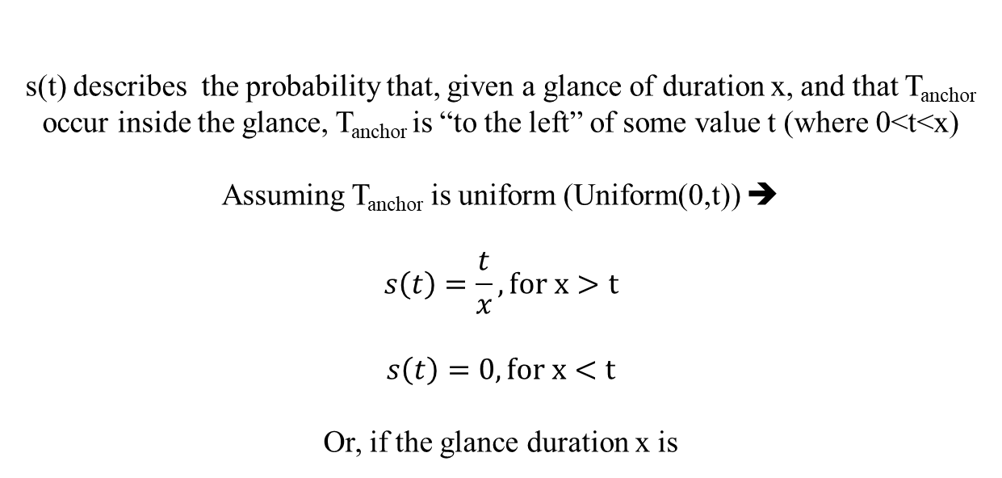
Overshoot distribution
s(t) describes the probability that, given a glance of duration x, and that T_{anchor} occur inside the glance, T_{anchor} is “to the left” of some value t (where 0<t<x)
Assuming T_{anchor} is uniform (Uniform(0,t)) ➔
$$s\left(t\right)=\frac{t}{x}, for x>t$$
$$s\left(t\right)=0, for x<t$$
Or, if the glance duration x is
Notes:
Research gap:

Slide 44
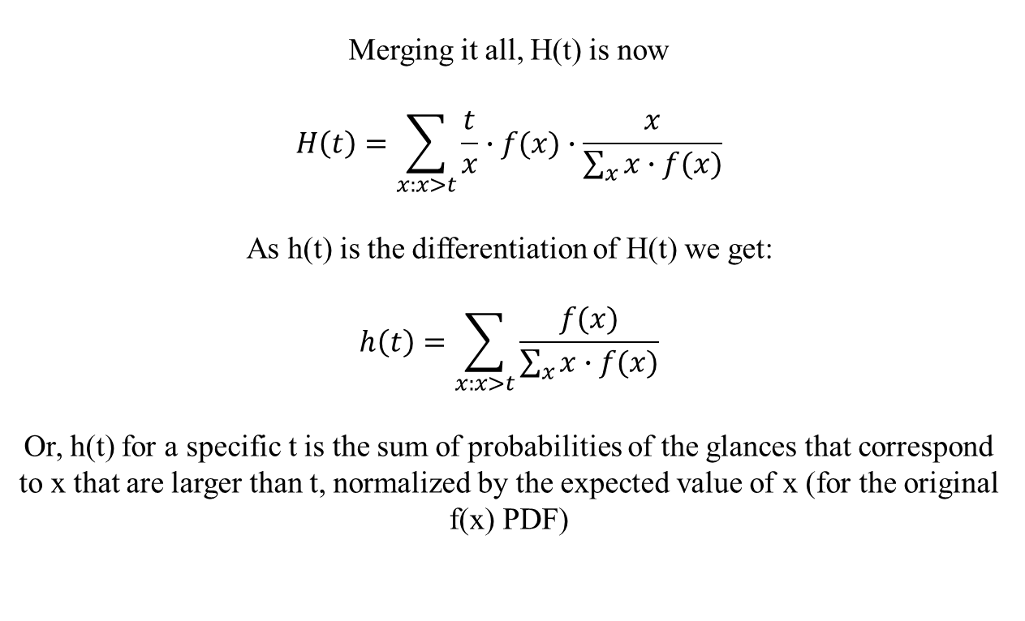
Overshoot distribution
Merging it all, H(t) is now
$$H\left(t\right)=\sum_{x:x>t}{\frac{t}{x}∙f(x)∙\frac{x}{\sum_{x}{x∙f(x)}}}$$
As h(t) is the differentiation of H(t) we get:
$$h\left(t\right)=\sum_{x:x>t}{\frac{f(x)}{\sum_{x}{x∙f(x)}}}$$
Or, h(t) for a specific t is the sum of probabilities of the glances that correspond to x that are larger than t, normalized by the expected value of x (for the original f(x) PDF)
Notes:
Research gap:

Slide 45






Overshoot distribution
P₁
P₂
P₃
0.33
Probability
µ=1∙P₁+2∙P₂+3∙P₃=2
$${1 (or P}_{1}{+P}_{2}{+P}_{3})$$
x<1
1
2
3
EOFF duration [s]
1-H(x)=
$$P_{2}{+P}_{3}$$
1≤x <2
$$P_{3}$$
2≤x <3
F(x)
1.0
$$\frac{1}{{1∙P}_{1}+{2∙P}_{2}{+3∙P}_{3}}$$
x<1
Cumulative distribution function (CDF)
h(x)=
$$\frac{P_{2}+P_{3}}{{1∙P}_{1}+{2∙P}_{2}{+3∙P}_{3}}$$
1≤x <2
$$\frac{P_{3}}{{1∙P}_{1}+{2∙P}_{2}{+3∙P}_{3}}$$
2≤x <3
1
2
3
EOFF duration [s]
Notes:
Research gap:

Slide 46


Combine the size bias and the overshoot
P₁
P₂
P₃
µ=1∙1/3+2∙1/3+2∙1/3=2
0.33
Probability
1
x<1
1-F(x)=
1≤x <2
2/3
$$1/3$$
2≤x <3
1
2
3
overshoot(x)=
$$\frac{x∙f(x)}{μ}$$
EOFF duration [s]
$$\frac{1}{2}$$
x<1
P₁
P₂
P₃
$$\frac{1}{3}$$
0.33
f(x)=
1≤x <2
Overshoot distribution
$$\frac{1}{6}$$
2≤x <3
1
2
3
EOFF duration [s]
Notes:
Research gap:

