Slide 1
Database Termproject
Team5 강승민, 최준서, 송민규, 김유현, 조민주

Slide 2
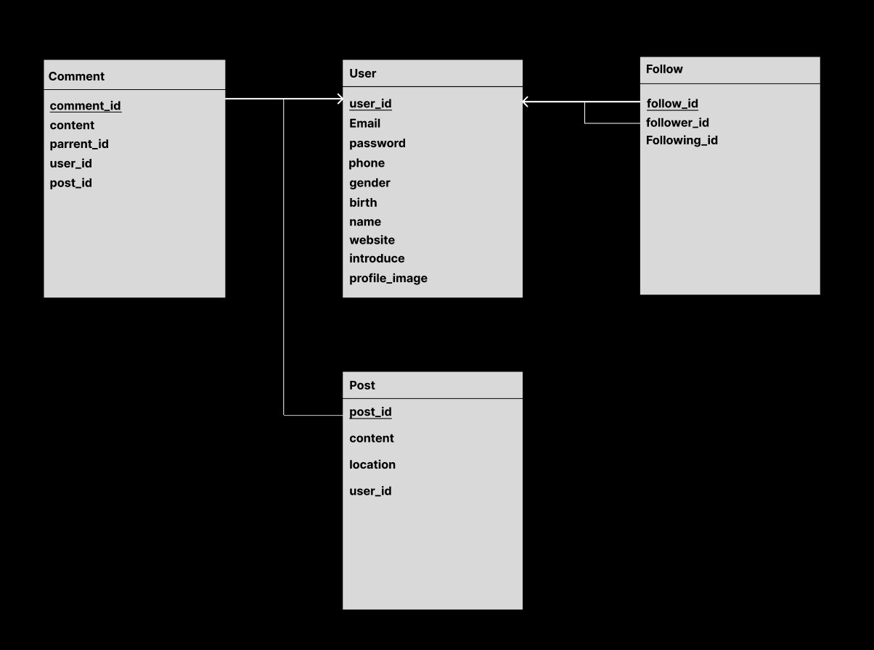
Database Schema

Slide 3
Normalization
1NF
2NF
The domains of all attributes are atomic →
not exist duplicate tuples.
Satisfies 1NF and no Partial Dependencies → Values depend on the whole of every candidate key.
3NF
Satisfies 2NF and no Transitive Dependencies →
Values depend only on Candidate keys

Slide 4
Normalization
BCNF
user table : user_id is the candidate key, and all other attributes are dependent on it, so it satisfies BCNF.
Follow Table : satisfies BCNF because follow_id is the candidate key and there is no dependency other than following_id being dependent on user_id.
Post Table : post_id is the candidate key, and all other attributes are dependent on it, so it satisfies BCNF.
Comment table : comment_id is the candidate key, and all other properties are dependent on it, so it satisfies the BCNF.

Slide 5
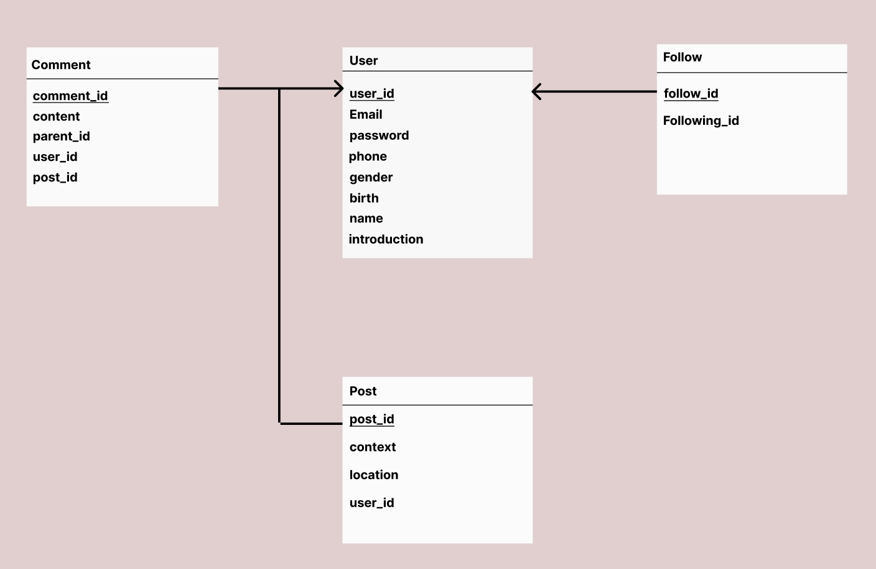
Final Database schema

Slide 6
Demo

Slide 7
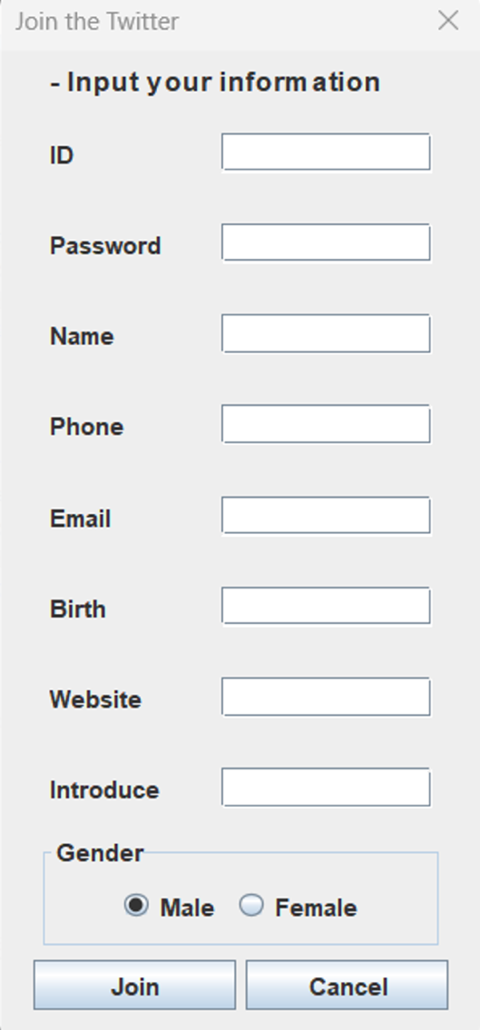
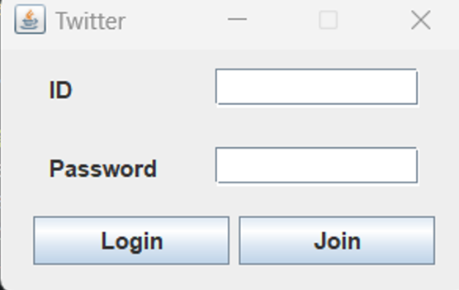
Login, sign up

Slide 8
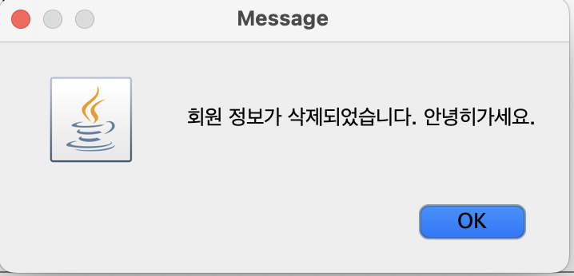
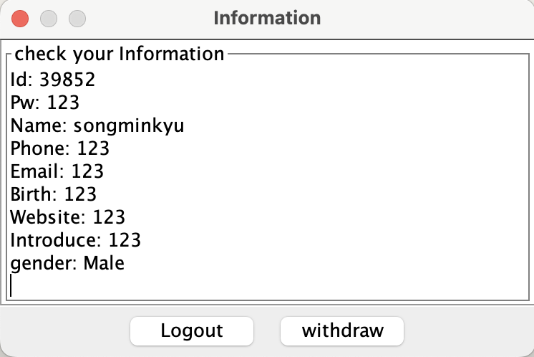
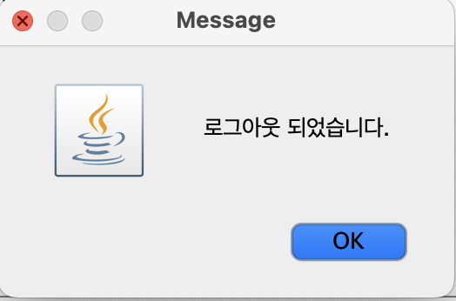
Logout, withdraw

Slide 9
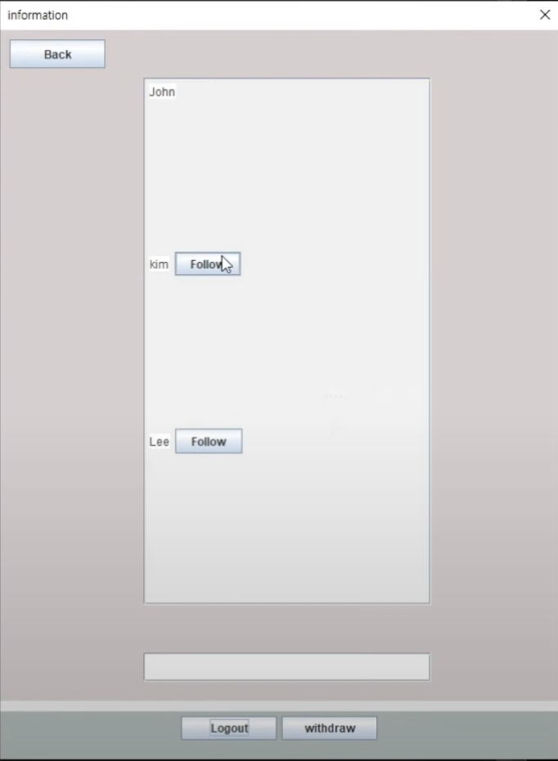
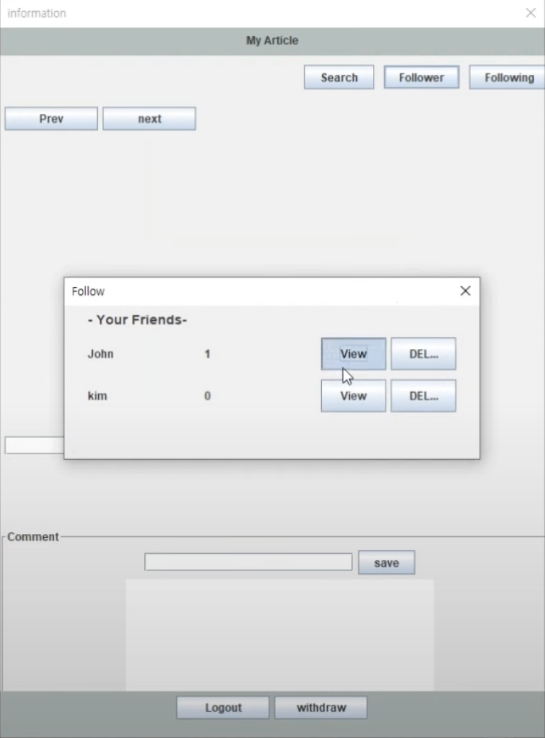
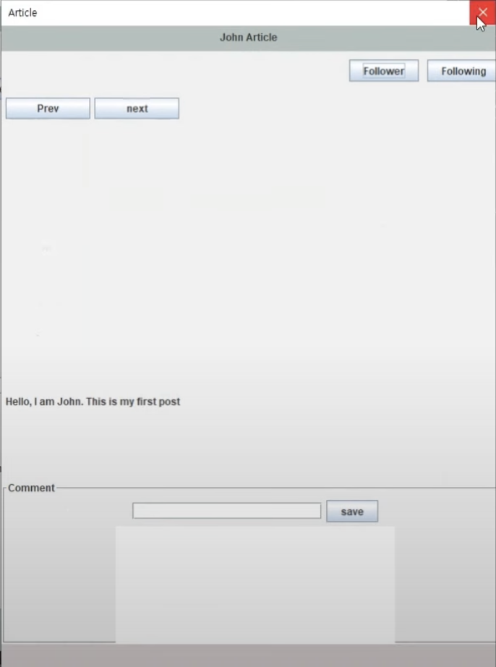
Follow

Slide 10
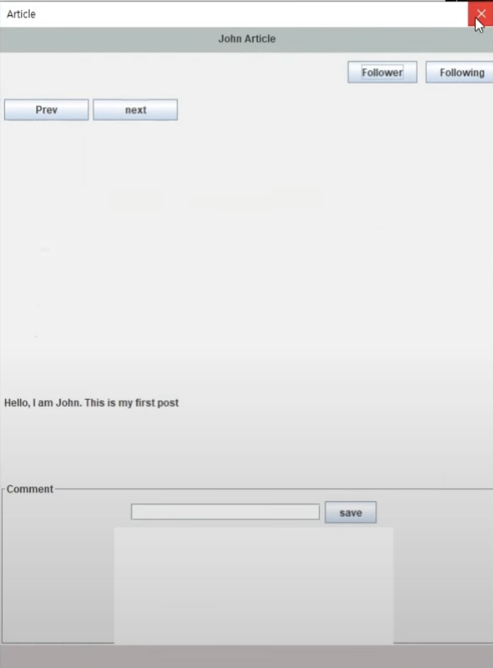
Post

Slide 11
Demo Short
https://youtu.be/wOkXtYCHayI

Slide 12
Thank you!

