Slide 1
VQA Based on Stacked Attention Networks
小组成员：程川洋 顾核金 刘亦晗 汪紫菱

Slide 2
01 算法与模型

Slide 3


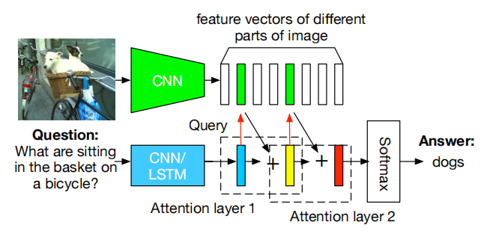
整体框架 | Frame
Notes:
flex词法分析，parser语法分析
AST：抽象语法树

Slide 4
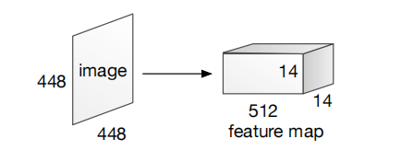
模型细节 | Image Model
use VGGNet to extract the image feature map
choose the features from the last pooling layer，which retains spatial information of images
use a single layer perceptron to transform each feature vector
Notes:
flex词法分析，parser语法分析
AST：抽象语法树

Slide 5
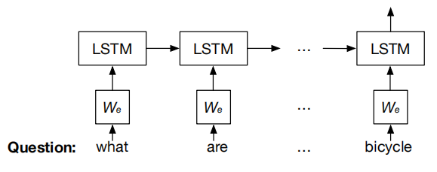
模型细节 | Question Model
LSTM unit takes one input vector
updates the memory cell
output a hidden state
use nn.LSTM from mindspore
Notes:
flex词法分析，parser语法分析
AST：抽象语法树

Slide 6
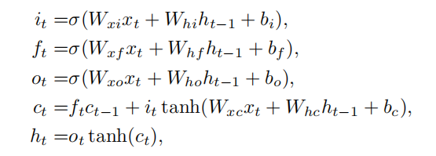
模型细节 | Question Model
forget gate controls how much information from past state is preserved
input gate controls how much the current input updates the memory cell
output gate controls how much info of the memory is fed to output as hidden state
Notes:
flex词法分析，parser语法分析
AST：抽象语法树

Slide 7
模型细节 | Stacked Attention Model
Notes:
flex词法分析，parser语法分析
AST：抽象语法树

Slide 8
02 主要创新点

Slide 9
03 结果展示

Slide 10
所用工具 | structure
操作系统：linux
编译环境：
- Flex
- Bison
- LLVM 9.0.0

Slide 11
谢谢观看

