Slide 1



ModeFlow
The Tiny SW Framework started in Rivian R1 project
Oct 26, 2021

Slide 2
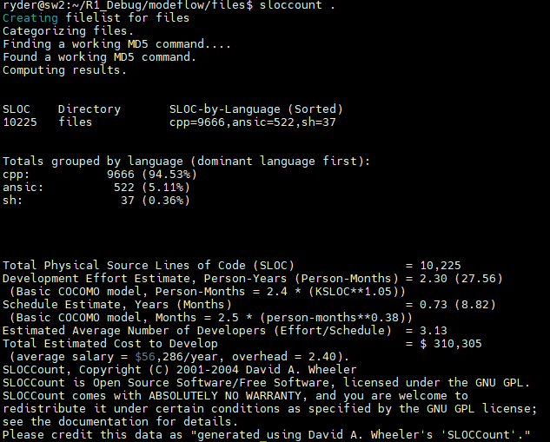
ModeFlow framework Core features
High productivity.(supported 10 thousand lines of source code in
R1 project. Also supported MD project.)
High stability.(auto recoverable and No Crash in R1 modeflow)
Highly isolated SW modules(Easy for unit development/debug/test)
Support Concise logic.(Regular Expression supported event/mode matching.)
Intelligent Message dispatching by caching logic.
High configurability for modules to be either processes or threads.
Support Replaying by using logs to simulate input.
Cross Platform design.
Automatically generated logs from SW internal/IPC messages.
Automatically generated internal/IPC messages from modeflow APIs.
Threads resources can be flexibly shared between modules.(Shared threads)

Slide 3
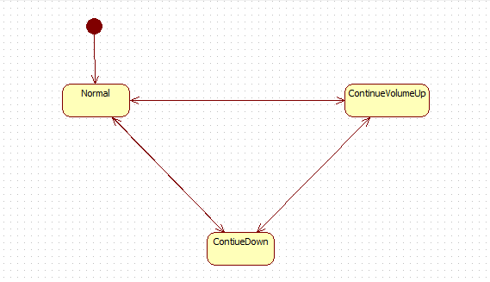
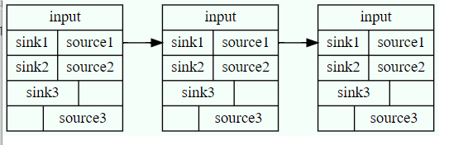
Meta-Model
Module(Thread/Process)
Module(Thread/Process)
Module(Thread/Process)
Module(Thread/Process)
Mode
IPC
Flow x
Flow y

Slide 4
Meta-Model
Basic:
mode(event) >modechangeEvent(ModuleName::modex2modey)-> <action>
mode(event) ->event(ModuleName::eventx)-> <Action>:Flow Focus
mode(event)->action-><event(ModuleName::eventx) > :Action Focus
Module connection:
ModuleName1::event (+ mode) ->ModuleName2::event
Delay:
Event/Action be issued after a delay.
Extra Event Generation:

Slide 5

CodeCheck
sourcecheck.sh

Slide 6
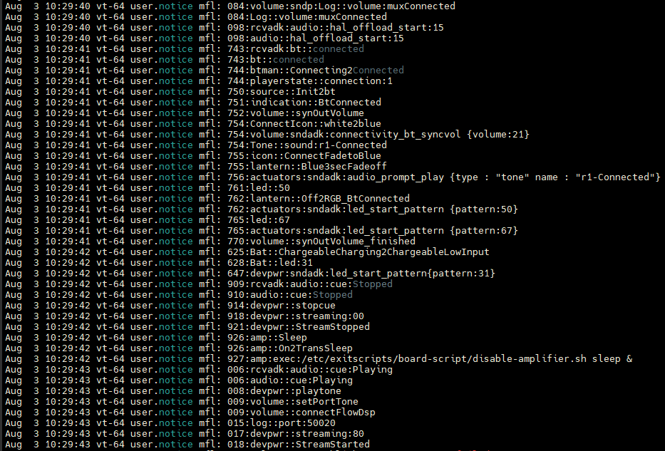
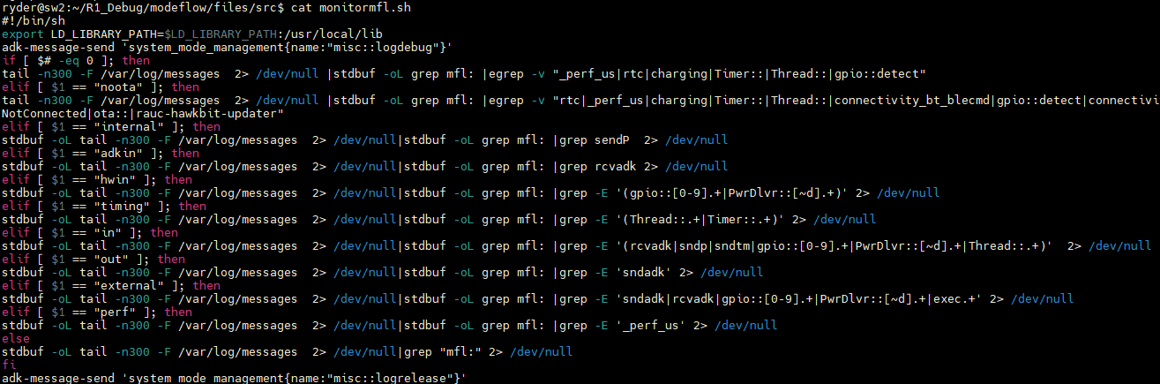
Log
Replay:
./r1-modeflow < inEventLog(output of monitormfl.sh in)

Slide 7
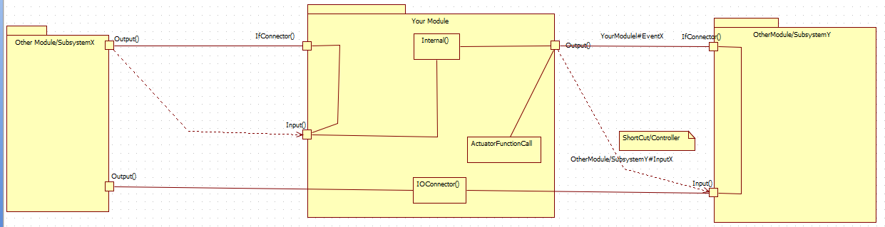
Coding Rule
IfConnector()
External msg
input()
output()
Internal()
IOConnector()(no state change)
output

Slide 8
Coding Rule
Target: mode changing target
Sequence: high level flow
Lower level flow
Flow: lowest level flow
Log: log with below format string:
Log::ModuleName:logevent
Internal message
Modulename::i:messageName

Slide 9
Other issues with Examples
Thread::Charger:stopCharge
Plan to change to Charger::… in the future, consider as Charger::…
In new code, please do not use it. Use em2dme serials API instead.

