Slide 1
LLVM
김태현

Slide 2
instrument 과정
PASS
(LLVM)
target
(.c / .cpp)
clang
.bc
output
(.bc)
llc
output
(.s)
gcc
exefile
(.navtive)

Slide 3
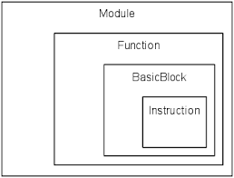
LLVM 구성
∙Module : LLVM programs are composed of Module‘s, each of which is a translation unit of the input programs.
∙Function : LLVM function declarations consist of the “declare” keyword.
ex) a return type
∙BasicBlock : A basic block represents a single entry, single exit section of code.
∙instruction : The LLVM instruction set consists of several different classifications of instructions.
ex) terminator instructions, binary instructions, bitwise binary
global

Slide 4
standard pass
목적 : 공유변수가 Load or Store 지점에 printf 삽입
과정
star pass를 변형시켜 새로운 패스를 생성
module pass 사용
insert할 함수 생성 후 공유변수가 Load or Store 되는 지점에 삽입

Slide 5
사용된 함수
∙ void insertBefore(Instruction *InsertPos)
- Insert an unlinked instruction into a basic block immediately before the specified instruction.
∙ void insertAfter(Instruction *InsertPos)
- Insert an unlinked instruction into a basic block immediately after the specified instruction.
∙ bool isa (const Y &Yal)
- The isa<> operator works exactly like the Java “instanceof” operator.
It returns true or false depending on whether a reference or pointer points to
an instance of the specified class.

Slide 6
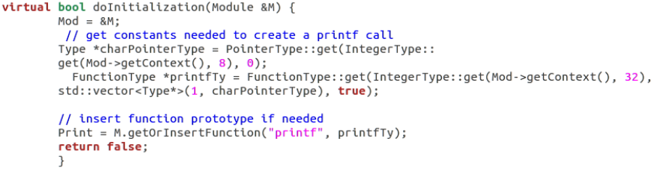
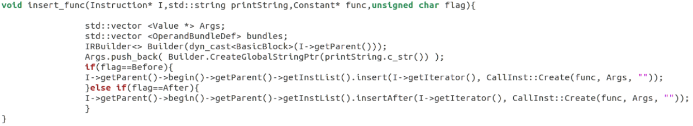
standard pass
pass 기능 : 공유변수가 Load or Store 지점에 printf 삽입
printf 생성
사용자 정의 함수
iterator을 받아 printf생성 후 삽입

Slide 7
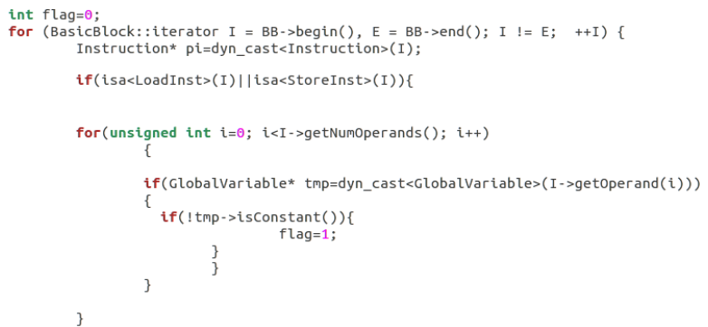
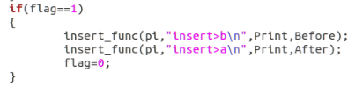
standard pass
instruction Load & Store 확인
Globalvariable 로 변환이 가능하면 flag=1
insert>a insert>b
삽입 후 flag 초기화

Slide 8
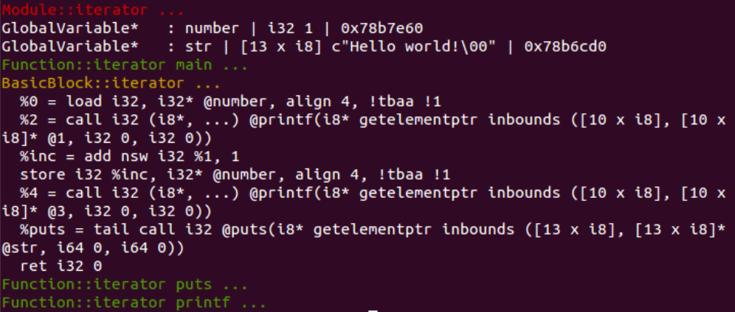
standard pass –실행 결과
GlobalVariable
Instruction
전역변수(number) Load or Store
printf

Slide 9
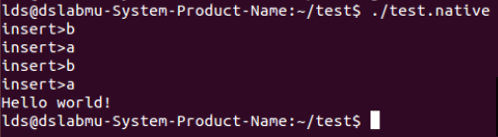
standard pass –실행 결과 (1)
native 파일 생성
instrumented 된 응용프로그램

Slide 10
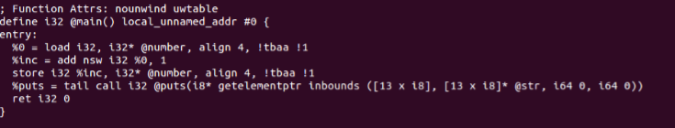
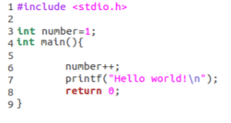
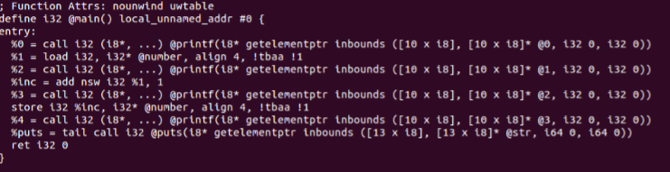
결과 비교
hello.bc
hello.c
test.bc

Slide 11
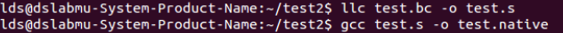
standard pass –실행 과정
1
2
output
pass
target
target
bitcode
1
transformed target bitcode
2
Output

Slide 12
평가
LLVM shared variable access trace and insert code
LLVM LOAD & STORE Instruction trace
isa<LoadInst>,isa<StoreInst>
LLVM Insert printf
Insert , InsertAfter
LLVM global variable trace
Module::global iterator

Slide 13
향후 진행
custom pass 생성 및 적용
conditional branch 앞뒤로 printf 삽입
isa<>를 사용해 branch를 확인

