Slide 1
ToDo List Application for UWC
Description:
    Application uses Java threads
    Uses DataBase and FireBase services
    Uses RecyclerView
Usage:
    Create ToDo tasks with description and due date
    Edit already existing tasks
    Delete tasks
    Mark tasks as done

Slide 2
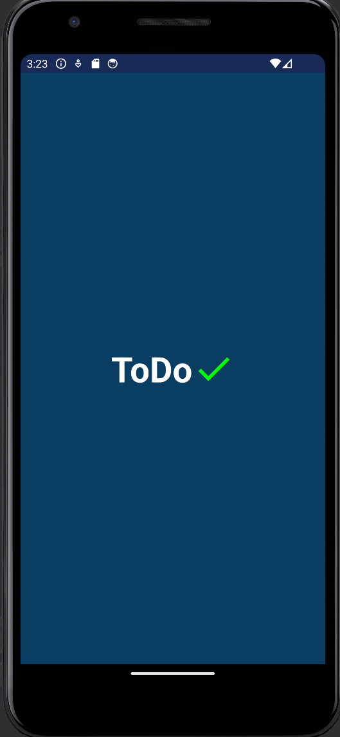
Application startup
Application starts with Splash screen

Slide 3
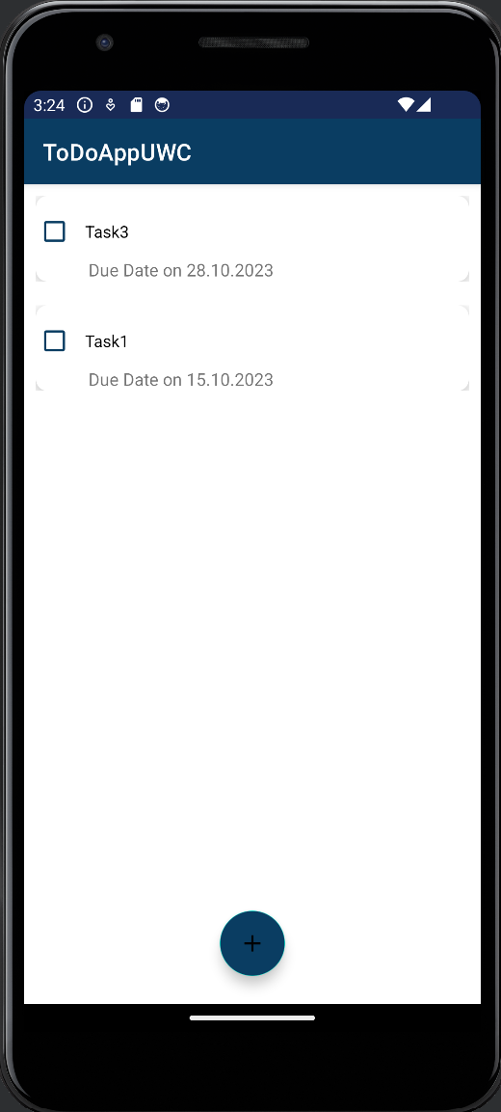
Initial View | Task List
On startup all previously created tasks are shown
After creating new task list was updated
Task’s due date and description are shown

Slide 4
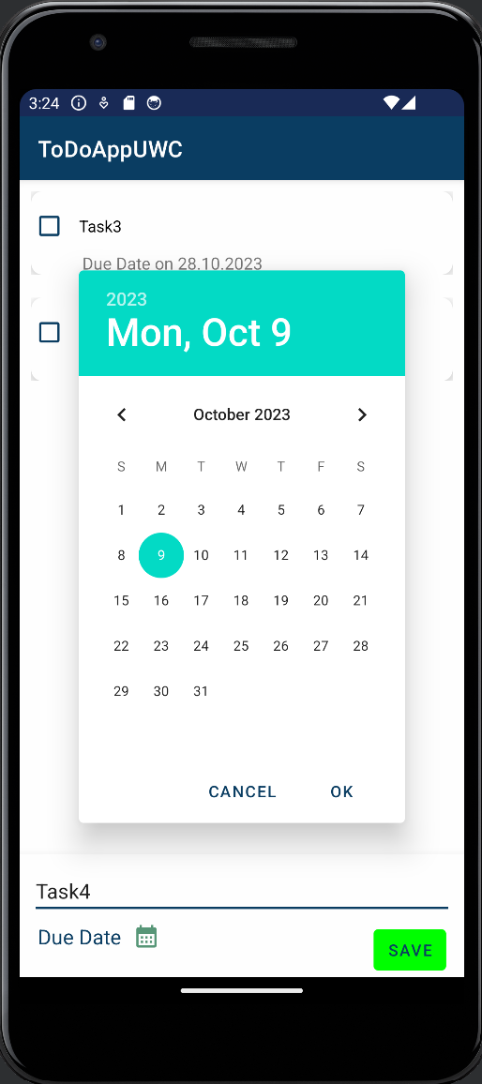
Creating new Task
Tasks can be created by clicking on add button
Tasks have 2 properties:
  Description(Mandatory)
  Due date(Optional)

Slide 5
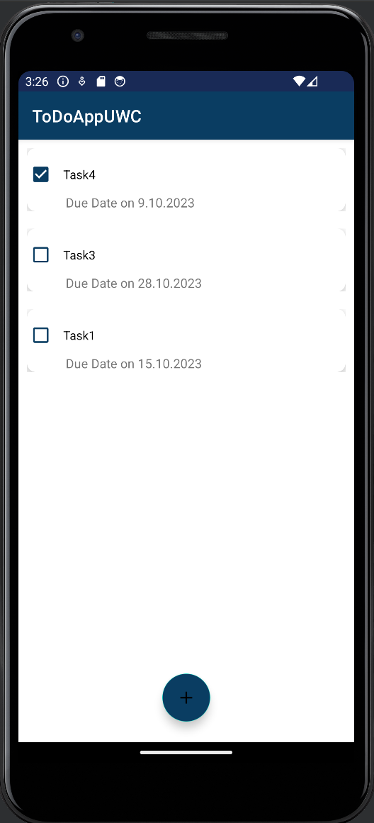
Marking Task as Done
Tasks can be marked as done by clicking on corresponding checkbox

Slide 6
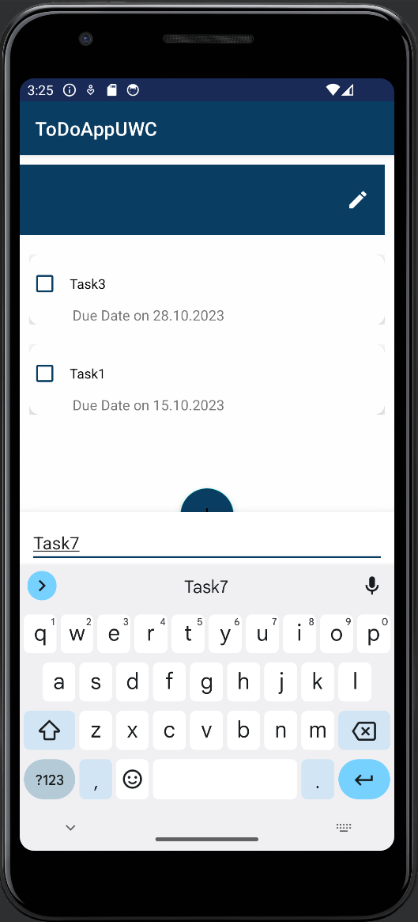
Editing Task
Tasks can be deleted via swapping task to left
Edit task description and due date

Slide 7
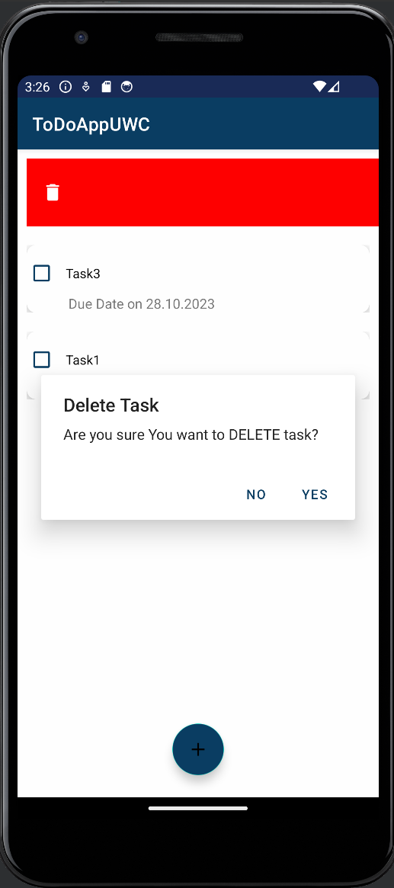
Deleting Task
Tasks can be deleted via swapping task to right
Pop-up window for confirming task deleting

