Slide 1



VULNERABILITIES OF DIFFERENT ELEMENTS EXPOSED TO SPECIFIC HAZARDS

Slide 2
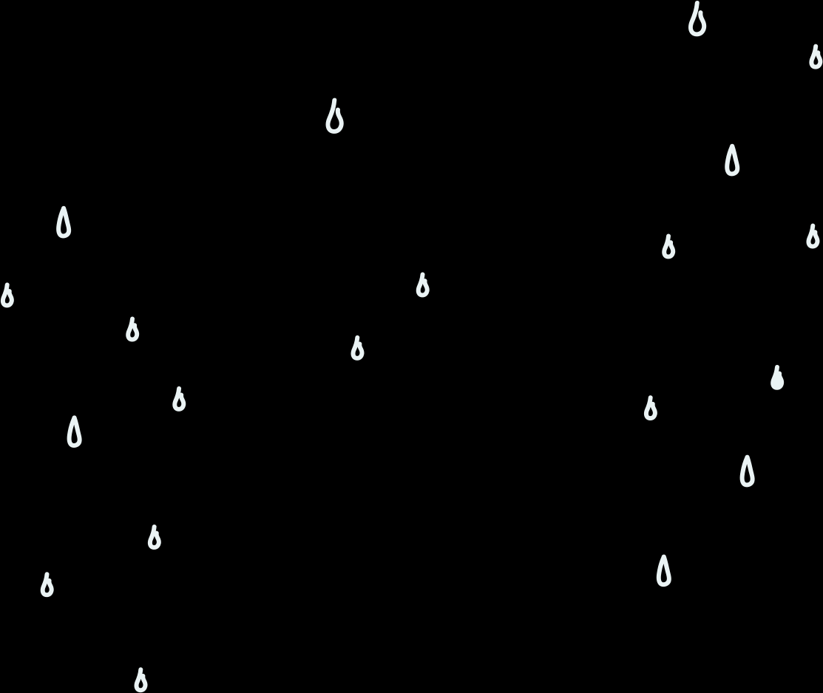

WHAT ARE THEY?
  Hazards are events or conditions that may cause harm to people, property, or the environment.
  Vulnerability is the degree to which people, structures, or systems can be damaged when exposed to a hazard.
  Visual Idea: A simple flow diagram showing Hazard → Vulnerability → Impact to illustrate how danger leads to exposure and results in consequences.

Slide 3
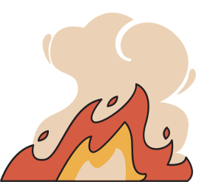
TYPES OF ELEMENTS EXPOSE
1. Human Elements – People, communities, and workers that may be affected by a hazard.
2. Physical Elements – Buildings, infrastructure, and equipment that can be damaged.
3. Natural Elements – Forests, rivers, and wildlife found in the environment.
4. Economic Elements – Businesses, crops, and industries that may experience losses.
5. Social Elements – Institutions, cultural heritage, and essential services that support society.

Slide 4
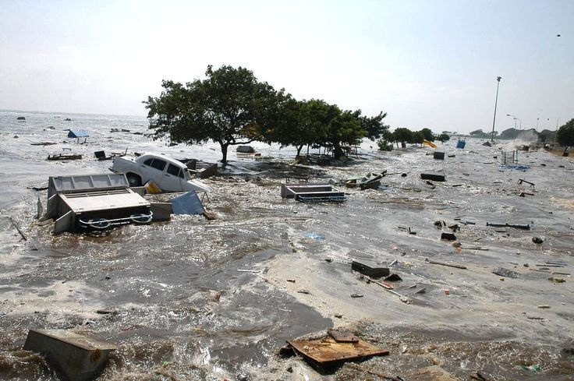
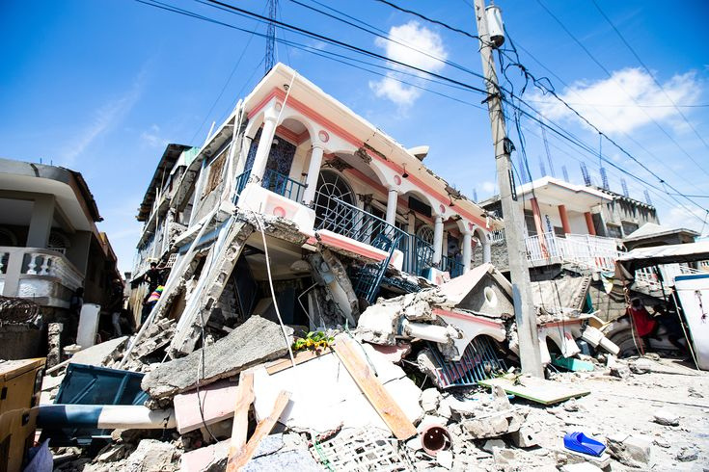
COMMON HAZARD
1.Natural Hazards – Earthquakes, typhoons, floods, volcanic eruptions, landslides.
Example:

Slide 5
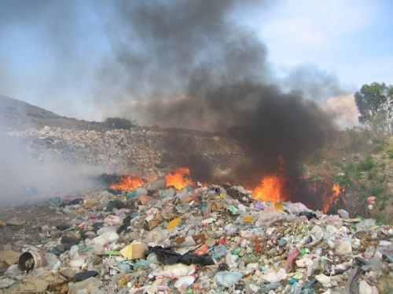
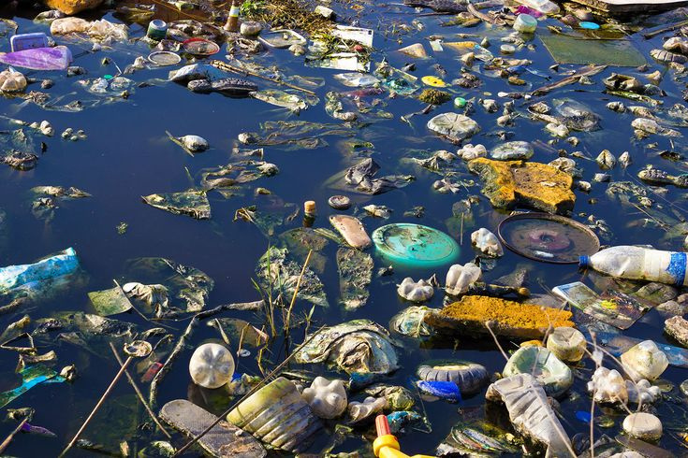
COMMON HAZARD
2. Environmental Hazards – Pollution, soil erosion, water contamination.
Example:

Slide 6
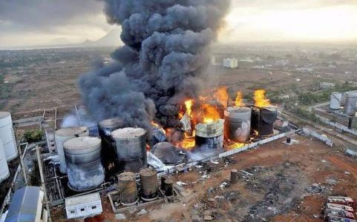
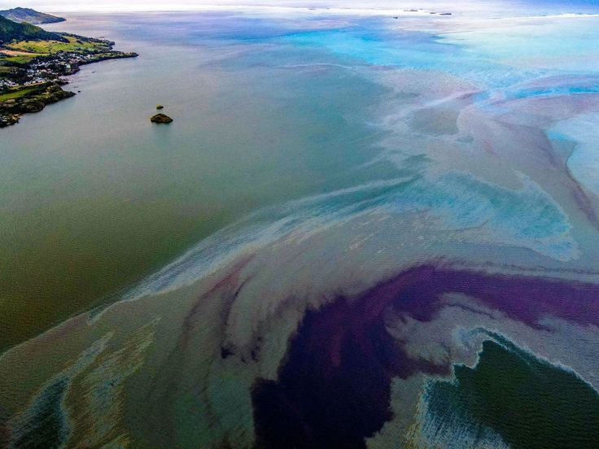
COMMON HAZARD
3. Technological Hazards – Industrial accidents, power failures, chemical spills.
Example:

Slide 7

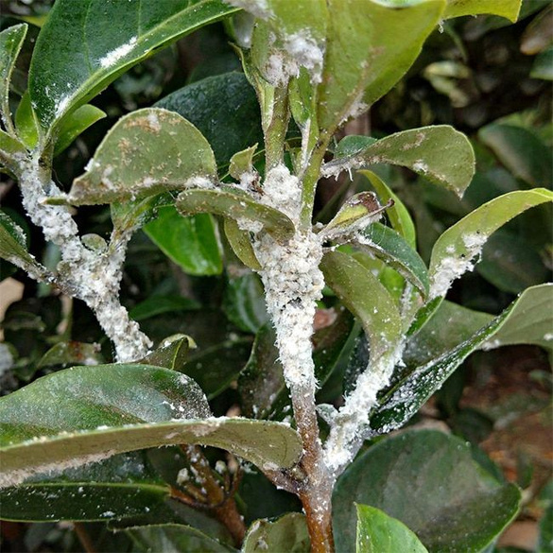
COMMON HAZARD
4. Biological Hazards – Diseases, viruses, pests, toxic organisms.
Example:

Slide 8
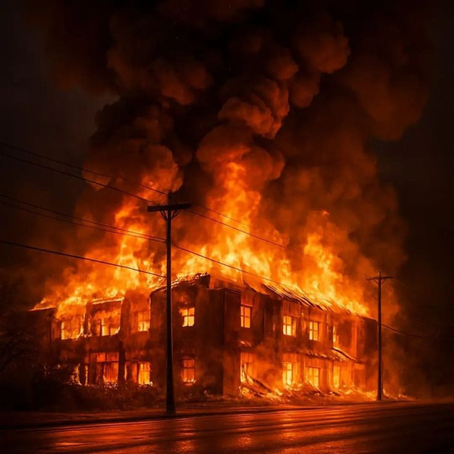

COMMON HAZARD
5. Human-Induced Hazards – Fire, conflict, deforestation, improper waste disposal.
Example:

Slide 9
CONCLUSION
Understanding hazards and the elements at risk helps communities prepare, respond, and reduce potential impacts. By identifying different types of hazards and recognizing how human, physical, natural, economic, and social elements can be affected, we can strengthen safety measures and promote resilience. Effective awareness and planning are key to minimizing damage and protecting lives.

Slide 10

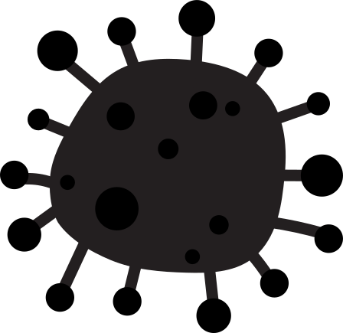
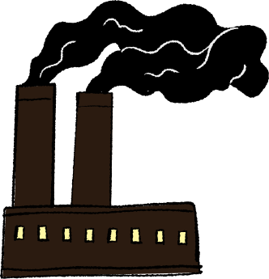

THANK YOU

