Slide 1
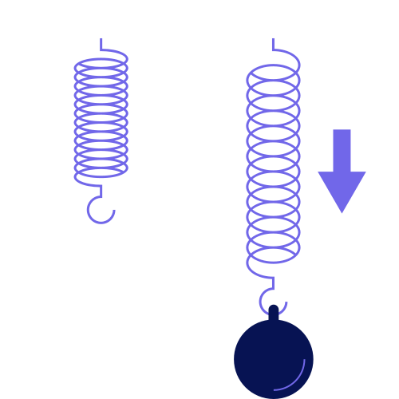
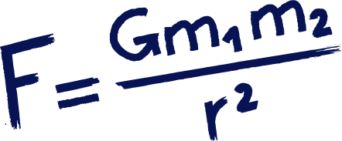



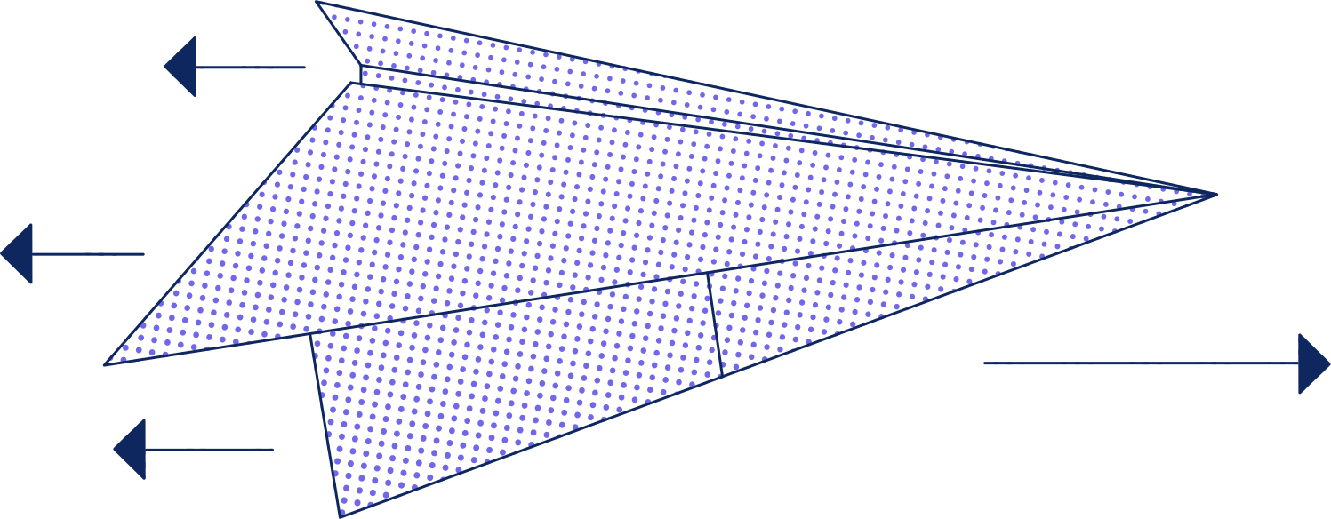
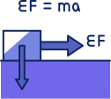
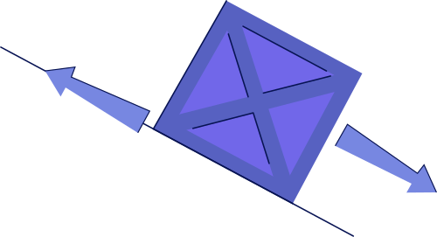
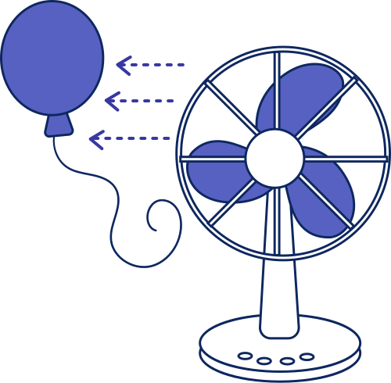
MOMENTUM AND IMPULSE

Slide 2
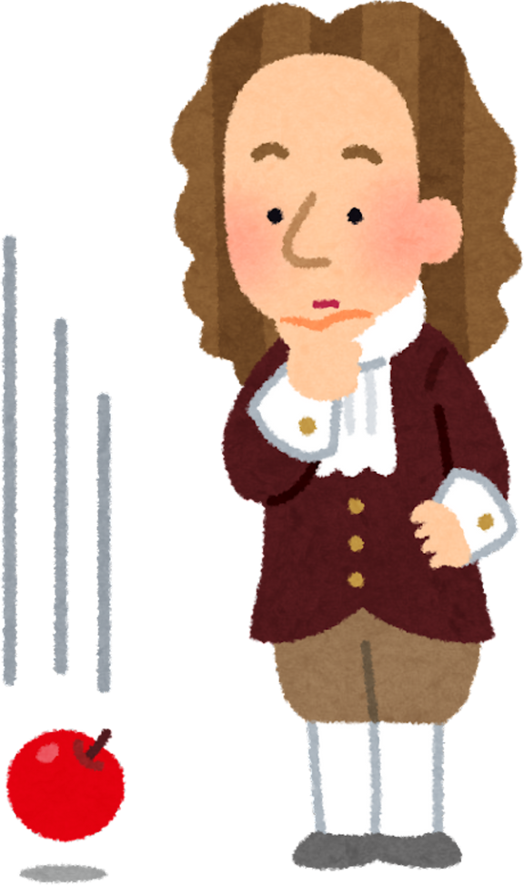

WHAT IS MOTION &
MOMENTUM
Motion
Motion is the change in position of an object over time. If something moves from one place to another, it is in motion.
Example:
A car driving on a road, a ball falling, or a person walking - all are in motion.
Momentum
Momentum is the quantity of motion an object has. It depends on how heavy the object is and how fast it is moving.
Formula:
p = mv
where:
  p represents momentum,
  m represents mass,
  v represents velocity.

Slide 3
MOMENTUM EXAMPLE
1. A car with a mass of 900 kg is moving at 10 m/s. Find its momentum.
Formula:
p=mv
Solution:
p=900x10 = 9000kg m/s
2. A 4 kg ball is rolling with a speed of 3 m/s. What is its momentum?
Formula:
p=mv
solution:
p=4×3 =12kg m/s
3. A 0.2 kg baseball is thrown at 20 m/s. What is its momentum?
Formula:
p=mv
solution:
p=0.2×20 =4kg m/s

Slide 4
WHAT IS IMPULSE?
Impulse is the change in momentum of an object caused by a force acting on it for a certain amount of time.
Simple Definition:
Impulse tells how much a force changes an object’s motion.
Formula:
Impulse=F×t
where:
  F = force
  t = time the force acts

Slide 5
IMPULSE EXAMPLE
  A force of 10 N acts on a ball for 3 seconds. What is the impulse?
Formula:
J=F×t
Solution:
j=10x3 =30N/s
2. A 50 N force pushes a box for 2 seconds. Find the impulse given to the box.
Formula:
J=F×t
Solution:
j=50x2 =100N/s

Slide 6
RELATIONSHIP OF MOMENTUM
&
IMPULSE
Impulse causes a change in momentum.
When a force acts on an object for a certain time, it gives the object impulse, which either increases or decreases its momentum.
Example:
When a bat hits a ball, the force from the bat acts for a short time. This impulse changes the ball’s momentum, making it move faster.

Slide 7
EXAMPLE
A 2 kg ball is moving at 5 m/s to the right. A player hits the ball, giving it a velocity of 15 m/s to the right.
  What is the initial momentum of the ball?
  What is the final momentum of the ball?
  What impulse did the player apply to the ball?
Step 1: Calculate Initial Momentum
p=2x5 = 10kg m/s
Step 2: Calculate Final Momentum
p=2x15 = 30kg m/s
Step 3: Calculate Impulse
j=30-10 N/s

Slide 8
REMEMBER
Momentum is how hard it is to stop a moving object.
It depends on how heavy it is and how fast it is going.
MOMENTUM
Impulse is the push or hit that changes an object’s momentum.
It comes from a force acting for a short time.
IMPULSE

Slide 9
QUIZ TIME
1. A 3 kg ball is moving at 4 m/s. What is its momentum?
A) 7 kg·m/s
B) 12 kg·m/s
C) 1.33 kg·m/s
D) 0.75 kg·m/s
2. A 5 kg cart is initially at rest. A force is applied for 2 s and the cart reaches a velocity of 3 m/s. What is the impulse delivered?
A) 5 N·s
B) 15 N·s
C) 10 N·s
D) 30 N·s
3. Impulse measures:
A) The speed of an object
B) The change in momentum of an object
C) The mass of an object
D) The distance an object moves
4. A 2 kg ball moving at 6 m/s is stopped by a player. What is the impulse applied by the player?
A) 12 N·s
B) -12 N·s
C) 6 N·s
D) -6 N·s
5. A 4 kg object has an initial momentum of 20 kg·m/s. If a force gives it an impulse of -10 N·s, what is the final momentum?
A) 10 kg·m/s
B) 30 kg·m/s
C) -10 kg·m/s
D) 0 kg·m/s

Slide 10
QUIZ TIME
6. If a force acts opposite to an object’s motion, the impulse is:
A) Positive
B) Negative
C) Zero
D) Equal to mass
7. A 1 kg ball is moving at 5 m/s to the right. Another force acts on it for 0.2 s, producing an impulse of -2 N·s. What is the final velocity of the ball?
8. A car of mass 1000 kg has a momentum of 20,000 kg·m/s. What is its velocity?
A) 10 m/s
B) 20 m/s
C) 200 m/s
D) 2 m/s
9. Which of the following statements is true?
A) Momentum depends on mass and velocity
B) Impulse depends only on mass
C) Impulse cannot change momentum
D) Momentum is always negative
10. A ball moving at 3 m/s is struck in the same direction and its velocity becomes 7 m/s. Mass of ball = 2 kg. What is the impulse?
A) 4 N·s
B) 10 N·s
C) 8 N·s
D) 6 N·s

Slide 11
THANK
YOU

