Slide 1
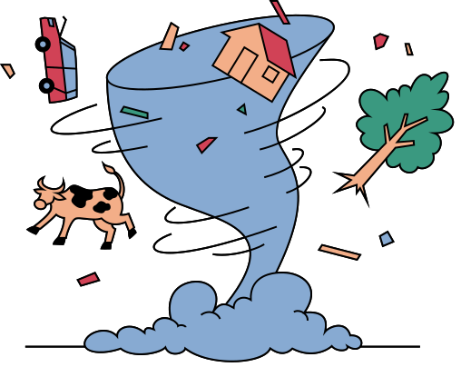
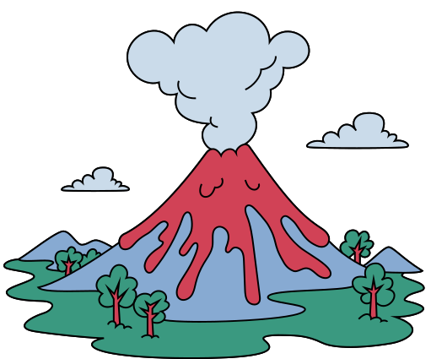
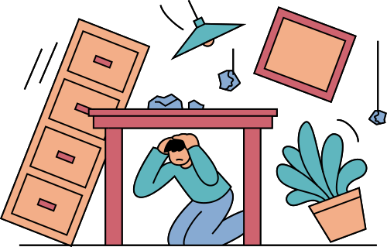
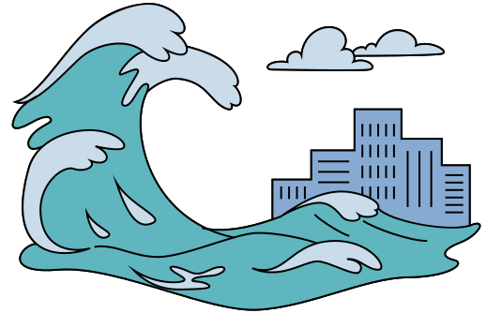
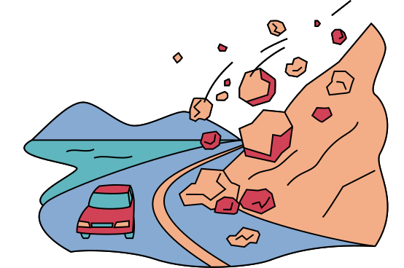
Recognize the Signs of an Impending Volcanic Eruption
a presentation

Slide 2
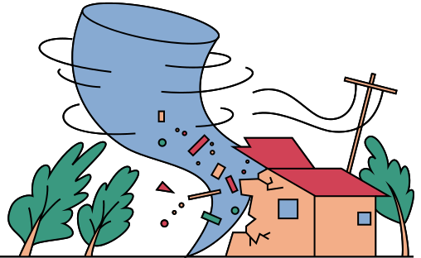
What Is a Volcanic Eruption?
A volcanic eruption happens when magma, ash, and gases escape from a volcano
Pressure builds up beneath the Earth’s surface
When pressure becomes too strong, an eruption occurs

Slide 3
Why Recognizing Warning Signs Is Important?
Helps reduce loss of life
Allows early evacuation
Early alerts give people time to move to safety before the disaster strikes.
Communities can evacuate dangerous areas in advance, avoiding panic and congestion.
Gives authorities time to issue warnings
Improves disaster preparedness
People and organizations can plan, practice, and respond more effectively to emergencies.
Officials can quickly inform the public and coordinate emergency responses.

Slide 4
Sign 1: Increased Volcanic Earthquakes
Frequent small earthquakes near the volcano
Caused by magma moving underground
These occur as rocks crack and shift beneath the volcano.
Rising magma forces its way through the Earth’s crust, creating vibrations.
Earthquake activity increases as eruption nears
As pressure builds and magma moves closer to the surface, earthquakes become more frequent and stronger.

Slide 5
Sign 2: Ground Deformation
•Swelling or bulging of the volcano’s surface
•Cracks may appear on the ground
The ground expands as magma accumulates beneath the volcano.
Pressure from rising magma causes the surface rocks to split.
•Indicates magma rising below the surface
These changes show that molten rock is moving upward toward an eruption.

Slide 6
Sign 3: Increased Gas Emissions
•Strong smell of sulfur or rotten eggs
•Increase in steam, smoke, or gas release
This smell comes from sulfur gases released by magma underground.
More heat and pressure cause gases and steam to escape from vents.
•Change in gas composition is a major warning sign
Different gas levels can indicate magma is rising closer to the surface and an eruption may be near.

Slide 7
Sign 4: Rising Temperature
•Hotter ground, water, or steam vents
•Water in nearby rivers or lakes may heat up
Rising magma increases heat at the surface and in underground water systems.
Heat from magma transfers to surrounding water sources.
•Indicates magma getting closer to the surface
Higher temperatures suggest magma is moving upward and an eruption may be approaching.

Slide 8
Sign 5: Visible Changes
•Ash emissions from the crater
•Glowing crater at night
Small releases of ash show that material is being pushed out by rising magma.
The glow comes from hot magma or lava close to the surface.
•Rockfalls or small explosions
These happen as pressure increases and the volcano becomes more unstable.

Slide 9
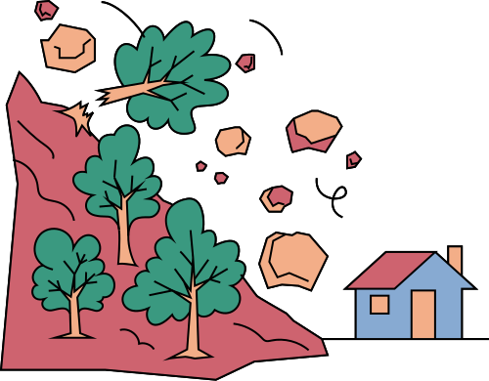
What To Do When Warning Signs Appear?
Stay updated with official announcements, prepare an emergency kit, follow evacuation orders immediately, and avoid restricted danger zones to stay safe during a volcanic event.

Slide 10
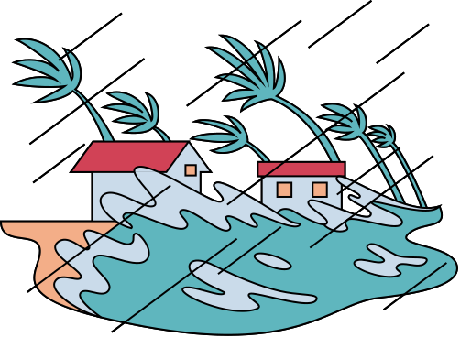
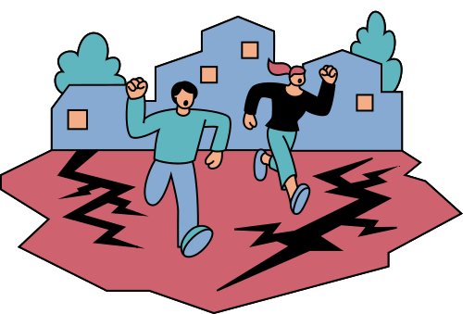
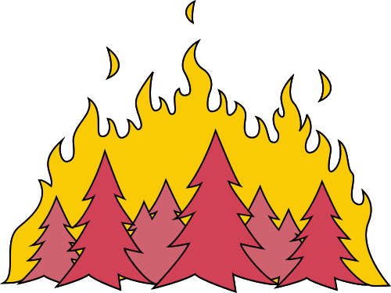
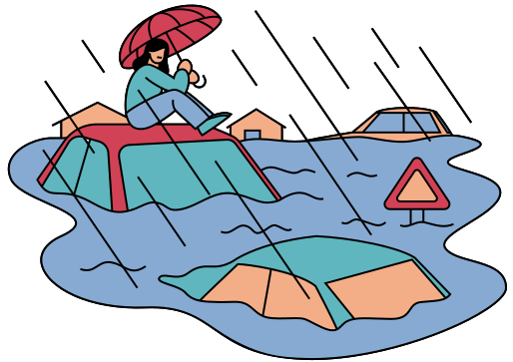
Conclusion
Volcanoes often show warning signs before erupting, including frequent earthquakes, changes in gas emissions, rising heat, and swelling or cracking of the ground, and being aware of these signs early, while following guidance from authorities, can help save lives and allow for timely evacuation and preparation.

