Slide 1




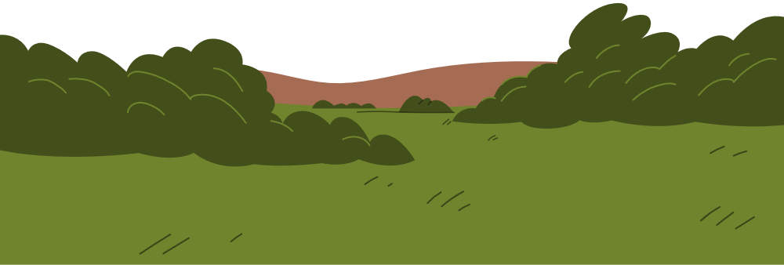
RECOGNIZING THE NATURAL SIGNS OF AN IMPENDING TSUNAMI

Slide 2

WHAT IS A TSUNAMI?
A tsunami is basically a series of very large ocean waves caused by something that suddenly moves a huge amount of water. Most of the time, it’s triggered by:
Underwater earthquakes (the most common cause)
Volcanic eruptions
Landslides under the ocean or along coasts
Meteorite impacts (super rare)

Slide 3
WHY DO WE NEED TO RECOGNIZE NATURAL SIGNS
Recognizing natural signs is important for staying safe during disasters. Signs like sudden changes in water, or small ground tremors can warn us about tsunamis, earthquakes, or volcanic eruptions. Noticing these signs early helps people act quickly, protect themselves, and reduce the risk of injury or damage.

Slide 4
⚠ NATURAL SIGNS OF AN IMPENDING TSUNAMI
#1: Strong Ground Shaking near coastline
Feeling strong shaking of the ground, especially near the coast, can be a sign of an earthquake that might trigger a tsunami. If this happens, it’s important to move to higher ground immediately, because a tsunami could follow within minutes.
#2: Sudden and unusual changes in the sea
If the sea suddenly rises, falls, or retreats far from the shore, it can be a warning that a tsunami is coming. People near the coast should quickly move to higher ground, as these changes often happen just minutes before the waves arrive.

Slide 5
⚠ NATURAL SIGNS OF AN IMPENDING TSUNAMI
#3: Strange sounds coming from the ocean
Unusual roaring, rumbling, or loud sounds from the ocean can be a sign that a tsunami is approaching. These sounds often happen before the waves reach the shore, so it’s important to move to higher ground immediately if you hear them.
#4: Animals acting strangely
Animals often sense danger before humans do. If birds, fish, or other animals suddenly leave the area or behave nervously, it could be a warning that a tsunami or other disaster is coming. People should pay attention and move to a safe place right away.

Slide 6

WHAT TO DO AND
WHAT NOT TO DO
IF YOU NOTICE TSUNAMI SIGN
What To Do:
Move to higher ground immediately go as far inland or as high as possible.
Take your emergency kit if there’s time (water, food, flashlight, important documents).
Listen to authorities follow evacuation orders or emergency instructions.
Stay alert keep updated through radio, phone, or official apps.
Help others assist children, elderly, or people with disabilities if you can.
What Not to Do:
Do not go to the beach to watch the waves.
Do not wait for confirmation tsunamis can arrive quickly.
Do not stay in low-lying areas they are most at risk.
Do not drive into flooded areas roads can be dangerous or washed away.
Do not ignore warning signs acting late can be deadly.

Slide 7
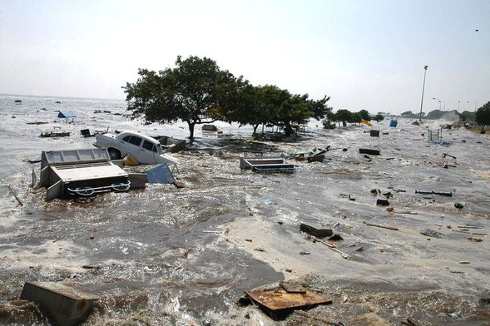
REAL LIFE
EXAMPLE
2004 Indian Ocean Tsunami
One of the deadliest tsunamis in history. A massive undersea earthquake off the coast of Sumatra, Indonesia, caused huge waves that hit Indonesia, Thailand, India, and other countries, killing over 230,000 people.

Slide 8
SUMMARY
Recognizing natural warning signs is crucial for staying safe during a tsunami. These include strong ground shaking, sudden sea changes, strange ocean sounds, and unusual animal behavior. If noticed, move to higher ground, follow authorities’ instructions, and take emergency supplies if possible. Avoid the beach, low-lying areas, and flooded roads. Acting quickly can save lives.

Slide 9
THANK YOU

