Slide 1
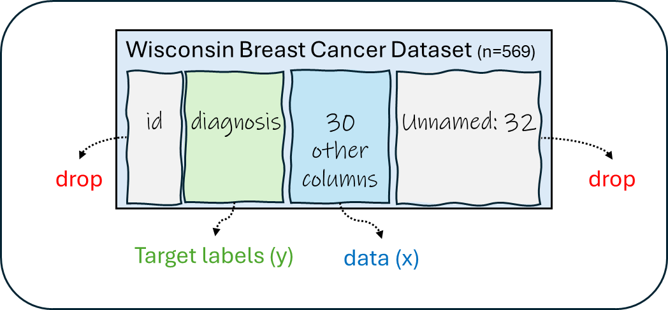
Wisconsin Breast Cancer Dataset (n=569)
id
diagnosis
30 other columns
Unnamed: 32
drop
drop
Target labels (y)
data (x)

Slide 2
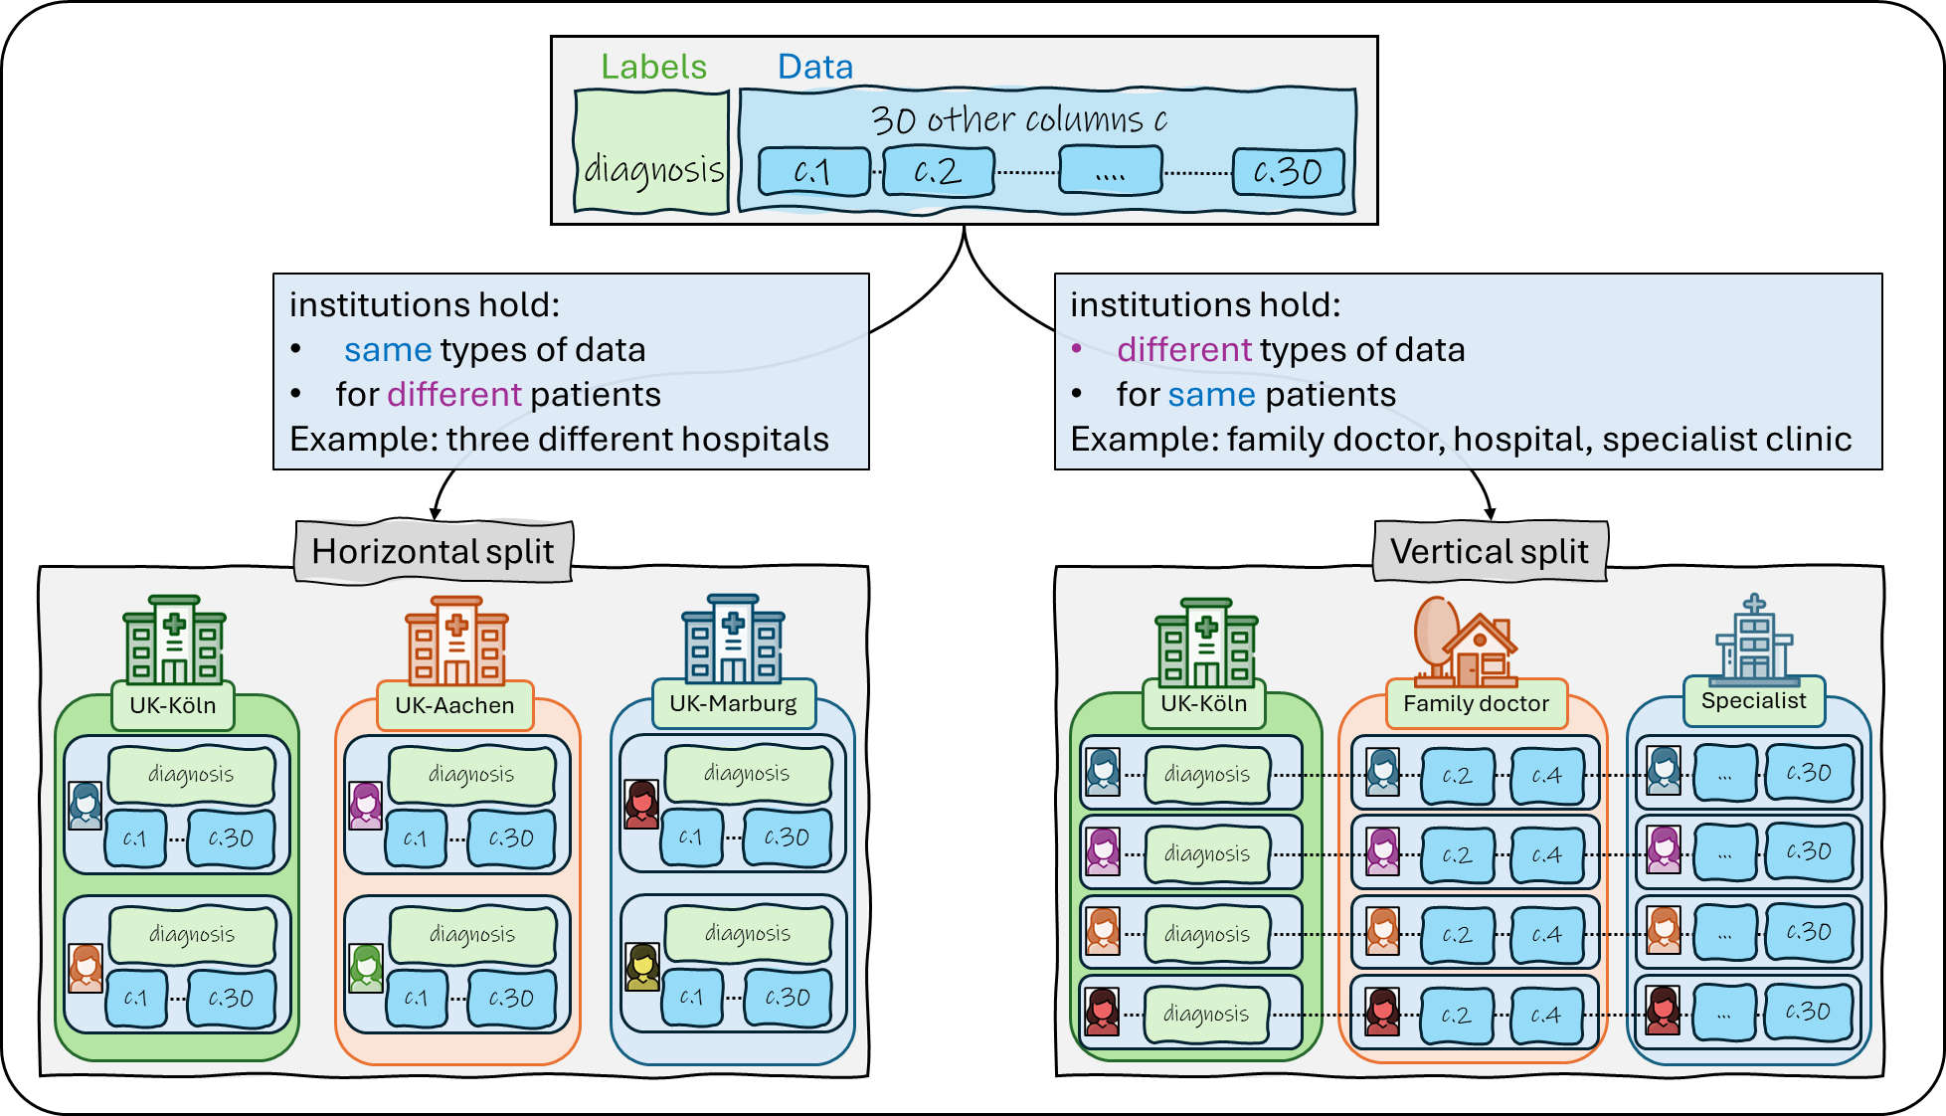




Labels
Data
30 other columns c
diagnosis
c.1
c.2
.…
c.30
institutions hold:
same types of data
for different patients
Example: three different hospitals
institutions hold:
different types of data
for same patients
Example: family doctor, hospital, specialist clinic
Horizontal split
Vertical split
UK-Köln
UK-Aachen
UK-Marburg
UK-Köln
Family doctor
Specialist
diagnosis
diagnosis
diagnosis
diagnosis
c.2
c.4
…
c.30
c.1
c.30
c.1
c.30
c.1
c.30
diagnosis
c.2
c.4
…
c.30
diagnosis
diagnosis
diagnosis
diagnosis
c.2
c.4
…
c.30
c.1
c.30
c.1
c.30
c.1
c.30
diagnosis
c.2
c.4
…
c.30

Slide 3
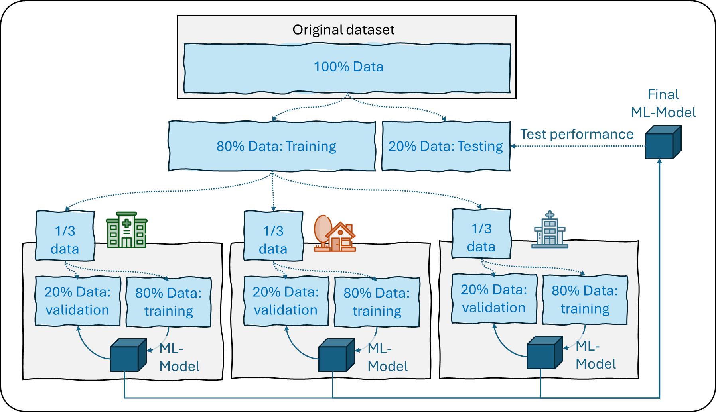
Original dataset
100% Data
Final ML-Model
Test performance
80% Data: Training
20% Data: Testing
1/3 data
1/3 data
1/3 data
20% Data: validation
80% Data: training
20% Data: validation
80% Data: training
20% Data: validation
80% Data: training
ML-Model
ML-Model
ML-Model

