Slide 1
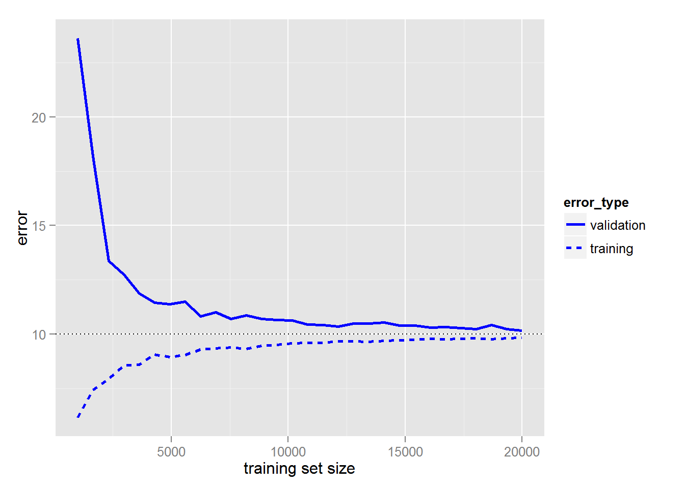

Data Prep
Dataset x
Split
70% as seen/training data
30% as unseen/testing/validating data
Evaluation
Learning Curve
Modelling
GA
Chromosomes = 7?
Population = 100
Fitness = Rank selection method – top 20%
Selection = Tournament
Crossover function = random 2 point crossover operator
Mutation operator = mutate child (take from sky) keep the fittest of d parent o child.
Replacement =
Iterations/epoch
Equation Selection
Polynomial Equation
Y = (${ax}^{2}$ + $bx$ + c) x sin(${dx}^{2}$ + $ex$ + f) + g

Slide 2
Crossover Function
Random Picked Parent 1
0 | 1 | 0 | 1 | 0 | 1 | 0
0 | 1 | 0
0 | 1 | 0 | 1
0 | 1 | 0 | 1
0 | 0 | 0
0 | 0 | 0
1 | 1 | 1 | 1 | 0 | 0 | 0
1 | 1 | 1 | 1
Random Picked Parent 2

Slide 3
nPop = 1st
a | b | c | d | e | f | g
nPop = n^{th}
a | b | c | d | e | f | g
…
1
1
1
1
1
1
1
n
n
n
n
n
n
n
nPop = 2nd
a | b | c | d | e | f | g
…
nPop = 100th
a | b | c | d | e | f | g
2
2
2
2
2
2
2
100
100
100
100
100
100
100

Slide 4
Random Picked Parent 1
0 | 1 | 0 | 1 | 0 | 1 | 0
0 | 1 | 0
0 | 1 | 0 | 1
Child
0 | 1 | 0 | 1
0 | 0 | 0
0 | 0 | 0
1 | 1 | 1 | 1 | 0 | 0 | 0
1 | 1 | 1 | 1
Child
Random Picked Parent 2
0 | 1 | 1 | 1
0 | 1 | 0
Random Replacement

Slide 5
Top 20% chromosomes

Slide 6
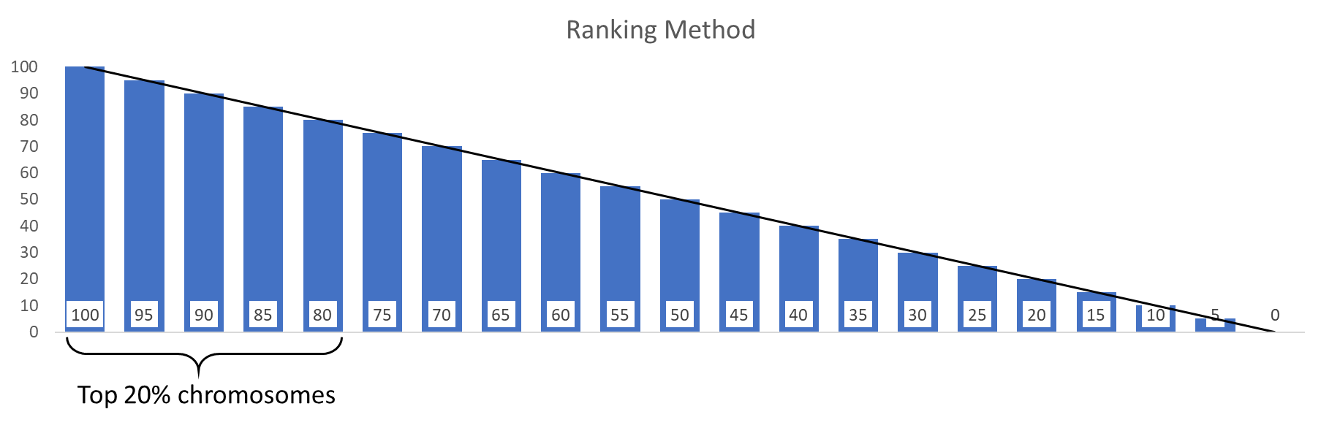
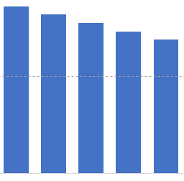
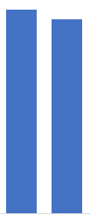
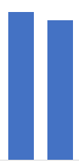
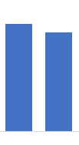
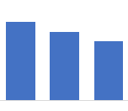
Rank
Keep
Create new offspring
Compete
+
C
P
P
C
C
Top 20%
Offspring
Random Re-generation
+
+
C
P
P
C
C

