Slide 1
Bestseller - React 2 Kursus/Workshop
Velkommen til Bestseller ReactJS Kursus/Workshop 2 – 14/1 til 17/1 2019
Indhold
React Fundamentals
React og Redux
GraphQL
REST/API
Bestseller Komponent Bibliotek (NPM)
Hands-on øvelser
Bestseller React Template Application
Mål
Forståelse for muligheder for udvikling med React som UI-Library inkl. material-ui
Udvikling af Bestseller React Template Application

Slide 2
Kursus indhold
React Fundamentals
NPM and Node.js Concepts
Material-UI
UI Components in material-ui
React-Redux
Building React Apps with React-Redux
REST API/JSON
GraphQL
Bestseller React Template Application
React Debug
React Test
Lab 1. Fundamental React
Lab 2. Basic Node.js
Lab 3. NPM
Lab 4. Material-UI basic
Lab 5. Material-UI components
Lab 5. React-Redux
Lab 6, React-Redux Rest API
Lab 7. GraphQL Basic
Lab 8. React Application
Lab 9. Debugging React
Lab 10. React Test

Slide 3
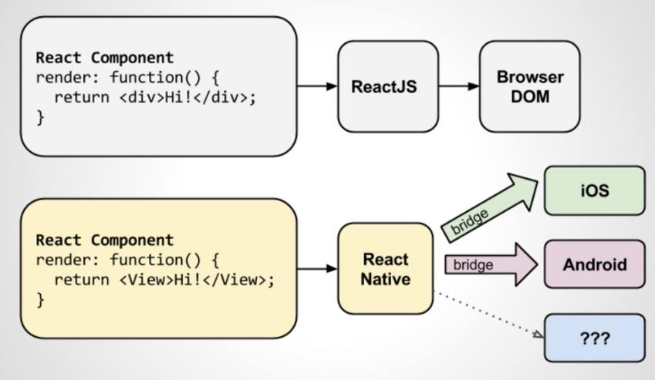
React Fundamentals
Overview
React.js and React Native
React.js often referred to as React or ReactJS is a JavaScript library responsible for building a hierarchy of UI components or in other words, responsible for the rendering of UI components. It provides support for both frontend and server-side.
React Native is a framework for building native applications using JavaScript.
React Native compiles to native app components, which makes it possible for you to build native mobile applications

Slide 4
React Fundamentals
Overview
ReactJS is JavaScript library used for building reusable UI components. According to React official documentation, following is the definition −
React is a library for building composable user interfaces. It encourages the creation of reusable UI components, which present data that changes over time. Lots of people use React as the V in MVC. React abstracts away the DOM from you, offering a simpler programming model and better performance. React can also render on the server using Node, and it can power native apps using React Native. React implements one-way reactive data flow, which reduces the boilerplate and is easier to reason about than traditional data binding.
React Features
JSX − JSX is JavaScript syntax extension. It isn't necessary to use JSX in React development, but it is recommended.
Components − React is all about components. You need to think of everything as a component. This will help you maintain the code when working on larger scale projects.
Unidirectional data flow and Redux − React implements one-way data flow which makes it easy to reason about your app. Redux is a pattern that helps keeping your data unidirectional
Seneste version: 16.7.0.

Slide 5
React Fundamentals
We expect that you already have installed these software on your computer:
Visual Studio Code (Kan findes i software center)
Git (https://git-scm.com/downloads)
NodeJS (https://nodejs.org/en/download/) for at få NPM
Test node.js og npm: node –version og npm –version
Install the create-react-app generator: npm install -g create-react-app
Create a new React application: create-react-app my-app
Start web server: cd my-app og npm start og gå til http://localhost:3000
Åben VS Code: cd my-app og skriv: code .
class HelloWorld extends React.Component {
render() {
return React.createElement("div", null, "Hello World")
}
}

Slide 6
React Fundamentals
Virtual DOM
Elements
React JSX
Components
State
Props
Props Validation
Component API
Component Life Cycle
https://github.com/KimFriisHansen/React-Kursus-2/blob/master/react-redux-fundamental/02-react.md

Slide 7
React Fundamentals
BASIC CONCEPTS
Elements
Elements are the smallest building blocks of React apps.
const element = <h1>Hello, Bestseller</h1>;
Unlike browser DOM elements, React elements are plain objects, and are cheap to create.
React DOM takes care of updating the DOM to match the React elements.
To render a React element into a root DOM node, pass both to ReactDOM.render():
const element = <h1>Hello, world</h1>;
ReactDOM.render(element, document.getElementById('root'));
React elements are immutable. Once you create an element, you can’t change its children or attributes.
Unidirectional data flow
The data in a React application flows from top to bottom.
A typical React application can be seen as a tree of components. The data always flows from the components at the higher level, to the components at the lower level.

Slide 8
React Fundamentals
BASIC CONCEPTS
React bruger JSX til templating i stedet for alm. JavaScript.
Elements, components :
- Det er hurtigere fordi det udfører optimering ved compilering til JavaScript.
- Det er type-safe og de fleste fejl fanges ved compilering
- Det er nemmere og hurtigere at skrive templates-HTML.
import React from 'react';
class App extends React.Component {
render() {
return (
<div>
Hello World!!!
</div>
);
}
}
export default App;

Slide 9
React Fundamentals
React bruger JSX til templating i stedet for alm. JavaScript.
Det er ikke nødvendigt at bruge JSX men det har nogle fordele:
- Det er hurtigere fordi det udfører optimering ved compilering til JavaScript.
- Det er type-safe og de fleste fejl fanges ved compilering
- Det er nemmere og hurtigere at skrive templates-HTML.
import React from 'react';
class App extends React.Component {
render() {
return (
<div>
Hello World!!!
</div>
);
}
}
export default App;

Slide 10
React Fundamentals - Components
The component is the essential part of React. With React you can build interactive and reusable components
Components let you split the UI into independent, reusable pieces, and think about each piece in isolation
Conceptually, components are like JavaScript functions. They accept arbitrary inputs (called “props”) and return React elements describing what should appear on the screen.
Function and Class Components
function Komponent(props) {
return <h1>Hej, {props.name}</h1>;
}
ES6 class - ECMAScript 6 is also known as ES6 and ECMAScript 2015.
import React, { Component } from 'react';
class Welcome extends React.Component {
render() { return <h1>Hej, {this.props.name}</h1>; }
}
export default Komponent;

Slide 11
React Fundamentals - State
State is the place where the data comes from. We should always try to make our state as simple as
possible and minimize the number of stateful components. If we have, for example,
ten components that need data from the state, we should create one container
component that will keep the state for all of them.
Each component has the ability to manage its own state and pass its state down to child components if needed
State is similar to props, but it is private and fully controlled by the component..
class BestsellerUser extends React.Component {
constructor(props) {
super(props)
this.state = { username: 'Angelo' }
}
render() {
return ( <div> Hej {this.state.username} </div> )
}
}

Slide 12
React Fundamentals - Props
Short for “properties”
The main difference between state and props is that props are immutable. This is why the container component should define the state that can be updated and changed, while the child components should only pass data from the state using props.
class HelloUser extends React.Component {
render() {
return ( <div> Hello, {this.props.name}</div> )
}
}
ReactDOM.render(<HelloUser name="Angelo"/>, document.getElementById('root'));

Slide 13
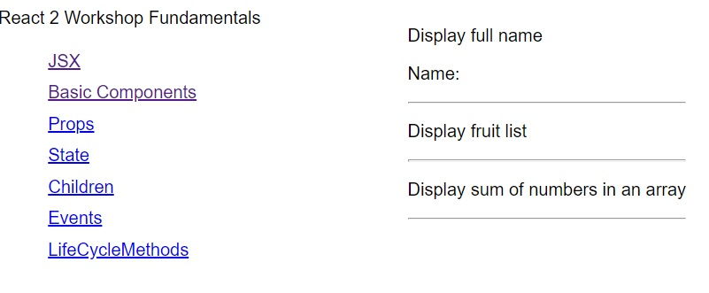
React Fundamentals - Excercise
React fundamentals exercise :
https://github.com/KimFriisHansen/React-Kursus-2/tree/master/react2-fundamental-workshop

Slide 14
Node.js
Node.js is a JavaScript runtime built on Chrome's V8 JavaScript engine.
As an asynchronous event driven JavaScript runtime, Node is designed to build scalable network applications.
const http = require('http');
const hostname = '127.0.0.1';
const port = 3000;
const server = http.createServer((req, res) => {
res.statusCode = 200;
res.setHeader('Content-Type', 'text/plain');
res.end('Hello World\n');
});
server.listen(port, hostname, () => {
console.log(`Server running at http://${hostname}:${port}/`);
});

Slide 15
NPM
NPM is the package manager for JavaScript and the world’s largest software registry.
https://www.npmjs.com/
npm is the package manager for Node.js. It was created in 2009 as an open source project to help JavaScript developers easily share packaged modules of code
The npm Registry is a public collection of packages of open-source code for Node.js, front-end web apps, mobile apps, robots, routers, and countless other needs of the JavaScript community.
npm is the command line client that allows developers to install and publish those packages.
CLI documentation: https://docs.npmjs.com/cli-documentation/
Example:
npm update [-g] [<pkg>...]
aliases: up, upgrade
Update a package

Slide 16
NPM
NPM example:
npm install (with no args, in package dir)
npm install [<@scope>/]<name>
npm install [<@scope>/]<name>@<tag>
npm install [<@scope>/]<name>@<version>
npm install [<@scope>/]<name>@<version range>
npm install <git-host>:<git-user>/<repo-name>
npm install <git repo url>
npm install <tarball file>
npm install <tarball url>
npm install <folder>
alias: npm i
common options: [-P|--save-prod|-D|--save-dev|-O|--save-optional]
[-E|--save-exact] [-B|--save-bundle] [--no-save] [--dry-run]

Slide 17
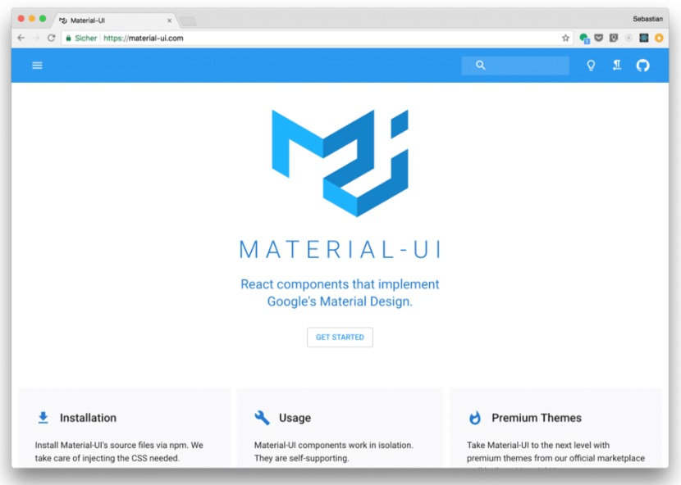
Material UI
Material UI - React components that implement Google's Material Design.
https://material-ui.com/
Installation: npm install @material-ui/core
npm install @material-ui/icons --save

Slide 18
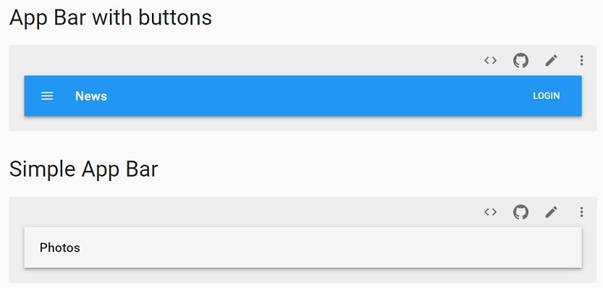
Material UI
Some Material-UI Components:
App Bar, Avatars, Badge, Bottom Navigation, Buttons,Cards
Dialogs, List Dividers, Drawer, Lists, Menus, Paper, Tables
Tabs, Text Fields, etc...
https://material-ui.com/demos/app-bar/

Slide 19
Material UI
Create a react component with the following code inside the AppButton.js file
import React, { Component } from 'react';
import Button from '@material-ui/core/Button';
class AppButton extends Component {
render() {
return (
<Button variant="contained" color="primary">
Welcome Material UI
</Button>
);
}
}
export default AppButton;
Lab/exercise: WelcomeMaterialUI

Slide 20
Material UI
Using icons in the following code.,
import React, { Component } from 'react';
import Button from '@material-ui/core/Button';
import Bookmarks from '@material-ui/icons/Bookmarks';
class AppButton2 extends Component {
render() {
return (
<Button variant="outlined" color="primary">
<Bookmarks></Bookmarks>
Chapter 2
</Button>
);
}
}
export default AppButton2;

Slide 21
Material UI
NavBar.js
import React from 'react';
import AppBar from '@material-ui/core/AppBar';
import Toolbar from '@material-ui/core/Toolbar';
const NavBar = () => {
return(
<div>
<AppBar position="static">
<Toolbar>
React Material UI Example
</Toolbar>
</AppBar>
</div>
)
}
export default NavBar;

Slide 22
Material UI
// App.js
import React, { Component } from 'react';
import Button from '@material-ui/core/Button';
import Bookmarks from '@material-ui/icons/Bookmarks';
import Navbar from './Navbar';
class App extends Component {
render() {
return (
<div>
<Navbar />
<Button variant="outlined" color="primary">
<Bookmarks></Bookmarks>
</Button>
</div>
); }
}
export default App;

Slide 23
Material UI
React material-ui stable version: "material-ui": "^0.20.2",
Check your package.json
"dependencies": {
"@material-ui/icons": "^3.0.2",
"material-ui": "^0.20.2",
"react": "^16.7.0",
"react-dom": "^16.7.0",
"react-scripts": "2.1.3"
},
Step 1: npm uninstall <package_name> “the installed @material-ui/core”
Step 2: npm install material-ui
Website: https://v0.material-ui.com/#/components/app-bar

Slide 24
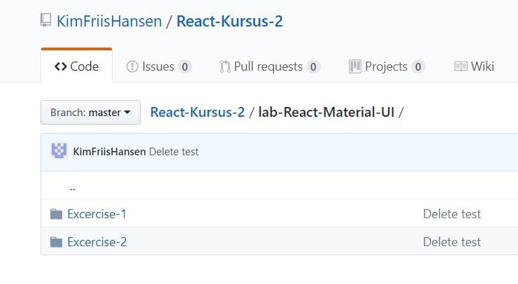
Material UI
Material-UI Lab excercises:
https://github.com/KimFriisHansen/React-Kursus-2/tree/master/lab-React-Material-UI

Slide 25
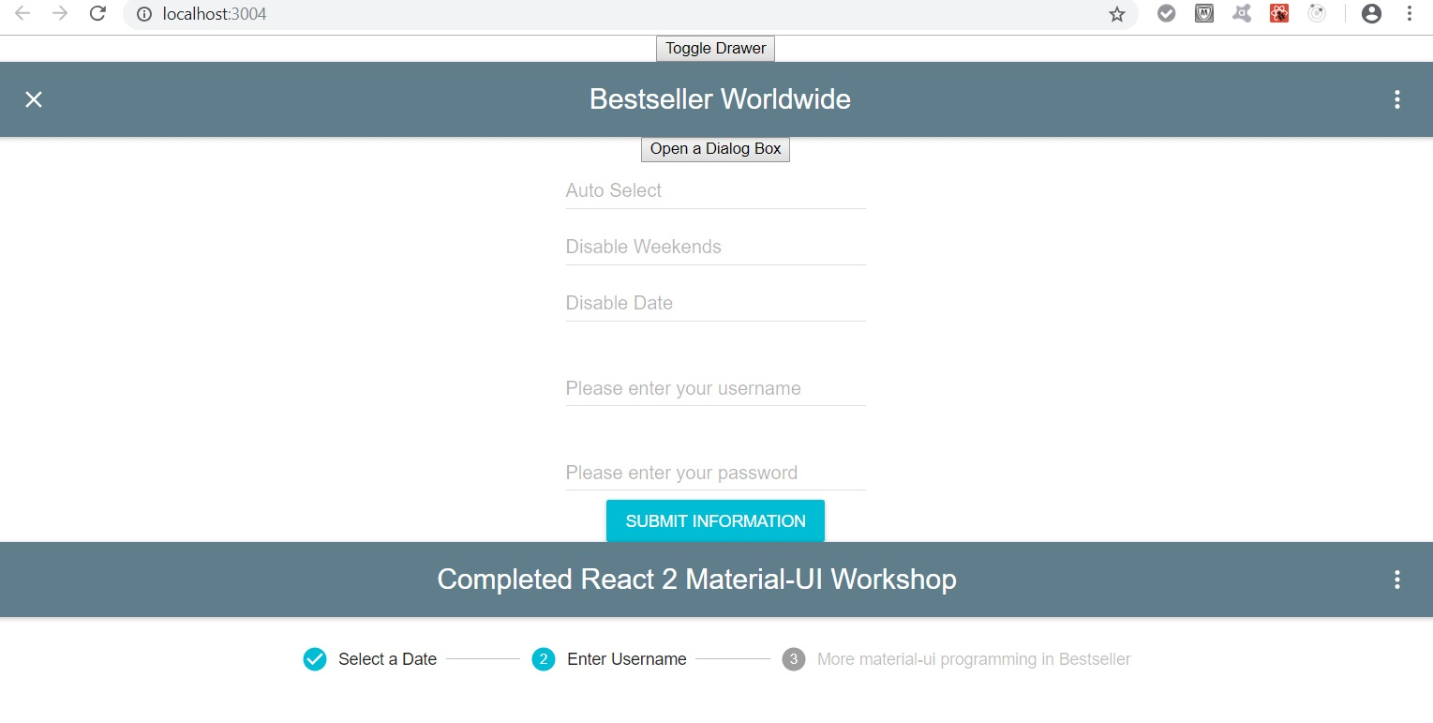
Material UI
Lab-React-Material-UI/Excercise-2

Slide 26
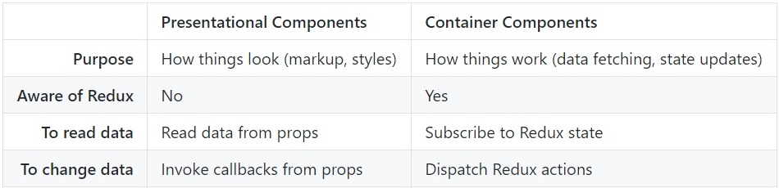
Presentational and Container Components
Container Components
Container components are primarily concerned with how things work
they rarely have any HTML tags of their own, aside from a wrapping <div>
they are often stateful
they are responsible for providing data and behavior to their children (usually presentational components)
Presentational Components
Presentational Components are primarily concerned with how things look
probably only contain a render method and little else logic
they do not know how to load or alter the data that they render
they are best written as stateless functional components

Slide 27
Presentational and Container Components
Container Component
class Collage extends Component {
constructor(props) { super(props); this.state = { images: [] }; }
componentDidMount() {
fetch('/api/current_user/image_list')
.then(response => response.json())
.then(images => this.setState({images}));
}
render() { return (
<div className="image-list">
{this.state.images.map(image => {
<div className="image">
<img src={book.image_url} />
</div> })}
</div>
)
}

Slide 28
Presentational and Container Components
Presentational Components
//defining the component as a React Component
class Image extends Component {
render() {
return <img src={this.props.image} />;
}
}
export default Image
//defining the component as a constant
const Image = props => (
<img src={props.image} />
)
export default Image

Slide 29
React Router
React Router is the de-facto React routing library, and it’s one of the most popular projects built on top of React.
React at its core is a very simple library, and it does not dictate anything about routing.
Routing in a Single Page Application is the way to introduce some features to navigating the app through links, which are expected in normal web applications:
The browser should change the URL when you navigate to a different screen
Deep linking should work: if you point the browser to a URL, the application should reconstruct the same view that was presented when the URL was generated.
The browser back (and forward) button should work like expected.
Routing links together your application navigation with the navigation features offered by the browser: the address bar and the navigation buttons.
React Router offers a way to write your code so that it will show certain components of your app only if the route matches what you define.

Slide 30
React Router
The 3 components you will interact the most when working with React Router are:
BrowserRouter, usually aliased as Router
Link
Route
BrowserRouter wraps all your Route components.
Link components are - as you can imagine - used to generate links to your routes
Route components are responsible for showing - or hiding - the components they contain.
import { BrowserRouter as Router } from 'react-router-dom'
ReactDOM.render(
<Router>
<div>
<!-- -->
</div>
</Router>,
document.getElementById('app')
)

Slide 31
React Router
Link component example:
import React from 'react'
import ReactDOM from 'react-dom'
import { BrowserRouter as Router, Link } from 'react-router-dom'
ReactDOM.render(
<Router>
<div>
<aside>
<Link to={`/dashboard`}>Dashboard</Link>
<Link to={`/about`}>About</Link>
</aside>
<!-- -->
</div
</Router>,
document.getElementById('app')
)

Slide 32
React Router
NavLink component excercise:
React-Kursus-1/ApplicationRouter/
Files:
Hovedside.jsx
Kunder.jsx
NavigeringApp.js
Produkter.jsx
Opg. 1: Opret filer i VS Code og kopier koden fra git
Opg 2: Tilret index.js så router komponenten kaldes og vises
Opg 3: Der er en fejl, find den og ret den :-)
Opg 4. Opret en ny komponent, f.eks Style.jsx og tilføj den I navigeringen
Opg 5. Opret en ny navigerings komponent med komponenter der kan navigeres til..

Slide 33
Building React Apps with Redux
Redux is a predictable state container for JavaScript apps.
It helps you write applications that behave consistently, run in different environments (client, server, and native), and are easy to test. On top of that, it provides a great developer experience, such as live code editing combined with a time traveling debugger.
You can use Redux together with React, or with any other view library. It is tiny (2kB, including dependencies), but has a large ecosystem of addons available
React bindings for Redux separate presentational components from container components.
This approach can make your app easier to understand and allow you to more easily reuse components

Slide 34
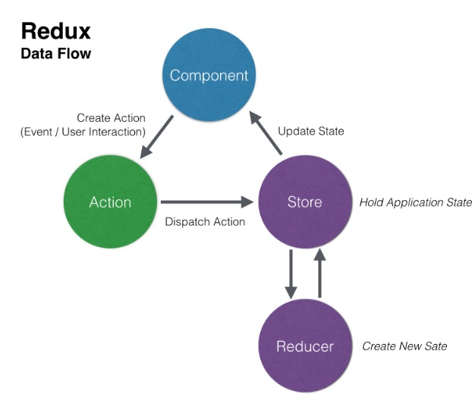
Building React Apps with Redux
Redux Flow

Slide 35
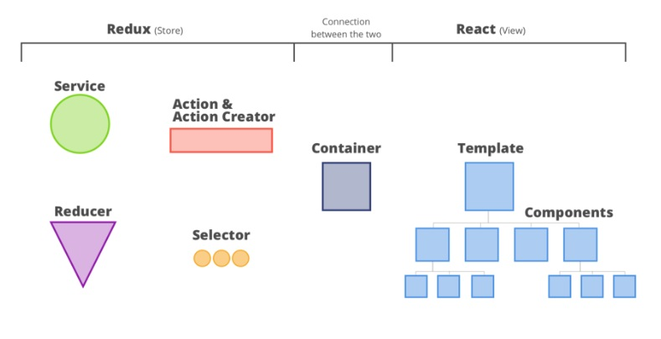
Building React Apps with Redux
Parts and Connections
Service API
Actions
Reducers
Selector
Container
Components.

Slide 36
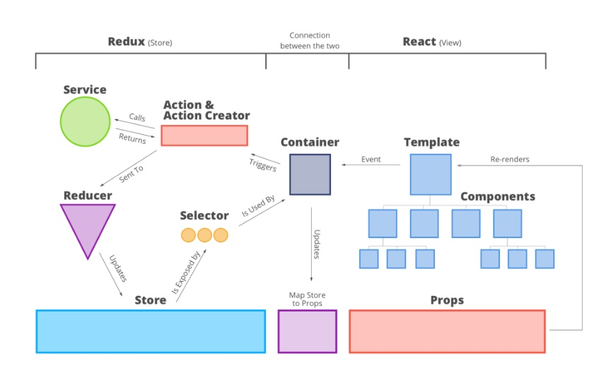
Building React Apps with Redux
Mapping and flow.

Slide 37
Building React Apps with Redux
https://redux.js.org/
https://www.npmjs.com/package/react-redux
npm install --save react-redux
https://www.npmjs.com/package/redux
npm install redux

Slide 38
Fetching Data from a REST API/JSON or GraphQL
Fetching Data
Apollo: Easy to set up and use GraphQL client.
Axios: Promise based HTTP client for the browser and node.js.
Relay Modern - A JavaScript framework for building data-driven React applications.
Request: Simplified HTTP request client.
Superagent: A lightweight “isomorphic” library for AJAX requests.

Slide 39
Fetching Data from a REST API/JSON
AJAX call
You can use any AJAX library you like with React. Some popular ones are Axios, jQuery AJAX, and the browser built-in window.fetch.
You should populate data with AJAX calls in the componentDidMount lifecycle method. This is so you can use setState to update your component when the data is retrieved.
React simply renders components, using data from only two places: props and state.
Choose an HTTP Library - To fetch that data from the server, you’ll need an HTTP library.
Axios, Superagent, Fetch, etc
example axios GET REQUESTS
const axios = require('axios')
const getData = async () => {
try {
return await axios.get('https://bestseller.com/api/data/list/all')
} catch (error) {
console.error(error)
}
}

Slide 40
Fetching Data from a REST API/JSON
Basic React.js fetch API example
import React, { Component } from 'react';
class App extends Component {
constructor(props) {
super(props);
this.state = { data: null, };
}
componentDidMount() {
fetch('https://api.mydomain.com')
.then(response => response.json())
.then(data => this.setState({ data }));
}
...
}
export default App;

Slide 41
Fetching Data from a REST API/JSON
//data from backend API
const data = { clothing: 2, shoes: 3, //...many more props}
//Parsing maps or logic which will be used for translations in UI
const clothing_Map = { 1: "Men", 2: "Women" }
const shoes_Map = { 1: "Addidas", 2: "Nike" }
//Render Root component in DOM
ReactDOM.render(
<Root {...data} />,
document.getElementById('root')
);
class Root extends React.Component { //TODO.... Root will pass props to Clothing and Shoes }
class Clothing extends React.Component {
//TODO...define component
}
class Shoes extends React.Component {
//TODO...define component
}

Slide 42
GraphQL
REST and GraphQL are two ways to send data over HTTP.
The REST-based approach is the traditional way of doing so and has gained a very high adoption rate in many application stacks in the last years.
As REST, GraphQL is an API design architecture, but with a different approach which is much flexible.
The main and most important difference is that GraphQL is not dealing with dedicated resources.
Instead everything is regarded as a graph and therefore is connected.
In GraphQL you simply send a single query to the GraphQL server that includes the concrete data requirements.
The server then responds with a JSON object where these requirements are fulfilled.
One of the most common problems with REST is that of over- and underfetching.
This happens because the only way for a client to download data is by hitting endpoints that return fixed data structures.
It’s very difficult to design the API in a way that it’s able to provide clients with their exact data needs.

Slide 43
GraphQL
To handle GraphQL queries, we need a schema that defines the Query type,
and we need an API root with a function called a “resolver” for each API endpoint. This API returns “Hello world!”.
var { graphql, buildSchema } = require('graphql');
// Construct a schema, using GraphQL schema language
var schema = buildSchema(`
type Query {
hello: String
}
`);
// The root provides a resolver function for each API endpoint
var root = { hello: () => { return 'Hello world!'; },};
// Run the GraphQL query '{ hello }' and print out the response
graphql(schema, '{ hello }', root).then((response) => {
console.log(response);
});

Slide 44
GraphQL -React
https://graphql.org/
https://www.apollographql.com/
https://github.com/facebook/graphql

Slide 45
GraphQL -React
Server-side Components
Schema
A GraphQL schema is at the center of any GraphQL server implementation and describes the functionality available to the clients which connect to it.
Query
A GraphQL query is the client application request to retrieve data from database or legacy API's.
Resolver
Resolvers provide the instructions for turning a GraphQL operation into data. They resolve the query to data by defining resolver functions.
Client-side Components
GraphiQL
Browser based interface for editing and testing GraphQL queries and mutations.
ApolloClient
Best tool to build GraphQL client applications. Integrates well with all javascript front-end.

Slide 46
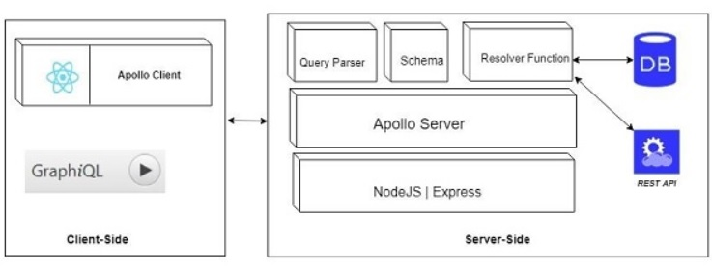
GraphQL -React
Client-Server Architecture/Components

Slide 47
GraphQL
GraphQL server with Nodejs
C:\Users\Admin>mkdir test-app
C:\Users\Admin>cd test-app
C:\Users\Admin\test-app>code .
Lab/Excercise - GraphQL
https://github.com/KimFriisHansen/React-Kursus-2/tree/master/lab-GraphQL
Install the dependencies from package.json
Create a Data Access Layer - db.js
Create Schema File, schema.graphql
Create Resolver File, resolvers.js
Server.js and Configure GraphQ server.js
npm start running on port 9000
Try http://localhost:9000/graphiql
{
Test
}

Slide 48
GraphQL
Create a data\department.json
[
{
"id": "S1001",
"name":"Bestseller",
"created_date":"25-SEP-05",
"email": "workshop2@bestseller.dk",
"password": "pass123",
"brandId": "col-102"
},
]

Slide 49
GraphQL
Create a data\brandhouse.json
[
{
"id": "col-101",
"name": "ONLY",
"location": "Brande",
"rating":1.0
},
{
"id": "col-102",
"name": "Jack & Jones",
"location": "Århus",
"rating":2.5
}
]

