Slide 1
Bestseller - React 3 Kursus/Workshop
Velkommen til Bestseller ReactJS Kursus/Workshop 3 – 28/1 til 29/1 2019
Indhold
React og Redux
Test/Jest/Enzyme
Introduktion til Bestseller React Template Application
Hands-on øvelser
Mål
Forståelse for React-Redux, Test af React komponenter og applikationer

Slide 2
Kursus/Workshop indhold
Material-UI
React-Redux
React Test
React Jest
React Enzyme
Apps with React-Redux
GraphQL
Lab 1. React-Redux
Lab 2. Material-UI and React-Redux
Lab 3. React Debug
Lab 4. React Test Jest
Lab 5. React Jest/Enzyme
Lab 6. Debugging
Lab 7. Apps with React-Redux
Lab 8. GraphQL

Slide 3
React-Redux
Redux is a predictable state container for JavaScript apps.
It helps you write applications that behave consistently, run in different environments (client, server, and native), and are easy to test. On top of that, it provides a great developer experience, such as live code editing combined with a time traveling debugger.
You can use Redux together with React, or with any other view library. It is tiny (2kB, including dependencies), but has a large ecosystem of addons available
React bindings for Redux separate presentational components from container components.
This approach can make your app easier to understand and allow you to more easily reuse components
react-redux is a Redux binding for React. It’s a small library for connecting Redux and React in an efficient way.
The most important method you’ll work with is connect.
What does react-redux’s connect do? Unsurprisingly it connects a React component with the Redux store.
You will use connect with two or three arguments depending on the use case. The fundamental things to know are:
the mapStateToProps function
the mapDispatchToProps function

Slide 4
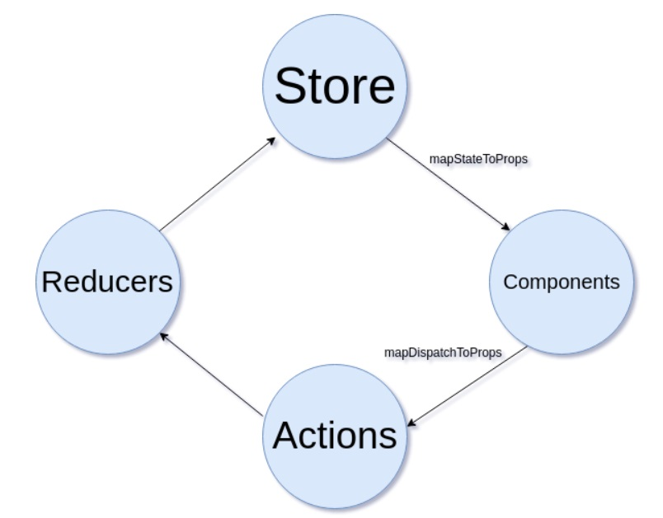
React-Redux
import { connect } from 'react-redux'
the mapStateToProps function
the mapDispatchToProps function

Slide 5
React-Redux
'react-redux' - state container for handling javascript application state.
A single object tree stores all of your application state
State is readonly and changes are triggered by actions
The state can only be manipulated by pure functions that are triggered by your actions
Actions
Action creators
Reducers
Creating a store
Store methods
getState
dispatch
Combining reducers
Provider
Connecting a component
mapStateToProps
mapDispatchToProps

Slide 6
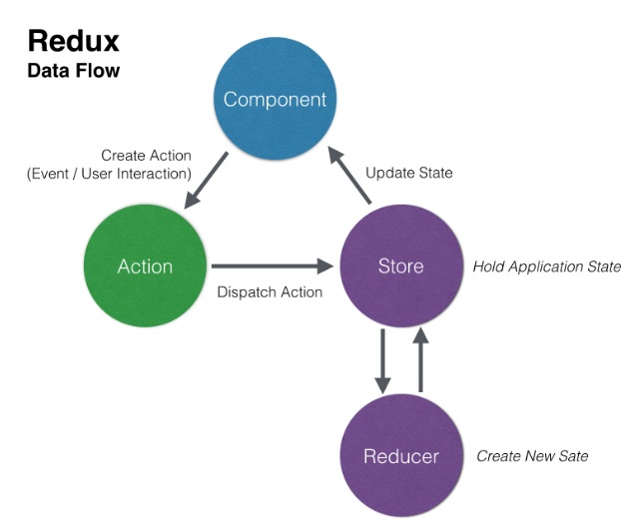
React-Redux
Redux Flow

Slide 7
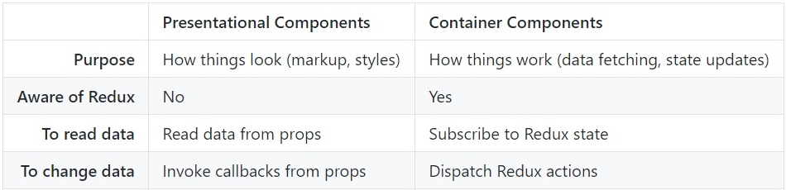
Presentational and Container Components
Container Components
Container components are primarily concerned with how things work
they rarely have any HTML tags of their own, aside from a wrapping <div>
they are often stateful
they are responsible for providing data and behavior to their children (usually presentational components)
Presentational Components
Presentational Components are primarily concerned with how things look
probably only contain a render method and little else logic
they do not know how to load or alter the data that they render
they are best written as stateless functional components

Slide 8
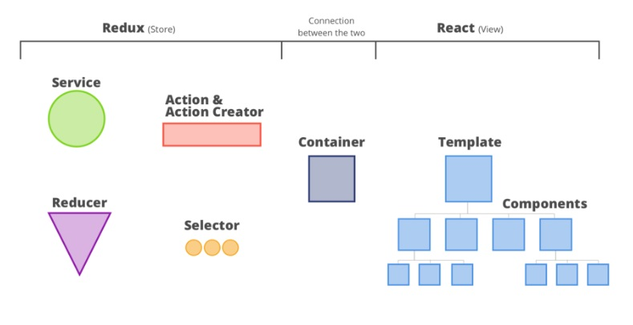
Building React Apps with Redux
Parts and Connections
Service API
Actions
Reducers
Selector
Container
Components.

Slide 9
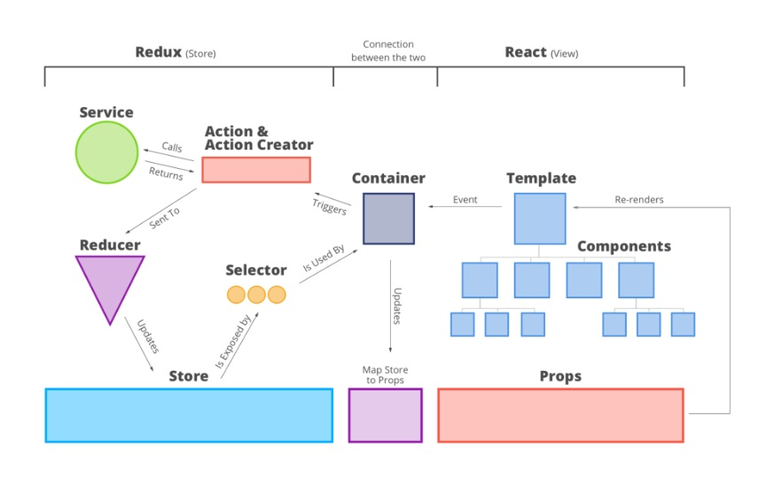
Building React Apps with Redux
Mapping and flow.

Slide 10
Building React Apps with Redux
Redux Flow

Slide 11
Building React Apps with Redux
https://redux.js.org/
https://www.npmjs.com/package/react-redux
npm install --save react-redux
https://www.npmjs.com/package/redux
npm install redux

Slide 12
React Test/Jest/Enzyme
Jest
https://jestjs.io/en/
Jest is a JavaScript unit testing framework, used by Facebook to test services and React applications.
Jest acts as a test runner, assertion library, and mocking library.
Enzyme
https://airbnb.io/enzyme/
Enzyme is a JavaScript Testing utility for React that makes it easier to assert, manipulate, and traverse your React Components’ output.
Enzyme adds some great additional utility methods for rendering a component (or multiple components), finding elements, and interacting with elements.
Jest and Enzyme are different but complimentary tools, that integrate well together to provide flexible and creative testing abilities
As described, we will use:
Jest as the test runner, assertion library, and mocking library
Enzyme to provide additional testing utilities to interact with elements

Slide 13
React Test/Jest/Enzyme
Create React App uses Jest as its test runner
Install Enzyme: npm install --save-dev enzyme enzyme-adapter-react-16 enzyme-to-json
Update your package.json :
"jest": {
"snapshotSerializers": ["enzyme-to-json/serializer"]
}
Create a setupTests.js file at ./src/setupTests.js:
import { configure } from 'enzyme';
import Adapter from 'enzyme-adapter-react-16';
configure({ adapter: new Adapter() });
React renderer that can be used to render React components to pure JavaScript objects, without depending on the DOM or a native mobile environment.
npm i react-test-renderer

Slide 14
React Test/Jest/Enzyme
Jest will go through your project searching for 3 types of files:
Ones held in every folder called __tests__
Every each and single file with *.test.js extension
Every each and single file with *.spec.js extension
npm test
Coverage Reporting
npm test -- --coverage
Link: https://facebook.github.io/create-react-app/docs/running-tests#writing-tests

Slide 15
React Test/Jest/Enzyme
Jest will go through your project searching for 3 types of files:
Ones held in every folder called __tests__
Every each and single file with *.test.js extension
Every each and single file with *.spec.js extension
npm test
Coverage Reporting
npm test -- --coverage
Link: https://facebook.github.io/create-react-app/docs/running-tests#writing-tests

Slide 16
React Test/Jest/Enzyme
Simpel example – test sum function
Sum.js
function sum(a, b) {
return a + b;
}
module.exports = sum;
sum.test.js
const sum = require('./sum');
test('adds 1 + 2 to equal 3', () => {
expect(sum(1, 2)).toBe(3);
});

Slide 17
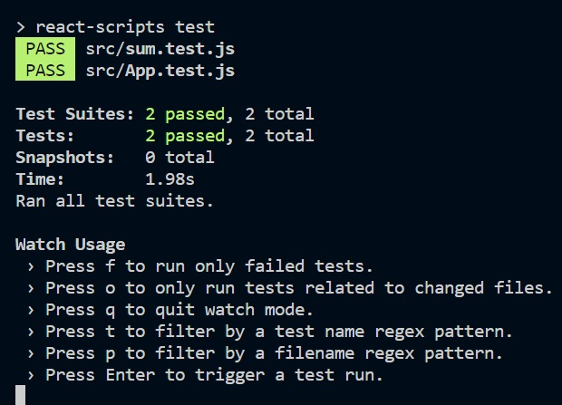
React Test/Jest/Enzyme
Npm test

Slide 18
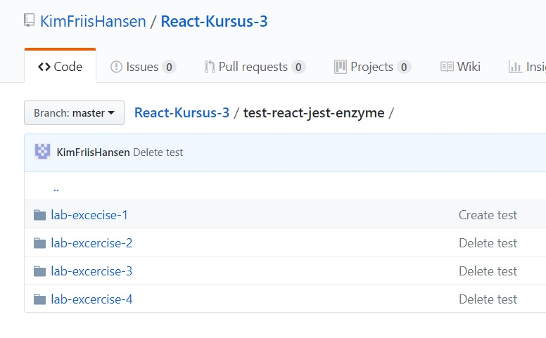
React Test/Jest/Enzyme
Test Lab-Excercises
https://github.com/KimFriisHansen/React-Kursus-3/tree/master/test-react-jest-enzyme/lab-excecise-1
https://github.com/KimFriisHansen/React-Kursus-3/tree/master/test-react-jest-enzyme/lab-excercise-2
https://github.com/KimFriisHansen/React-Kursus-3/tree/master/test-react-jest-enzyme/lab-excercise-3
https://github.com/KimFriisHansen/React-Kursus-3/tree/master/test-react-jest-enzyme/lab-excercise-4

Slide 19
React Test/Jest/Enzyme
Test Lab-Excercises
https://github.com/KimFriisHansen/React-Kursus-3/tree/master/test-react-jest-enzyme/lab-excercise-4
Test cases on:
action
reducer
component

Slide 20
Debugging React
install the Debugger for Chrome extension.
https://code.visualstudio.com/docs/nodejs/reactjs-tutorial#_debugging-react
Create file: launch.json
{
"version": "0.2.0",
"configurations": [
{
"type": "chrome",
"request": "launch",
"name": "Launch Chrome against localhost",
"url": "http://localhost:3000",
"webRoot": "${workspaceFolder}"
}
]
}

Slide 21
Fetching Data from a REST API/JSON or GraphQL
Fetching Data
Apollo: Easy to set up and use GraphQL client.
Axios: Promise based HTTP client for the browser and node.js.
Relay Modern - A JavaScript framework for building data-driven React applications.
Request: Simplified HTTP request client.
Superagent: A lightweight “isomorphic” library for AJAX requests.

Slide 22
Fetching Data from a REST API/JSON
AJAX call
You can use any AJAX library you like with React. Some popular ones are Axios, jQuery AJAX, and the browser built-in window.fetch.
You should populate data with AJAX calls in the componentDidMount lifecycle method. This is so you can use setState to update your component when the data is retrieved.
React simply renders components, using data from only two places: props and state.
Choose an HTTP Library - To fetch that data from the server, you’ll need an HTTP library.
Axios, Superagent, Fetch, etc
example axios GET REQUESTS
const axios = require('axios')
const getData = async () => {
try {
return await axios.get('https://bestseller.com/api/data/list/all')
} catch (error) {
console.error(error)
}
}

Slide 23
Fetching Data from a REST API/JSON
Basic React.js fetch API example
import React, { Component } from 'react';
class App extends Component {
constructor(props) {
super(props);
this.state = { data: null, };
}
componentDidMount() {
fetch('https://api.mydomain.com')
.then(response => response.json())
.then(data => this.setState({ data }));
}
...
}
export default App;

Slide 24
Fetching Data from a REST API/JSON
//data from backend API
const data = { clothing: 2, shoes: 3, //...many more props}
//Parsing maps or logic which will be used for translations in UI
const clothing_Map = { 1: "Men", 2: "Women" }
const shoes_Map = { 1: "Addidas", 2: "Nike" }
//Render Root component in DOM
ReactDOM.render(
<Root {...data} />,
document.getElementById('root')
);
class Root extends React.Component { //TODO.... Root will pass props to Clothing and Shoes }
class Clothing extends React.Component {
//TODO...define component
}
class Shoes extends React.Component {
//TODO...define component
}

Slide 25
GraphQL
REST and GraphQL are two ways to send data over HTTP.
The REST-based approach is the traditional way of doing so and has gained a very high adoption rate in many application stacks in the last years.
As REST, GraphQL is an API design architecture, but with a different approach which is much flexible.
The main and most important difference is that GraphQL is not dealing with dedicated resources.
Instead everything is regarded as a graph and therefore is connected.
In GraphQL you simply send a single query to the GraphQL server that includes the concrete data requirements.
The server then responds with a JSON object where these requirements are fulfilled.
One of the most common problems with REST is that of over- and underfetching.
This happens because the only way for a client to download data is by hitting endpoints that return fixed data structures.
It’s very difficult to design the API in a way that it’s able to provide clients with their exact data needs.

Slide 26
GraphQL
To handle GraphQL queries, we need a schema that defines the Query type,
and we need an API root with a function called a “resolver” for each API endpoint. This API returns “Hello world!”.
var { graphql, buildSchema } = require('graphql');
// Construct a schema, using GraphQL schema language
var schema = buildSchema(`
type Query {
hello: String
}
`);
// The root provides a resolver function for each API endpoint
var root = { hello: () => { return 'Hello world!'; },};
// Run the GraphQL query '{ hello }' and print out the response
graphql(schema, '{ hello }', root).then((response) => {
console.log(response);
});

Slide 27
GraphQL -React
https://graphql.org/
https://www.apollographql.com/
https://github.com/facebook/graphql

Slide 28
GraphQL -React
Server-side Components
Schema
A GraphQL schema is at the center of any GraphQL server implementation and describes the functionality available to the clients which connect to it.
Query
A GraphQL query is the client application request to retrieve data from database or legacy API's.
Resolver
Resolvers provide the instructions for turning a GraphQL operation into data. They resolve the query to data by defining resolver functions.
Client-side Components
GraphiQL
Browser based interface for editing and testing GraphQL queries and mutations.
ApolloClient
Best tool to build GraphQL client applications. Integrates well with all javascript front-end.

Slide 29
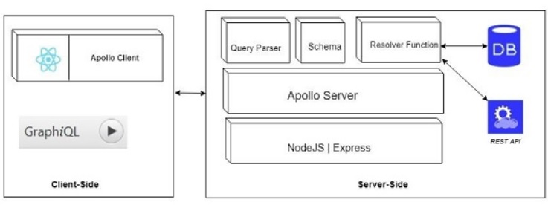
GraphQL -React
Client-Server Architecture/Components

Slide 30
GraphQL
GraphQL server with Nodejs
C:\Users\Admin>mkdir test-app
C:\Users\Admin>cd test-app
C:\Users\Admin\test-app>code .
Lab/Excercise - GraphQL
https://github.com/KimFriisHansen/React-Kursus-2/tree/master/lab-GraphQL
Install the dependencies from package.json
Create a Data Access Layer - db.js
Create Schema File, schema.graphql
Create Resolver File, resolvers.js
Server.js and Configure GraphQ server.js
npm start running on port 9000
Try http://localhost:9000/graphiql
{
Test
}

Slide 31
GraphQL
Create a data\department.json
[
{
"id": "S1001",
"name":"Bestseller",
"created_date":"25-SEP-05",
"email": "workshop2@bestseller.dk",
"password": "pass123",
"brandId": "col-102"
},
]

Slide 32
GraphQL
Create a data\brandhouse.json
[
{
"id": "col-101",
"name": "ONLY",
"location": "Brande",
"rating":1.0
},
{
"id": "col-102",
"name": "Jack & Jones",
"location": "Århus",
"rating":2.5
}
]

