Slide 1
Citizen Permit & Licensing System
Streamlining government services through digital transformation, transparency and efficiency
Student: NGABONZIZA Kim Gakuba (27670)

Slide 2

Problem Definition & context
Inefficient manual processes for permit and license applications lead to delays, errors, and lack of transparency in government services.
Specific Issue: Citizens face long wait times, redundant paperwork, and inconsistent reviews across departments.
Current Pain Points: High administrative burden, risk of corruption, and poor tracking of application status.
CONTEXT: used within government regulatory bodies and municipal offices where managing the end-to-end lifecycle of permits is critical for public service.

Slide 3

Target users & project goals
Target Users
Citizens: Seeking faster, transparent service.
Businesses: requiring operational licenses.
Government staff: needing efficient workflow tools.
Administrators: requiring oversight data.
Project goals
Transparency: real-time tracking for all stakeholders.
Efficiency: Reduce processing delays by 50%
Service delivery: digital-first, user friendly access.
Compliance: standardized validation rules.

Slide 4

End-to-end lifecycle
A streamlined digital workflow ensuring rapid processing and accountability.
Submission
Citizens submit applications via secure online portal with document upload.
Validation
Automated system checks for completeness and valid prerequisites
Review
Departmental staff review, comment and process approvals digitally.
Issuance
Official permit is generated and issued electronically to the citizen.

Slide 5
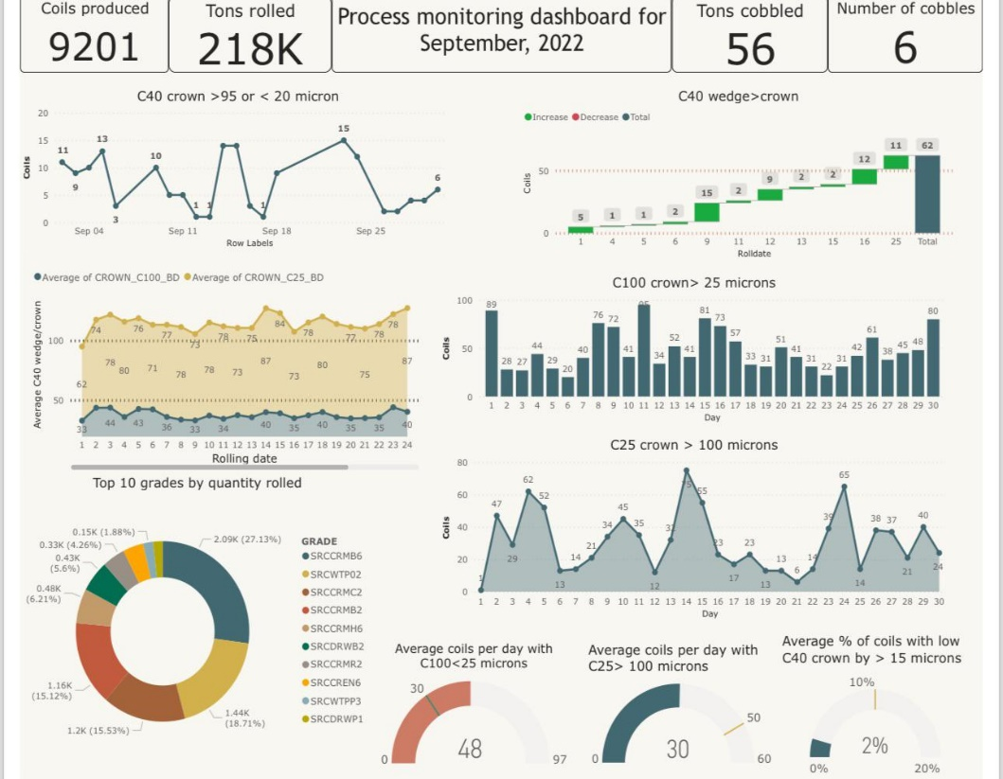
Business intelligence (bi)
Data-Driven decision making
Analytics enhance governance by transforming raw data into actionable insights:
Bottleneck analysis: identity which departments have the longest hold times.
Resource allocation: Predict licensing fees for budget planning.
Revenue forecasting: predict licensing fees for budget planning.
Fraud detection: flag anomalies in application patterns.

