Slide 1

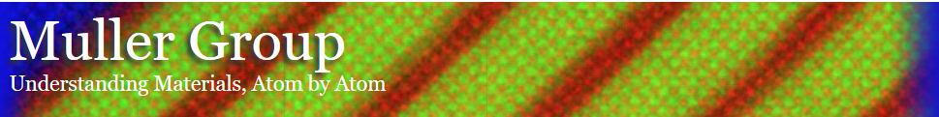
Data from a thick Nb₃Cl₈ sample for multi-slice ptychography
Zhen Chen
5/6/2018
Cornell University
School of Applied and Engineering of Physics

Slide 2
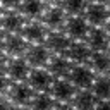
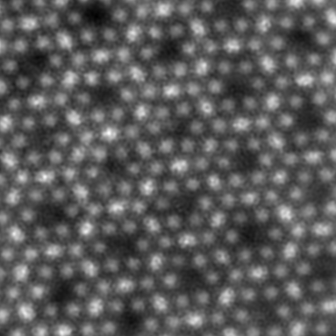
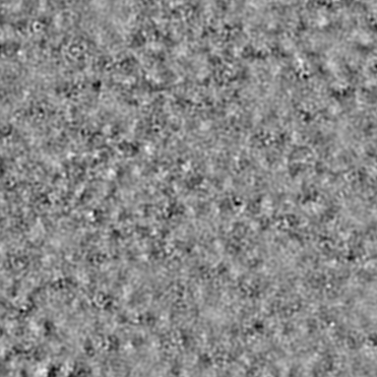
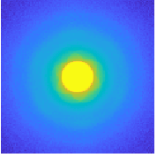
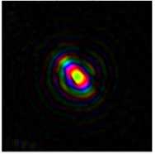
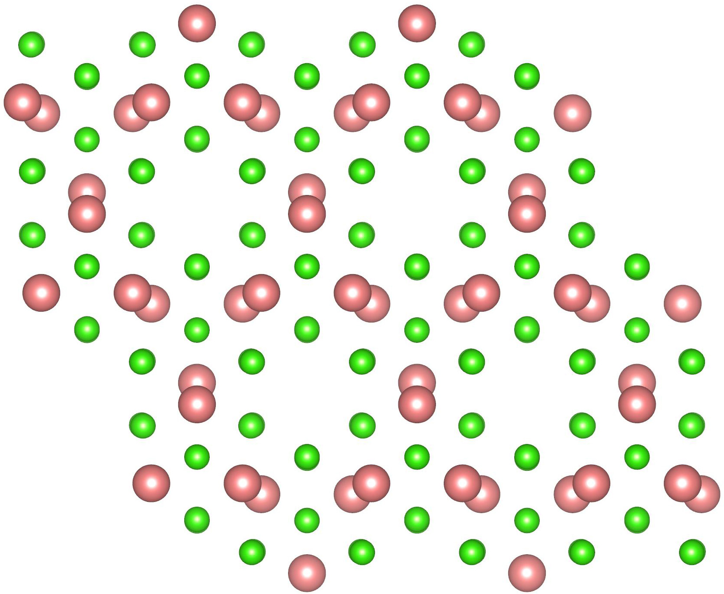
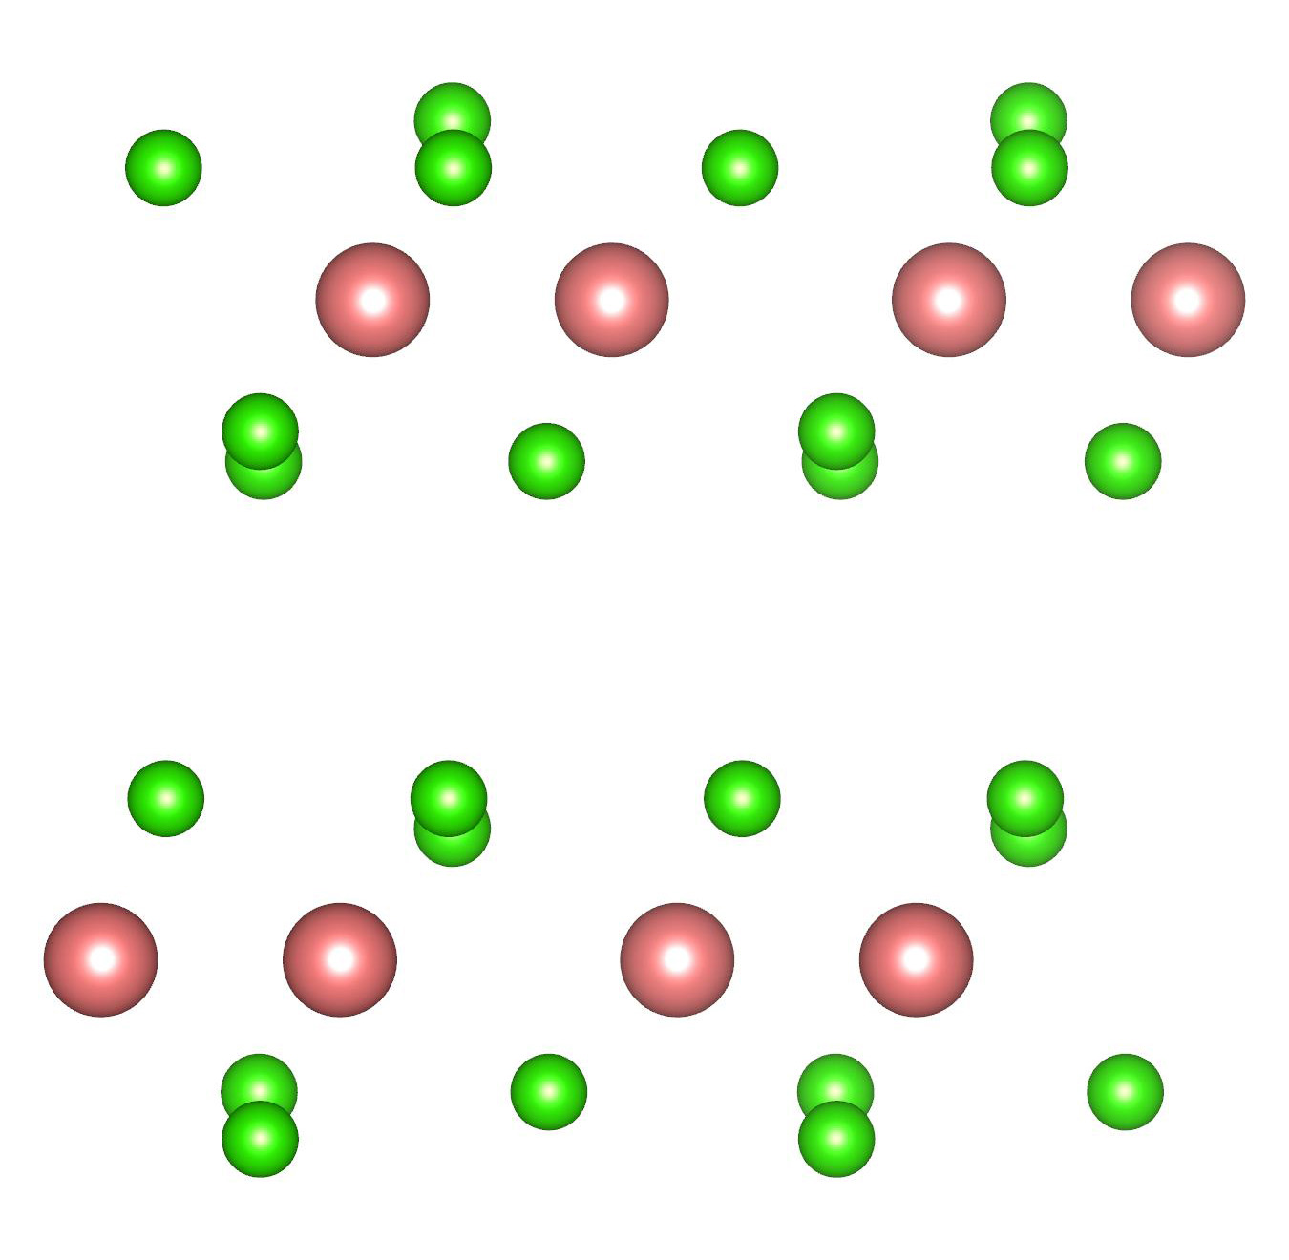
parameters:
voltage 120 kV
convergence angle 24 mrad
rotation angle 30⁰
scan step 0.43 Å
Single-slice Ptychography: Thickness limited resolution
ptychography
Annular dark-field image
Phase
Amplitude
dataset 83
Thickness of this sample is ~4 nm. The basic structure can be resolved from single-slice ptychography, but the 0.67 Å Nb-Nb dumbbell cannot be resolved.
scan position average diffraction
probe from ptychography
Structure model of this sample
0.67Å
13.375 Å
Nb
Cl
Notes:
83

Slide 3
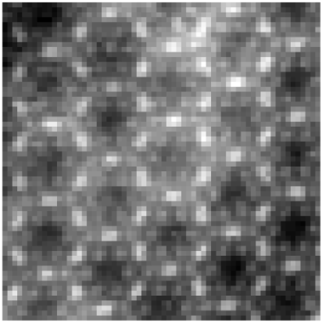
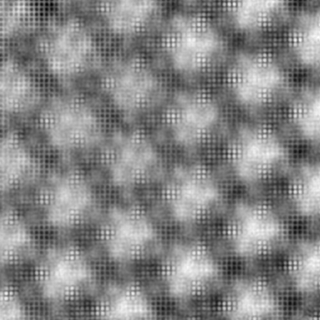
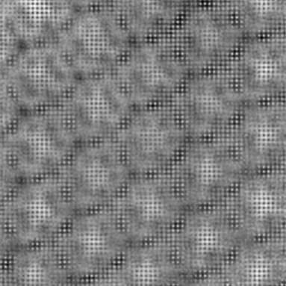
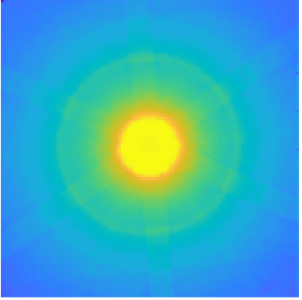

ePIE from a thicker sample
semi-convergence angle α=24 mrad, electron energy 120 keV
Single slice ptychography
Annular dark-field image
Phase
Amplitude
dataset 17
Thickness of this sample is ~16 nm
Thickness limit for a resolution 0.67 Å (using the equation below) is ~7nm
scan position average diffraction
Notes:
17

Slide 4
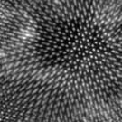
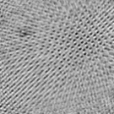
ePIE of dataset from a bilayer WS₂/MoSe₂ sample
Phase
Amplitude
parameters:
voltage 80 kV
convergence angle 21.4 mrad
rotation angle 30⁰
scan step 0.85 Å
defocus ~56 nm

