Slide 1
Face privacy
인텔 엣지AI 3기 김명준

Slide 2
Face Privacy
카메라에 잡히는 사람들의 개인정보 보호를 위하여 미등록 사용자 얼굴을 기본적으로 모자이크 처리를 하고, 손동작을 인식하여 모자이크 처리를 해제하거나 (얼굴이 보인다) 모자이크 처리 대신 얼굴 감정을 나타내는 이모티콘을 추가한다.

Slide 3
Mobility issues
휴대성의 문제

Slide 4
alternatives
Mobile App
Cloud-based
PyQT5
휴대기기의 성능 문제
다수의 인공지능 모델을 효과적으로 사용할 수 있을까?
휴대기기에서 사용을 전제
인공지능 모델을 활용하기에 부족한 하드웨어는 클라우드 서버 사용으로 해결
Amazon Interactive Video Service를 사용하는 데모 제작 중
휴대 가능한 해법이 불가능할 경우 마지막 선택

Slide 5
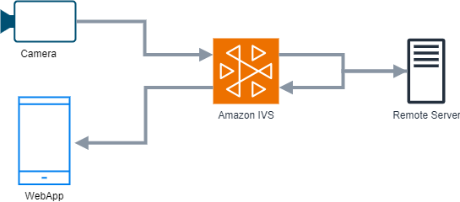
Cloud-based web app workflow

Slide 6
alternatives
CLOUD-BASED
CLOUD-BASED OPPORTUNITIES
Develop winning strategies to keep ahead of the competition
​Capitalize on low hanging fruit to identify a ballpark value
​Visualize customer directed convergence​
Iterative approaches to corporate strategy
​Establish a management framework from the inside​

Slide 7
AREAS OF GROWTH
​ | CATEGORY 1 | CATEGORY 2 | CATEGORY 3​ | CATEGORY 4​
Q1 | 4.5​ | 2.3​ | 1.7​ | 5​.0
Q2 | 3.2​ | 5.1​ | 4.4​ | 3​.0
Q3 | 2.1​ | 1.7​ | 2.5​ | 2.8​
Q4 | 4.5​ | 2.2​ | 1.7​ | 7.0

Slide 8
AGENDA
Introduction
Primary goals
Areas of growth
Timeline
Summary

Slide 9
BUSINESS OPPORTUNITIES ARE LIKE BUSES. THERE'S ALWAYS ANOTHER ONE COMING.​
Richard Branson

Slide 10




MEET OUR TEAM
TAKUMA HAYASHI
MIRJAM NILSSON
FLORA BERGGREN
RAJESH SANTOSHI
President
Chief Executive Officer
Chief Operations Officer
VP Marketing

Slide 11








MEET OUR TEAM
TAKUMA HAYASHI
MIRJAM NILSSON
RAJESH SANTOSHI
RAJESH SANTOSHI
President
Chief Executive Officer
Chief Operations Officer
VP Marketing
GRAHAM BARNES
ROWAN MURPHY
ELIZABETH MOORE
ROBIN KLINE
VP Product
SEO Strategist
Product Designer
Content Developer

Slide 12
PLAN FOR PRODUCT LAUNCH
Deploy strategic networks with compelling e-business needs
PLANNING
Synergize scalable e-commerce
MARKETING
Disseminate standardized metrics
DESIGN
Coordinate e-business applications
Foster holistically superior methodologies
LAUNCH
STRATEGY

Slide 13
TIMELINE
Q1
Synergize scalable e-commerce
Q2
Coordinate e-business applications
Q3
Deploy strategic networks with compelling e-business needs
Q4
Disseminate standardized metrics

Slide 14
SUMMARY
At Contoso, we believe in giving 110%. By using our next-generation data architecture, we help organizations virtually manage agile workflows. We thrive because of our market knowledge and great team behind our product. As our CEO says, "Efficiencies will come from proactively transforming how we do business."​

Slide 15
THANK YOU
Mirjam Nilsson
mirjam@contoso.com
www.contoso.com

