Slide 1
Water Pollution
in Califonia State
Behind the Scene
Hello
We’re [Chow Mein]
Kwon Taehyung Kim Hyungkeun

Slide 2
Contents
Story
Data mining
Data Visualizaiton

Slide 3
Why we make movie in data science?
We want to focus on story about our data.
We want to visualize of fluid data
It’s hard and take many time to develop web app...

Slide 4
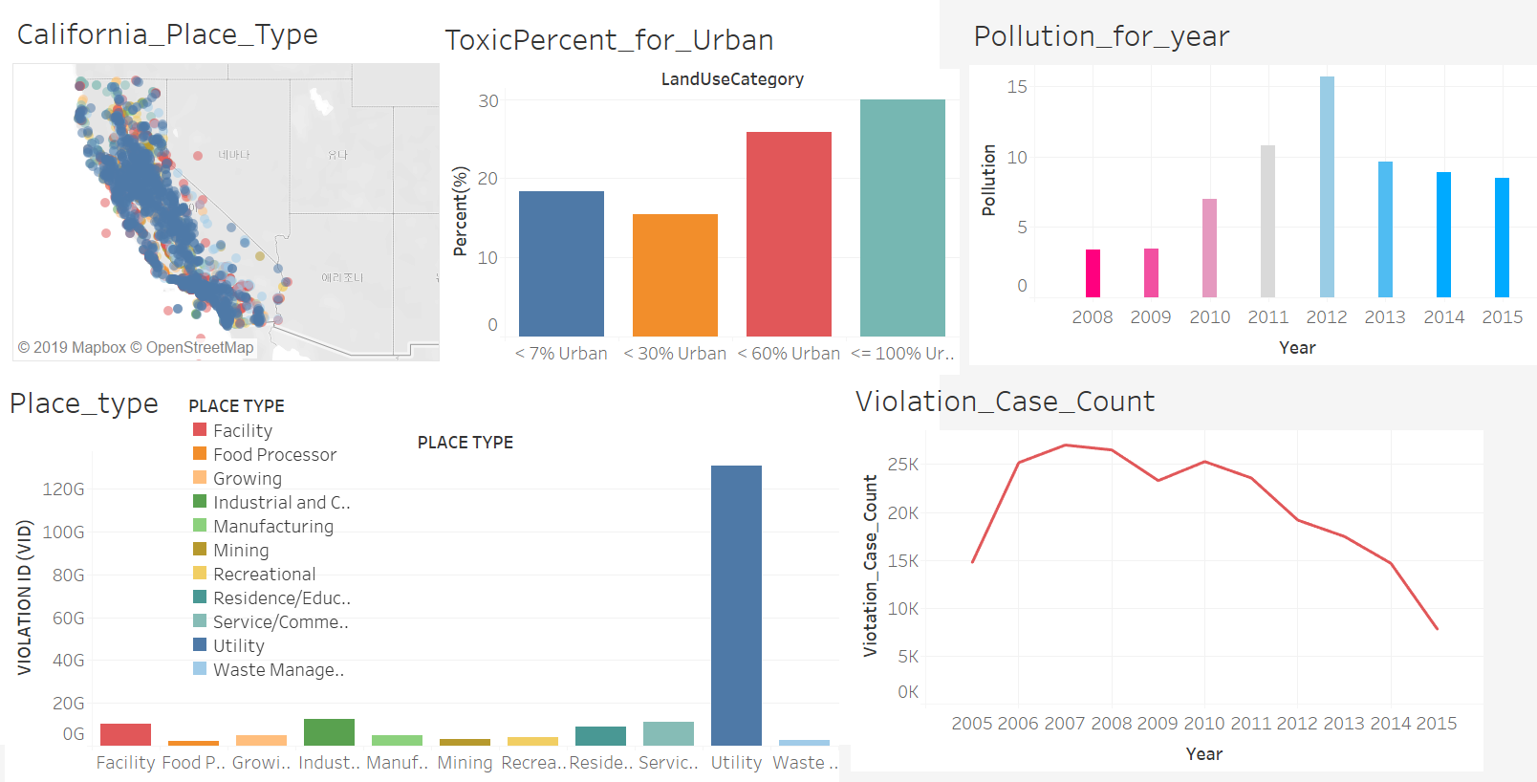

Slide 5
2. Data Mining
Used Tables - Toxicity and Urban Land Use.csv => Comparing each toxic_level from downtown to urban - Sum Pyrethroid Toxic Units.csv => Searching average pollution level per year - Water Board Wastewater Violations, 2001-2016.csv => Searching Violation Cases Data From : https://catalog.data.gov/dataset

Slide 6
2. Data Mining
How to mine? 1) Collected violation case counts from column “ViolationID” (using “Water Board Wastewater Violations, 2001-2016.csv”) 2) Showed the place_type using latitude, longitude (using “Water Board Wastewater Violations, 2001-2016.csv”) 3) Found the mean of pollution level per year (2008 ~ 2016) (using “Sum Pyrethroid Toxic Units.csv”)
4) Searched average pollution level per “LanduseCategory” (using “Sum Pyrethroid Toxic Units.csv” and “Toxicity and Urban Land Use.csv”) (Divided urban level : “< 25%” , “25 ~ 50%”, “50 ~ 75%”, “75% ~ 100%”)

Slide 7
Data Visualization with After Effect
There’re many Visualization tool for csv files…
But After Effect also read csv,json file(How it works when data meets Ae)
Benefit: We can make MotionGraph as we want, and also make Graph beautiful if much more easier than python tools
Disadvantage: We have to draw Graph by yourself. Python tools are much more easier to draw simple graph, We can’t react with graph

Slide 8
Thank you!

