Slide 1
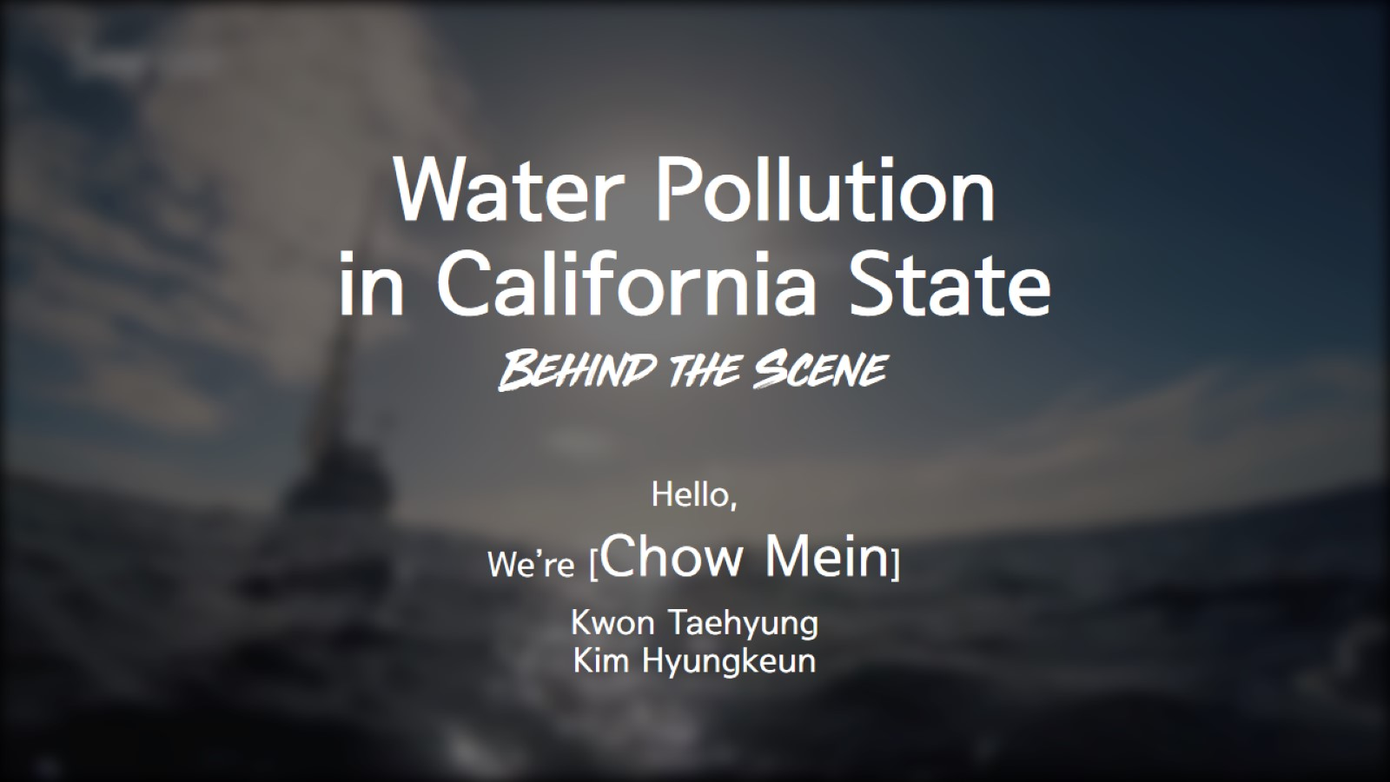
Water Pollution in California State Behind the Scene

Slide 2
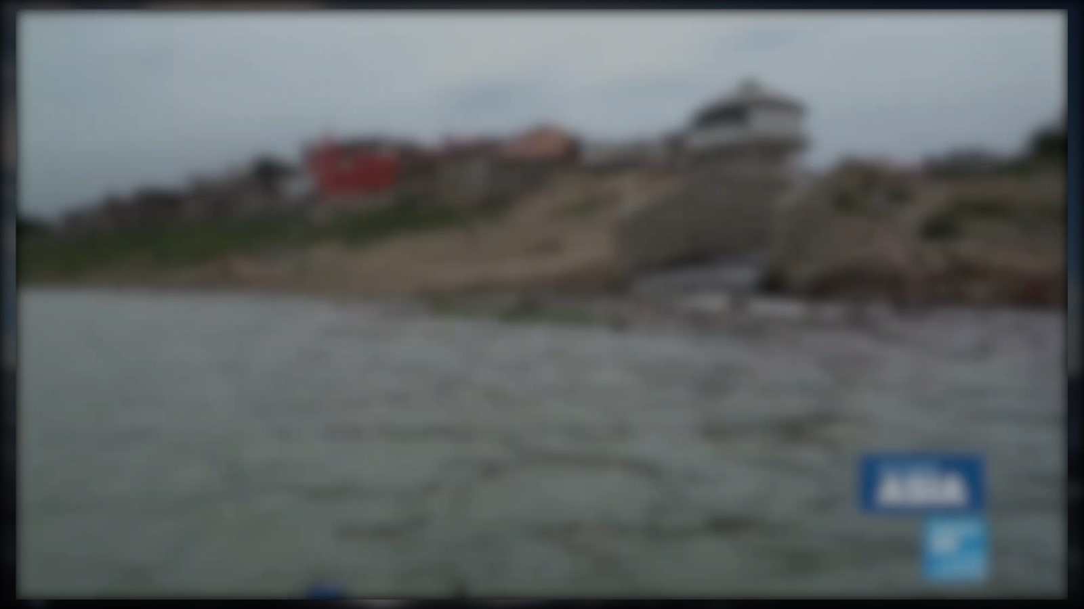

Slide 3
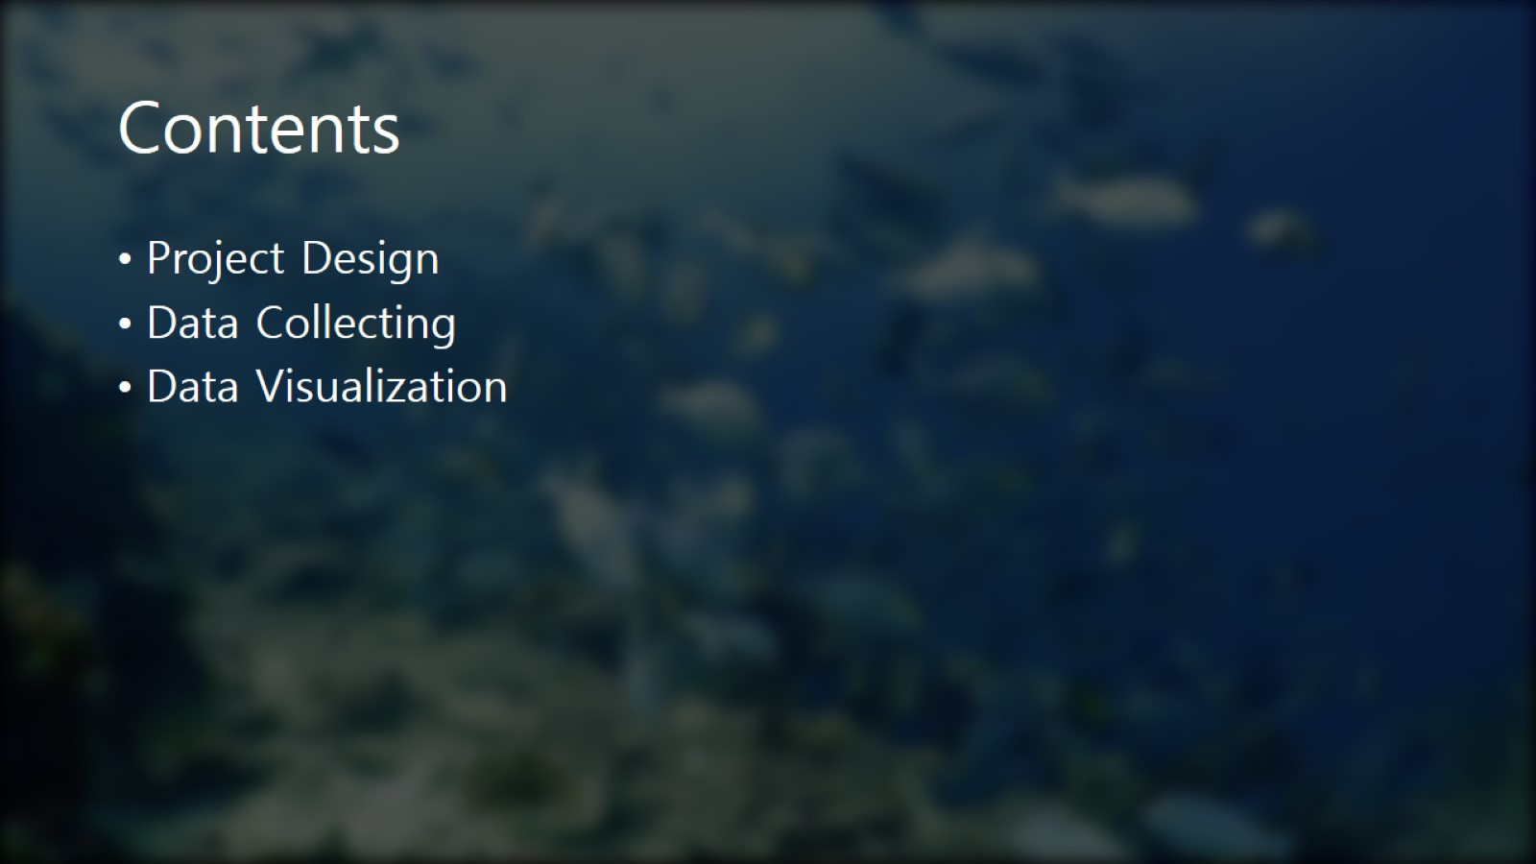
Contents

Slide 4
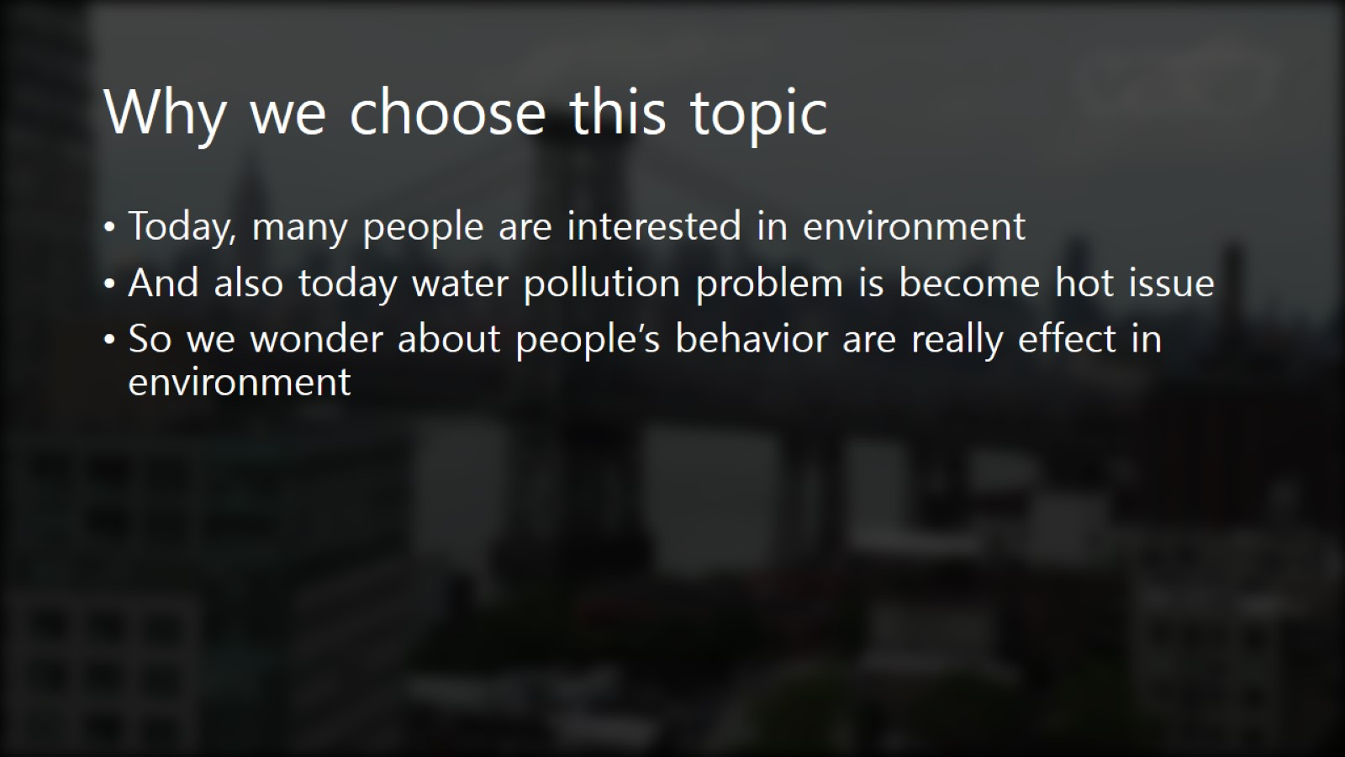
Why we choose this topic

Slide 5
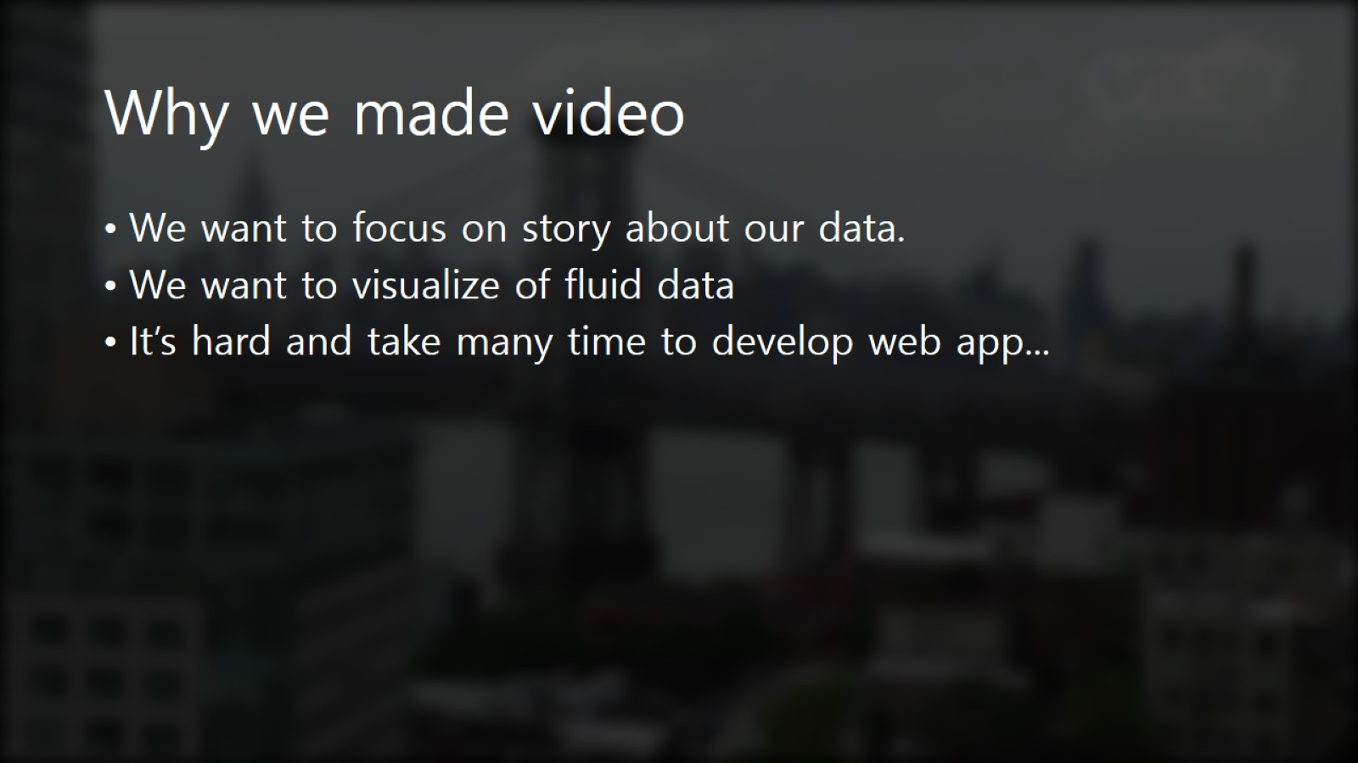
Why we made video

Slide 6
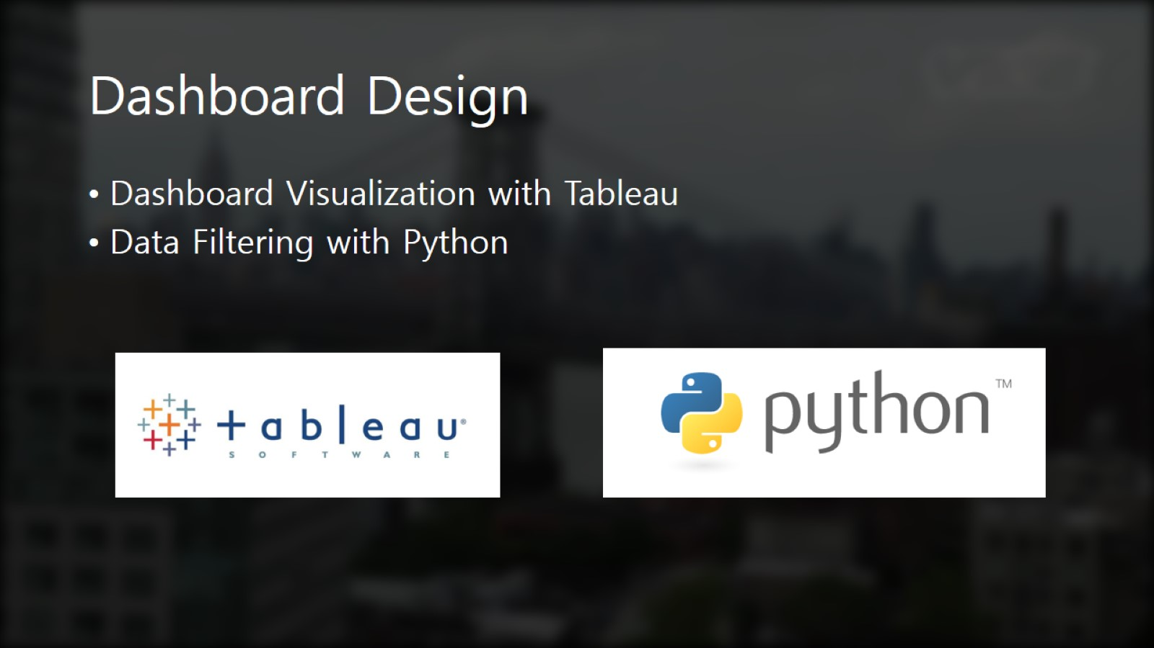
Dashboard Design

Slide 7
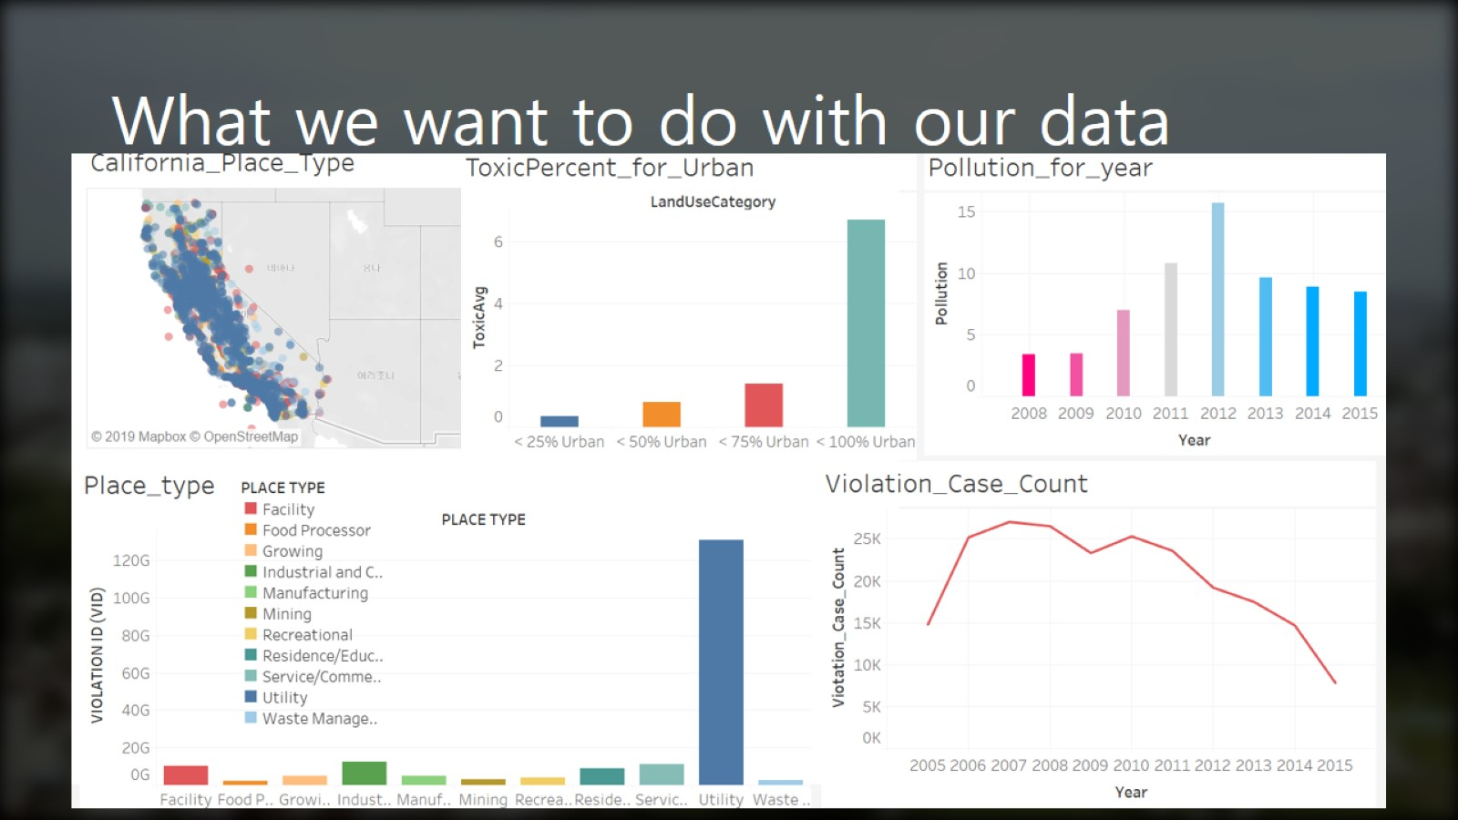
What we want to do with our data

Slide 8
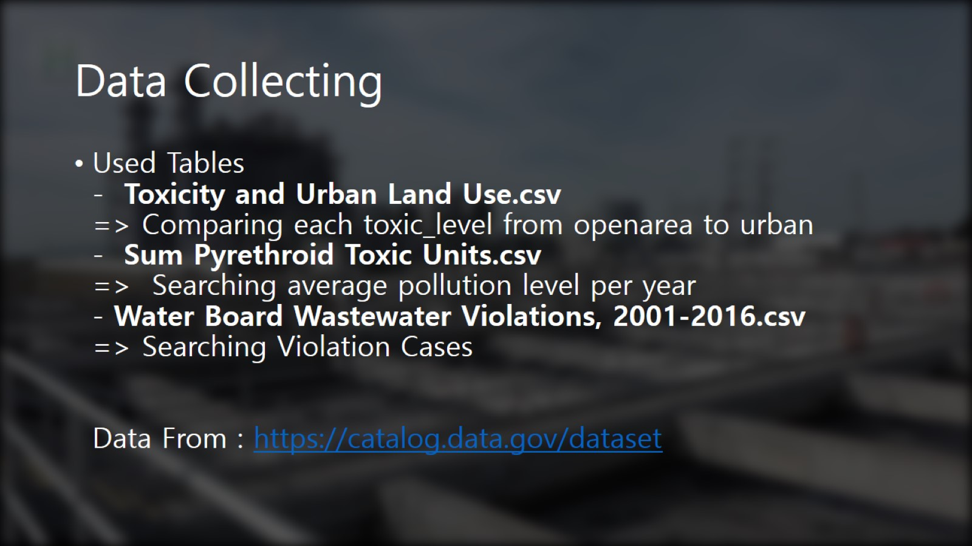
Data Collecting

Slide 9
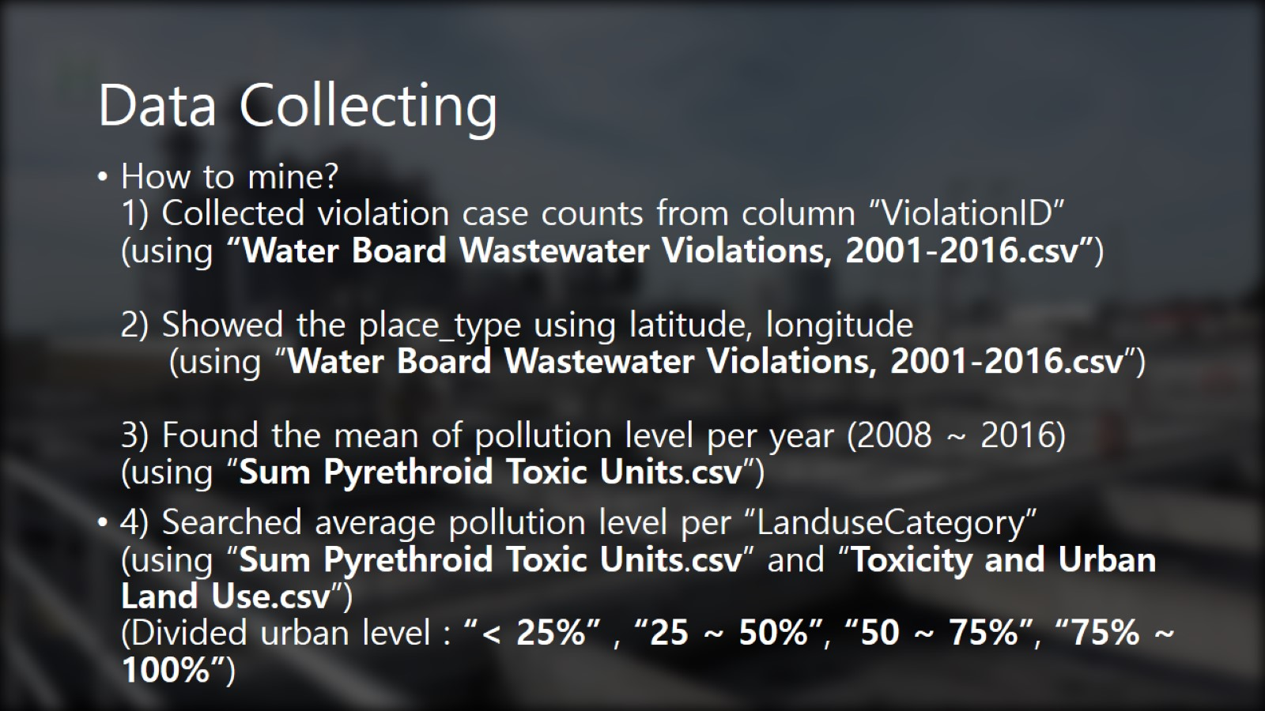
Data Collecting

Slide 10
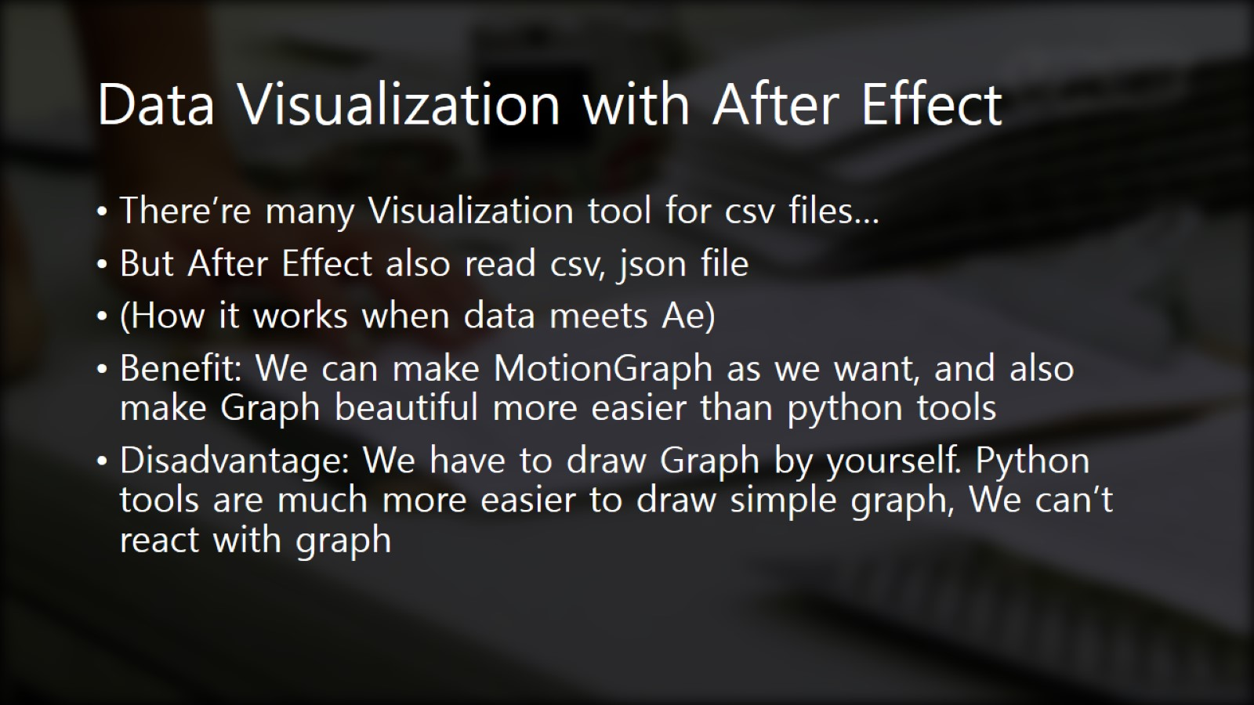
Data Visualization with After Effect

Slide 11
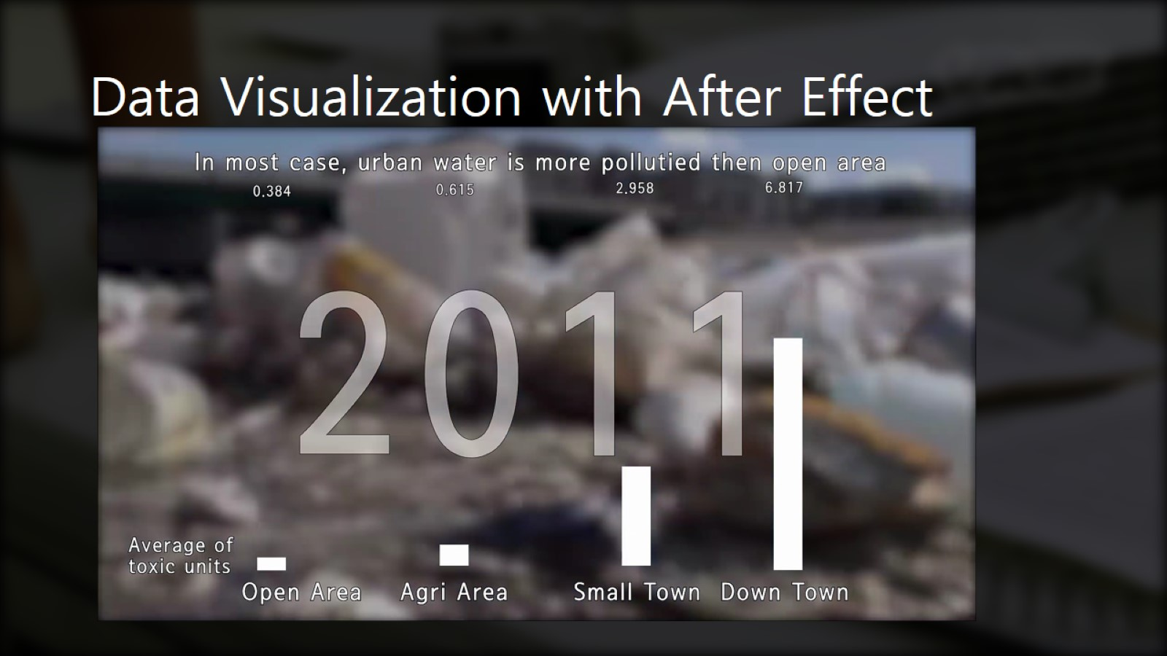
Data Visualization with After Effect

Slide 12
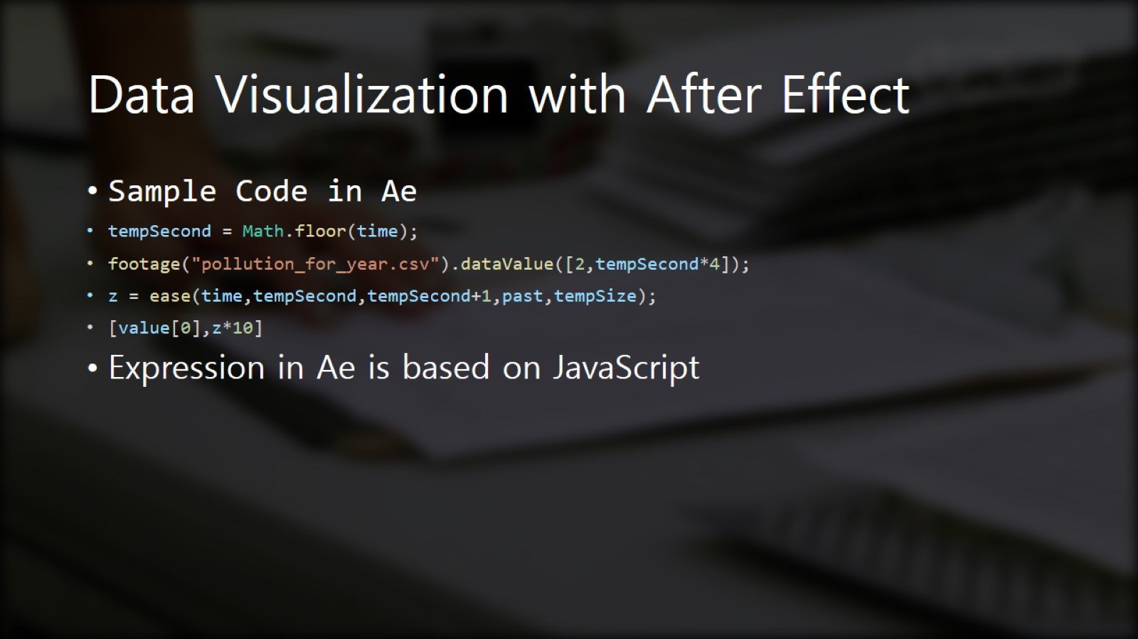
Data Visualization with After Effect

Slide 13

Thank you!

